Slide 1
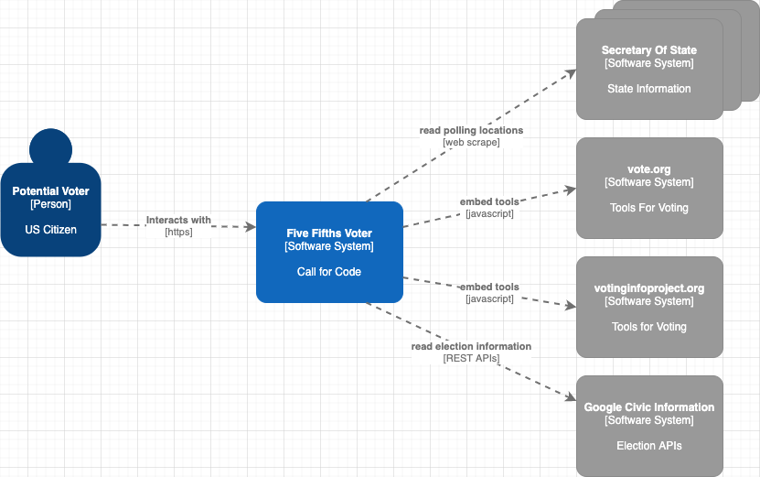
System Context

Slide 2
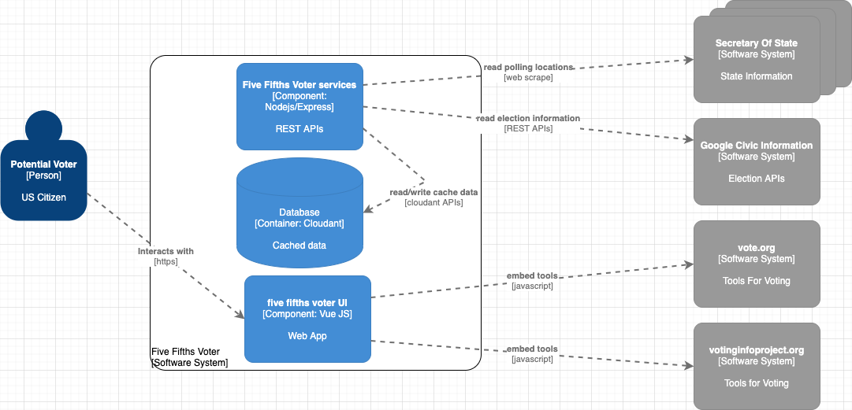
Components

Slide 3
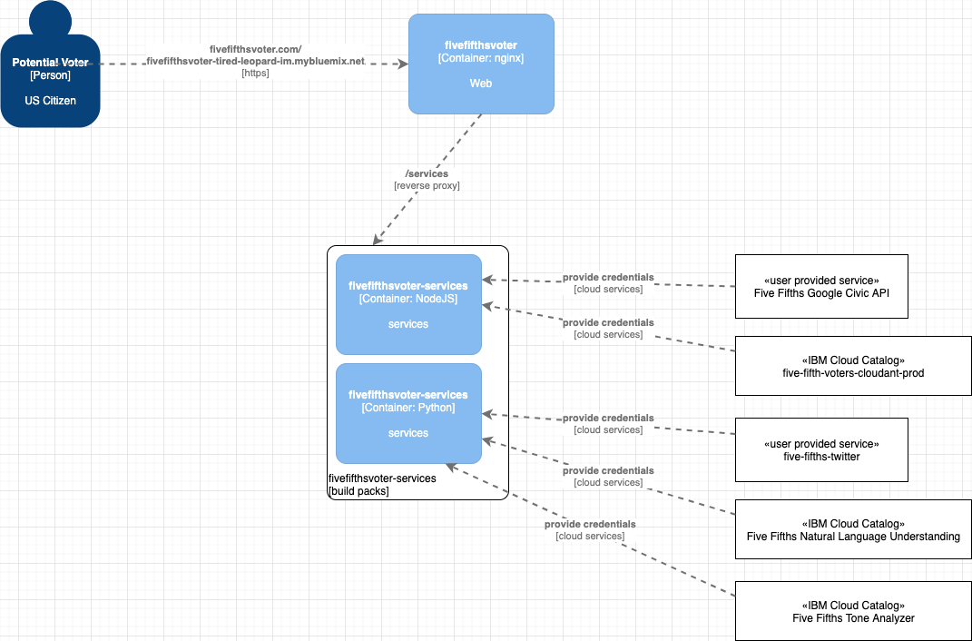
Deployment – IBM Cloud - Cloudfoundry

