Slide 1

Embrace CFC Fix Politics
Nikhil Raja, Tony Pearson, Bethany Morgan, Thomas Adams, Oiza Dorgu, Debra Scott, Mao Vang Corne, Denise Knorr, Lungelo Sikobi, Jia Liang Guo

Slide 2
Problem Statement
State of Arizona HB 2695
House of Representatives
Fifty-fourth Legislature
Second Regular Session
2020
AMENDING SECTION 46‑299, ARIZONA REVISED STATUTES; RELATING TO TANF ASSISTANCE.
5. The department shall:
THE DEPARTMENT MAY ALLOW A COURSE IN FINANCIAL LITERACY AND PERSONAL FINANCE TO QUALIFY AS A WORK ACTIVITY FOR THE PURPOSES OF THIS ARTICLE.
Disregard income earned by the subsidized employee in the subsidized job when determining the household's eligibility for cash assistance and the supplemental nutrition assistance program.
For the purposes of this section, "subsidized employee" means an individual who is engaged in this subsidized employment activity.
Legislation is written for lawyers and politicians, often with cryptic titles, and legal text with UPPER CASE and strike through statements to denote amendments to previous legislation.
Concerned citizens and impacted residents don't have a straightforward way of knowing what or how policies and regulations impact them or what they can do in response.

Slide 3
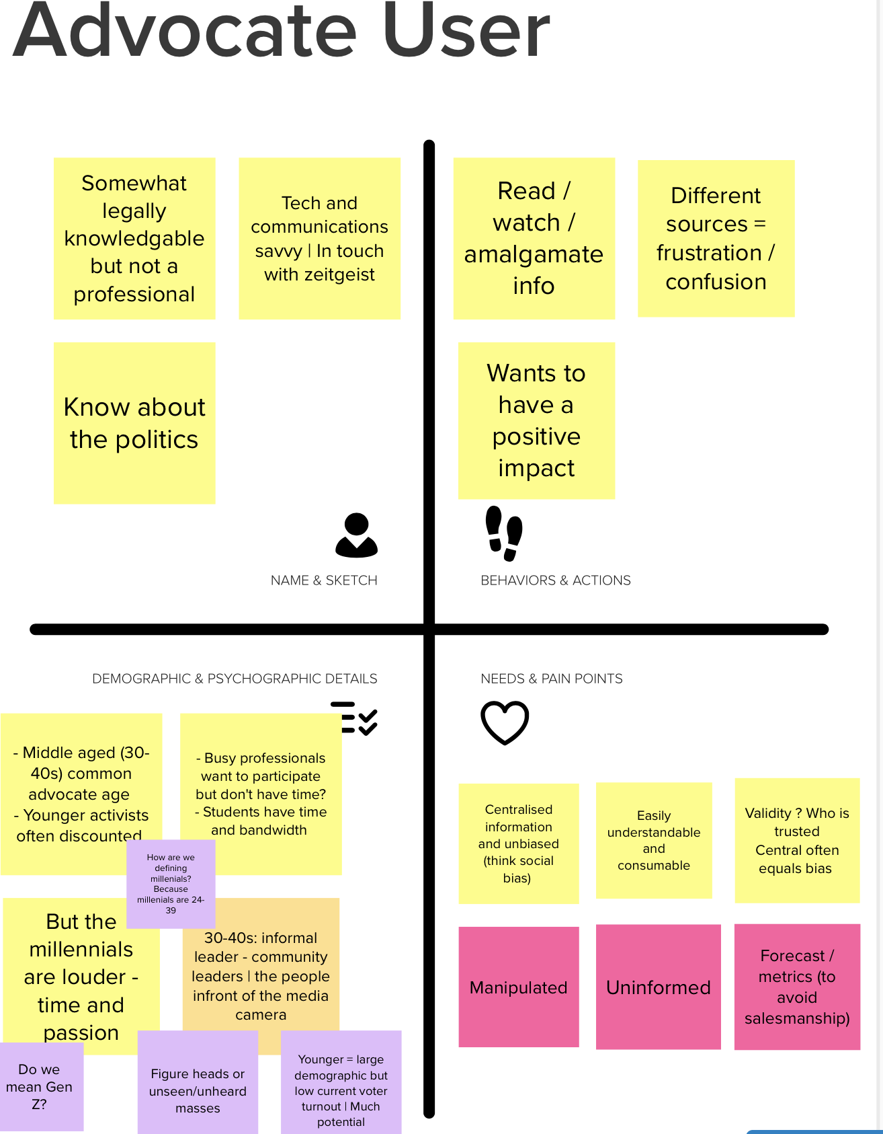
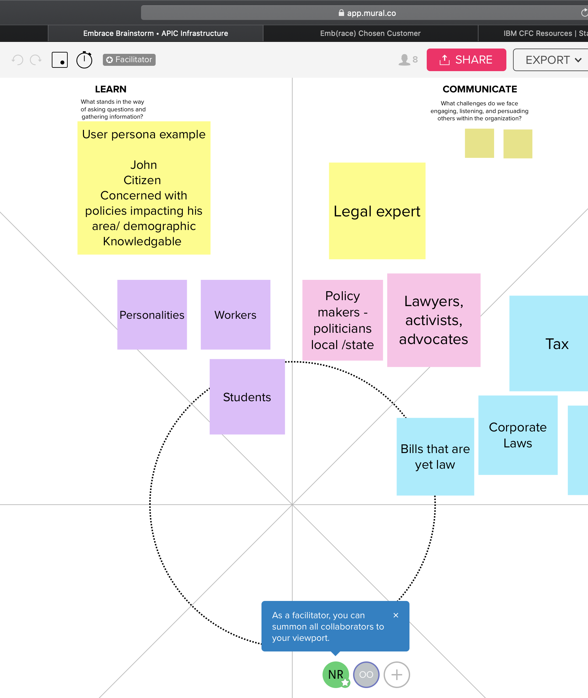
Who – why they want it. / why good user /. Why impactful
BAME citizens are severely & chronically underrepresented in voting activity
Data shows that Gen Z and millennials are massively underrepresented in voting activity - Hence capacity for impact
Notes:
1) The "18 to 24 years" demographic is very comparable in size to the "65 to 74 years" demographic, but approximately 28% less are registered to vote and turnout is less than HALF in the younger age group
3) 54 percent of non-ethnic Americans reported voting, compared with 49 percent of African Americans – similar to figures for ’80s and 90s
4) Among voting-age citizens, only 33 percent of Latin American and 35 percent of Asian Americans voted

Slide 4
Capturing Black Community Concerns
Focused on identifying coded / non-overt discrimination
ML → Tags for areas with over-representation of black residents Changes in public spending Changes in police laws
EG → Taxes on activities mainly carried by black community members

Slide 5
Initial roll-out | Ohio
Access to data
Reality due to voting disparity
Size of black community / BAME Black residents, accounting for 26% of city residents, embraced a first when not one, but three African American women won election to the city council last year. Reynoldsburg went to Democrats Barack Obama and Hillary Clinton by similar mid-teen margins in recent elections.
Potential for impact Black voters, whose numbers in Ohio have grown by 22% since 2000, are a growing suburban demographic.

Slide 6








Architecture – Fix Politics!
PUBLIC NETWORK
IBM CLOUD
Targeted user: An advocate who has a social media influence for citizens or residents in a community.
Responsive UI: Application works well across mobile devices, tablets and desktop systems
Anonymous Search: Application does not rely on session/cookies and works in TOR/Incognito browser mode.
User Profiles: Advocates can save their search preferences for frequent re-use.
Curated Data: Legislation has laymen-readable title and summary, classified by location and impact area.
embrace-dev-ocp43-vpc
DEVICE
USER DIRECTORY
EDGE
SERVICES
APPLICATION
USER
INSTANCE
BROWSER
CURATED DATA
SORUCES
Email to self
MESSAGING
Output CSV file
FILE
SYNC
Fix Politics

Slide 7
Hills – What we accomplished, and nice-to -haves
Hill 1:
Citizen/Residents are aware of policy that is being considered that is highly impactful to them, without needing to follow every vote.
All laws classified by location and impact
Hill 2:
Citizen/Residents are able to understand the specific impact of proposed policy on them without being a legal expert.
Title and Summary in easy-to-read language for laymen
Hill 3:
Citizens are able to share opinions so they can influence policy decisions before they are finalized.
Options save search results as CSV, or send as email in HTML/TEXT formats
Hill 4:
Citizens can easily ascertain the voting record themes or trend of their elected officials and political candidates without prior knowledge of who they are.
Nice to have
Hill 5:
Policy makers have visibility into how diverse citizenry will be impacted by multiple variations of a proposed policy.
Nice to have

