Slide 1
Fault Tolerant CAD
Members :
Peter Nilsson
Xiaotong Jiang
David Jacob

Slide 2
The goal
A drawing application that can be used by a number of clients.
When clients join, update them with what has been drawn.
All communication between server and client happens through the frontend with UDP.
Have multiple server replicas in case of crashes.
Replicas uses TCP to communicate.
A fault tolerant and failure silent system.

Slide 3
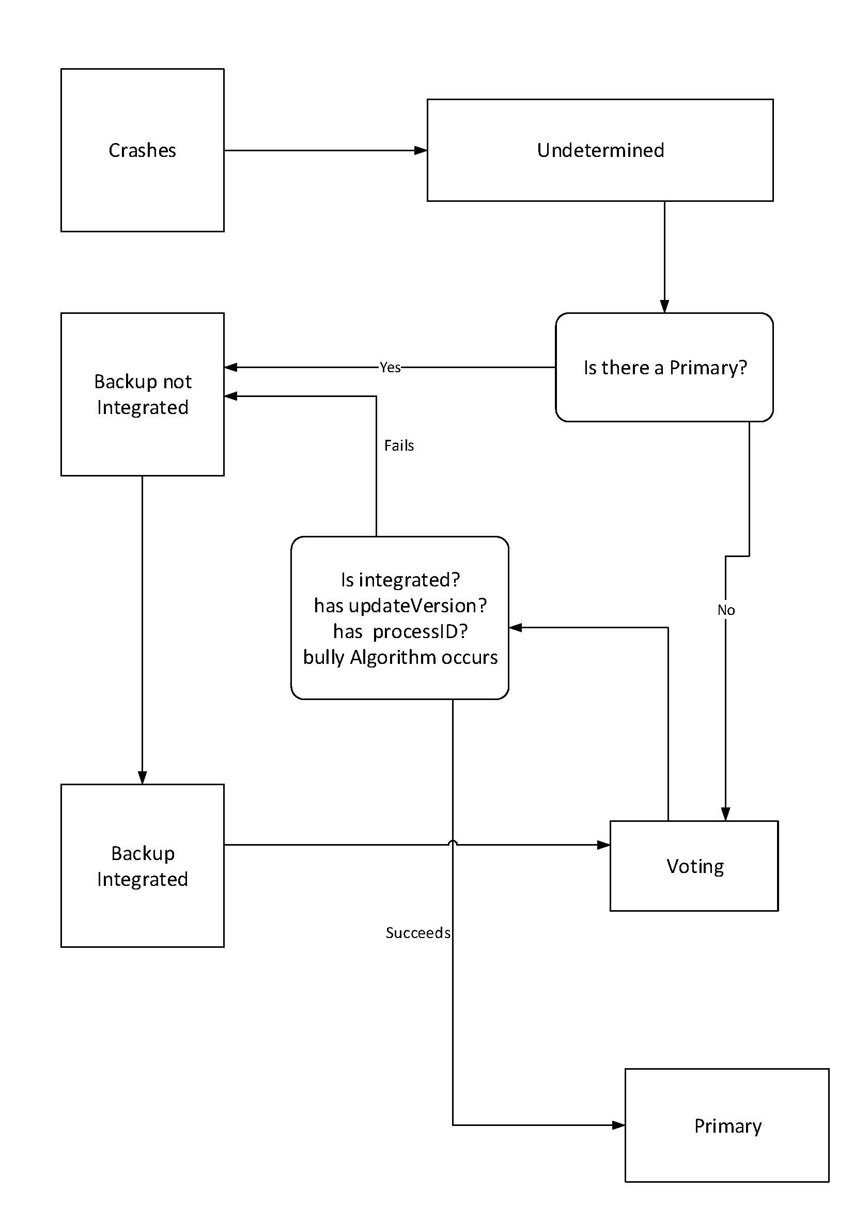
State Flow Diagram

Slide 4
Connection Types
The Server :
The connection type we choose between servers and their clients was UDP for the benefit of having better performence and to be able to re-establish the connection quickly.
The Server Replicas :
For applying server replicas we used TCP because of it’s reliability and since crashes will not occur multiple times due to the single system failure assumption.

Slide 5
Connection Types
The Front End Connection :
For implementing the front end we also used UDP for the connection due to similar reasons above. The front end needs to be up and running for the application.

Slide 6
What Was Challenging
Setting up, understanding and avoiding conflict in Git was hard.
(Thank you Andreas for solving this)
Time restraints. The workload was difficult in the time given.
Dealing with server replicas proved to be difficult.
Dividing up the work was difficult due to people having different strengths and weaknesses.

Slide 7
What We Achieved
We were able to set up a network with the drawing application.
We have a better understanding of distributed systems.
We created different connection types between servers, clients and front ends.
We learned new ways in which networks can be written Java.
We developed our team work skills.
We know different methods for elections such as the Bully algorithm and Ring based Selection.

