Slide 1



CryptDB: Confidentiality for Database Applications with Encrypted Query Processing
Raluca Ada Popa, Catherine Redfield, Nickolai Zeldovich, Hari Balakrishnan
MIT CSAIL
Supported by NSF & Google

Slide 2




Problem: Confidential Data Leaks
curious DB administrators
User 1
DB Server
SQL
User 2
Application
User 3
hackers
curious cloud/employees
physical attacks
Both on private clouds and public clouds
Regulatory laws
Notes:
Consider the layout of a database application. These are appls. They are quite frequent
There are many things that can go wrong. For example, a curiosus DB Admin has root access may read and leak conf company data; this part
These are issues both in private data center and pubic clouds. In particular, public clouds
Mention that hackers are the main problem for applications; give gawker media example
The motivation is straightforward:there are lots of cases confidential data leaks all the time.
Consider the case of a database application. These are applications that store their data in a database. There are lots of such applications, for ex; this is especially worrisome for companies with financial data, such as banks, and even for medical data
Don’t spend much time here, most important is hackers, gloss over others, don’t give specific examples

Slide 3




CryptDB
Goal: protect confidentiality of data
user password
Threat 2: active/passive attacks on all servers
Threat 1: passive attacks on DB server
User 1
DB Server
Proxy
SQL
User 2
Application
User 3
Process SQL queries on encrypted data
Capture and enforce cryptographically access control in SQL: chain keys from user passwords to data item
Notes:
To address these problems, we propose CryptDB, a system aiming to protect. We break the problem into two subproblems. The first is arbitrary attacks to confidentiality of data on the DB server, for example, the DB admin has root access on the DB server. A natural solution
Note that the key will never be given to the DB server!
CryptDB is a system that aims to solve these problems and protects the confidentiality of the data,
Already say we chain to user passwords
In interest of time, I will only present our mechanism for protecting against the first threat.

Slide 4
Threat Model
Consider attacks on any part of the servers
We do not consider integrity attacks
Can affect data integrity, but not confidentiality
Notes:
Say: : e.g., root access, physical access to RAM
Note that we consider confidentiality attacks to any part of the servers, we do not trust anything on the server side, This is a departure from existing systems (no detail)
And is part of our future work
Describe an example; say that data could be modified in any way we do not protect against this

Slide 5

Threat 1: Passive attacks to DB Server
Trusted
Under attack
Proxy
DB Server
unencrypted
query/response
SQL
Application
Use cases:
Private data center: hide DB from sys admins, proxy is available to few
Outsourcing the database: DB runs on cloud, proxy runs on local server
Notes:
For the second goal, say: to process queries completely at the server; the Proxy should only encrypt the queries and decrypt query results, but perform no query processing
Let’s zoom in to the first threat ; the db server, but the app is trusted and our aprooach is to compute ; In out setup, proxy is lightweight: the proxy only encryption of query constants and decrypts results but no query processing on the much larger DB
Db administrator, cloud employees curious, physical attacks
Slow down, don’t go so fast on this part
Do not say the over 30 years of experience

Slide 6
Threat 1: Passive attacks to DB Server
Trusted
Under attack
Proxy
DB Server
unencrypted
query/response
SQL
Application
Stores schema, master key
Decrypts results
No query execution
Goal: Perform SQL query processing on encrypted data
Support standard SQL queries on encrypted data
Process queries completely at the DB server
No change to existing DBMS
Notes:
For the second goal, say: to process queries completely at the server; the Proxy should only encrypt the queries and decrypt query results, but perform no query processing
Let’s zoom in to the first threat ; the db server, but the app is trusted and our aprooach is to compute ; In out setup, proxy is lightweight: the proxy only encryption of query constants and decrypts results but no query processing on the much larger DB
Db administrator, cloud employees curious, physical attacks
Slow down, don’t go so fast on this part
Do not say the over 30 years of experience

Slide 7

Example
Application
60
100
800
100
SELECT * FROM emp WHERE salary = 100
≥
table1 (emp)
SELECT * FROM table1 WHERE col3 = x5a8c34
col1/rank
col2/name
col3/salary
≥
x638e54
Proxy
x934bc1
x1eab81
x4be219
x5a8c34
x638e54
x95c623
x5a8c34
x922eb4
x5a8c34
x638e54
?
?
x84a21c
x2ea887
x638e54
x5a8c34
x5a8c34
x17cea7
x5a8c34
x922eb4
x5a8c34
x638e54
Notes:
Let me start by showing an example of our solution strategy. That allows no computation on the data. Consider the query notice that the value in the query predicate is encrypted. Currently, salary is encrypted with a probabilistic encryption scheme which maps
In order to allow the server to perform this query on encrypted data as it would on cleartext data,
But how do we know which encryption scheme to use ahead of time? The idea is to morph somehow.

Slide 8
Approach: SQL-aware encryption
Observation: limited set of common SQL operators
Different encryption schemes can provide functionality for each operator

Slide 9
SQL-aware encryption
Highest
Scheme
Operation
Details
RND
None
AES in UFE
e.g., Paillier
e.g., =, !=, GROUP BY, IN, COUNT, DISTINCT
HOM
+, *
Security
DET
equality
AES in CTR
JOIN
join
new
SEARCH
ILIKE
Amanatidis et al.’07
e.g., >, <, ORDER BY, SORT, MAX, MIN
OPE
order
Boldyreva et al.
’09
first practical implementation

Slide 10

Challenge: avoid storing, revealing all ciphertexts
Idea: onions of encryption
RND
DET
RND
SEARCH
OPE
JOIN
OPE-JOIN
HOM
Any value
Any value
int value
Onion 1
Onion 2
Onion 3
Significant confidentiality and space savings
Each column has the same key in a given layer of an onion

Slide 11
Example
RND
DET
emp:
DET
SEARCH
rank
name
salary
JOIN
Any value
SELECT * FROM emp WHERE salary = 100
UPDATE table1 SET col3onion1 =
DecryptRND(key, col3onion1)
SELECT * FROM table1 WHERE col3onion1 = x5a8c34

Slide 12
Other queries
Various others supported:
Inserts, updates, deletes, nested queries
Indexes
Transactions, auto-increments
Not supported: A.a + A.b > B.c

Slide 13

Implementation
SQL Interface
Server
Encrypted Query
Unmodified DBMS
CryptDB PK tables
Query
Application
CryptDB Proxy
Results
Encrypted Results
CryptDB UDFs (user-defined functions)
No change to the DBMS
Portable: from Postgres to MySQL with 86 lines
Single-key: no change to applications
Multi-user keys: annotations and login/logout

Slide 14
Evaluation
Four applications running on CryptDB:
phpBB (web forum)
HotCRP (conference review)
grad-apply (MIT grad admissions)
TPC-C (standard database benchmark)
How many application changes?
What is the resulting confidentiality?
What is the performance overhead?

Slide 15
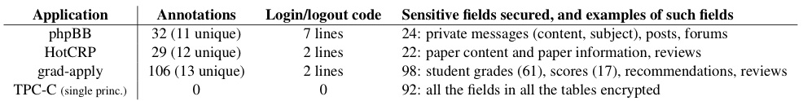
Application changes
phpBB, HotCRP, grad-apply: only sensitive fields encrypted, encryption keys chained to user password
TPC-C: all fields encrypted, encryption uses single key
CryptDB supports all application functionality
Notes:
These are complex applications with lots of lines of code yet it is easy to support this

Slide 16
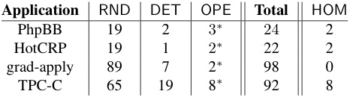
Confidentiality in the DB
All the most sensitive fields remained at RND
Fields at OPE were either semi-sensitive or not sensitive
Adjusting onion encryption levels based on queries improves confidentiality
Notes:
As seen in these applications, in practice we expect sensitive fields to remain at RND or DET

Slide 17
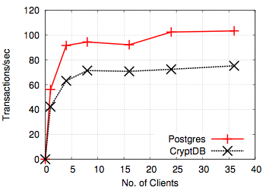
Low overhead
TPC-C
Throughput loss 27%
phpBB: throughput loss of 13%
Encrypted DBMS is practical

Slide 18
Related work
Theoretical approaches ([Gentry’10], [Gennaro et al., ’10])
Inefficient
Search on encrypted data (e.g., [Song et al., ’00])
Restricted set of queries, inefficient
Systems proposals (e.g., [Hacigumus et al., ’02])
Lower degree of security, rewrite the DBMS, client-side processing
Software checks (e.g., PQL, UrFlow, Resin)
No protection against adversaries with complete access to servers

Slide 19
Conclusions
CryptDB is the first practical DBMS for running most standard queries on encrypted data
CryptDB incurs a modest runtime overhead
CryptDB requires no application changes (for single-key operation)
Thanks!

