Slide 1
NWEN304 Group Project
Callan McAllister & Ashley Raine Legaspi
Coffee & Co Web Application

Slide 2
Planned Web Application
Our Planned Web Application was intended to be a Coffee Marketplace where a user could log in and add items to their cart
A user would be able to create an account
Once an account was created, a user could log in and add items to their cart
User password would be encrypted and stored in the database.
Products would also be stored in the database
Products could be added through a form or through POST requests to the server API

Slide 3
Delivered Web Application
Our delivered web application missed several features due to the size of our group, but many of the core features are functional
Users can create accounts
Passwords are encrypted and have to follow specific specifications
Users can log in
All users and products are stored in the database
Products are fetched from the database on page load for displaying
Structured with MVC
Web application supports RESTful requests
GET
POST

Slide 4
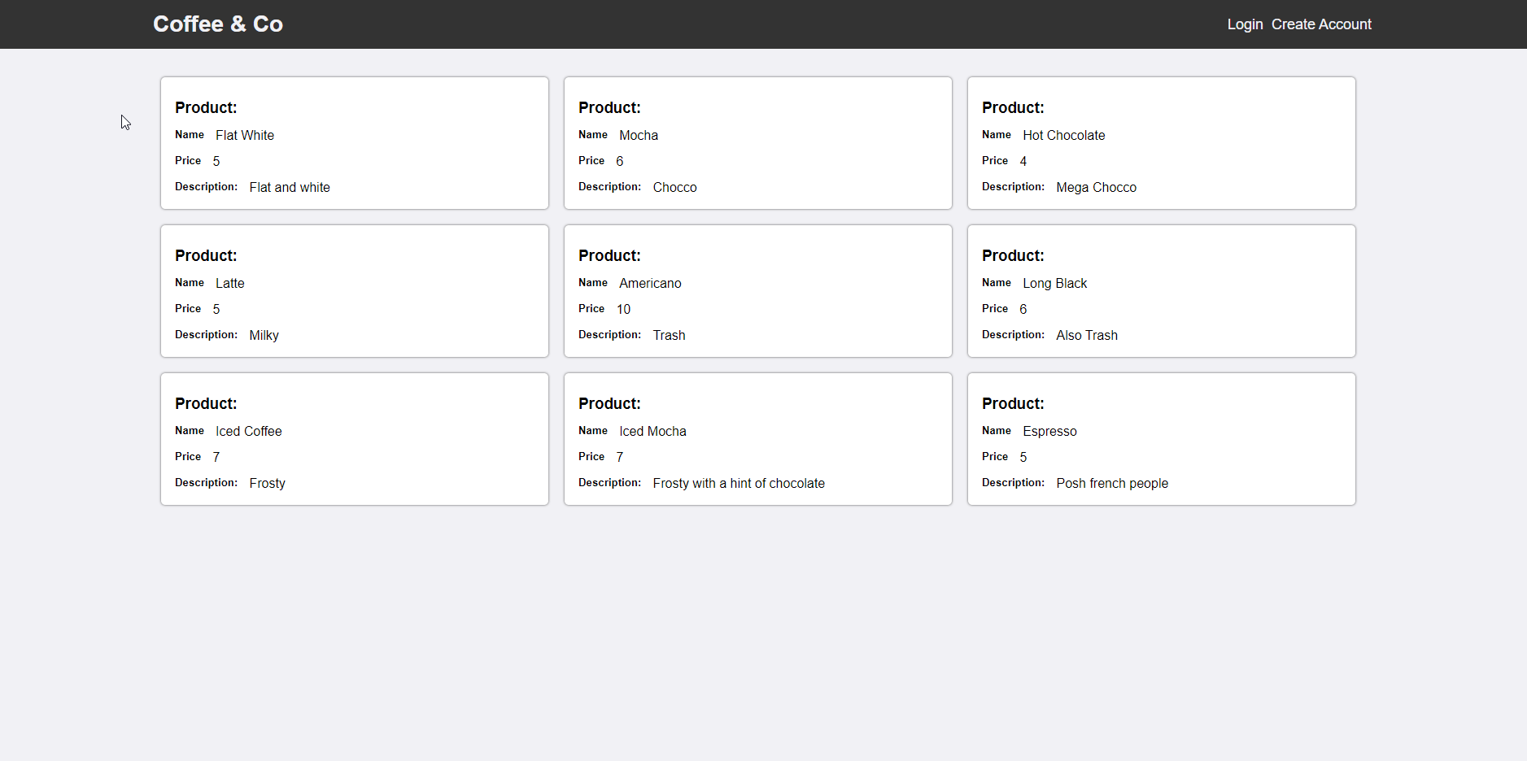
Front End of Web Application - Homepage

Slide 5
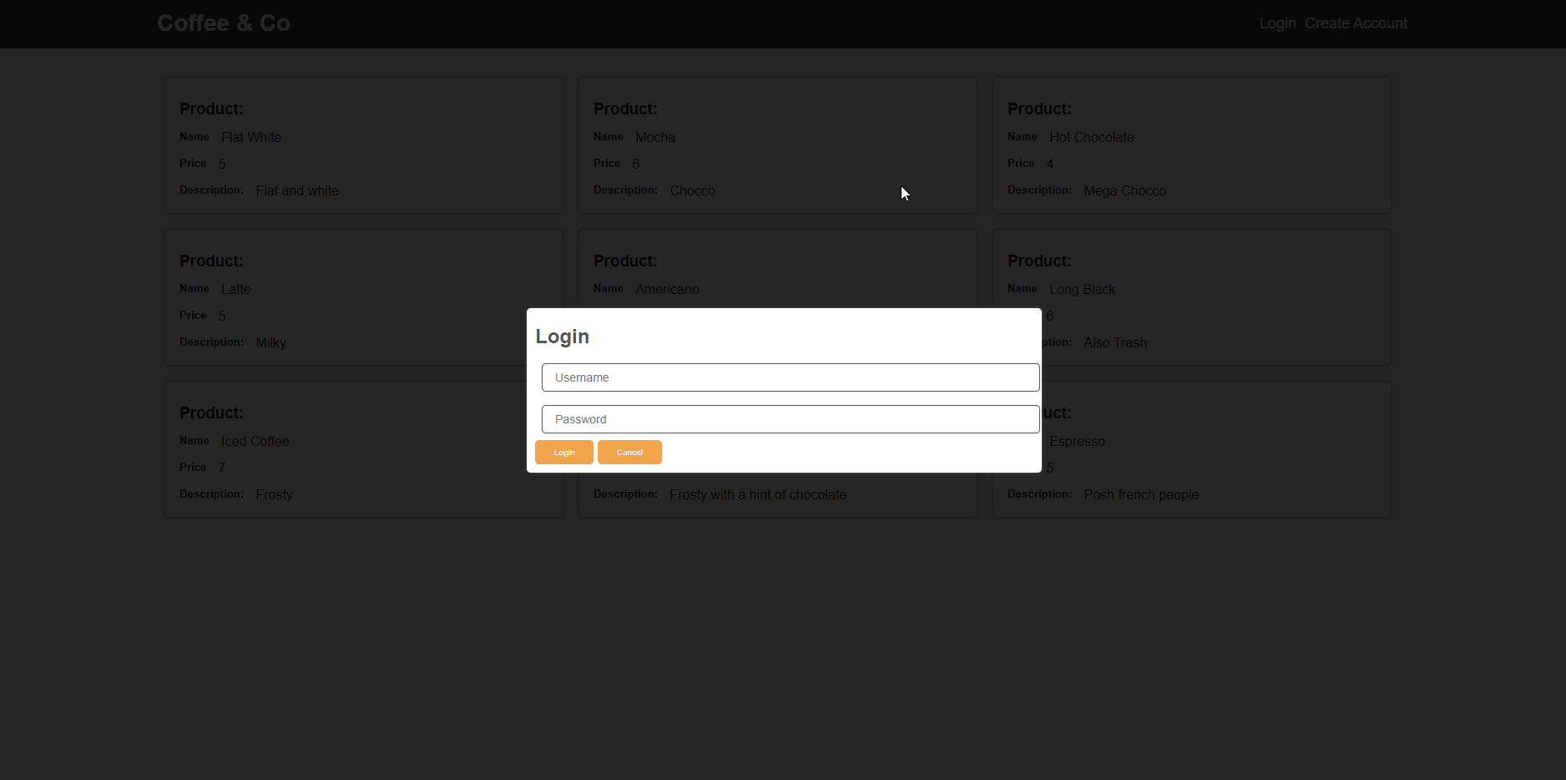
Front End of Web Application - Login

Slide 6
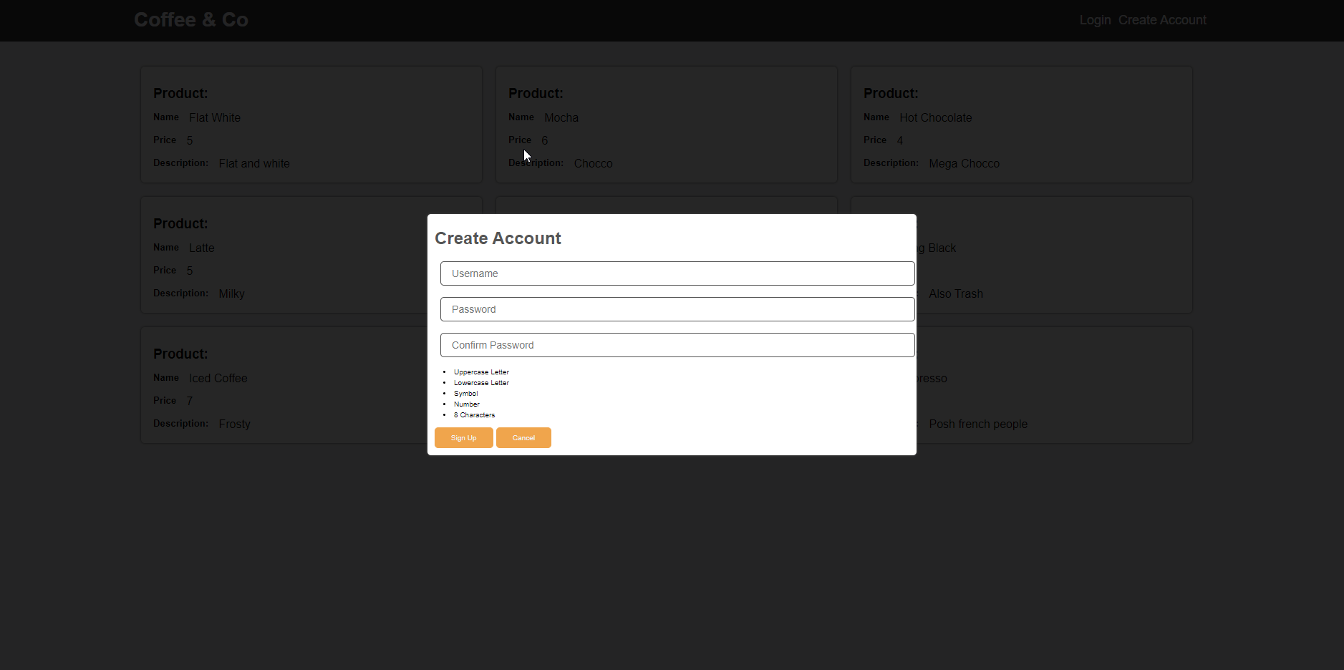
Front End of Web Application – Create Account

Slide 7
What our application doesn’t do
These are missing features due largely to time constraints and the size of our group
EJS Template Code (Webpage is HTML)
Admin privileges (Product Editing, Deleting, etc.)
Sessions / Cookies
OAUTH / OpenID Connect
These features were planned, but could not be implemented as our workload was simply too high only having a group of 2

Slide 8
Database
Our database design is reasonably simple
2 Collections
Products Collection
Users Collection
Stored in JSON Format
All passwords encrypted with Salt + Hash

Slide 9
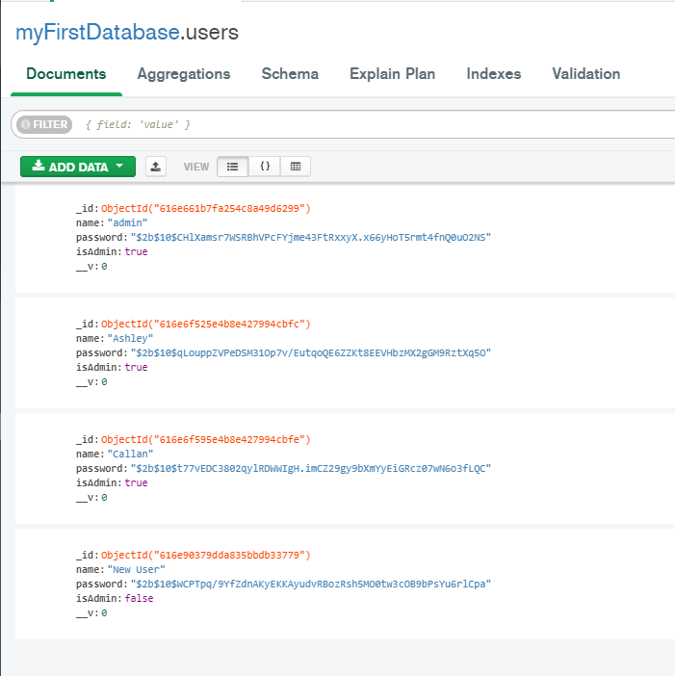
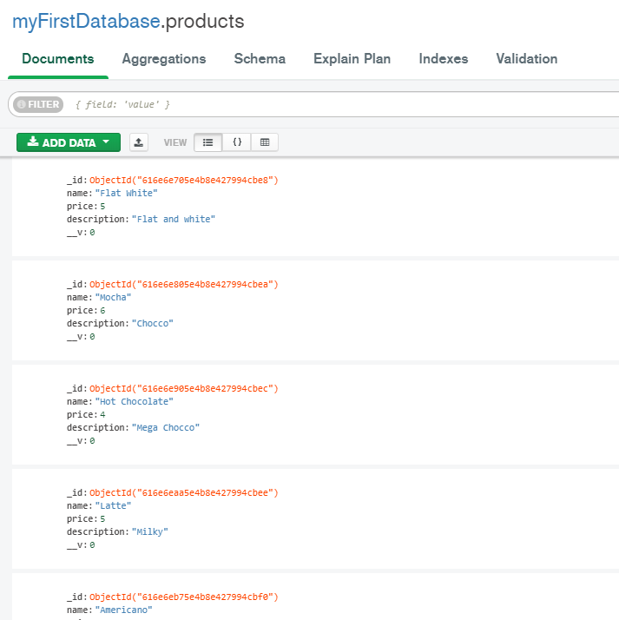
Database – MongoDB Compass

Slide 10
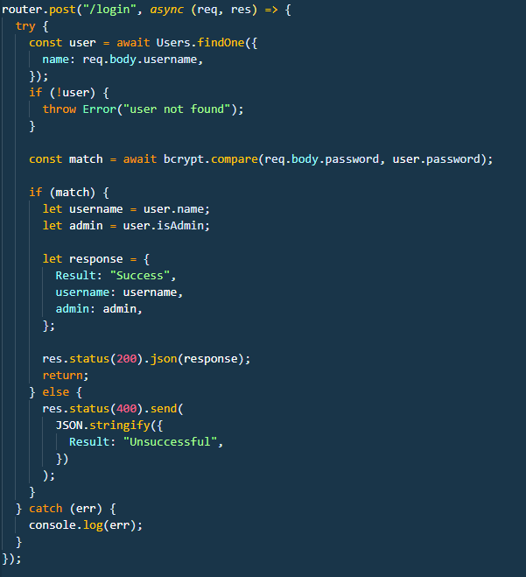
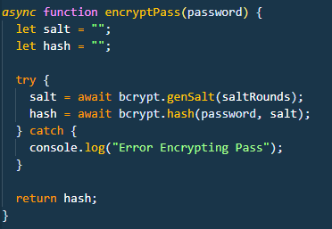
Password Encryption
All password encryption is done by bcrypt.js (Open Source Library)
Encryption is a one way Salt + Hash algorithm
All Encryption is done server side
User login password is compared to user encrypted password through bcrypt compare function

Slide 11
Restful Requests
Our web application does support GET and POST requests through the server API
These include
POST new products
GET all products
POST new user
GET all users
POST login (This was somewhat accidental)

Slide 12
Restful Requests
REST Requests were tested through VSCode using the “REST Client” Extension.
This extension allows you to write REST Requests and send them directly from VSCode, and displays the response

Slide 13
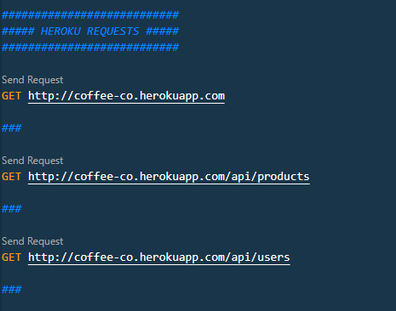
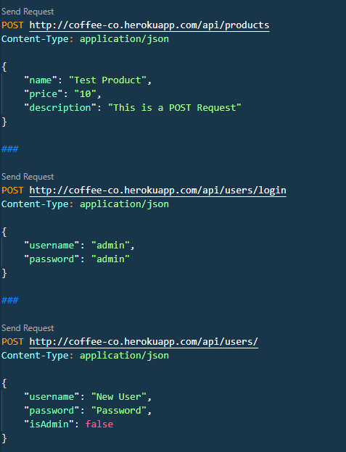
Restful Requests

Slide 14
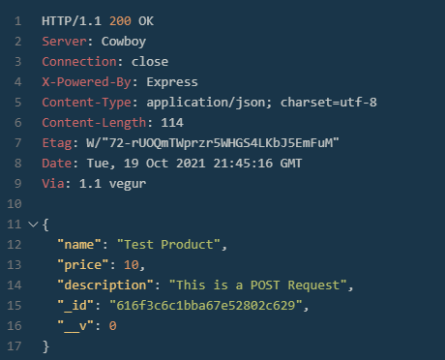
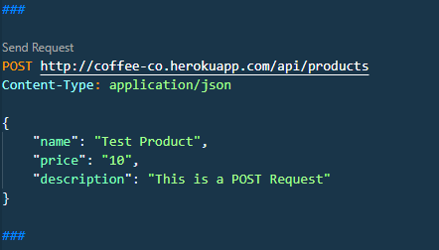
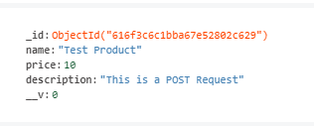
Restful Reponses
Response:
Upon a successful request, a response will be sent.
Request:
Database Entry:

Slide 15
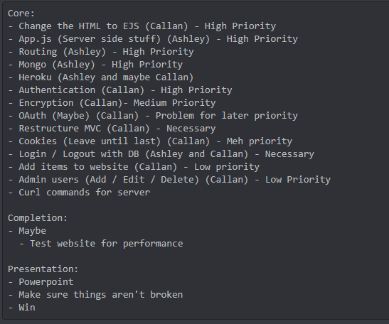
Work Distribution
I feel both myself and Ashley had a reasonable work distribution between the two of us.
Initially we made a plan on work distribution, but having only 2 people in the group made this hard to follow and changes were made accordingly
Initial Distribution:

Slide 16
Actual Work Distribution
Callan
Front End Design
Login / Logout
Encryption
Heroku Setup
Client Side GET / POST
Connecting client and server
Ashley
Server Design
API Design
Creating endpoints for REST
Database Design
Routing
Tying everything together
There was also lots of overlap of work, working on the same components at the time
Work distribution felt healthy, didn’t feel like one member of the group was unfairly burdened with more work

Slide 17
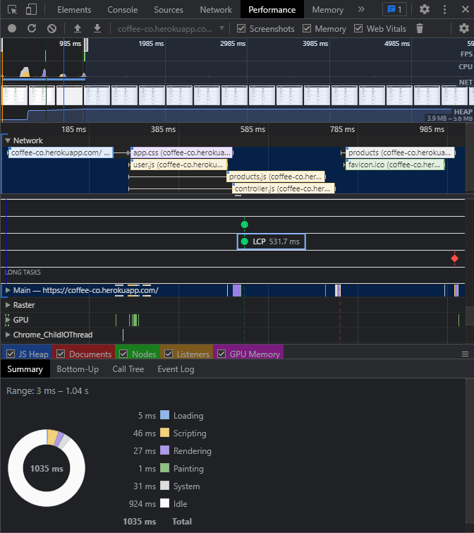
Website Performance
Developer Tools provides some handy metrics for analysing performance
Total Load time ~985ms
Total time loading scripts / HTML ~110ms
We can see the majority of the loading time was a result of the fetching of resources
This could be remedied / mitigated through a more streamlined resource loading pipeline

Slide 18
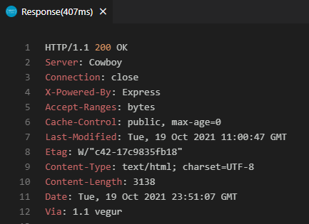

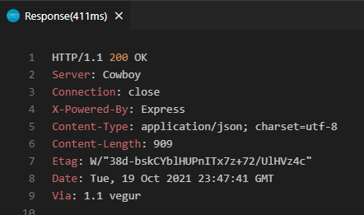

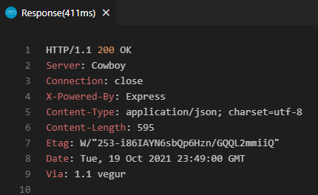

REST Response Times - GET
407ms
411ms
411ms

Slide 19
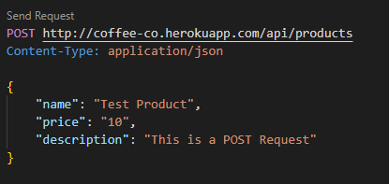
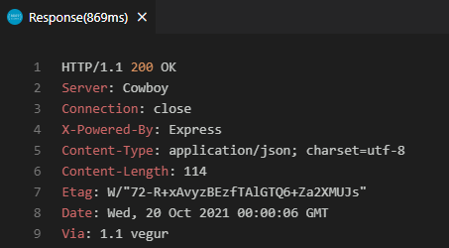
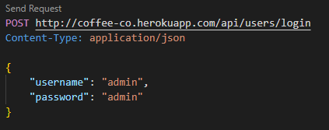
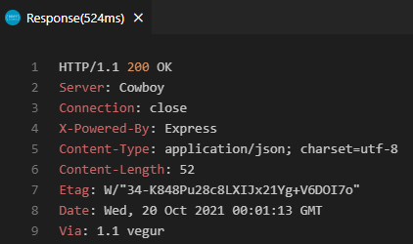
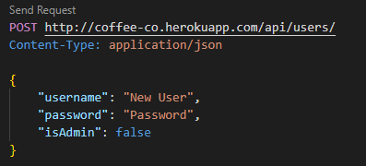
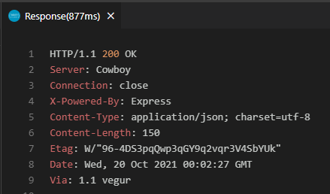
REST Response Times - POST
869ms
524ms
877ms

Slide 20
REST Response times – Discussion
Our REST Response times are definitely reasonably high.
This will create a bottleneck on the server side
The client side should be mostly unaffected as these requests are largely ASYNC requests, however, some requests such as GET products will affect the user experience
This is definitely something that would need to be addressed should the web application be scaled up for increased use

Slide 21
Demonstration
http://coffee-co.herokuapp.com/
Database
REST Requests

