Slide 1
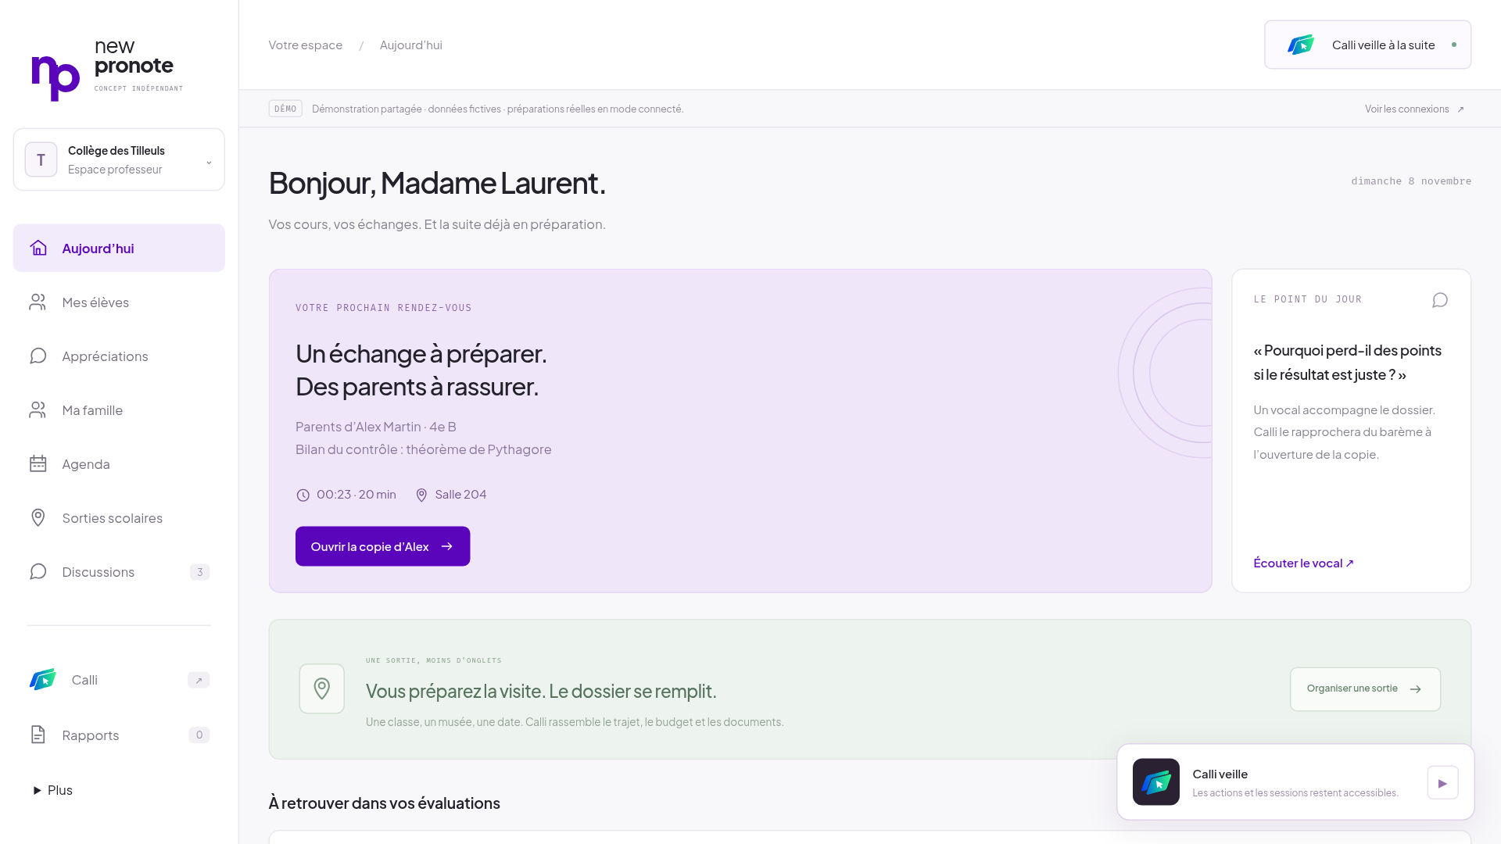

CALLI
An assistant that works alongside you.
Observe context.
Prepare useful work in parallel.
Act through tools and computer use.
First demonstrated application: education, with New Pronote.
One mechanism, a concrete application: the school workspace. Observation is scoped to Calli.
1
Notes:
Calli uses the context of the current task to prepare useful work in parallel, then combines functions and computer use to carry out an explicit request in existing software. Education is the first demonstrated application; New Pronote is its role-specific interface. Observation currently covers registered document openings inside Calli, not the whole desktop. Real screenshot: New Pronote Today, commit 2c1f5a4.

Slide 2
HOW CALLI WORKS
Observe. Prepare. Act.
Observe
Prepare
Act
A document opens inside Calli.
Useful work starts beside you.
Carry out your explicit request.
Selected case and sources
Sourced help and parallel tools
Functions + Holo computer use
Context-bound jobs · one native item at a time · read-back comparison · STOP
Observation inside Calli; concurrent outing collectors; explicit native writes. docs/calli-system.md
2
Notes:
A registered document opening inside Calli provides context. A preparation starts against a frozen case and validated sources while the user continues working. Independent school-trip collectors can run concurrently when H requests them. On explicit dictation, the native writer uses Holo and bounded functions to operate PRONOTE. These are separate flows: opening a document does not silently write a comment. Python owns the queue, checks and journal. The product demonstrates this mechanism in education; it does not claim universal desktop observation.

Slide 3
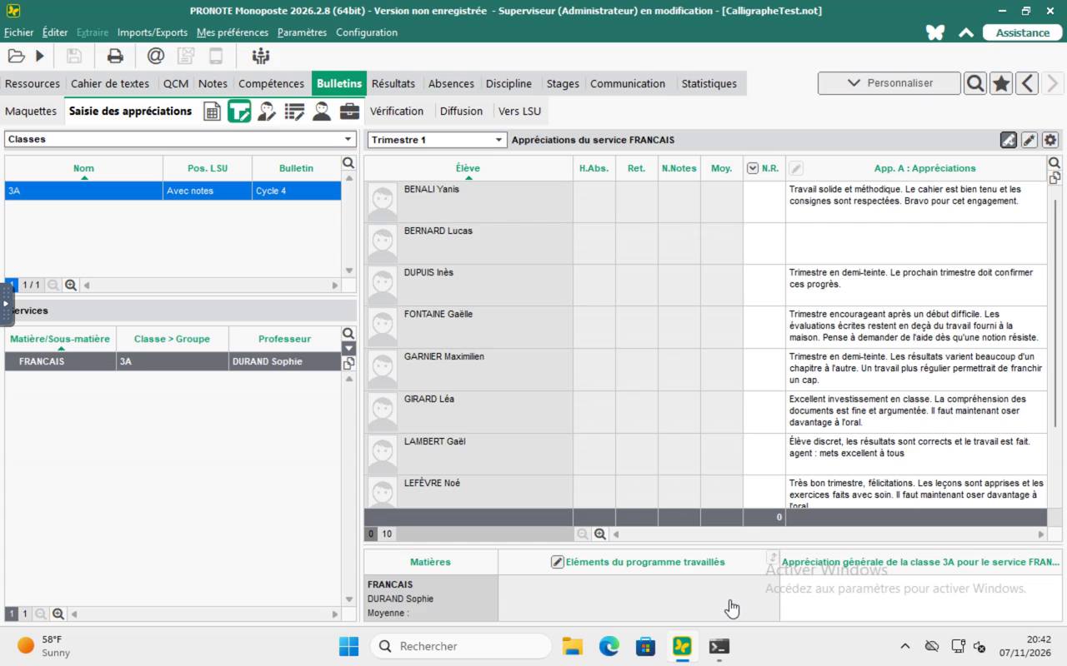
NATIVE WRITING
A dictated comment lands in real PRONOTE, then is read back.
Gladia
speech to text
Python
pupil, course, text, STOP
Holo 4
navigate, type, save
Verify
Holo reads; Python compares and journals
Recorded run on the real PRONOTE desktop (Windows trial build). Queue → verified comment: 25.57 s, one item.
3
Notes:
Flow of the recorded run: the teacher dictates; Gladia transcribes; Python checks pupil, course, text and STOP; Holo (H computer use) takes one item through next_item, navigates, types, saves, reads the cell back and calls report_result; Python compares and journals. Queue to verified: 25.57 s for one recorded item (docs/calli-api-and-architecture.md). The recorded pupil is Lucas Bernard from the native trial roster. One item is not a reliability study.

Slide 4
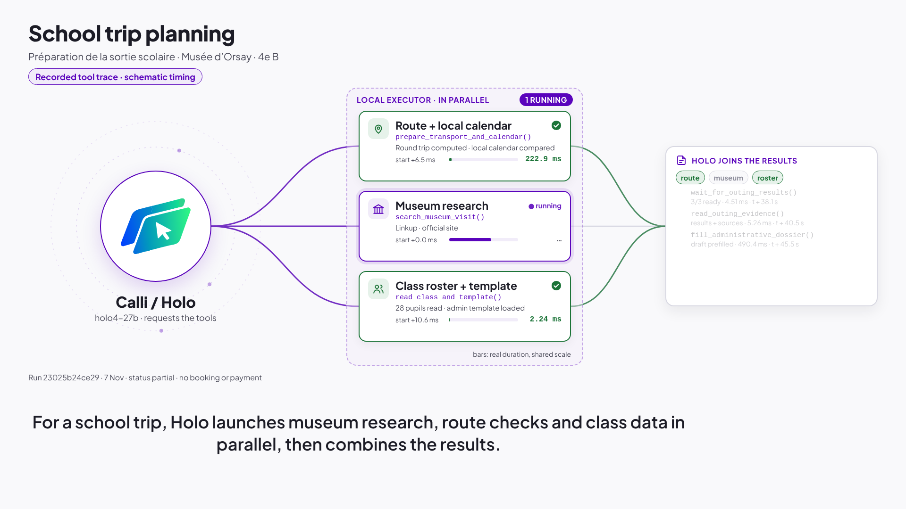
H FUNCTION CALLING
Function calling does the structured work, in parallel.
Read & transcribe
Gladia
Search sources
Linkup
Validate
H managed agent · 97.31 s
3 collectors
ran concurrently for the outing draft
Outing run 23025b24ce29: partial draft, 90.22 s, no booking or payment. Recorded tool trace, schematic timing.
4
Notes:
Structured work runs through tools, not pixels: transcription (Gladia), source search (Linkup), validation against sources (H managed agent, 97.31 s, session e1f16a50). For a school outing, Holo started three collectors concurrently: route, museum and class roster (run 23025b24ce29, partial draft in 90.22 s). Calendar and payment are separate steps; payment is a simulation and neither is part of this concurrent trace.

Slide 5
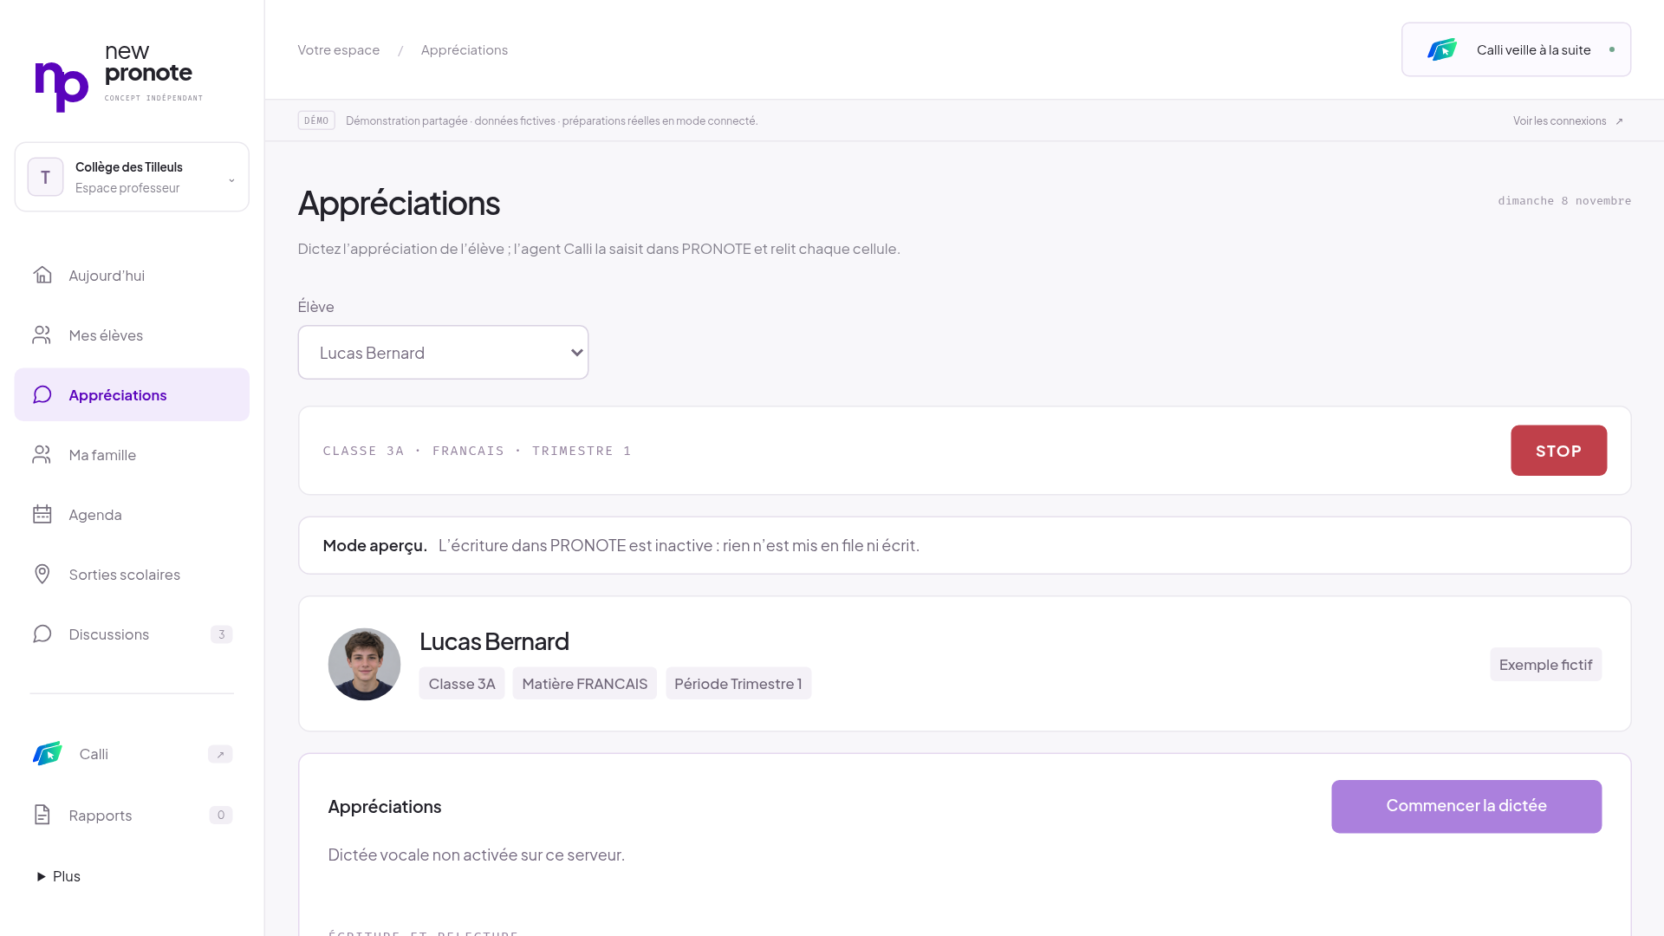
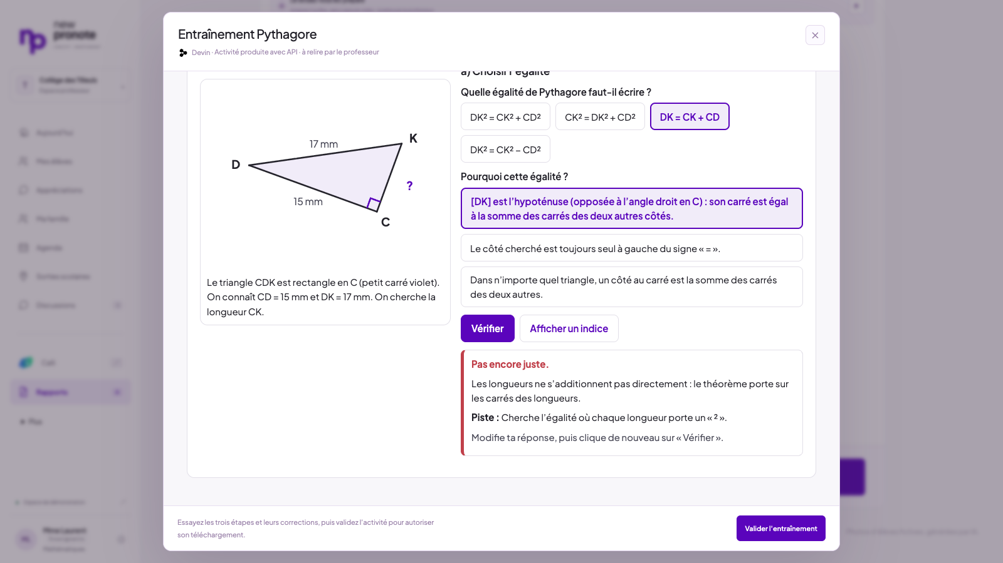
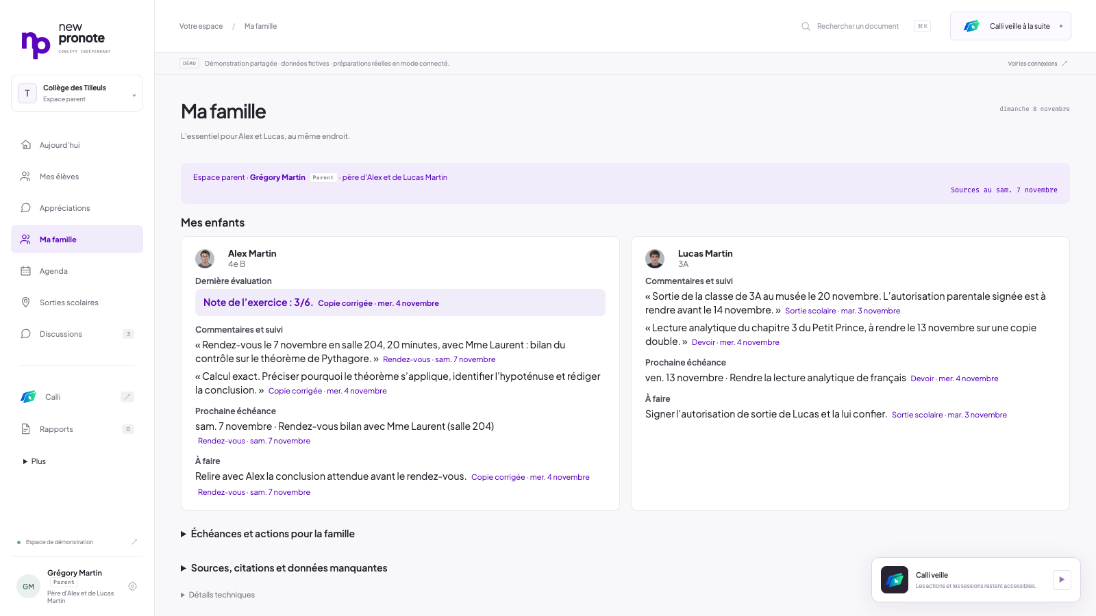
EXPERIENCE ADAPTED TO THE USER
Education: one workspace, different needs.
Teacher
Student
Parent
Mme Laurent dictates
Research-informed Devin exercise
Grégory Martin · Alex and Lucas
Teacher and parent views; student exercise shown in teacher preview. Administrative workflows are a next step.
5
Notes:
Same New Pronote workspace: the teacher (Mme Laurent) dictates for a pupil of the native roster; the student practice activity generated through the Devin API (about 565 s, session 71991d82) is previewed with wrong-answer feedback; the parent view shows Grégory Martin's two children, Alex Martin and Lucas Martin, each point linked to its source. The parent persona is a demo view, not an authorization boundary.

Slide 6
IMPACT SCENARIO
An estimated 43% less active entry time.
~3M hours / year
~€120M time value
Secondary teachers in France
Full adoption · €40/hour assumed
Gross time value before costs
Scenario, not a human benchmark. DEPP 2026 headcount; national-scenario.json. 33–52% input sensitivity.
6
Notes:
43% is the rounded median of the declared input-sensitivity model, not a measured human comparison or a share of all working hours. The annual teacher median is 6.0555 hours across selected tasks. Scaling to 485,450 secondary teachers gives 2.94 million hours; at an assumed EUR40/hour this is EUR117.6 million of gross time value, rounded to 3M hours and EUR120M. This assumes complete adoption and excludes technology costs. No cash saving or net ROI is established.

Slide 7
EVIDENCE
Measured, with its scope.
What | Measured | Scope · source
Native queue → verified comment | 25.57 s | one recorded item · docs/calli-api-and-architecture.md
Native item, next_item → report_result | 12.3 s | one item · video/calli-ui-demo/timeline.json
H sourced preparation | 97.31 s | H session e1f16a50
New Devin API practice generation | ~565 s | session 71991d82 · 23 functional checks
Outing partial draft | 90.22 s | run 23025b24ce29 · 3 concurrent collectors
Single recorded runs, not reliability statistics. Failed trials are retained in the repository.
7
Notes:
Each value is one recorded run with its own scope; they are not interchangeable and they are not reliability statistics. Queue to verified 25.57 s and item 12.3 s (next_item to report_result) are different scopes of the native writer. Failed trials are kept in the repository next to the successful ones.

Slide 8
STARTING WITH EDUCATION
Your software. Less repetitive work.
Watch youtu.be/mILSh_vLQck (1:59.8)
Code github.com/CalliH2026/app
Explore saved runs calli-demo.leisurelychestnut.chatgpt.site
François · Wilfred · Liqin
Built with H Company (Holo, Agents API), Gladia, Linkup and the Cognition Devin API.
8
Notes:
Close on the general mechanism and the concrete educational benefit. The team combines parallel assistance, native software integration and a role-specific experience. Video: https://www.youtube.com/watch?v=mILSh_vLQck (1:59.8). Public source: https://github.com/CalliH2026/app. Explore saved runs: https://calli-demo.leisurelychestnut.chatgpt.site (the New Pronote UI with saved H and outing reports, family sources and the interactive Devin exercise; no new provider or native execution). Team: François, Wilfred, Liqin.

Slide 9
SCENARIO METHOD
Backup · National impact, with explicit assumptions.
485,450 teachers × 6.0555 h/year × €40/h = €117.6M/year
Official population: DEPP 2026
Workload: 450 comments, 20 meetings, 2 outings
Setup and assisted interventions included
Primary and administrative work not extrapolated
100% adoption: ~3M h / ~€120M
10% adoption: ~294k h / ~€12M
€25–60/h valuation: ~€73–176M
Gross value of capacity; costs not deducted
Scenario assumptions; not a forecast, measured saving, budget cut or net ROI. No double counting across actors.
A
Notes:
DEPP 2026 reports 47,000 primary schools, 7,000 colleges, 3,700 lycees and 485,450 secondary teachers. Establishment count is context; secondary-teacher headcount is the multiplier. Workload assumptions stay those of the previous model. 100,000 input samples describe sensitivity, not statistical confidence. At 10% adoption the same scenario is about 294,000 hours and EUR11.8 million gross time value; costs and other actors are excluded. See docs/national-impact-scenario.md.

Slide 10
INVENTORY
Backup · APIs and tools actually used.
Service | Used for | Verified
H Agents API · Holo 4 | Operate PRONOTE through next_item / report_result | native write and read-back, 25.57 s
H managed agents | Sourced preparation, family digest selection | preparation 97.31 s; family run 16.29 s
Gladia | Speech to text | live transcription of a synthetic dictation
Linkup | Educational source search | preparation + learning-science research
Cognition Devin API | Development, Windows VMs, practice | new activity: 23 functional checks
ElevenLabs | Fictional parent audio, narration | synthetic audio, labelled
OSRM | Outing route estimate | present in the outing flow; not a booking
Stripe: Checkout sandbox adapter implemented; account test pending. Video checkout is a local illustration.
B
Notes:
Only verified integrations are listed (docs/calli-api-and-architecture.md). Stripe in the outing flow creates non-routable preview links only: no Stripe payment. A separate Checkout sandbox adapter is implemented and tested offline; account validation remains pending. A logo is not evidence of an API call.

Slide 11
TECHNICAL APPENDIX · UI RETROFIT
Modernize the experience. Keep the installed application.
Holo 4
+ tools
→
New Pronote → bounded Python jobs → Holo 4 → existing PRONOTE → read-back
No change to the native application code or database. A demonstrated workflow, not a complete PRONOTE replacement.
C
Notes:
New Pronote is a new task-oriented interface. Holo 4 drives the installed PRONOTE desktop while Python owns structured jobs, functions, validation and the journal. We do not modify the native executable or database. This is a UI retrofit, not a cloned PRONOTE backend. The demonstrated integration is one desktop writing flow, not a universal connector.

Slide 12
TECHNICAL APPENDIX · API, MCP OR COMPUTER USE?
Use the best integration for each operation.
Supported API / CLI
MCP server
Computer use
Structured operations
Expose implemented capabilities
Operate an existing interface
Prefer when available, licensed and adequate for the task.
A standard tool interface; the underlying integration still needs to exist.
Useful when the required operation is accessible through the installed UI.
MCP architecture and INDEX EDUCATION export-service documentation; direct source links in speaker notes.
D
Notes:
An API or CLI is preferred when a supported interface exposes the needed operation with adequate access and guarantees. MCP exposes capabilities implemented by a server; it does not create a missing vendor operation. INDEX EDUCATION documents export services and connectors. We have not established that PRONOTE has no APIs, nor that writing an MCP server is impossible. Our native demonstration operates a particular installed desktop flow through its existing UI. Sources: https://modelcontextprotocol.io/docs/learn/architecture and https://telechargement.index-education.com/fr/pronote-info1420-services-export-de-donnees.php

Slide 13
LINKUP → DEVIN
Learning science informs the activity. Tests check its behavior.
Linkup: source the principles
Devin: build the interactive exercise
Try → explain → practise again
23 functional checks · 450 triangle cases
Real new API output, sandboxed preview. Functional verification is separate from a learning-effectiveness study.
E
Notes:
Linkup helped locate learning-science guidance, checked against IES and EEF sources. The product adds optional worked examples, attempts before correction, explanatory feedback and retry. Devin session 71991d82 generated the new interactive artifact; 23 independent functional checks and 450 generated triangle cases passed. These checks do not demonstrate better learning outcomes. Devin was also used throughout development and for Windows VM setup. See docs/learning-science-and-impact.md.

