Slide 1







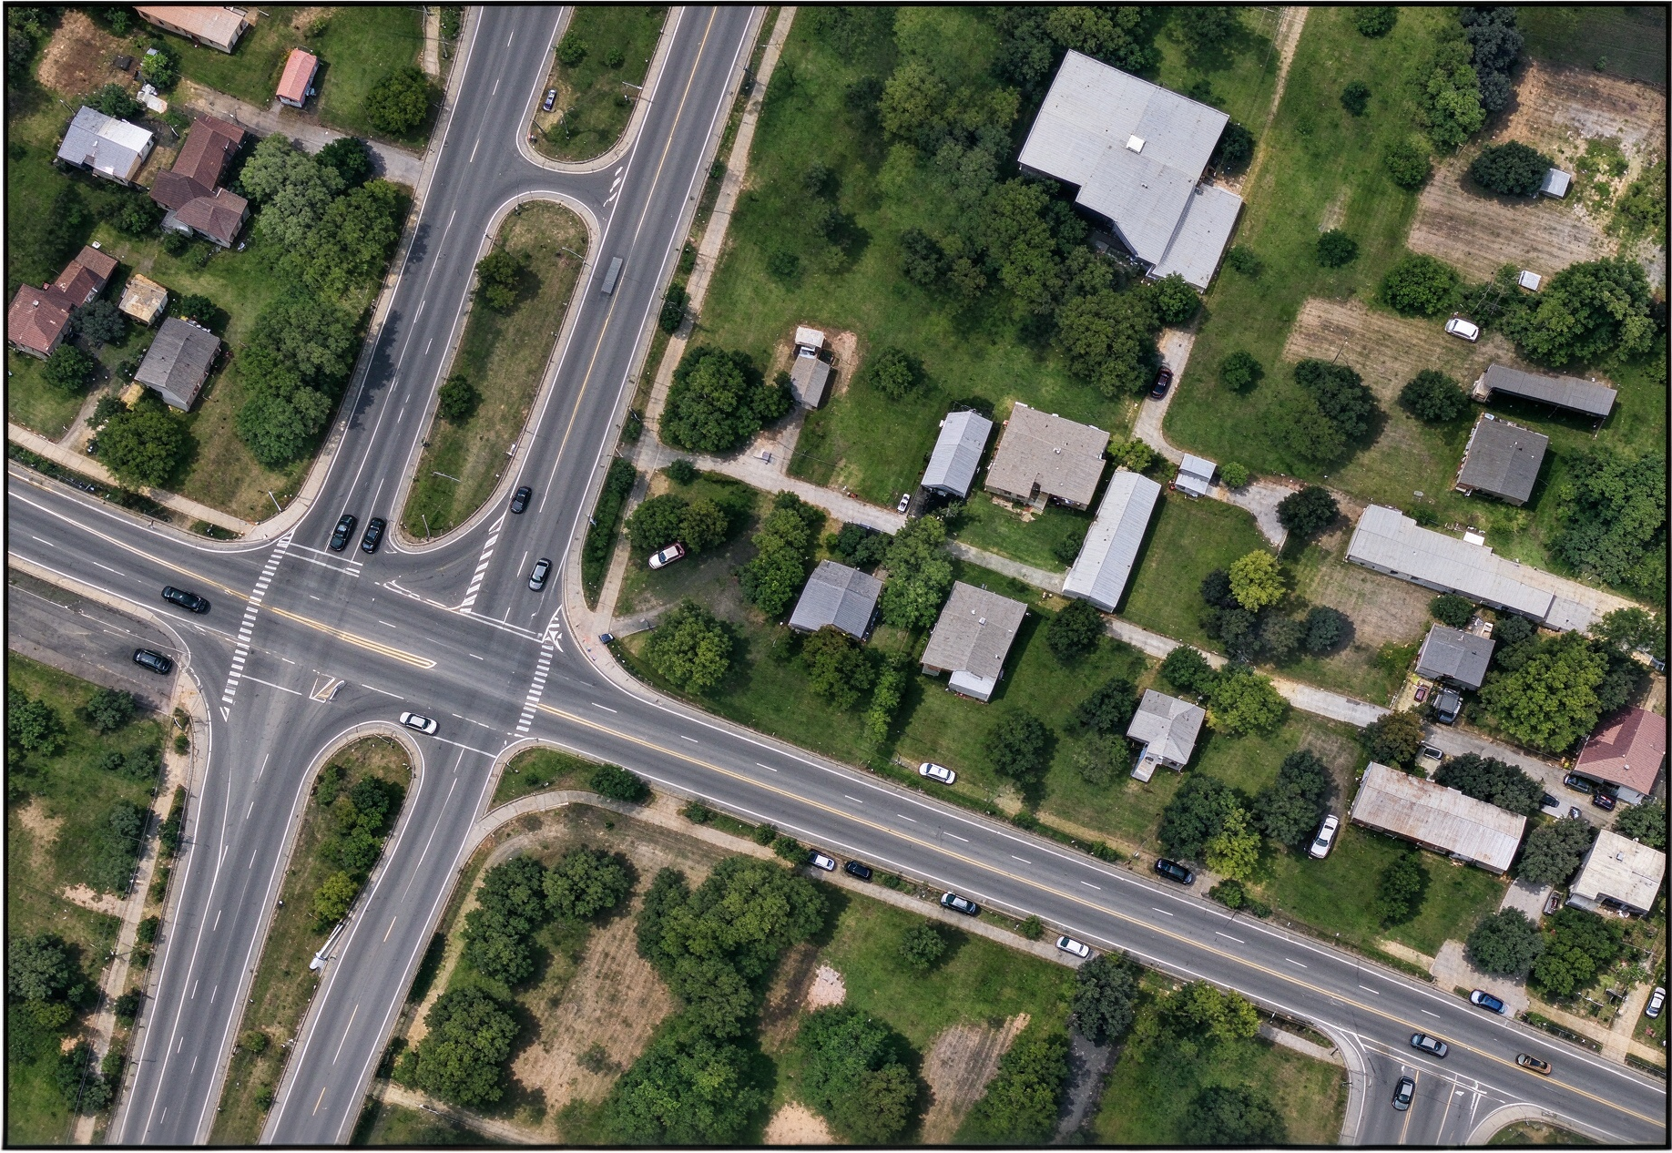
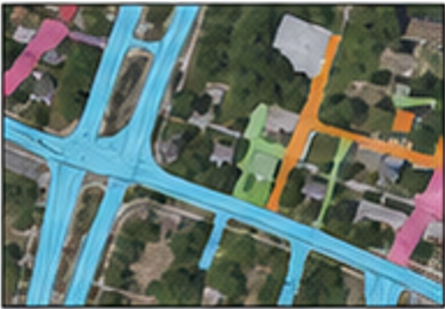
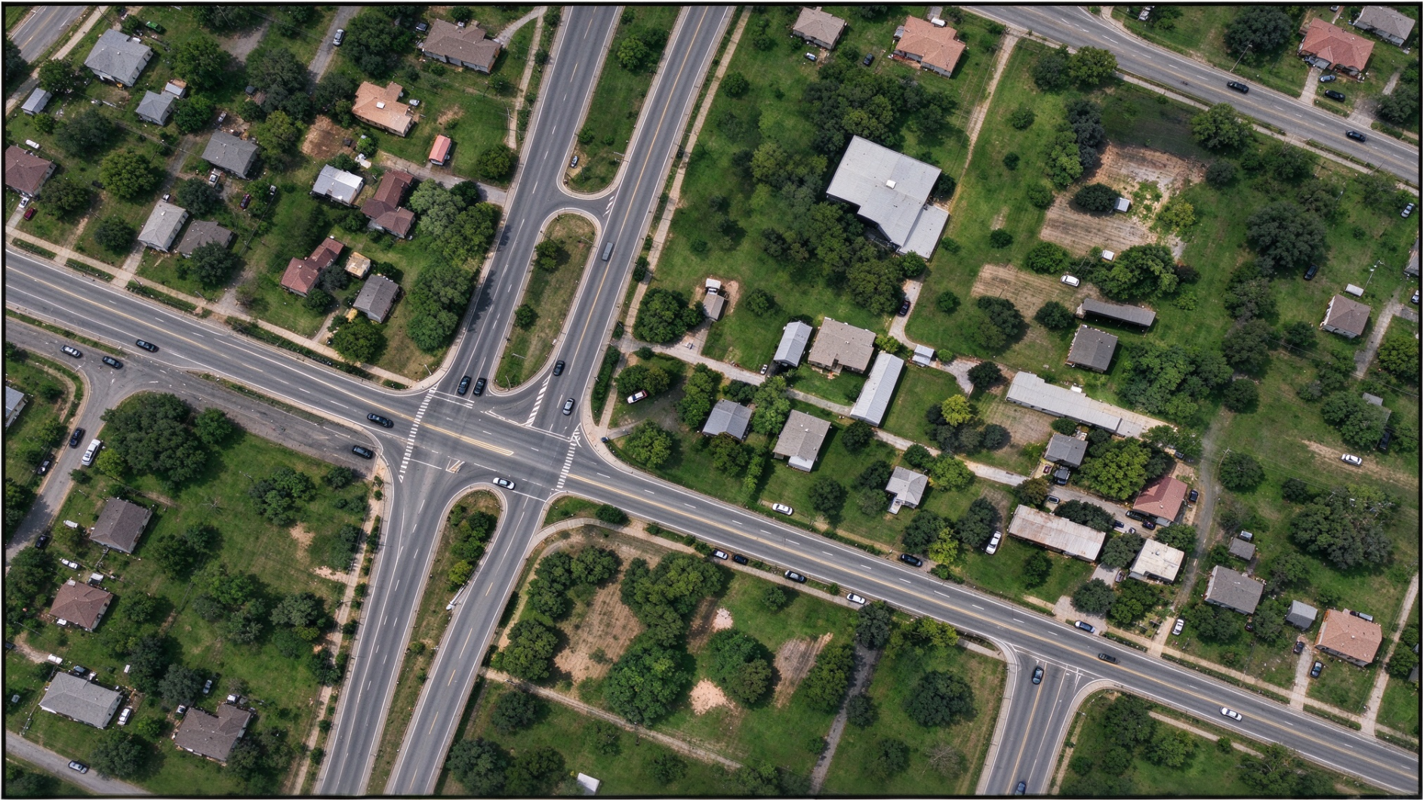
(a) Role-Functional Text
Functional Supplements
“Road network”
“continuous paved road surface”
“connected road region”
Concept anchor
“road”+ aliases
Presence
Semantic
Instance
Shared role profile
(b) Local and Context Observations
(c) Joint Role-View Composition
SAM3
Bounded residual correction
Local-detail view
Native Role Composition
Role-Aligned View Integration
Input image
Wide-context view

