Slide 1

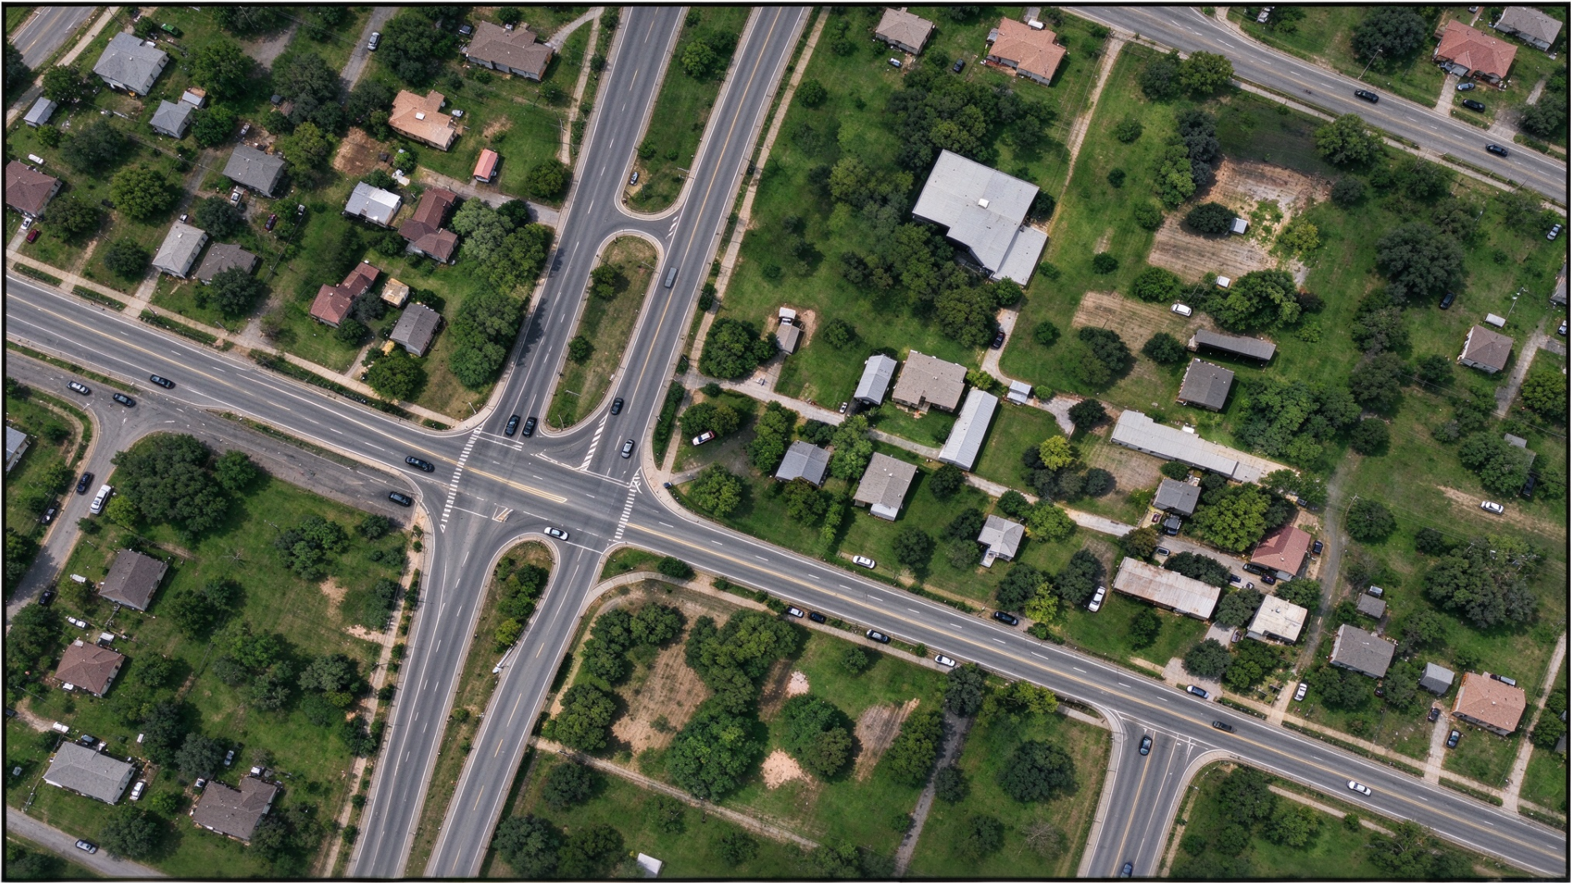
Joint Role–View Specialization
Frozen concept grounding · role-specific evidence use · aligned score-field fusion
(a) Role-functional text
Official anchor
Presence
Semantic
Instance
“road” + official aliases
“Road network”
“continuous paved road surface”
“connected road region”
Fixed dataset profile π: selected role slots and view operator; shared by both observations
(b) Observations
(c) Grounding and composition
(d) View fusion
Frozen SAM3
Role updates
Restore
Each required prompt
→ full P / S / I outputs
Bounded updates
+ native p × max(S, I)
Official map
+ coordinates
ḠL
Decision
Local observation
Ψω
Argmax +
background rule
Frozen SAM3
Role updates
Restore
Each required prompt
→ full P / S / I outputs
Bounded updates
+ native p × max(S, I)
Official map
+ coordinates
Segmentation Ŷ
ḠG
Context observation
Same weights and role profile in both rows • Fusion uses complete class-score fields before argmax
Notes:
Main method figure. Source: author-kit-main/sec/3_method.tex, 中文论文/论文中文版.md, 最终方法规范.md. Prompt phrases are illustrative examples retained from the original PPT, not a claim that these exact slots are chosen for every dataset. Images are copied from the original PPT. Score stacks are schematic; no prediction map is fabricated. Each required prompt is fully grounded. Presence–Instance coupling and official alias compensation are expanded on slide 2. Profile selection is offline and dataset-level; see the manuscript for evaluation-set selection limitations. Local/Context photos illustrate the observation types and are not quantitative results. All text, blocks and arrows are editable PPT objects.

Slide 2
Anchor-preserving role composition
Apply this same computation to Local and Context; the SAM3 weights remain frozen.
(a) Complete grounding
(b) Selective evidence updates
(c) Native composition
Full frozen SAM3 per prompt
Presence update
Shared weights; separate grounding runs
p̃ = B(pᴬ, pᴾ)
Prompt
P
S
Queries
Native fusion
Anchor A
pᴬ
Sᴬ
Qᴬ
Semantic update
Fπ = p̃ × max(S̃, Ĩ)
S̃ = B(Sᴬ, Sˢ)
Presence πP
pᴾ
Sᴾ
Qᴾ
Presence controls instance construction
Semantic πS
pˢ
Sˢ
Qˢ
Instance reconstruction + update
Official-map correction
Rebuild anchor / candidate maps using p̃
Ĩ = B(Iᴬ(p̃, a), Iᴵ(p̃, a))
Gv,π = clip(Gᵒv + Fv,π − Fᴬv)
Instance πI
pᴵ
Sᴵ
Qᴵ
Colored cells indicate evidence used downstream.
Preserves official aliases
and baseline aggregation order
B(a, b) = clip[0,1] [a + α · clip(b − a, −τ, τ)] α = 0.5, τ = 0.25
Admission a = p̃ (native) or pᴬ (anchor admission). Zero role updates recover the official map for that observation.
Notes:
Technical detail corresponding to manuscript equations (4)–(8). Q denotes the query-mask/confidence package used for reconstruction; it does not imply a learned routing module. Presence modifies admission in native mode and amplitude in both modes. Anchor-admission affects membership only. Instance maps are rebuilt before the bounded Instance update. The same p̃ is used in final scaling. Outer clip is to [0,1]. Gv,π is observation-level output; spatial restoration and averaging occur subsequently as shown on slide 1. Selecting evidence happens after complete grounding; this is not three independently trained heads. All non-image elements are editable.

