Slide 1
WHAT IS PHISHING?
Phishing is a fraudulent attempt to obtain sensitive information via email, websites, or social engineering

Slide 2
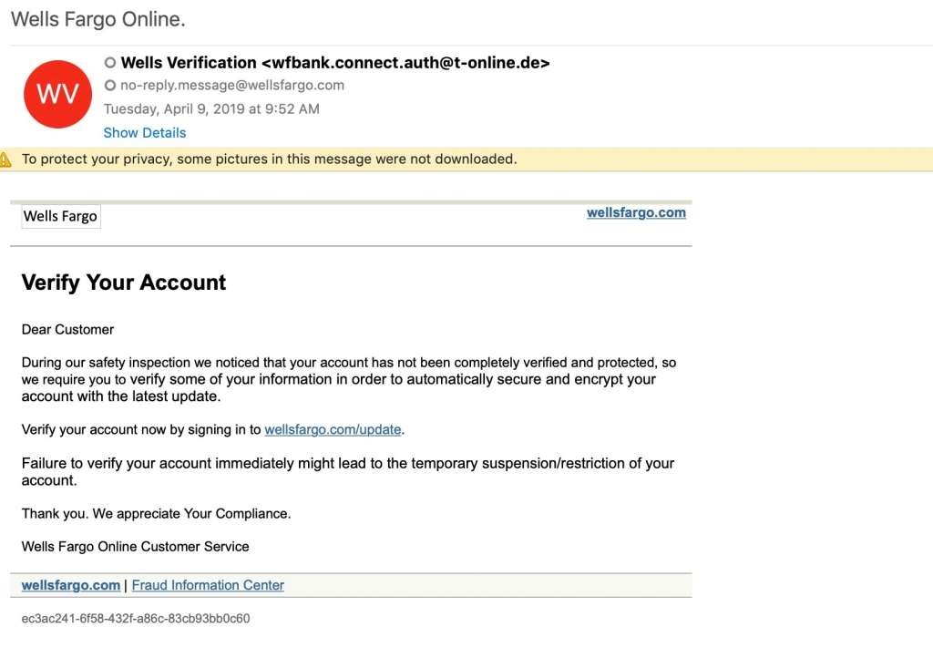
EXAMPLE OF A PHISHING EMAIL

Slide 3
Types of Phishing
Deceptive Phishing
Spear Phishing
Whaling
Smishing (SMS)
Vishing (Voice)

Slide 4
Deceptive Phishing
Deceptive phishing, also known as email phishing, is a cybercrime where attackers send fraudulent emails to trick individuals into revealing sensitive information, such as passwords, phone numbers, or social security numbers. These emails are crafted to appear as if they come from legitimate organizations like banks or government agencies. They often include links to fake websites or contain malware designed to steal personal data. For example, a phishing email might falsely warn that a user's password is expiring and prompt them to visit a fraudulent site to "renew" it. The goal is to steal personal and financial information.

Slide 5
Spear Phishing
Spear phishing is a targeted phishing attack aimed at specific individuals or organizations, typically through deceptive emails. The attacker carefully researches the target, making the email appear as if it’s from a trusted source. Using social engineering techniques, the email encourages the recipient to click on a malicious link or attachment. Once the victim takes this action, the attacker can steal sensitive information, like login credentials, or infect the device with malware, allowing them to access the network undetected

Slide 6
Whaling
A whaling attack targets high-level executives, such as CEOs and CFOs, aiming to steal confidential or financial information. Like spear-phishing, it uses personalized strategies, but focuses on senior management to cause greater damage. These attacks are typically carried out via email, text messages, or phone calls, using social engineering to craft convincing messages that seem to come from trusted contacts. Attackers often impersonate someone within the company, creating a sense of urgency. For example, they might send an email posing as a CFO, asking the CEO to wire money to a supposed vendor.

Slide 7
Smishing (SMS)
Smishing is a type of phishing that uses text messages (SMS) to deceive people into sharing sensitive information or taking actions that compromise their security. Scammers send fake messages that appear to come from trusted sources like banks, delivery services, or government agencies. These messages often contain links to fraudulent websites or phone numbers, aiming to trick recipients into revealing personal or business information. By playing on emotions such as fear, curiosity, or urgency, scammers manipulate individuals into falling for the scam

Slide 8
Vishing (Voice)
Vishing is a type of phishing that combines "voice" and "phishing," where fraudsters use phone calls or voice messages to trick individuals into revealing sensitive information. Scammers often impersonate trusted entities like banks or government agencies, using urgency or alarm to pressure victims. For instance, they may claim that your account has been compromised, you owe money, or you've won a prize. These scams rely on social engineering tactics, manipulating emotions to gain personal details. Vishing can involve direct calls or robocalls, and scammers often use toll-free numbers or VoIP to appear legitimate.

Slide 9
Common Phishing Tactics
Urgency
Fear
Curiosity
Authority
Social Engineering

Slide 10
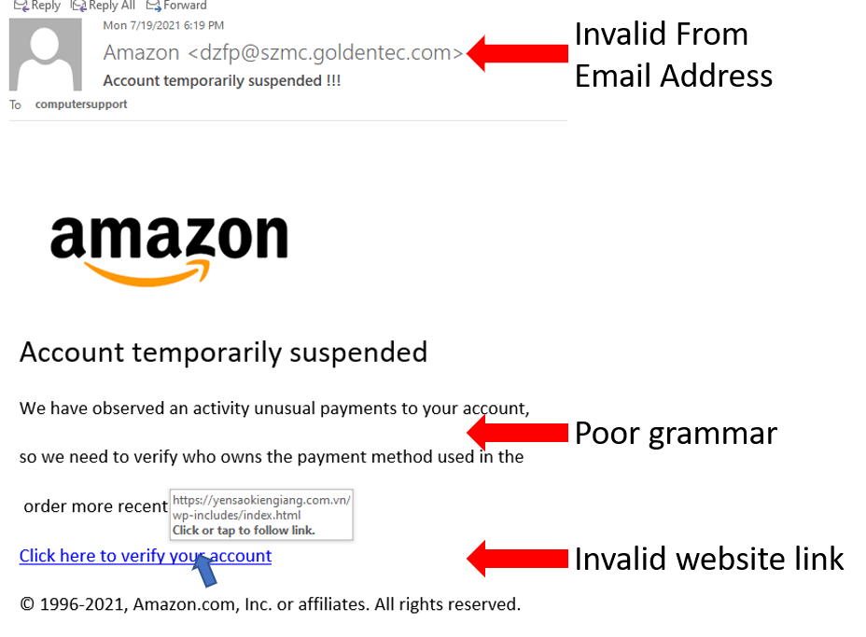
Fake email claiming account suspension

Slide 11
REDFLAGS TO LOOK OUT FOR
Suspicious sender
Grammar/Spelling mistakes
Urgent/Threatening language
Unusual requests
Fake links/Attachments

Slide 12
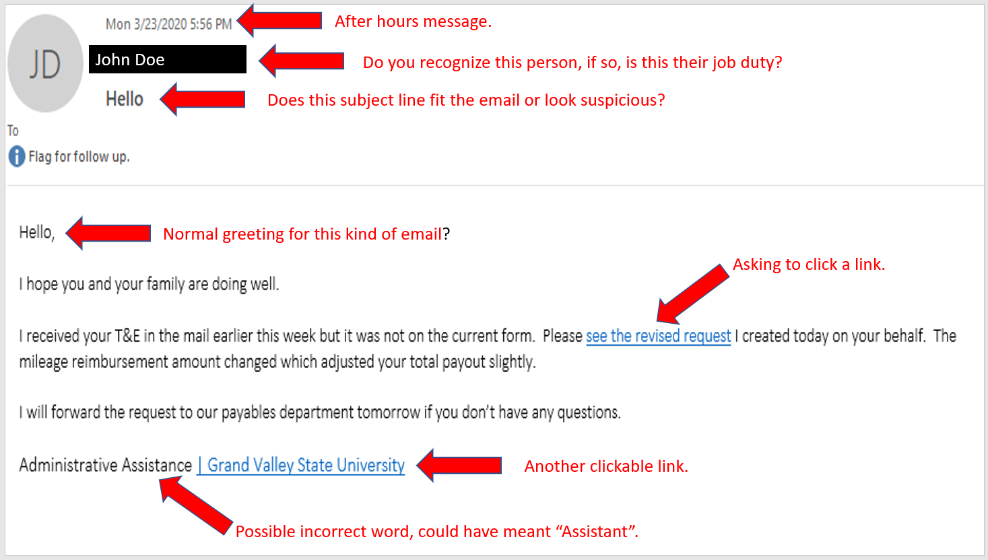
Example of a phishing email with red flags highlighted

Slide 13
Safe Email Practices
Best Practices include:
Verify sender
Be cautious with links/attachments
Use strong passwords
Enable 2FA
Report suspicious email

Slide 14
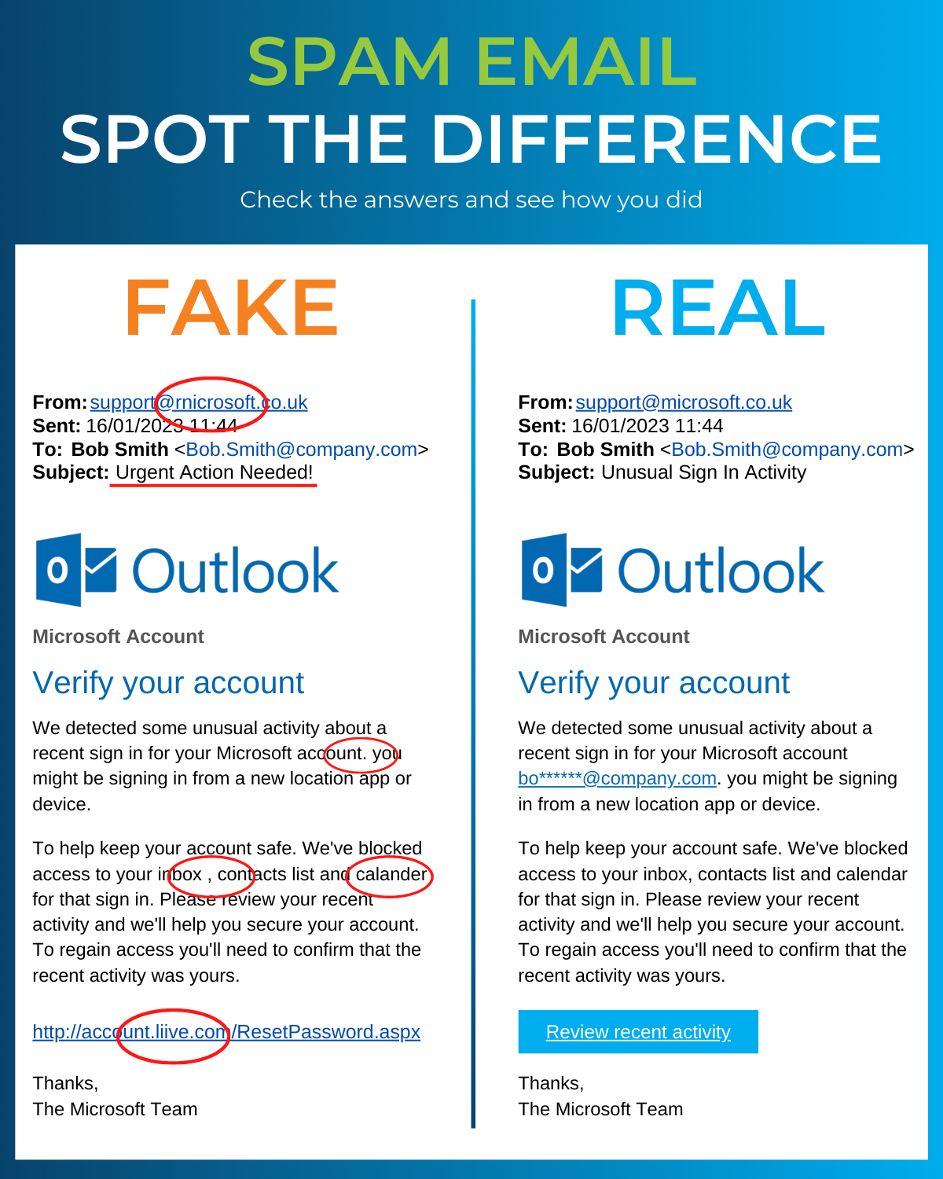
Example of a legitimate email vs. phishing email

Slide 15
Social Engineering
Social engineering is a tactic used by attackers to manipulate individuals into divulging confidential information or performing certain actions. It methods include:
Pretexting
Baiting
Quid Pro Quo
Tailgating

Slide 16
Pretexting
Pretexting involves creating a fabricated scenario or identity to deceive someone into sharing personal or sensitive data

Slide 17
Baiting
Baiting, on the other hand, tempts a target with a seemingly desirable offer, such as free software or a device, that often hides malicious intent.

Slide 18
Quid Pro Quo
Quid Pro Quo offers something in return for the desired information or action, such as pretending to be technical support in exchange for login details.

Slide 19
Tailgating
Tailgating occurs when an unauthorized person gains physical access to a restricted area by following someone with legitimate access, often by exploiting politeness or lack of security awareness.

Slide 20
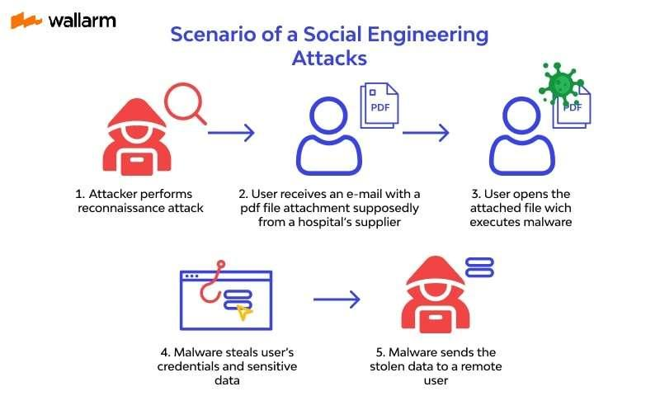
Example of social engineering scenario

Slide 21
How to Protect Yourself
Protection Measures:
Keep software up-to-date
Use antivirus
Monitor accounts
Use password managers
Educate yourself

Slide 22
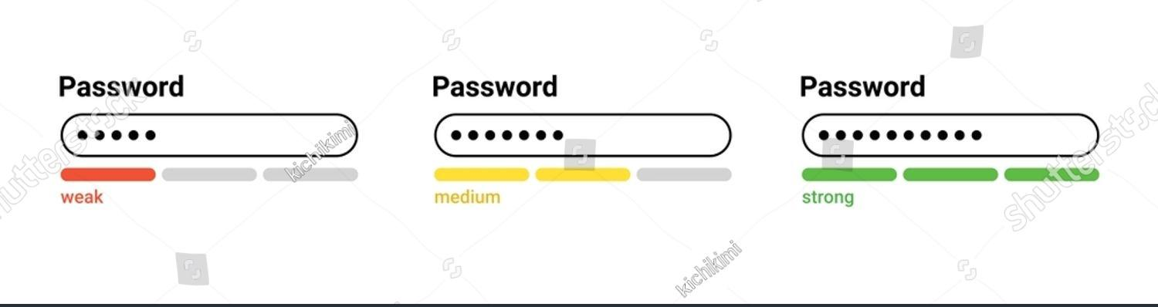
Person using strong password manager

Slide 23
Conclusion
Key Takeaways:
Be vigilant
Verify information
Report suspicious activity
Stay informed
"Stay Safe Online – Report Phishing Attempts”

