Slide 1
Power System Fault Detection and Classification
CAPSTONE PROJECT
Presented By:
1. Ashutosh Kumar Soni-Shri Shankaracharya Group of Institutions-CSE

Slide 2
OUTLINE
Problem Statement
Proposed System/Solution
System Development Approach
Algorithm & Deployment
Result (Output Image)
Conclusion
Future Scope
References

Slide 3
Problem Statement
Design a machine learning model to detect and classify different types of faults in a power distribution system. Using electrical measurement data (e.g., voltage and current phasors), the model should be able to distinguish between normal operating conditions and various fault conditions (such as line-to-ground, line-to-line, or three-phase faults). The objective is to enable rapid and accurate fault identification, which is crucial for maintaining power grid stability and reliability.

Slide 4
Proposed Solution
The proposed system aims to automate the process of detecting and classifying power system faults to ensure timely and reliable operation of the grid. It leverages electrical phasor data (voltage and current) and machine learning techniques to accurately identify various fault types. The solution consists of the following components:
Data Collection:
Use the publicly available Power System Faults Dataset from Kaggle, which contains labeled examples of different fault types and normal operating conditions.
The dataset includes voltage and current phasor measurements essential for fault classification(e.g., line-to-ground, line-to-line, three-phase faults).
Data Preprocessing:
Clean and normalize the data to handle missing values, noise, and inconsistencies.
Extract relevant features (e.g., phase differences, magnitude deviations) that indicate fault conditions.
Machine Learning Algorithm:
Implement a classification algorithm such as Random Forest, SVM, or Neural Networks to distinguish between different fault types.
Train the model using labeled fault data and validate its accuracy using cross-validation techniques.
Deployment:
Develop an interactive dashboard or tool for real-time fault monitoring and classification.
Deploy the model on IBM Cloud Lite, ensuring scalability, low latency, and secure access.
Evaluation:
Evaluate the model using metrics like Accuracy, Precision, Recall, and Confusion Matrix.
Continuously fine-tune the model with feedback and real-time data for improved fault prediction performance.

Slide 5
System Approach
The "System Approach" section outlines the overall strategy and methodology for developing and implementing the power system fault detection and classification. Here's a suggested structure for this section:
System requirements
IBM Cloud(Mandatory).
IBM Watsonx.ai Studio for model development and deployment.
IBM Cloud Object Storage for dataset handling.
AutoAI–Automate pipeline creation and optimization.
User Environment
Web browser (Chrome/Firefox recommended), stable internet connection
RAM: 8 GB (minimum)
OS: Windows/macOS/Linux

Slide 6
Algorithm & Deployment
Algorithm Selection:
Used Random Forest and SVM for classification.
Chosen for high accuracy and noise tolerance.
Data Input:
Voltage & current features (magnitude, angle).
Labeled data with different fault types.
Training Process:
Dataset split into training and testing sets
GUI-based training with cross-validation
Prediction Process:
Model deployed on Watsonx.ai Studio with API endpoint for real-time predictions.
The GUI allows easy upload and prediction using the built model.

Slide 7
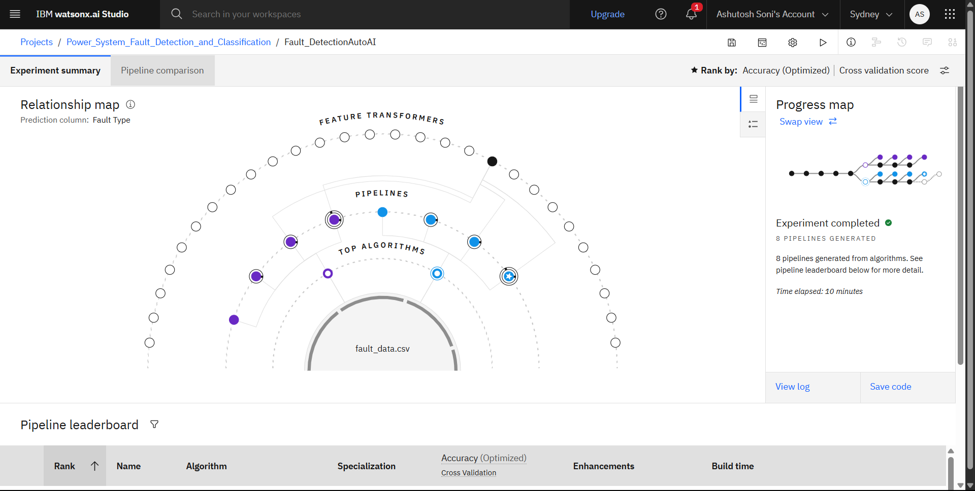
Result

Slide 8
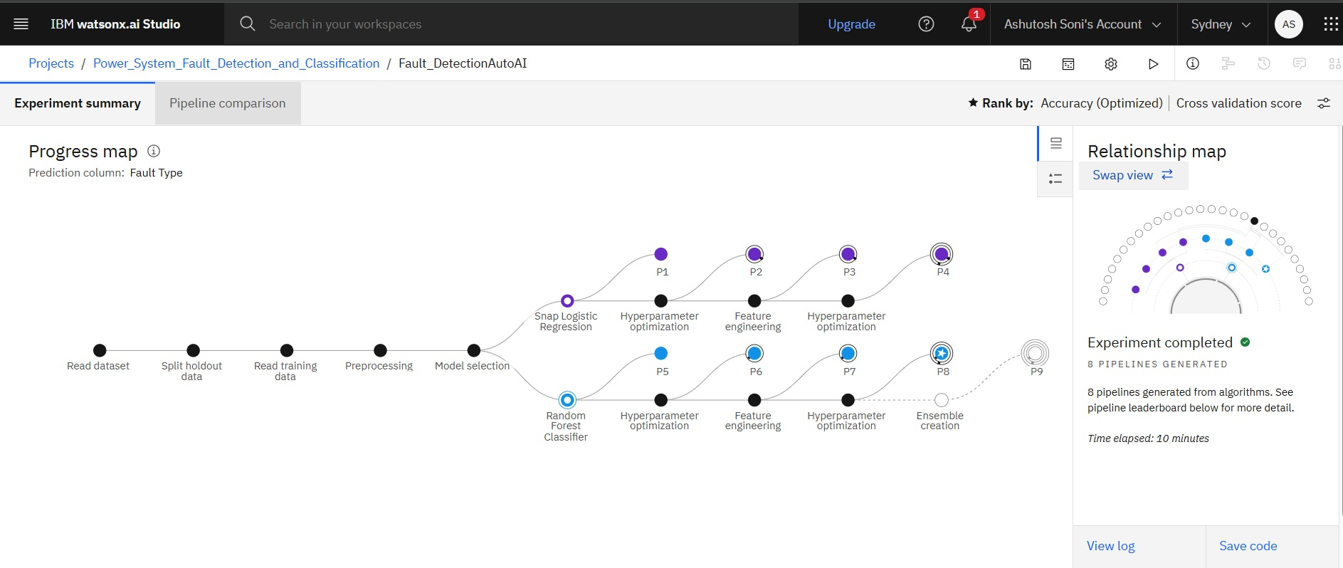
Result

Slide 9
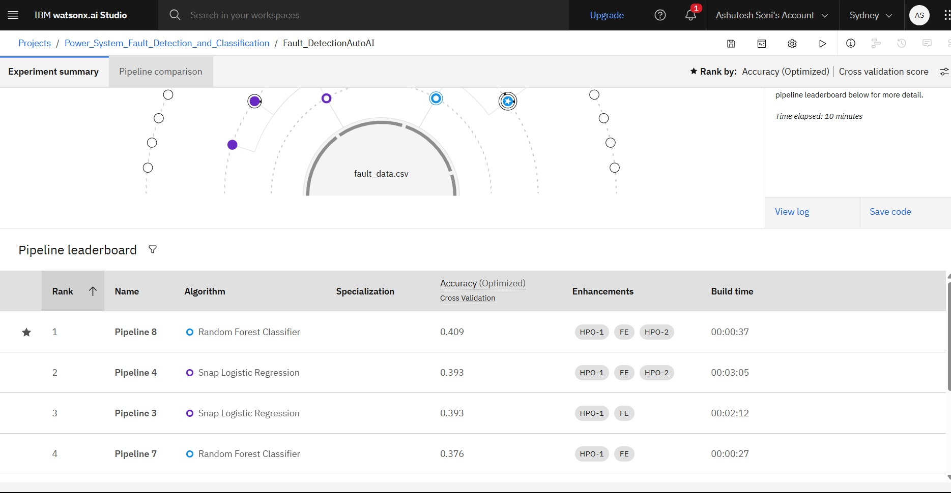
Result

Slide 10
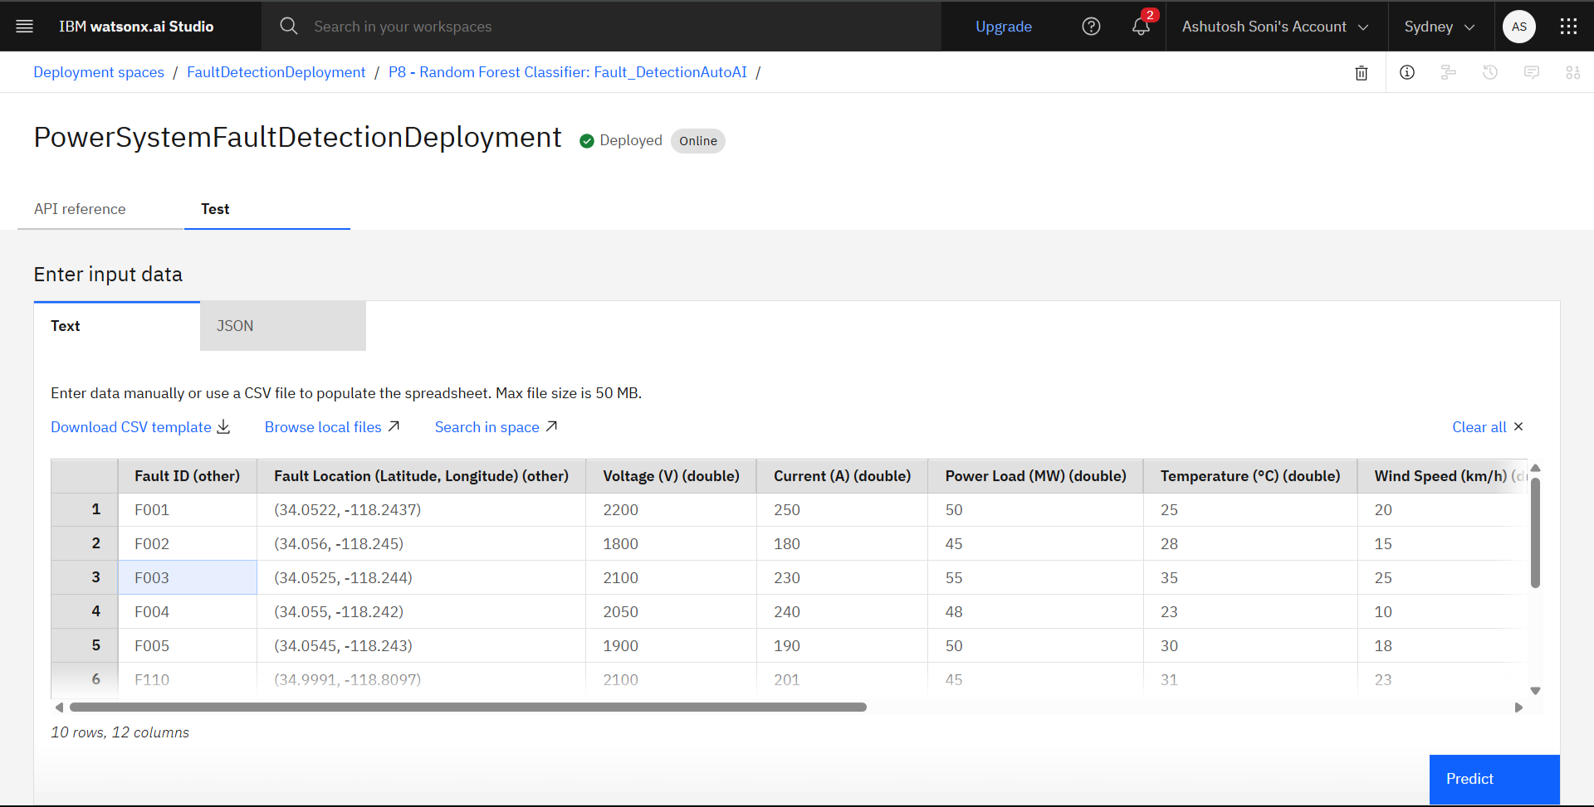
Result

Slide 11
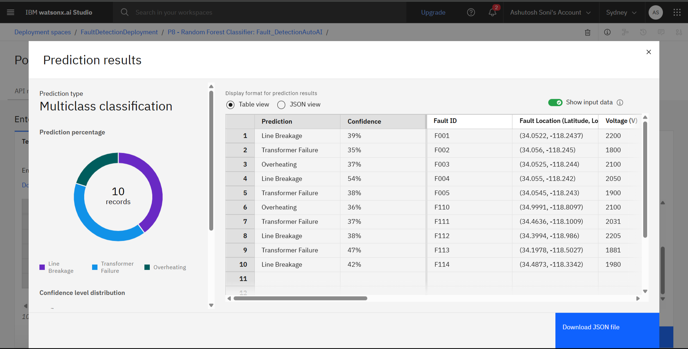
Result

Slide 12
Conclusion
This project demonstrates the effectiveness of machine learning in detecting and classifying power system faults using electrical measurement data. By accurately identifying fault types such as line-to-ground, line-to-line, and three-phase faults, the model enhances grid stability and enables faster response times. With potential for real-time deployment and integration into smart grid systems, the solution contributes to a more reliable and intelligent power distribution network.

Slide 13
Future scope
1. *Real-Time Grid Deployment*
Integrate the model with SCADA/PMU systems for real-time fault detection and response.
2. *Advanced Fault Handling*
Extend detection to complex, multi-fault, and intermittent fault scenarios.
3. *Scalable Transfer Learning*
Adapt models across different regions or grids using transfer learning.
4. *Smart Grid Integration*
Embed the system in IoT-enabled smart grids and edge devices for predictive maintenance.
5. *Explainable AI*
Use interpretable models (e.g., SHAP) to help operators understand fault causes.
6. *Cyber-Physical Security*
Enhance fault models to detect and differentiate cyber-induced faults.
7. *Cloud-Based Scalability*
Deploy via IBM Cloud Lite and edge platforms for accessible, scalable monitoring.

Slide 14
References
Ziya Uddin, Power System Faults Dataset, Kaggle
(https://www.kaggle.com/datasets/ziya07/power-system-faults-dataset)
IBM Watsonx.ai Documentation
(https://www.ibm.com/docs/en/watsonx)
IEEE Xplore – Research articles on fault classification in power systems
(https://ieeexplore.ieee.org)
Scikit-learn: Random Forest & SVM Theory
(https://scikit-learn.org/stable/user_guide.html)

Slide 15
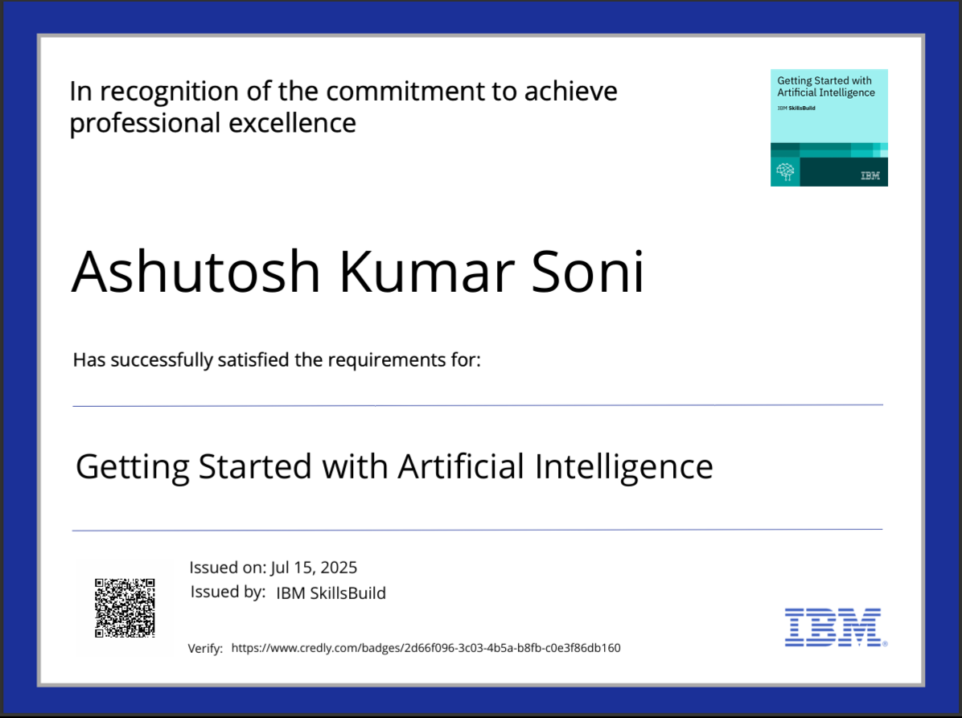
IBM Certifications

Slide 16

IBM Certifications

Slide 17
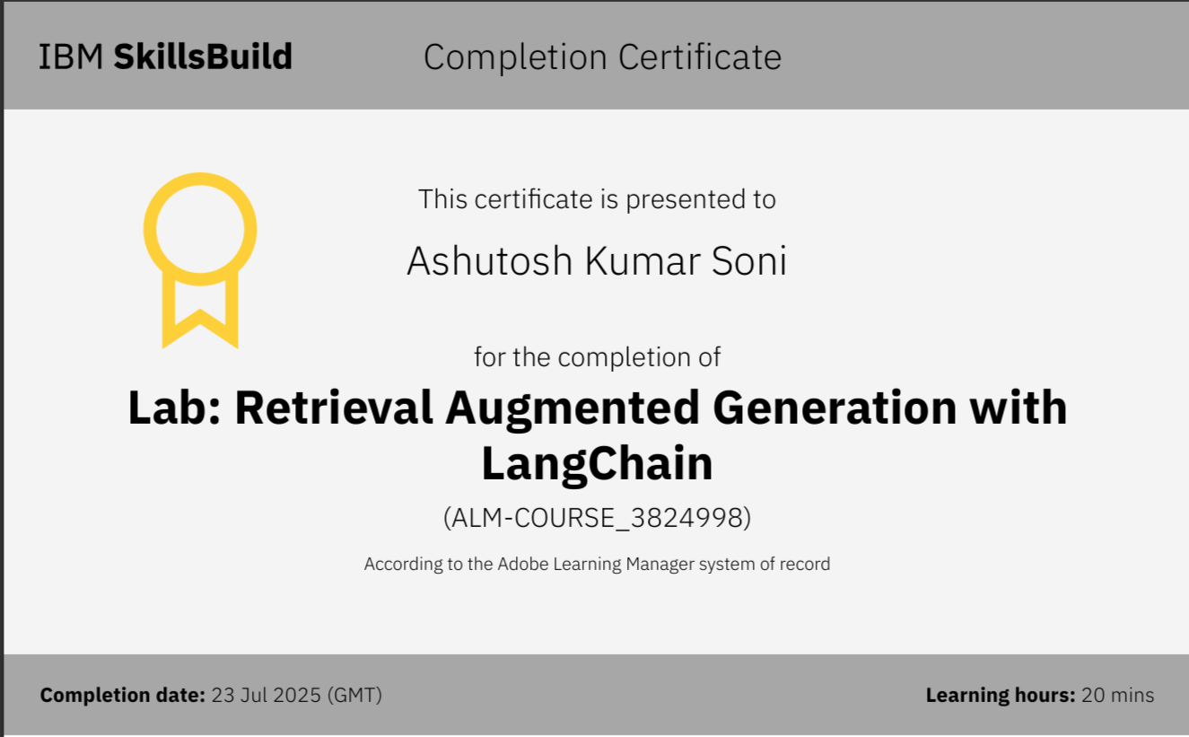
IBM Certifications

Slide 18
THANK YOU

