Slide 1
2020 Maude -REPOR T-
5/11
金鹏 蒋清源 吴捷程 顾佳鑫

Slide 2
Overview
/ 01

Slide 3
Programming Language
Work on Unix
Unique Syntax
Built-in Search Engine ➡ Framework

Slide 4
Rewriting Logic
/ 02

Slide 5
Rewriting Logic
Important idea of abstracting models from concrete examples
Main content of code
Makes Maude remarkably extensible and powerful

Slide 6
Background
/ 03

Slide 7
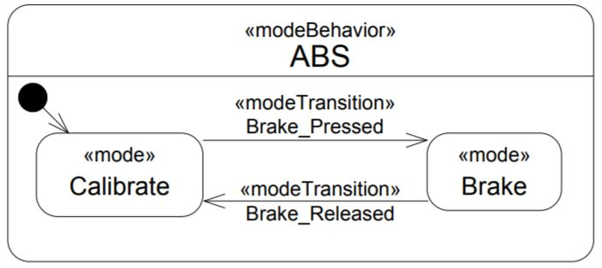
Anti-lock Braking System(ABS)
ABS is a control unit in a car that ensures the stability of the vehicle during drive and extreme brake situations.

Slide 8
Mode Analysis (ABS)
Calibrate mode:
SenseSpeed periodically senses the current wheel speed;
Calibrate estimates the speed to be adjusted.
Brake mode:
SenseBrake receives the current brake torque value;
BrakeControl determines the brake pressure to be applied;
BrakeWheel applies required brake pressure with anti-lock braking to
individual wheels.

Slide 9
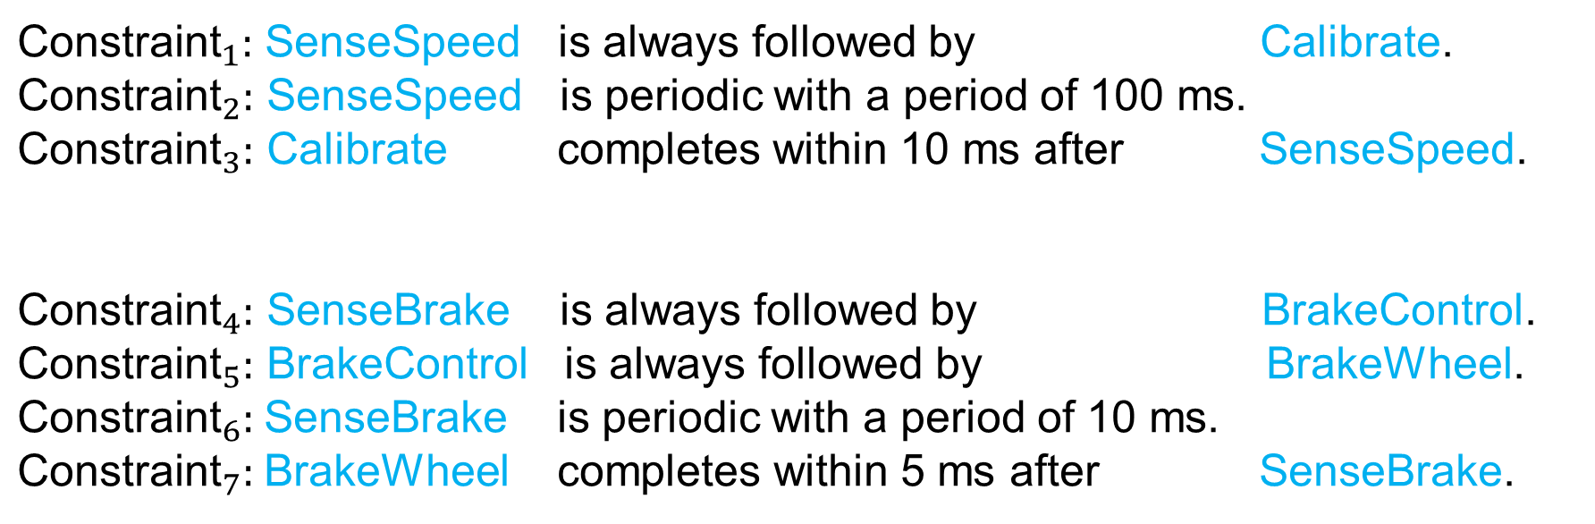
Constraints (ABS)
${\text{Constraint}}_{1}:$ SenseSpeed is always followed by Calibrate.
${\text{Constraint}}_{2}:$ SenseSpeed is periodic with a period of 100 ms.
${\text{Constraint}}_{3}:$ Calibrate completes within 10 ms after SenseSpeed.
${\text{Constraint}}_{4}:$ SenseBrake is always followed by BrakeControl.
${\text{Constraint}}_{5}:$ BrakeControl is always followed by BrakeWheel. ${\text{Constraint}}_{6}:$SenseBrake is periodic with a period of 10 ms.
${\text{Constraint}}_{7}:$BrakeWheel completes within 5 ms after SenseBrake.

Slide 10
Clock Constraint Specification Language(CCSL)
System ➡ Clocks ➡ Sequences ➡ Constraints
Consisted of
Generate
Satisfy
Schedule
Clock A: tick idle idle tick idle …
Clock B: tick idle tick tick tick …

Slide 11
Constraints(CCSL)
CCSL describes the relationships between events via constraints.
Example: Delay
$χ\left(c, n\right):$ The number of c ticks before the timestamp n.

Slide 12
Model(Strict)
/ 04

Slide 13
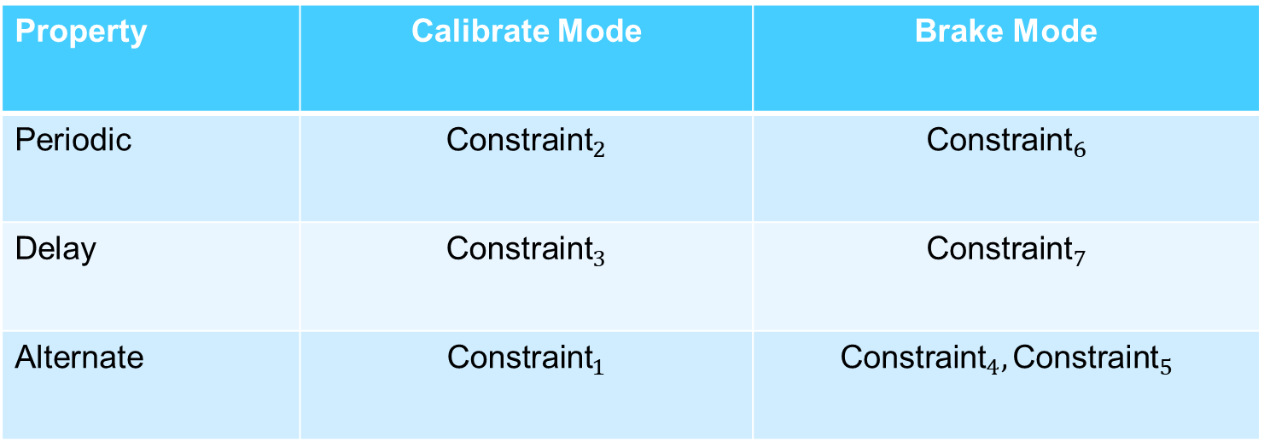
Derive & Category
Property | Calibrate Mode | Brake Mode
Periodic | $${\text{Constraint}}_{2}$$ | $${\text{Constraint}}_{6}$$
Delay | $${\text{Constraint}}_{3}$$ | $${\text{Constraint}}_{7}$$
Alternate | $${\text{Constraint}}_{1}$$ | $${\text{Constraint}}_{4}, {\text{Constraint}}_{5}$$

Slide 14
Specific Solution(extra clocks)
Set the minimal timestamp to 1 ms;
Introduce two reference periodic Clocks(tick per 10 ms / 100 ms);
Introduce two extra periodic Clocks(tick per 10 + 5 ms / 100 + 10 ms).
Precise enough to prioritize all the actions;
They have the same period with the SenseSpeed & SenseBrake;
Used to describe the ‘deadline’ of Calibrate & BrakeWheel.

Slide 15
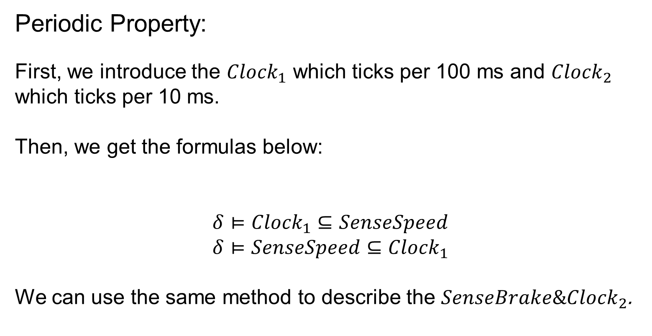
Specific Solution(common part)
Periodic Property:
First, we introduce the ${Clock}_{1}$ which ticks per 100 ms and ${Clock}_{2}$ which ticks per 10 ms.
Then, we get the formulas below:
$$δ⊨{Clock}_{1}⊆SenseSpeed$$
$$δ⊨SenseSpeed⊆{Clock}_{1}$$
We can use the same method to describe the $SenseBrake\&{Clock}_{2}$.

Slide 16
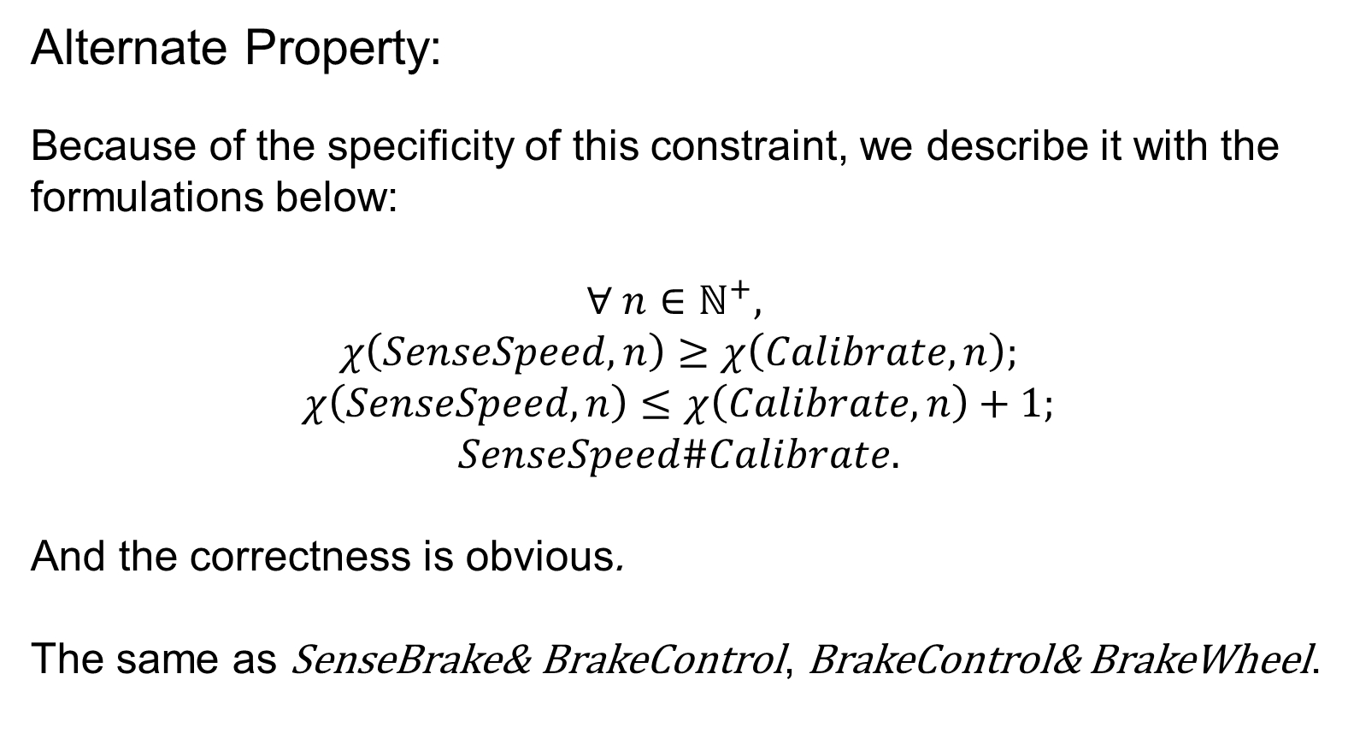
Specific Solution(unique part)
Alternate Property:
Because of the specificity of this constraint, we describe it with the formulations below:
$$∀ n∈ℕ^{+},$$
$$χ\left(SenseSpeed, n\right)≥χ\left(Calibrate, n\right);$$
$$χ\left(SenseSpeed, n\right)≤χ\left(Calibrate, n\right)+1;$$
$$SenseSpeed\#Calibrate.$$
And the correctness is obvious.
The same as SenseBrake& BrakeControl, BrakeControl& BrakeWheel.

Slide 17
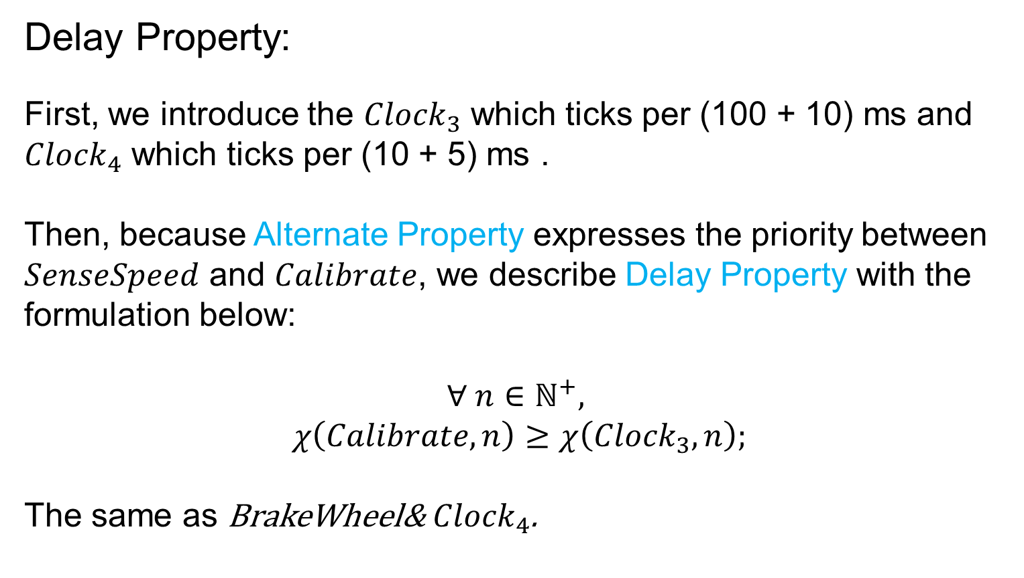
Specific Solution(unique part)
Delay Property:
First, we introduce the ${Clock}_{3}$ which ticks per (100 + 10) ms and ${Clock}_{4}$ which ticks per (10 + 5) ms .
Then, because Alternate Property expresses the priority between $SenseSpeed$ and $Calibrate$, we describe Delay Property with the formulation below:
$$∀ n∈ℕ^{+},$$
$$χ\left(Calibrate, n\right)≥χ\left({Clock}_{3}, n\right);$$
The same as BrakeWheel& ${Clock}_{4}$.

Slide 18
Experiment(Strict)
/ 05

Slide 19
Thanks

