Slide 1
Friendr: The friending site for lonely quarnatiners

Slide 2
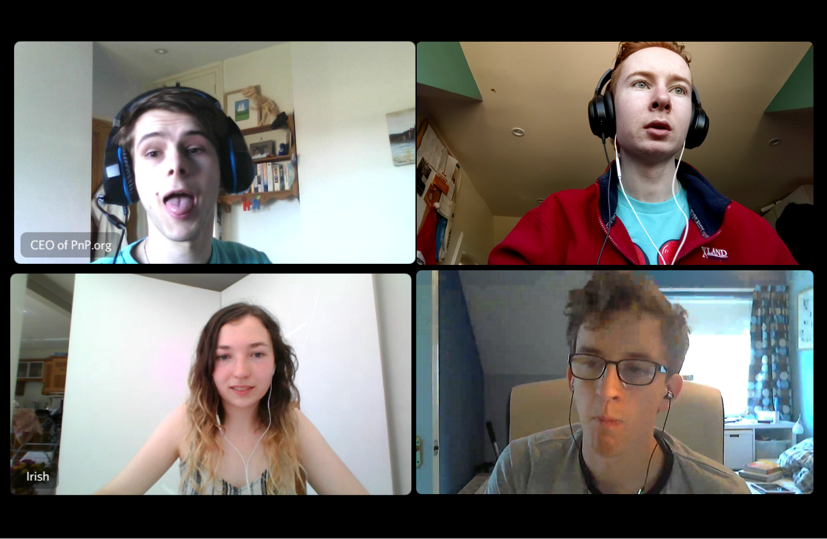
Who are we?
Four first year students from the University of Edinburgh

Slide 3
What did we set out to do?
Build a website to bring people of similar interests together
Allow people to sign up to find a match
Store and search account information in MongoDB
Host the site on Google Cloud

Slide 4
How did it all go?
Some highlights include:
An hour of Cal having broken audio
Lots of confusion about git and github
…

Slide 5
So where is Freindr now?

