Slide 1



WELCOME!
Callum Drake, Stephen Harkins and Melissa Williamson – COHORT 6 Get Into Tech

Slide 2

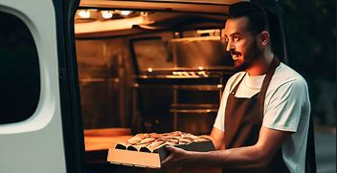
What is our product…?
An on trend product for the public.
A quick easy way for people to get a recipe for their favourite baked goods.
Option to purchase the ingredients directly from us premeasured in a box delivered straight to their door.
The intended future for the product -
To be able to order direct from a bakery if you do not have the time to bake it yourself.
To include other products such as Pizzas and other savoury items such as pies etc.

Slide 3

Working in an Agile way!
For the initial conception we each threw lots of ideas around and had a discussion and mutually agreed on our end product.
We then used an ideation board for what to add or items of work required.
We created a Team Charter Agreement.
We came up with what we would expect or like to be our customer journey.
For ensuring the project remained on track we used a story map.
Due to our shifts being very different we came together on Sunday mornings for a quick catch up and to create our plan of action for the week ahead.
We also used our Miro board to leaves notes of what we’ve done or needed to do.
As well as this we created a Bake It or Take It Whatsapp group for us all to communicate with each other. This turned out to be invaluable when we were all working on tasks at different times.

Slide 4

The technical chat!
How we pulled this together.
HTML
CSS
Flask
Python
Javascript
Bootstrap
Database (MySQL Workbench)

