Slide 1
QUIEAZY: FUN, EASY TO USE, LIVE INTERNETLESS
QUIZ APPLICATION
IVAN ALEX DELAS ALAS RECINTO
MARC PHILIP ARMADA LANDICHO
RIANER JUSTIN OSTAN NAMUCO
ZCHERHEINE AGUADO TORREFRANCA

Slide 2

GENERAL PROBLEM OF THE STUDY
This study aims to evaluate the creation of an alternative fun,and easy to use quiz maker application that can run offline live.

Slide 3
What is the level of acceptability of the application to learners and educators with respect to: usability, design, and security?
1
Statement of the Problem
What is the level of performance of the application with respect to: graphical performance, and transmission continuity?
2
Is there any significant relationship between the acceptability and performance of the application?
3

Slide 4
Research Paradigm
Input
Process
Output
- HTML - CSS
- JavaScript - Node.js
- NPM
- Electron
- Apache Cordova
- Ionic WebView for Cordova
- JDK 17
- Gradle
- Android SDK
- Conceptualization
- Development and designing
- Testing
- Bug fixing
- Finalization
- Quieazy (Application)

Slide 5






Research Methodology
Research Design
Population and Sampling
Instrument
Data Gathering Procedure
Statistical Treatment
268 Senior high school students from Santa Maria Integrated High School in Laguna,
Stratified random sampling
Self-made DCP questionnaire,
Likert-scale questionnaire for learners
Evaluate surveys, obtain authorization from school area, notify respondents, distribution of application, and questionnaires, and analyze acquired data.
True
Experimental
Weighted mean
Spearman Rho
Correlation

Slide 6
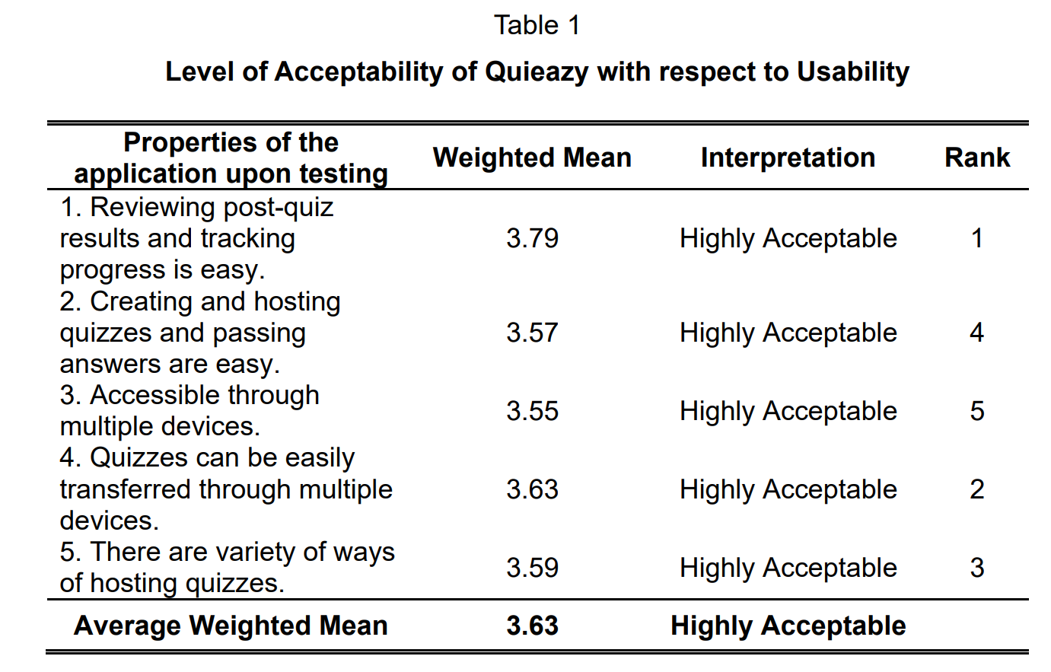
Findings
Result and Discussions
1.What is the level of acceptability of the application to learners and educators with respect to:
1.1.usability;
1.2.design; and
1.3.security?
F

Slide 7
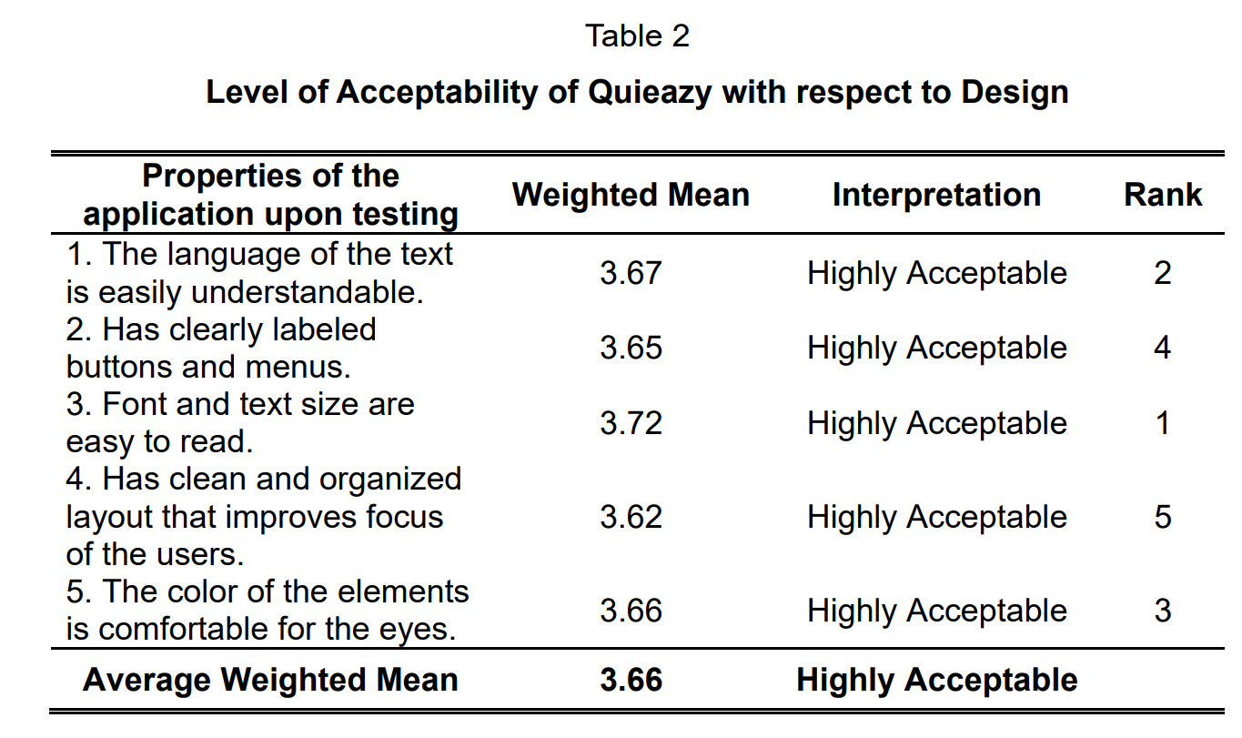
Findings
Result and Discussions
1.What is the level of acceptability of the application to learners and educators with respect to:
1.1.usability;
1.2.design; and
1.3.security?
F

Slide 8
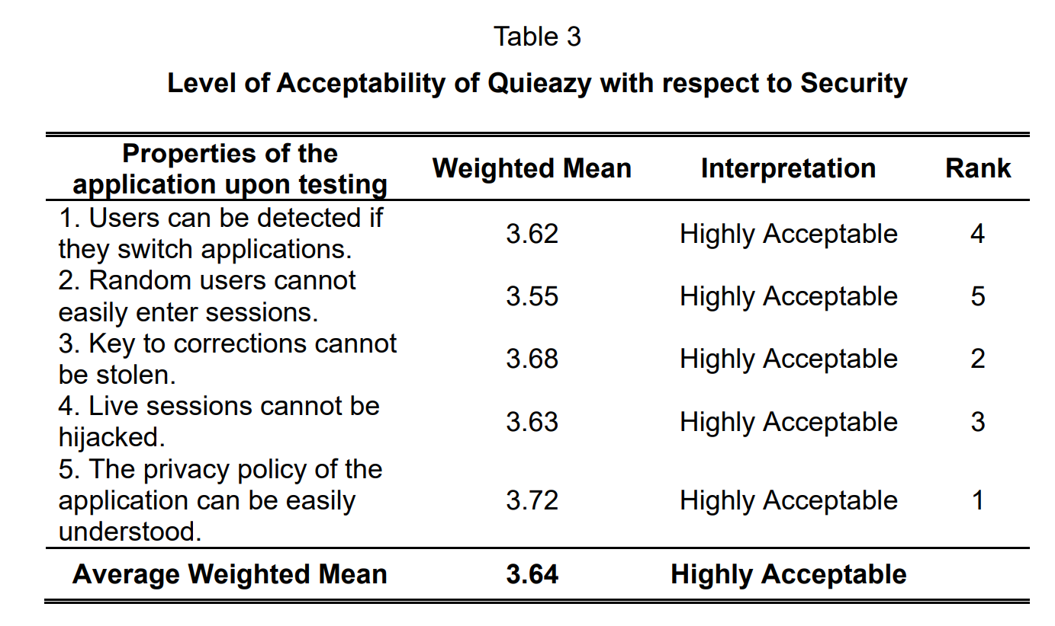
Findings
Result and Discussions
1.What is the level of acceptability of the application to learners and educators with respect to:
1.1.usability;
1.2.design; and
1.3.security?
F

Slide 9
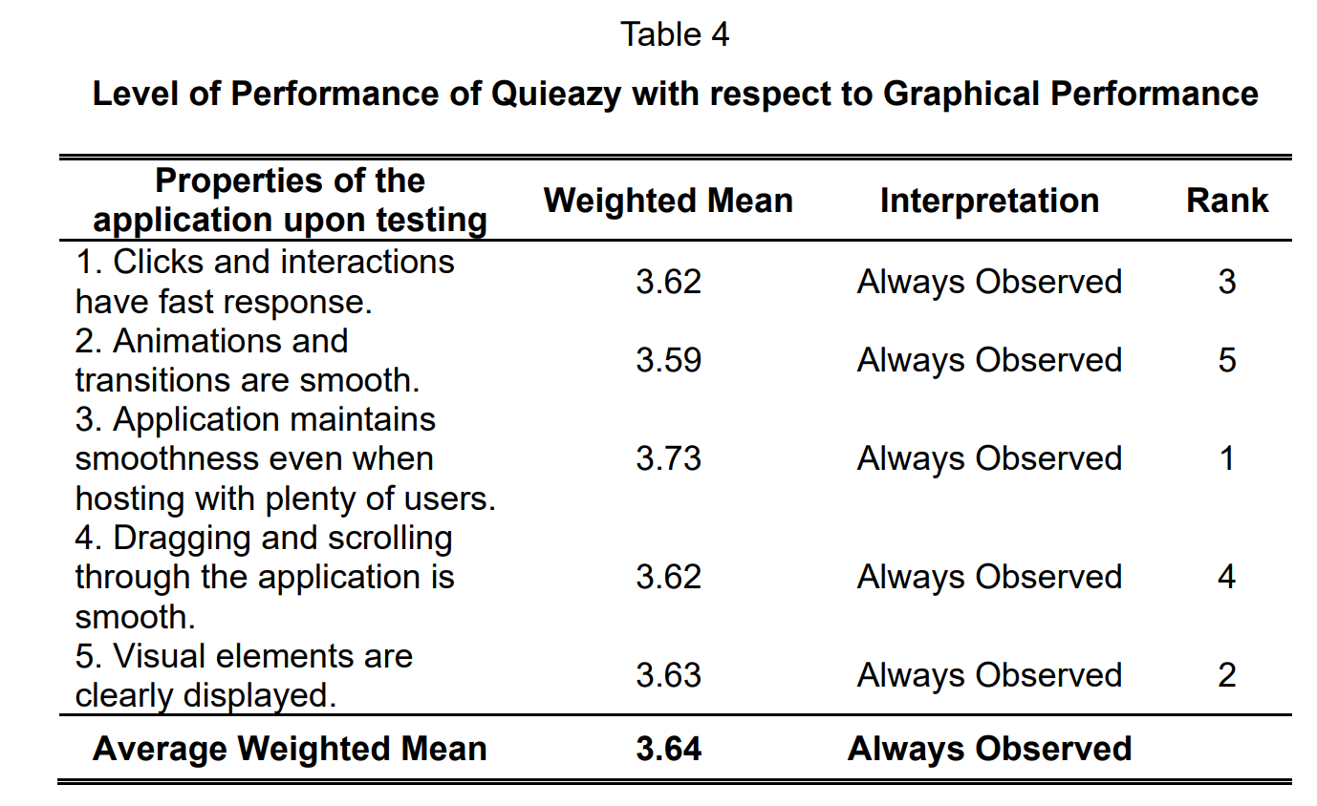
Findings
Result and Discussions
2.What is the level of performance of the application with respect to:
2.1.graphical performance; and
2.2.transmission continuity?
F

Slide 10
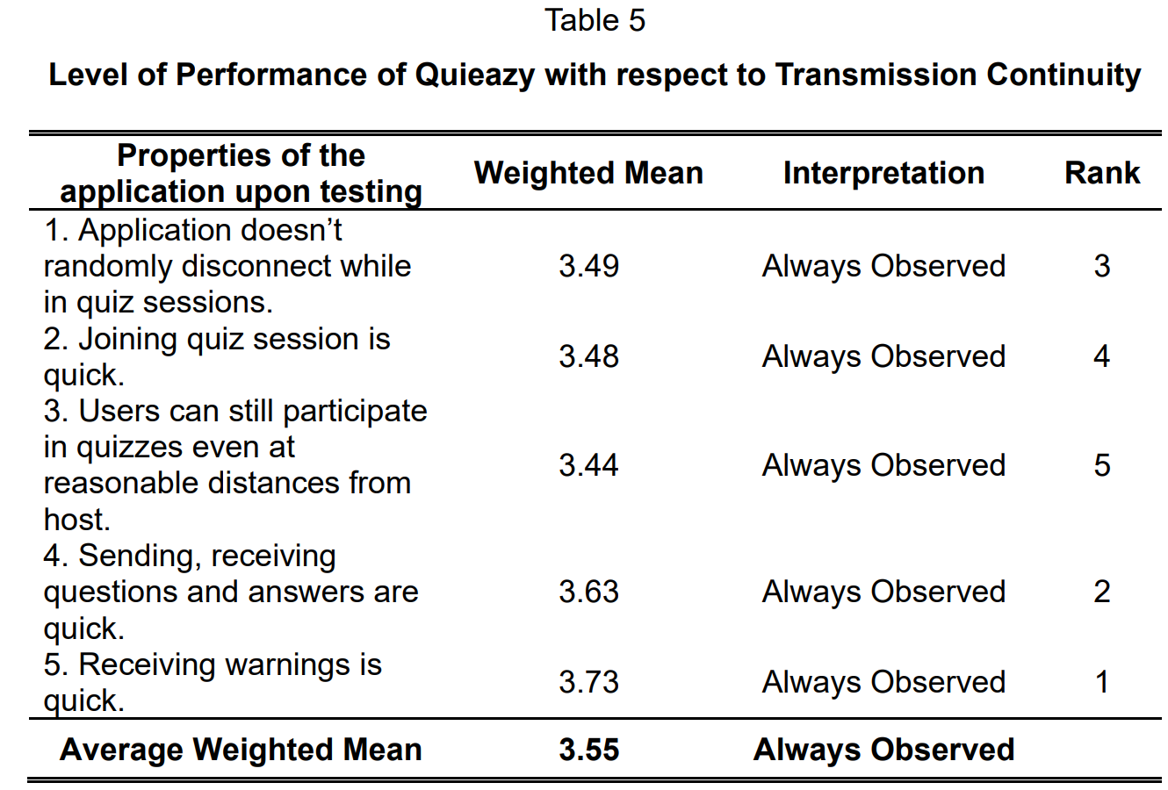
Findings
Result and Discussions
2.What is the level of performance of the application with respect to:
2.1.graphical performance; and
2.2.transmission continuity?
F

Slide 11
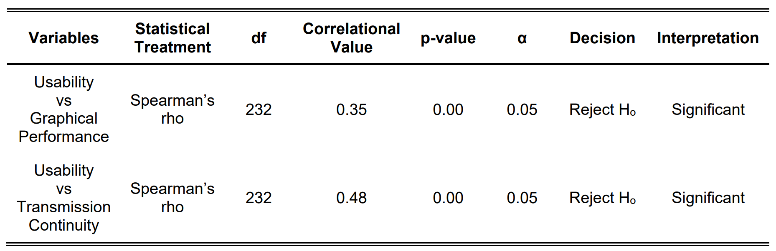
Findings
Result and Discussions
3.Is there any significant relationship between the acceptability and performance of the application?
F
Notes:
Concrete-Representation-Abstract Strategy (CRA). CRA is an instructional approach that is composed of three levels. First is the Concrete Level where the concepts are taught using a manipulative device to illustrate the concept and solve related problems. The second level is Representation. This involves the use of pictures, graphs or tallies to represent the concept being taught. Lastly is the Abstract level where the concept being taught will not use any device. In this level, the students will answer problems without manipulative devices or pictorial representations.
Constant Time Delay Approach (CTD). This makes use materials used by the teacher in teaching facts that result in near-errorless answers by the students. It involves the following steps: 1) present stimulus (e.g. flash card) to the students; 2) wait for students' response for 3 to 5 seconds; if the student did not respond or gave an incorrect answer, 3) state the problem and the answer; 4) students repeat the question and the answer.
Problem-Solving Approach using the STAR method. In order for the students to be able to enhance their computing skills, the problem-solving strategy is used in this guide. This approach utilizes the STAR method, an acronym for the four-step problem-solving method. These steps are: 1) Search the Problem; 2) Translate the Problem into an equation in an object, picture or mathematical form; 3) Answer the problem; 4) Review the solution.

Slide 12
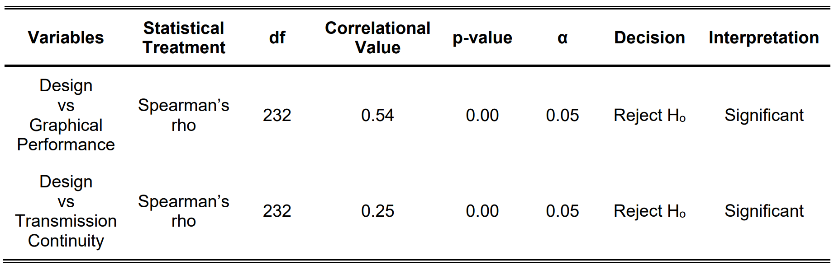
Findings
Result and Discussions
3.Is there any significant relationship between the acceptability and performance of the application?
F
Notes:
Concrete-Representation-Abstract Strategy (CRA). CRA is an instructional approach that is composed of three levels. First is the Concrete Level where the concepts are taught using a manipulative device to illustrate the concept and solve related problems. The second level is Representation. This involves the use of pictures, graphs or tallies to represent the concept being taught. Lastly is the Abstract level where the concept being taught will not use any device. In this level, the students will answer problems without manipulative devices or pictorial representations.
Constant Time Delay Approach (CTD). This makes use materials used by the teacher in teaching facts that result in near-errorless answers by the students. It involves the following steps: 1) present stimulus (e.g. flash card) to the students; 2) wait for students' response for 3 to 5 seconds; if the student did not respond or gave an incorrect answer, 3) state the problem and the answer; 4) students repeat the question and the answer.
Problem-Solving Approach using the STAR method. In order for the students to be able to enhance their computing skills, the problem-solving strategy is used in this guide. This approach utilizes the STAR method, an acronym for the four-step problem-solving method. These steps are: 1) Search the Problem; 2) Translate the Problem into an equation in an object, picture or mathematical form; 3) Answer the problem; 4) Review the solution.

Slide 13
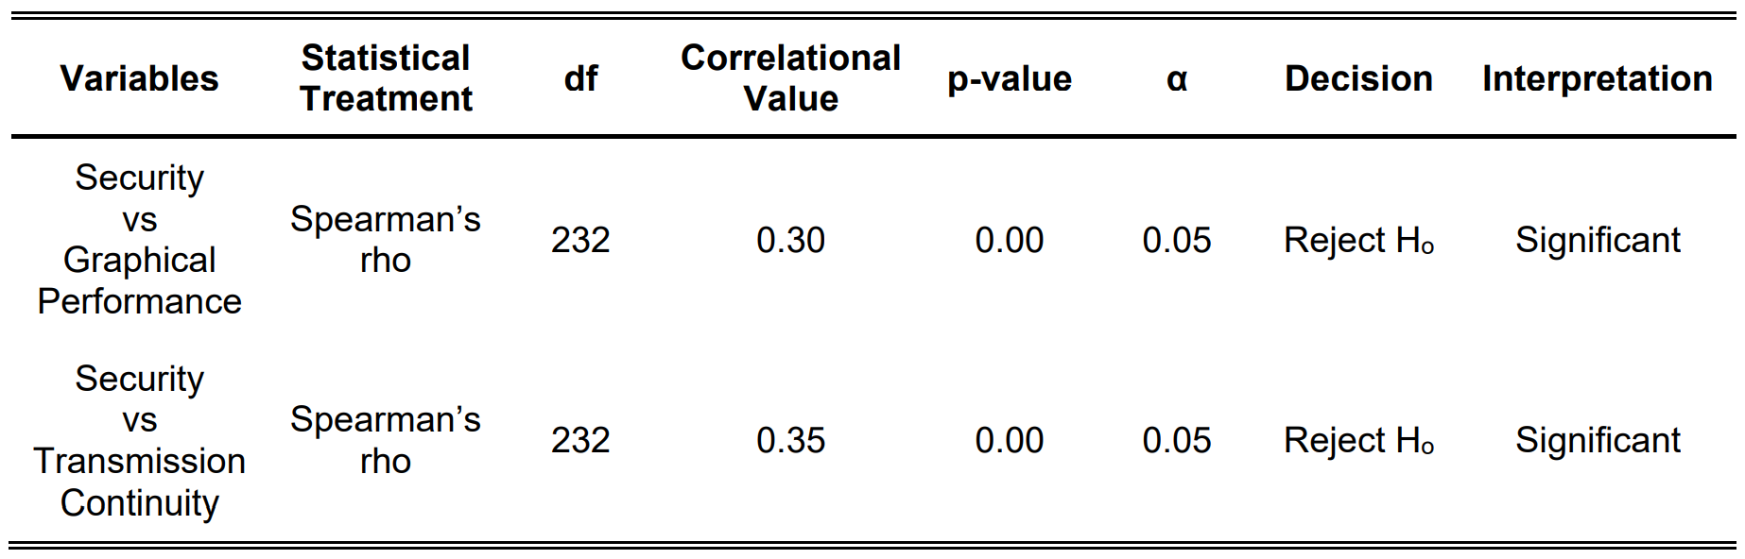
Findings
Result and Discussions
3.Is there any significant relationship between the acceptability and performance of the application?
F
Notes:
Concrete-Representation-Abstract Strategy (CRA). CRA is an instructional approach that is composed of three levels. First is the Concrete Level where the concepts are taught using a manipulative device to illustrate the concept and solve related problems. The second level is Representation. This involves the use of pictures, graphs or tallies to represent the concept being taught. Lastly is the Abstract level where the concept being taught will not use any device. In this level, the students will answer problems without manipulative devices or pictorial representations.
Constant Time Delay Approach (CTD). This makes use materials used by the teacher in teaching facts that result in near-errorless answers by the students. It involves the following steps: 1) present stimulus (e.g. flash card) to the students; 2) wait for students' response for 3 to 5 seconds; if the student did not respond or gave an incorrect answer, 3) state the problem and the answer; 4) students repeat the question and the answer.
Problem-Solving Approach using the STAR method. In order for the students to be able to enhance their computing skills, the problem-solving strategy is used in this guide. This approach utilizes the STAR method, an acronym for the four-step problem-solving method. These steps are: 1) Search the Problem; 2) Translate the Problem into an equation in an object, picture or mathematical form; 3) Answer the problem; 4) Review the solution.

Slide 14
Conclusions
1. Quieazy is an acceptable digital tool for learners in creating, hosting and taking quizzes, regarding its usability, design and security.
2. Quieazy is a performant digital tool for learners, based on its graphical performance and transmission continuity.
3. There is a significant relationship between the acceptability and performance of Quieazy.

Slide 15
Recommendations
1. The researchers recommend publishing the application on common application stores for easier download.
2. The researchers suggest making the application available on iOS and Mac devices.
3. The researchers also recommend implementing tokens and moderation tools to quiz sessions to increase security.
4. The researchers also recommend the ability to use themes, specifically light mode for better visibility.
5. The researchers propose to have tutorials in using the application.
6. The researchers recommend the ability to export results as an excel spreadsheet for efficient score collection.

Slide 16
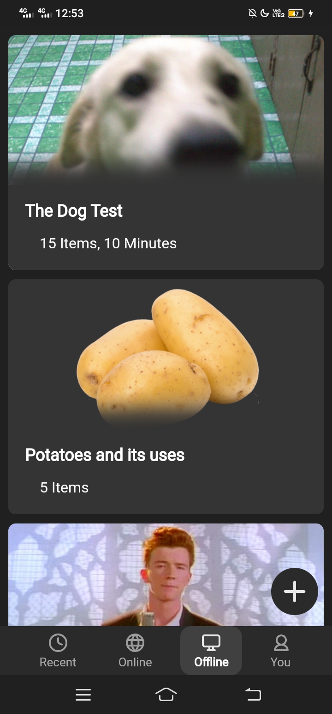
Storyboard
Expected Output from Title Proposal

Slide 17
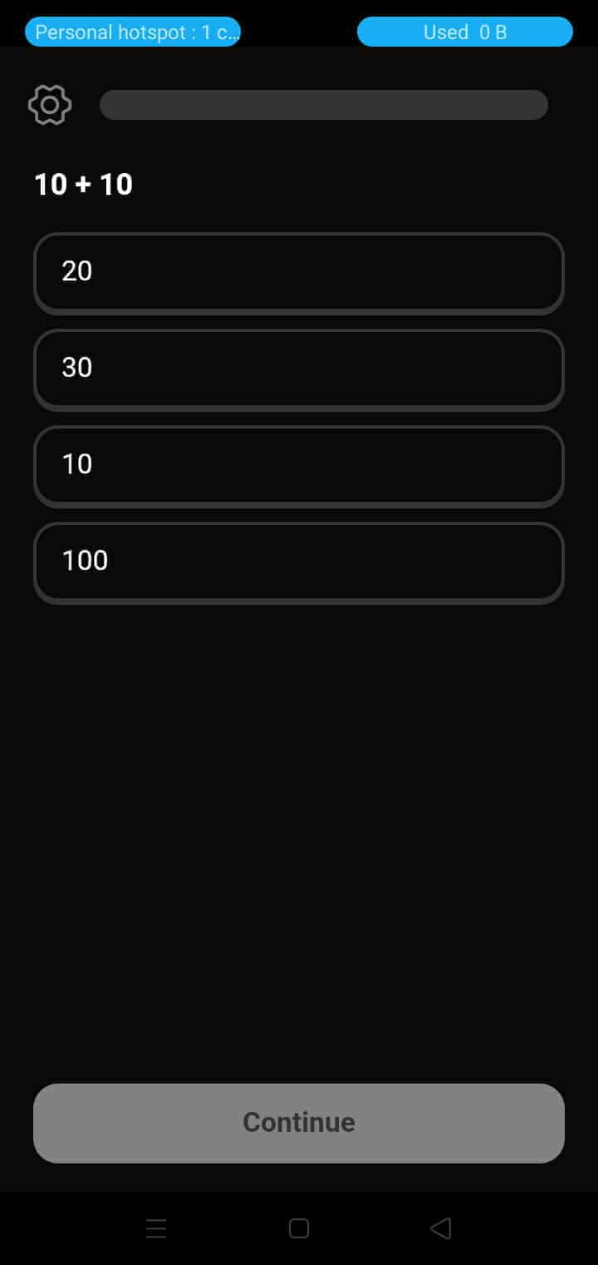
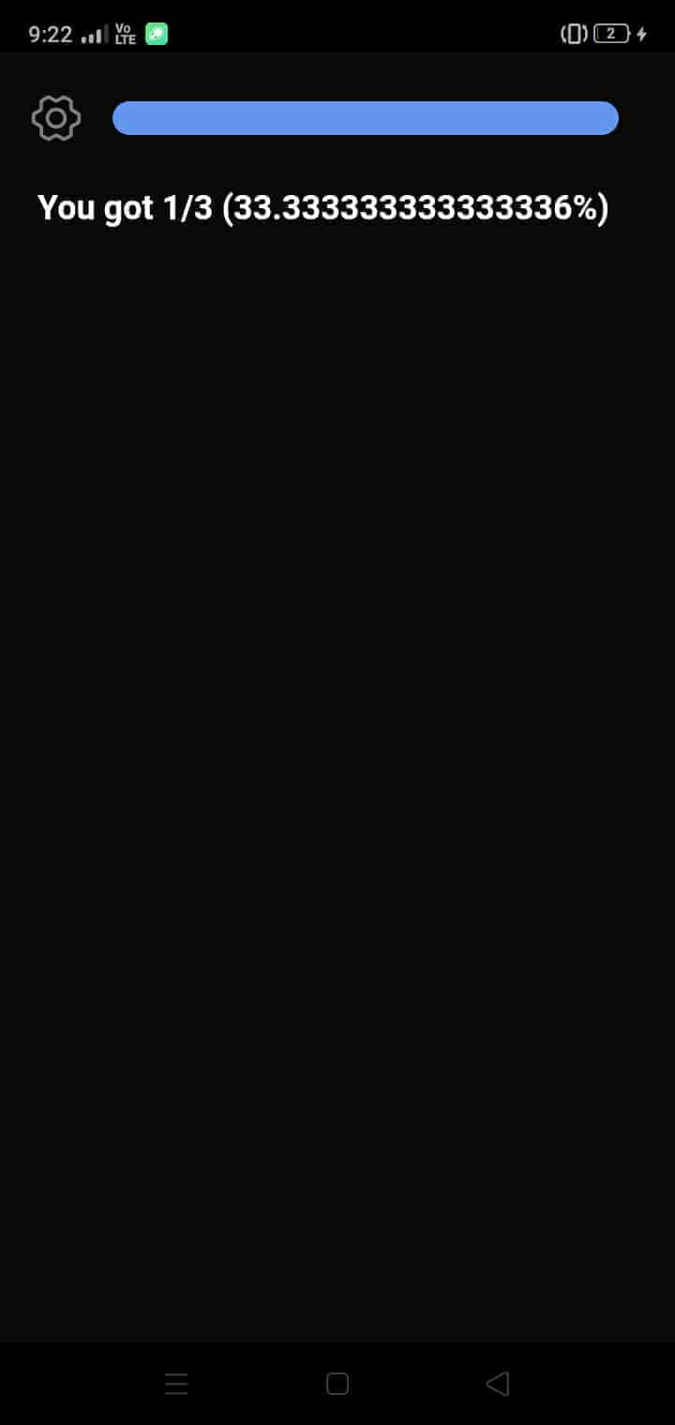
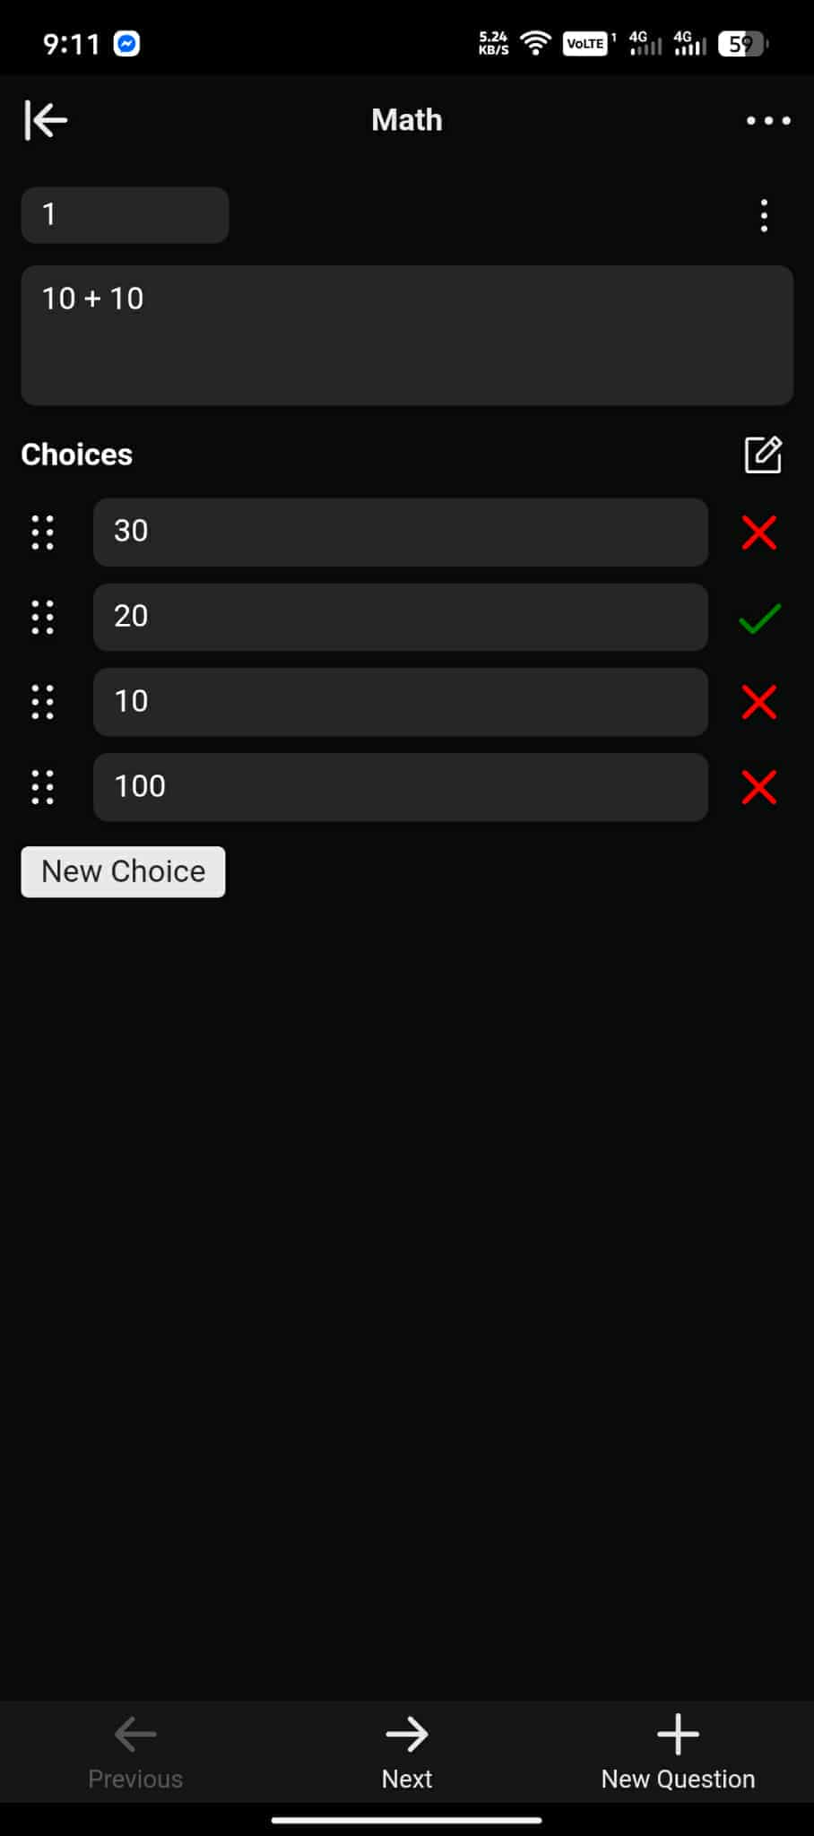
Storyboard
First Stable Prototype

Slide 18
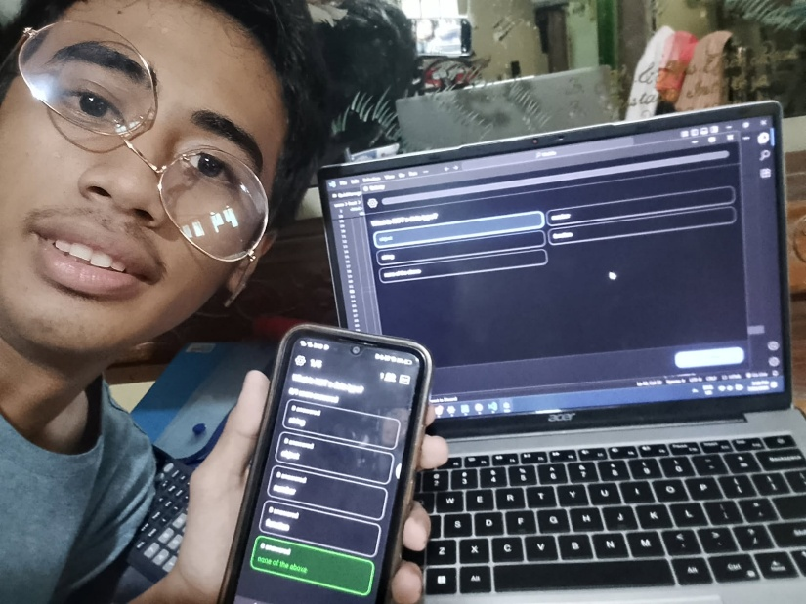
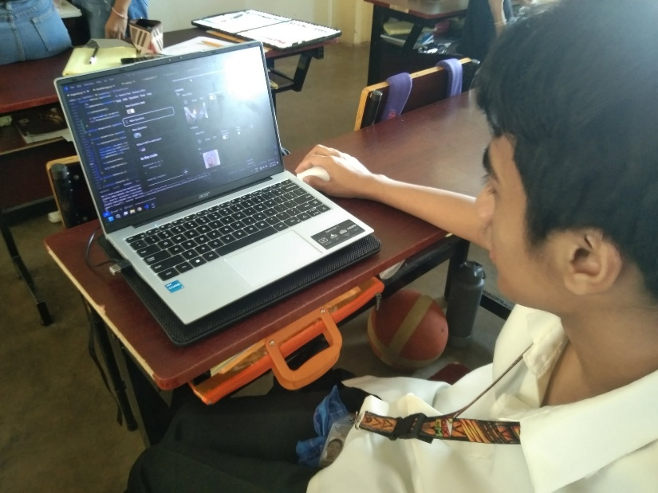
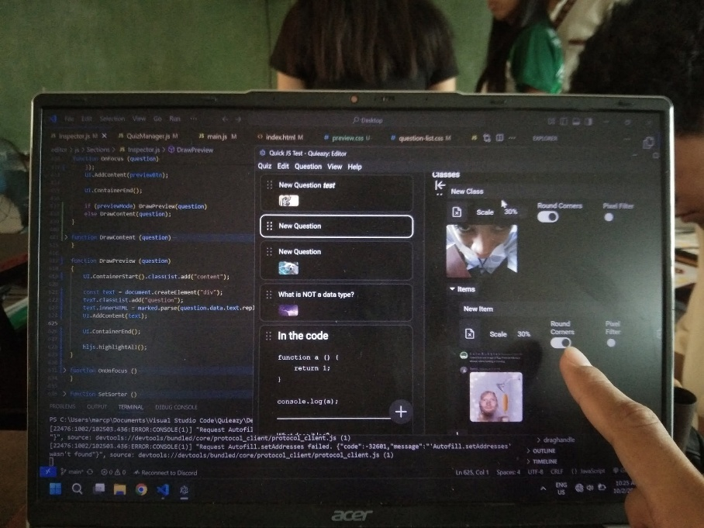
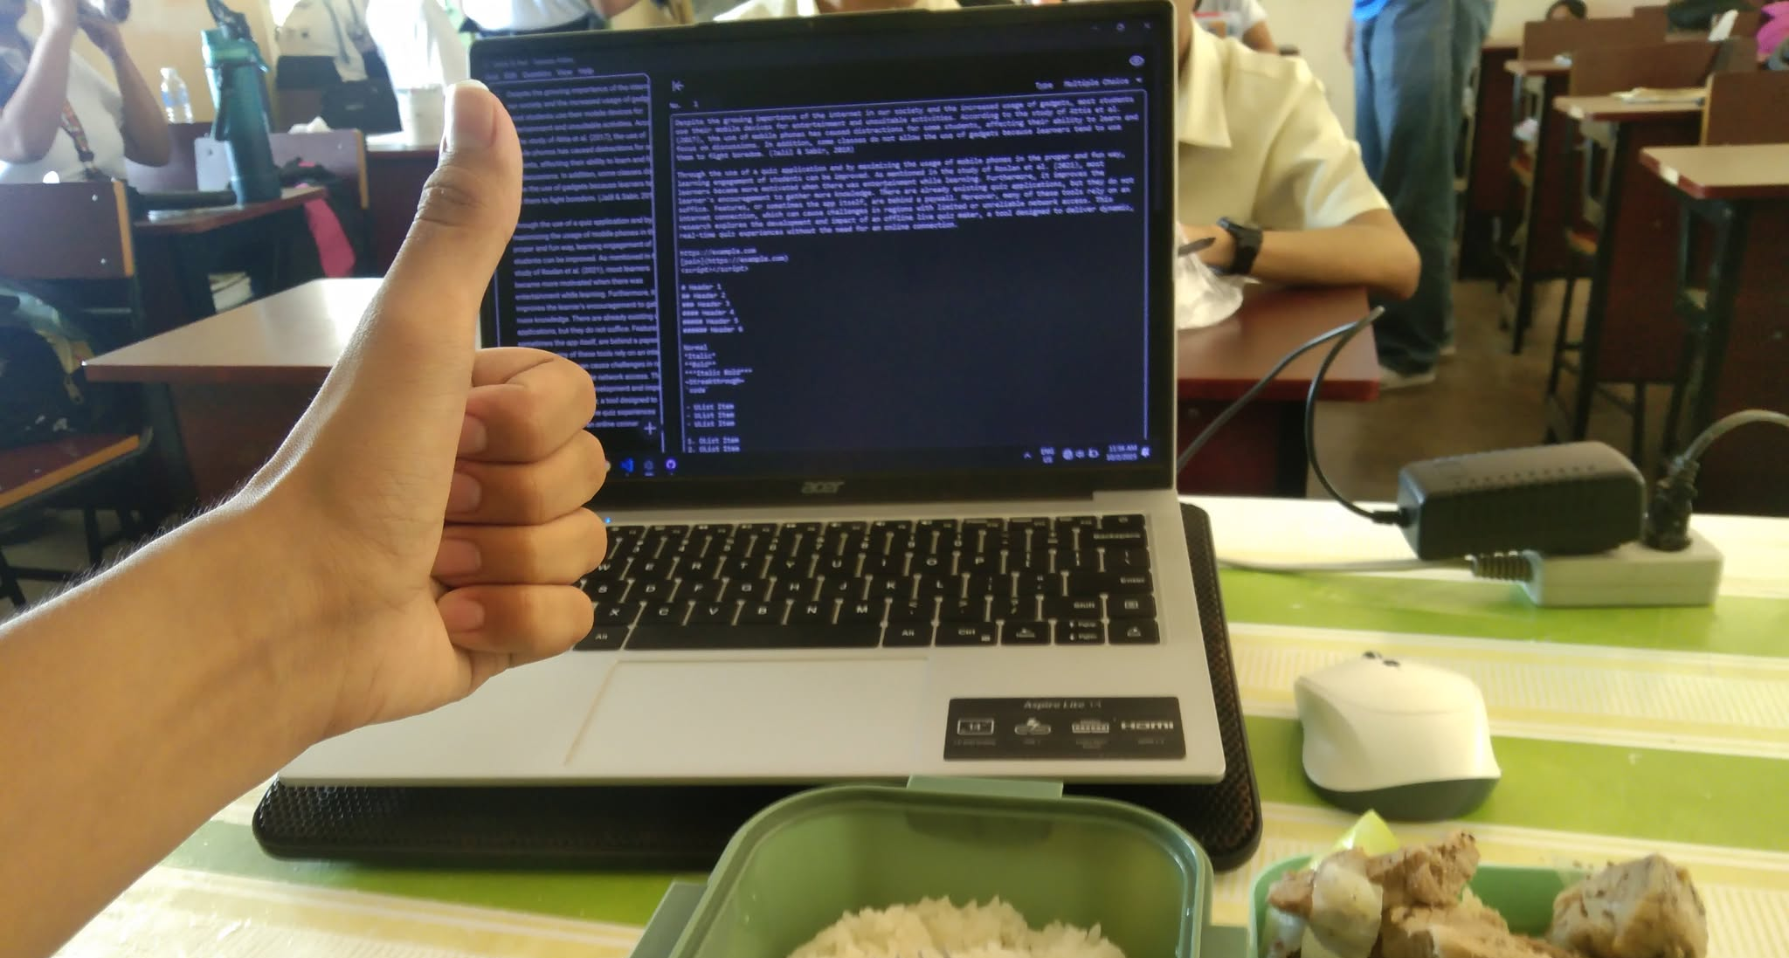
Storyboard
Development of the Application

Slide 19
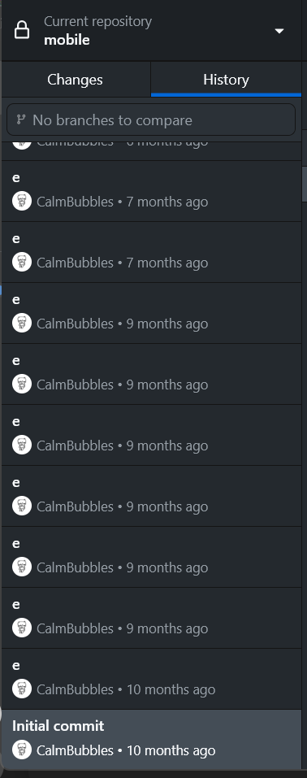
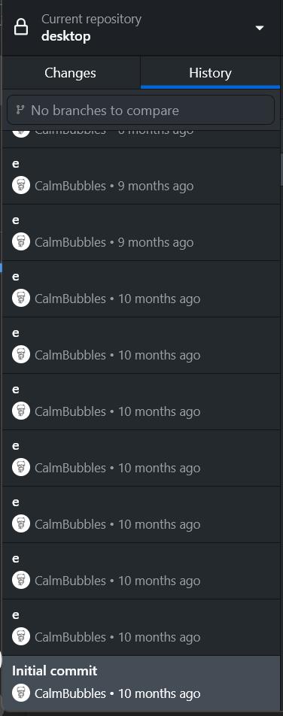
Storyboard
Repository Commits within the Development of the Application

Slide 20
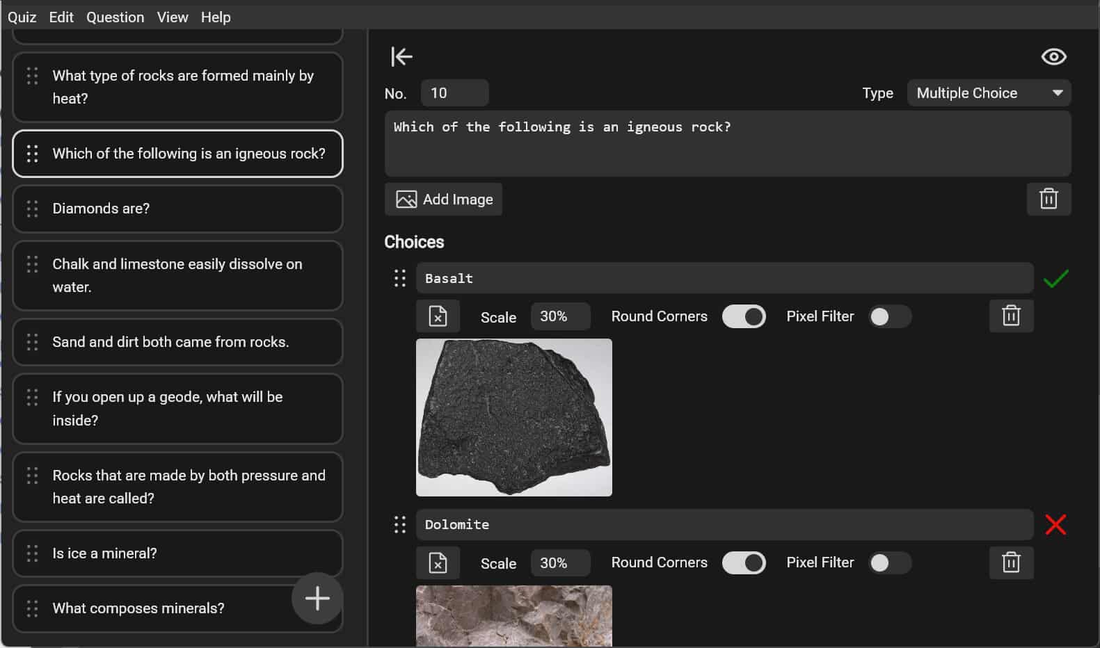
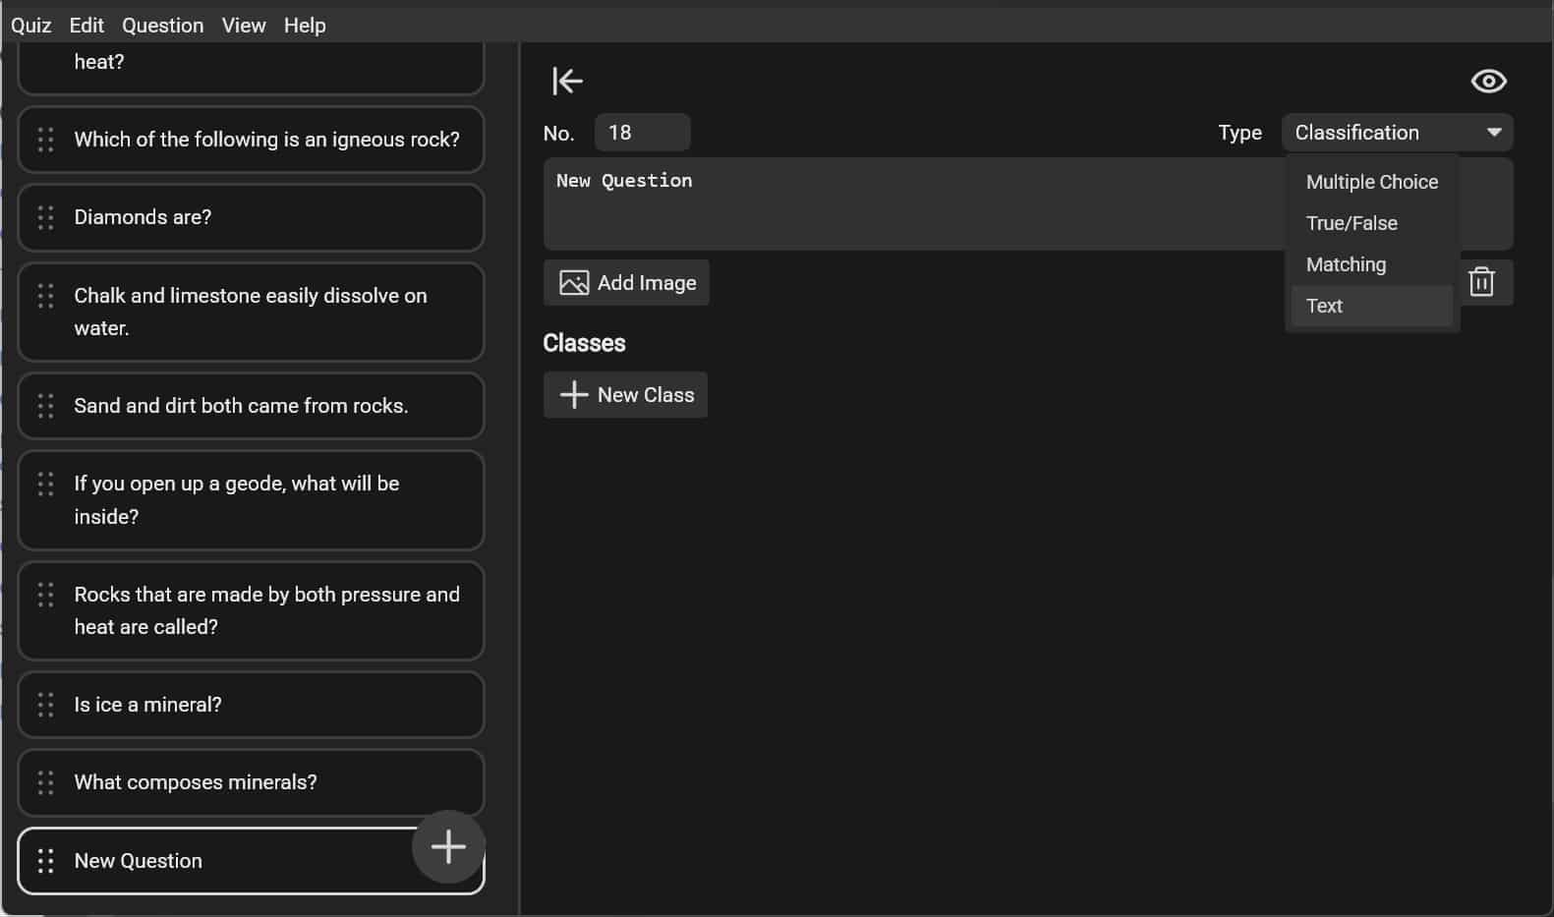
Storyboard
Final Output

Slide 21
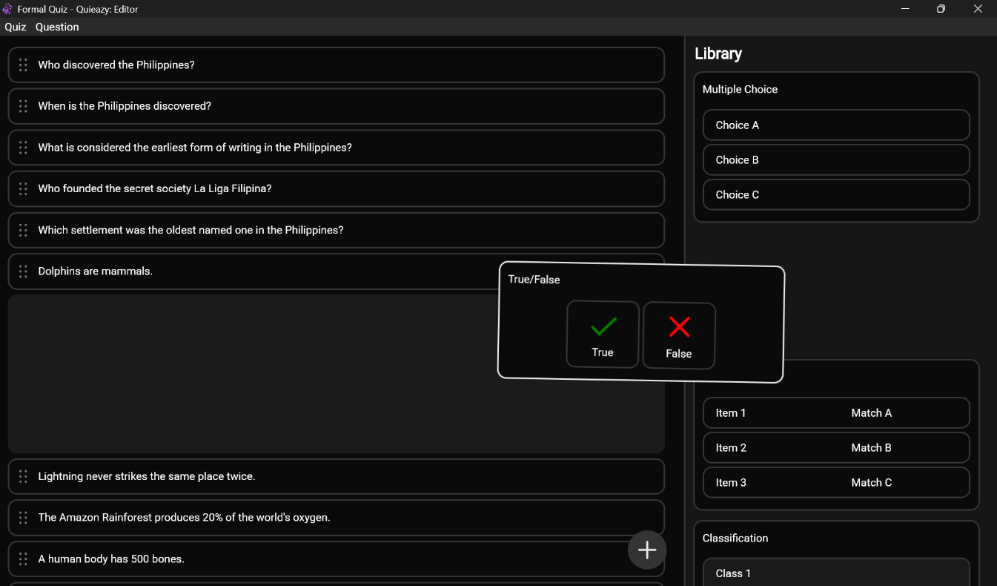
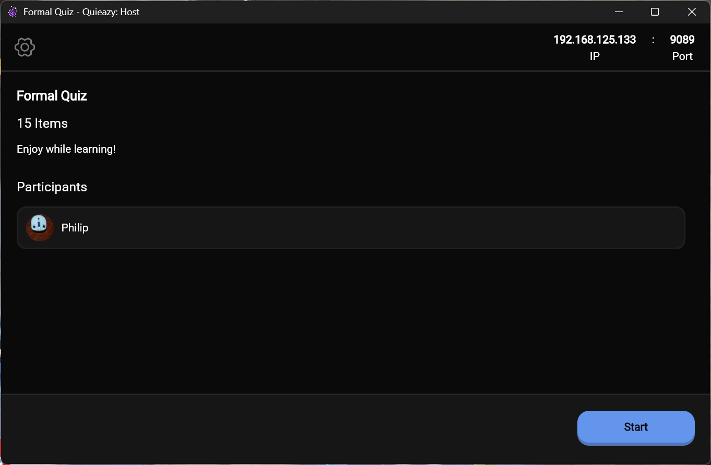
Storyboard
Final Output

Slide 22
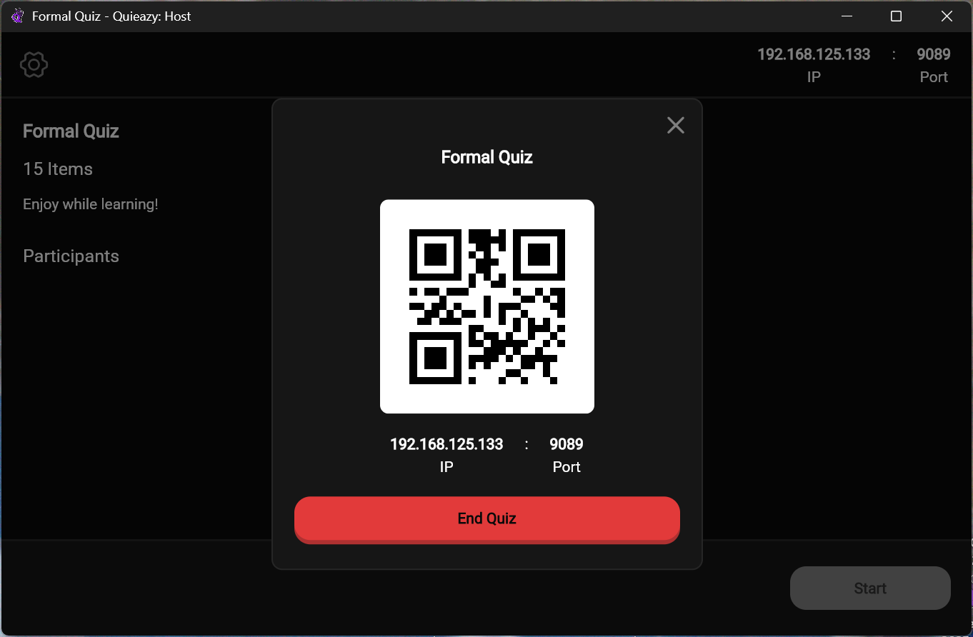
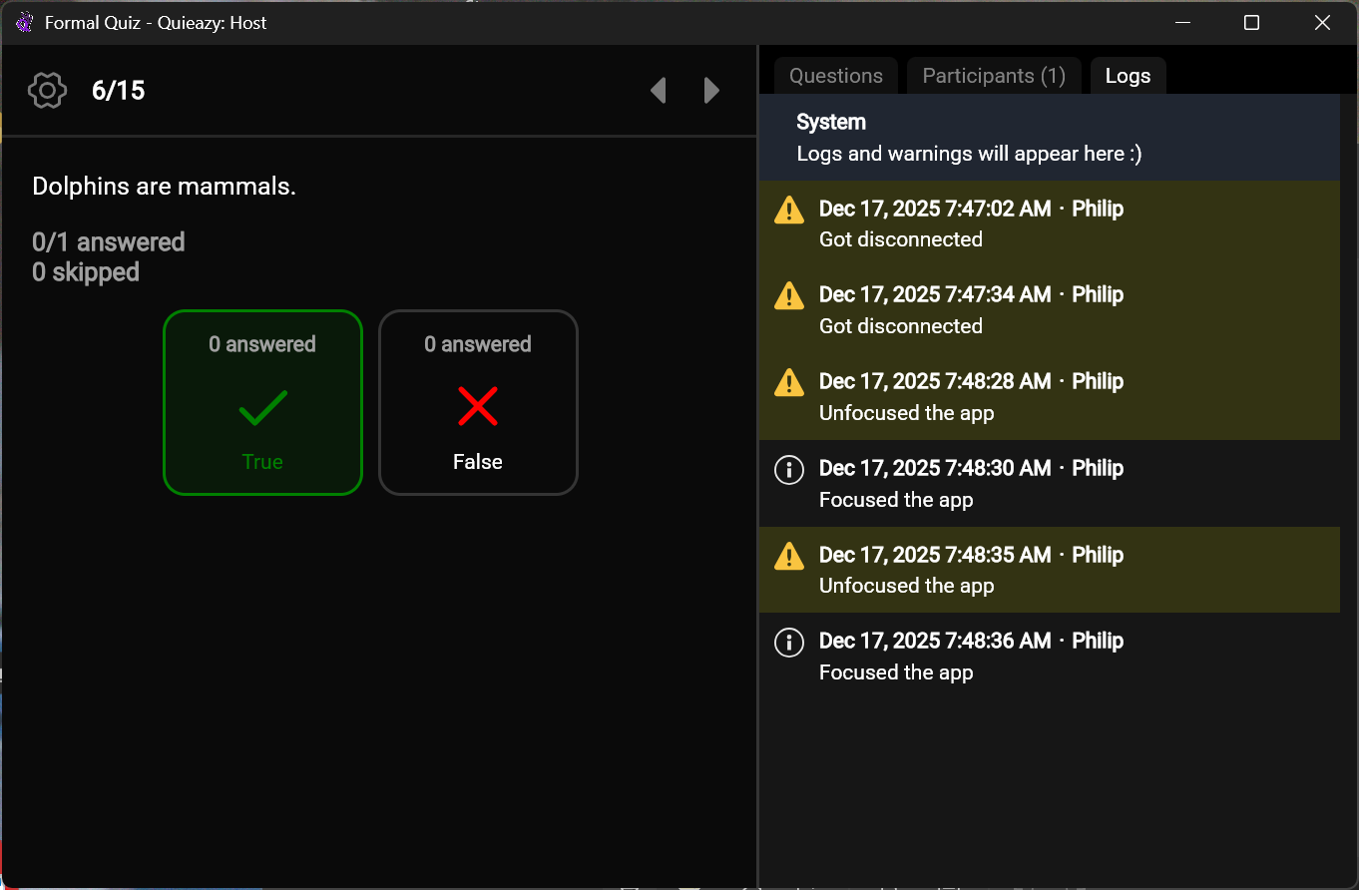
Storyboard
Final Output

Slide 23
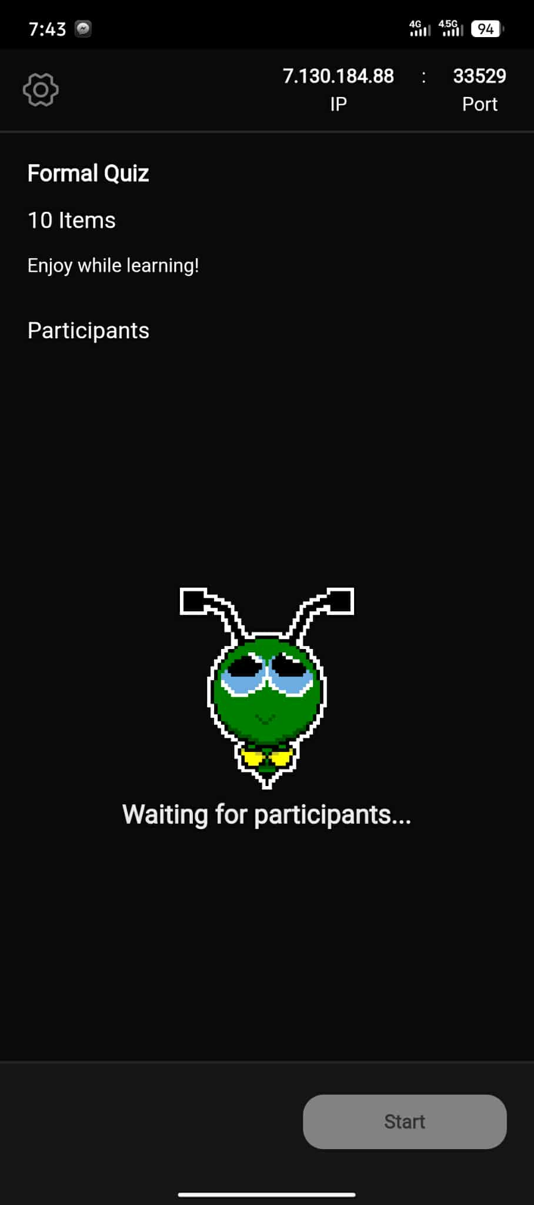

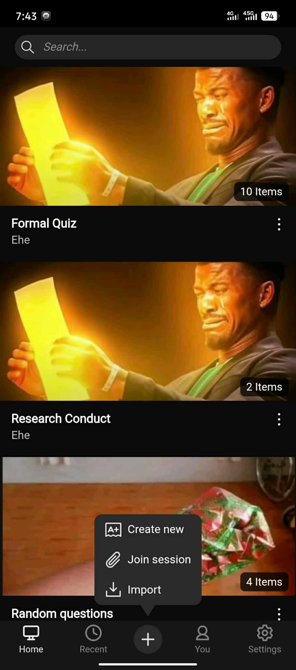
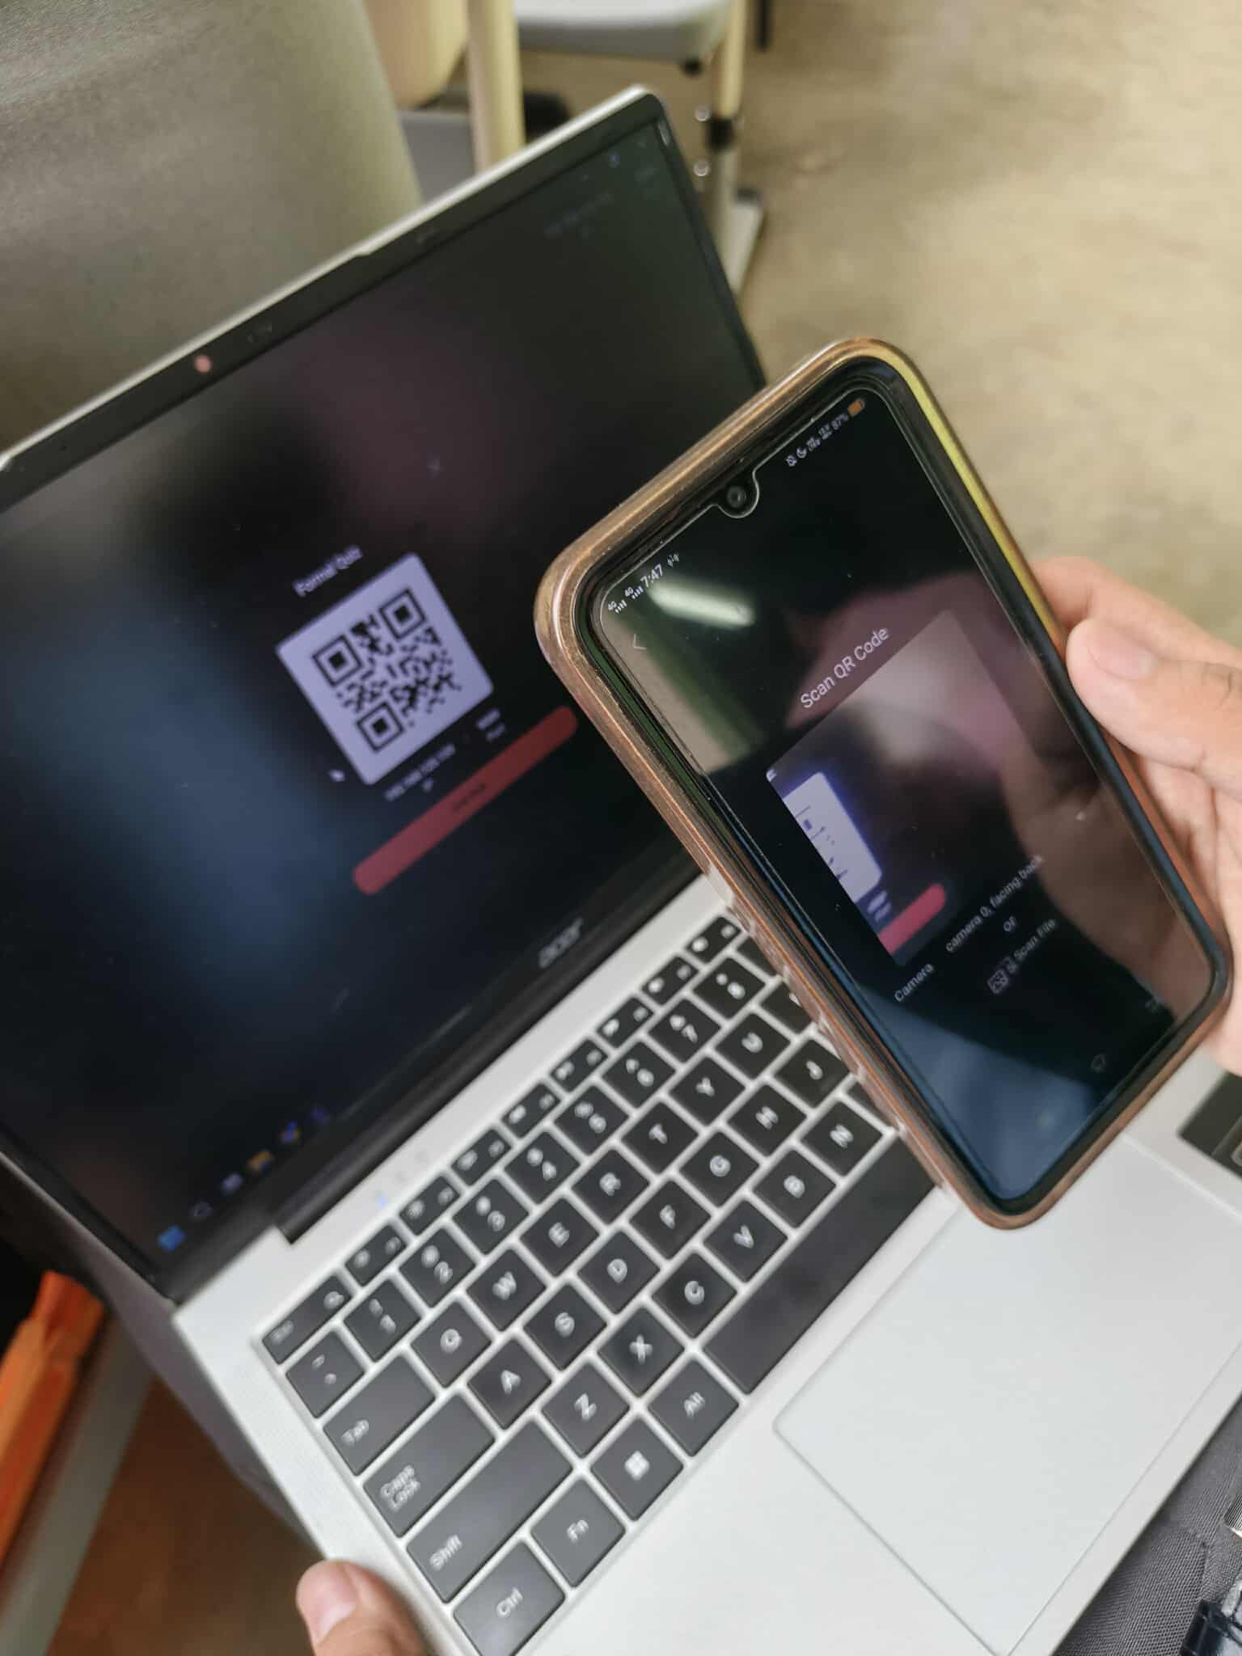
Storyboard
Final Output

Slide 24
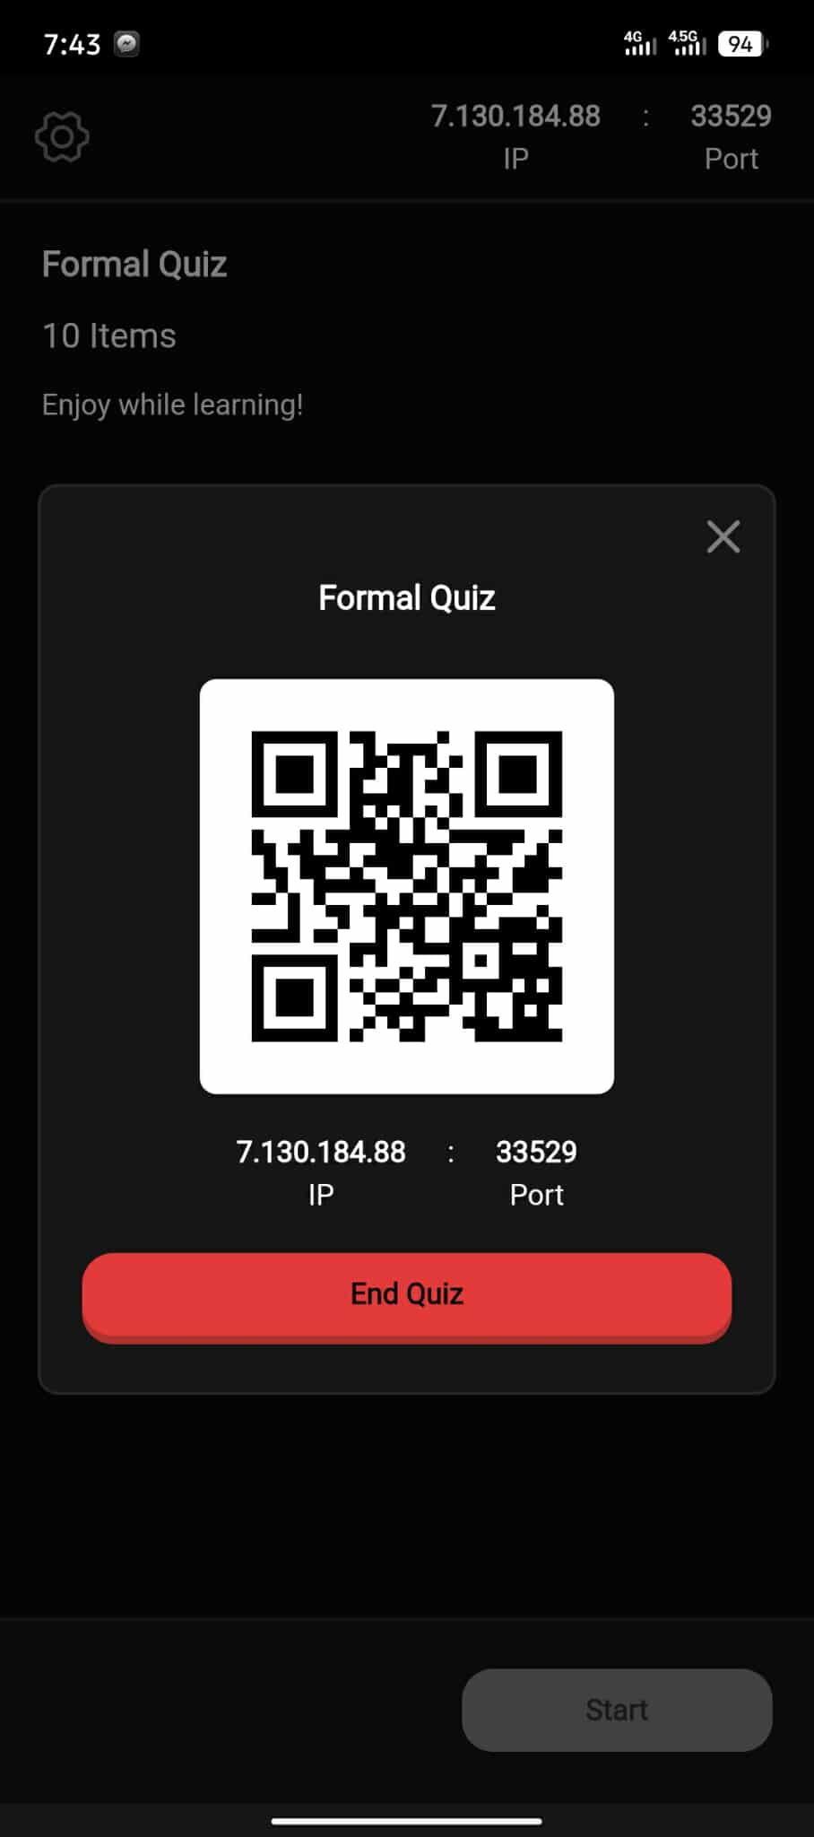
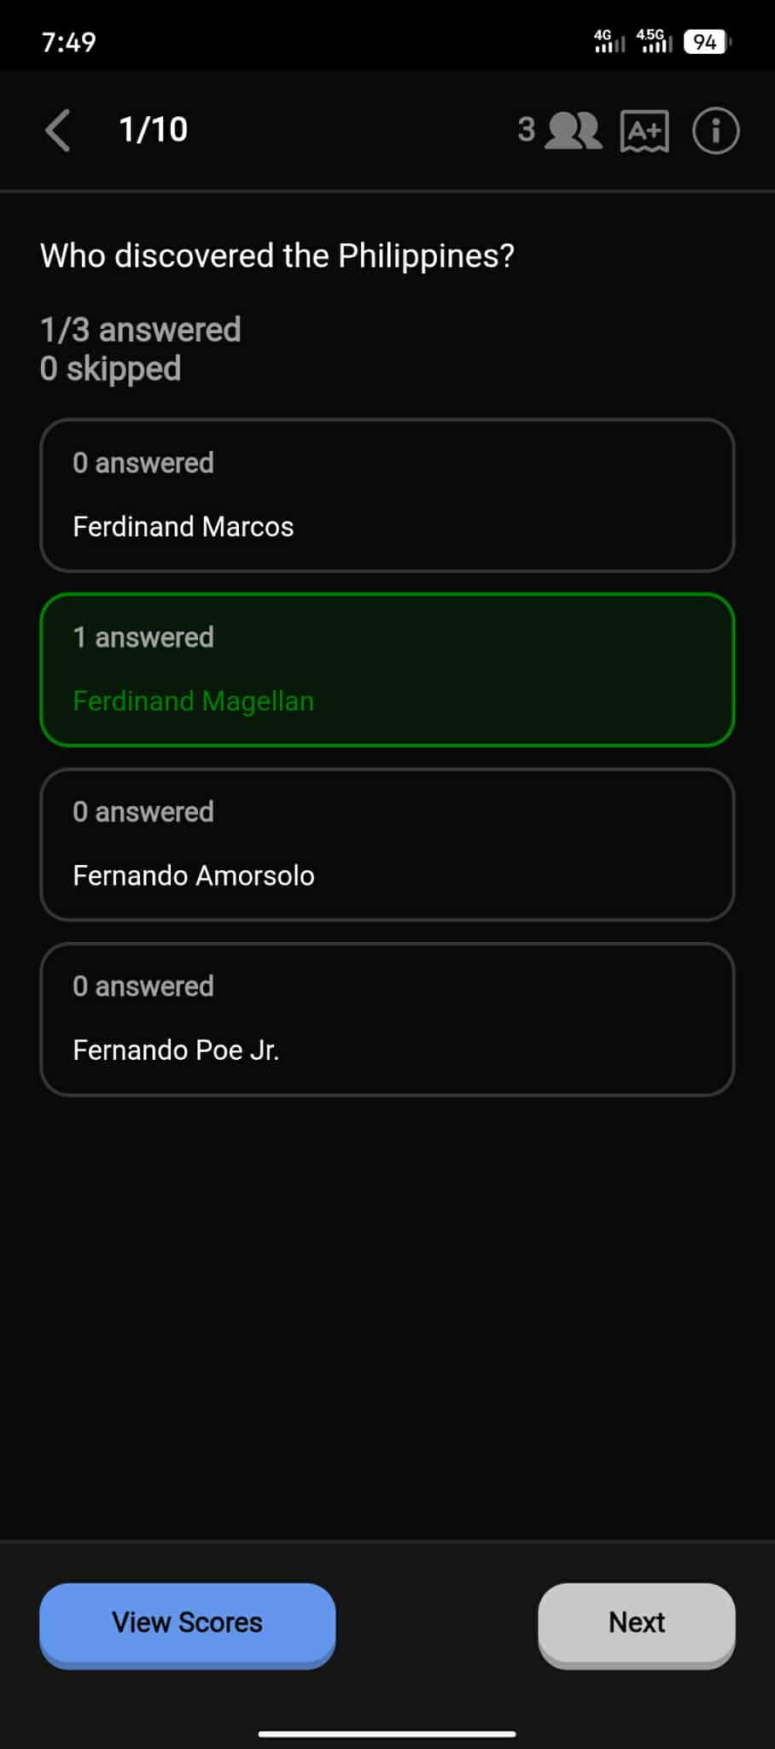
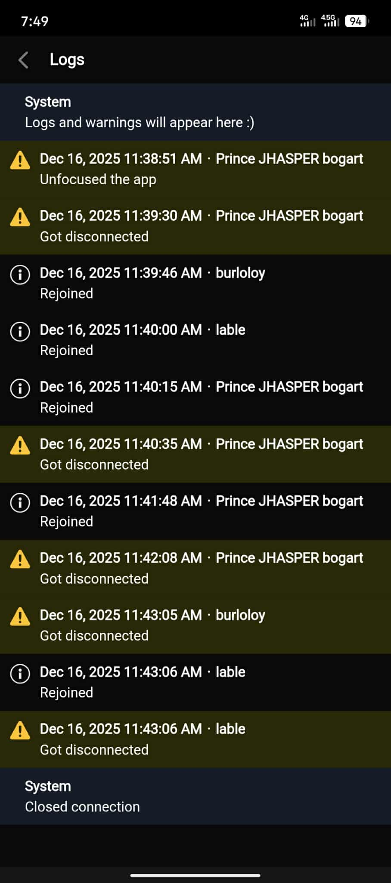
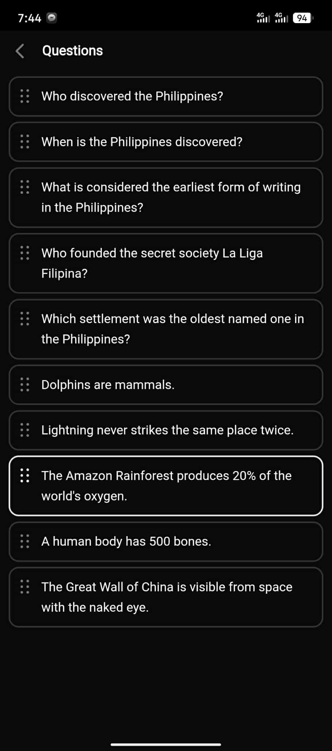
Storyboard
Final Output

Slide 25
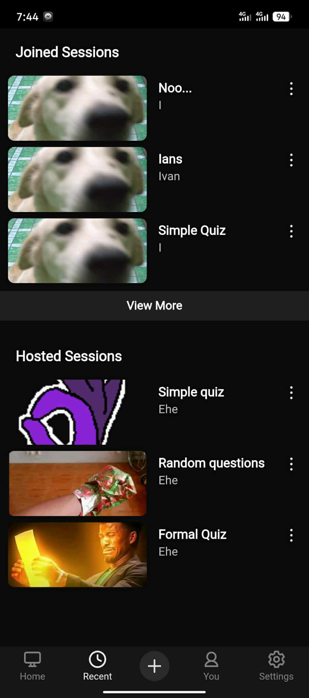
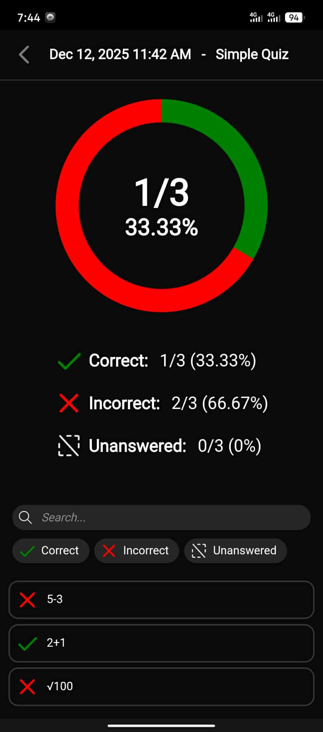
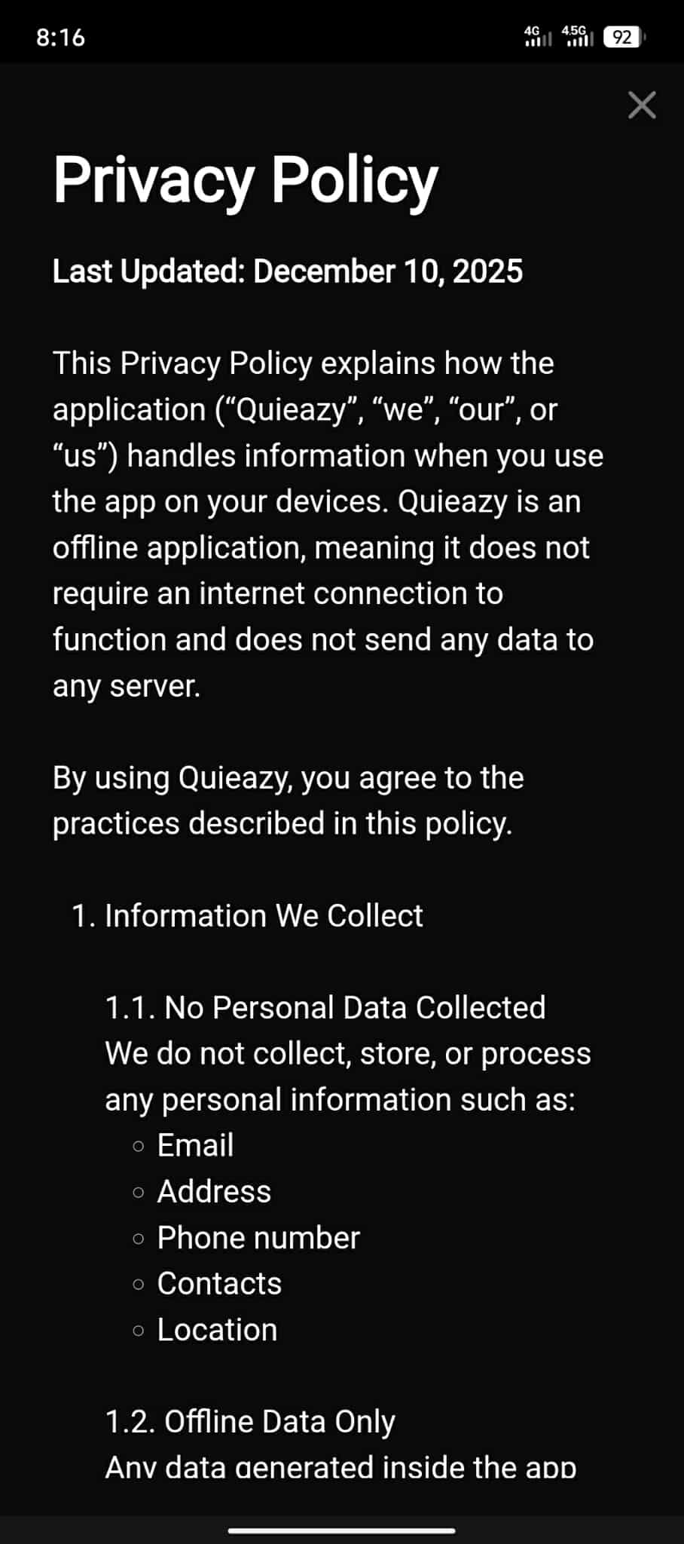
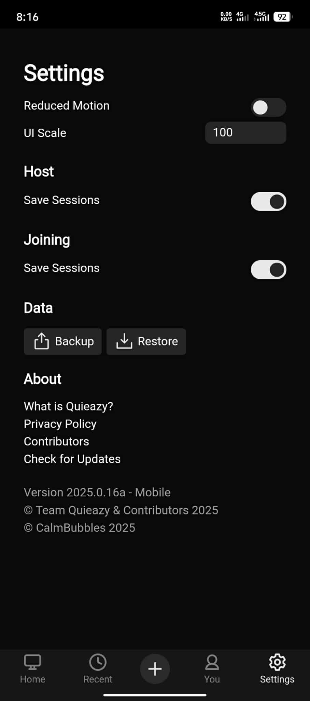
Storyboard
Final Output

Slide 26
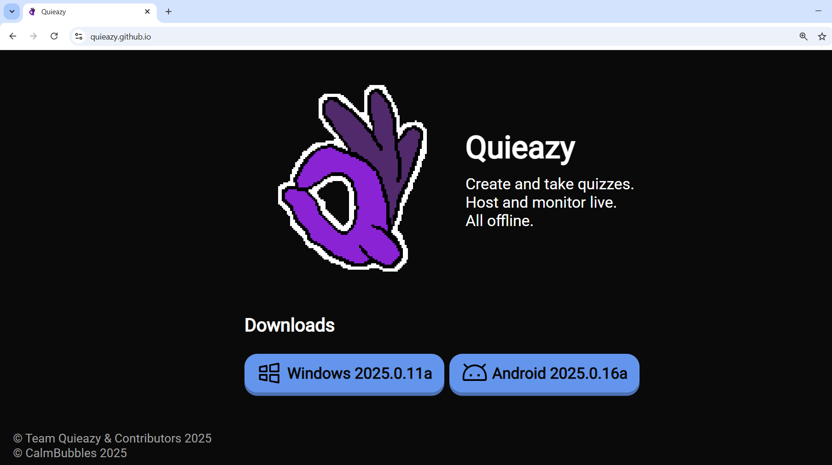
The app can also be downloaded from
quieazy.github.io

Slide 27
Thank you for listening!

