Slide 1
Non-Contact Water Level Indicator Alarm
Waterist
BSCPE-3C

Slide 2
Chapter 1
Introduction
Statement of the Problem
Objective of the Study
Scope and Limitation of the Study
Significance of the Study

Slide 3

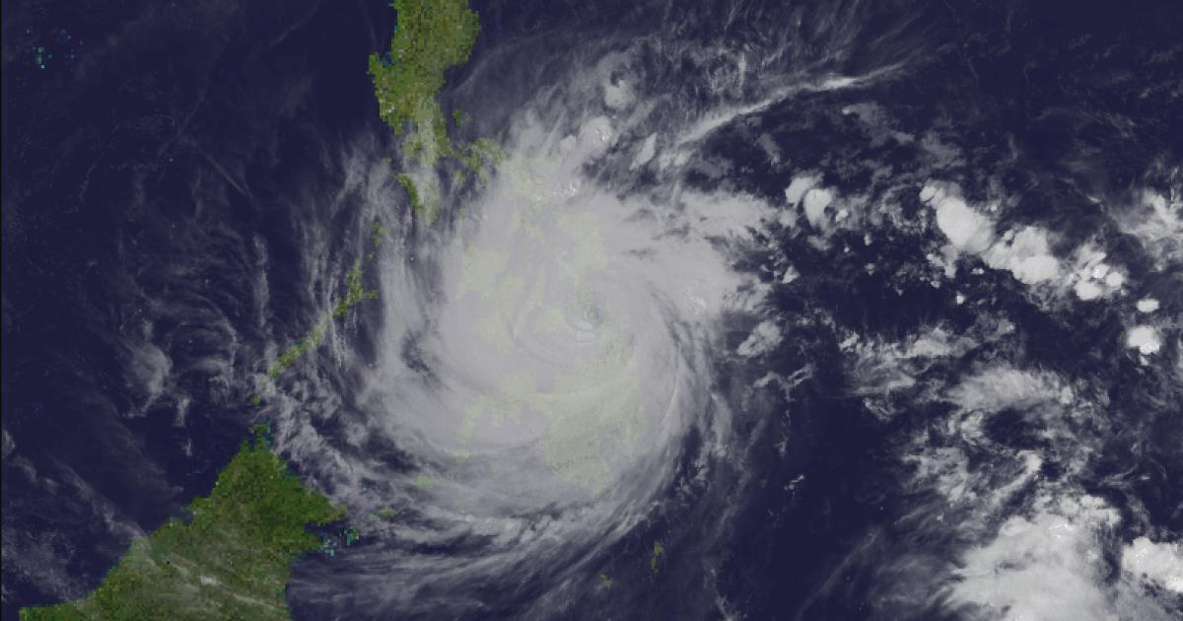
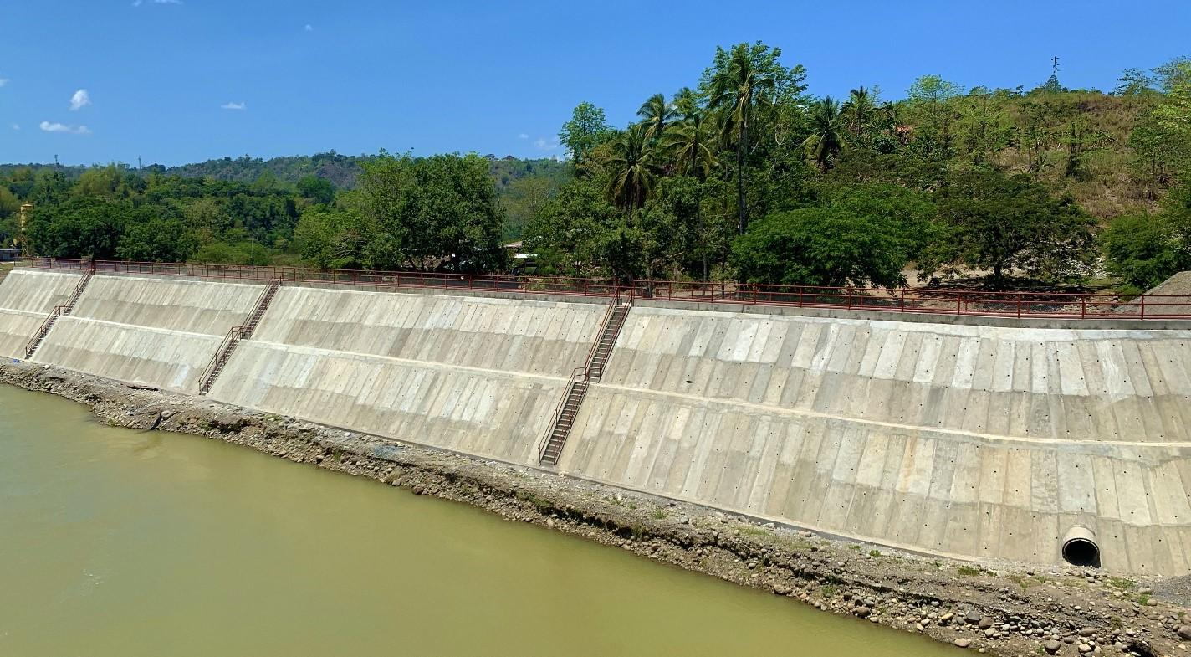
Introduction
Each year, the Philippines is hit by an average of 20 storms and typhoons.
The creation of dikes is one of the operations done that help prevent floods and control the flow of water.

Slide 4
Statement of the problem
Objectives
Possibility of overflowing in dike is a source of concern.
Residents living near the river visits the dike on regular basis to check the water level of the river
Our goal is to have a monitoring system that will indicate the water level of the river.

Slide 5
Scope and Limitation
Significance of the study
The project focuses solely on water level monitoring utilizing an ultrasonic sensor and an LCD display to show the current level.
And an alarm that uses Buzzer and LEDs that indicate warnings.
The outcome of this study will be beneficial to the residents in the community especially those who live near the river area in CDO.

Slide 6
Chapter 2

Slide 7
Related Literatures
Design and Implementation of Microcontroller Based Automated Water Level Indicator.
Design and Implementation Issues for Microcontroller-Based Automated Water Level Sensing and Control
River Water Level Sensor as River Flood Warning System.

Slide 8
Chapter 3
Component list and its Function
Circuit Diagram Flow
Flowchart
Schematic Diagram
Prototype

Slide 9
Components
Circuit Diagram Flow
9V Battery
5 Resistors
3 LED
1 Buzzer
1 Microcontroller
1 Ultrasonic Distance Sensor
1 LCD
Ground
When the software has completed its setup, the Vin and ground pins of the Arduino are connected to the 9V battery to supply power via single pole double throw switch. The ultrasonic sensor is connected to the 5V supply of the Arduino as well as to the ground pin while the signal pins of the sensor such as the trigger and echo pins are connected to the specific digital I/O ports of the Arduino for its specific instruction assigned by the code. The three LEDs associated with the buzzer are connected to each of the digital I/O pins of the Arduino based on their specific instruction assigned by the code as well. The LCD display's Vcc and ground pins receive 5 volts from the Arduino, while its signal pins are connected to the Arduino's Analog ports.

Slide 10
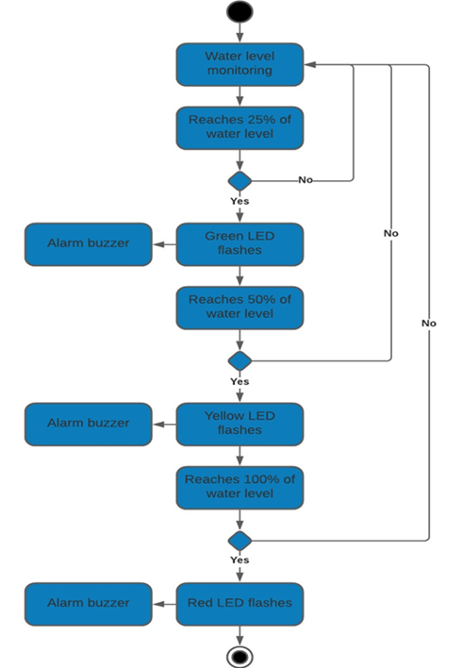
Flowchart

Slide 11
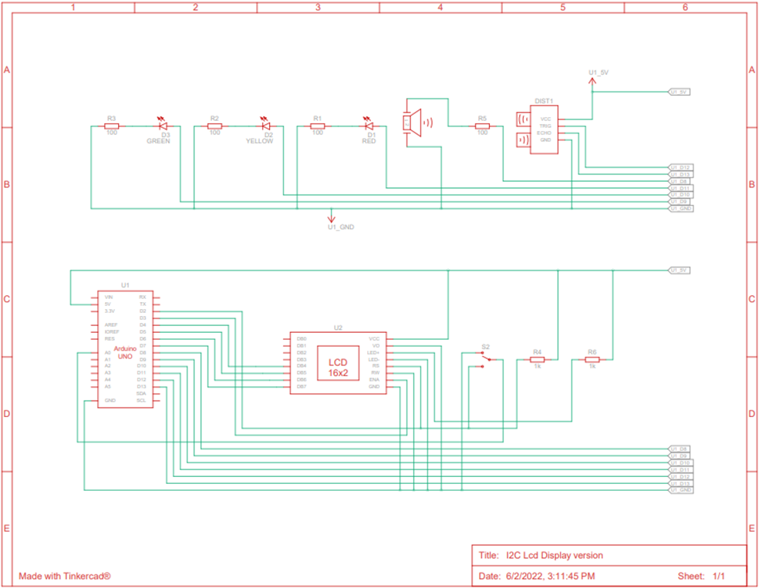
Schematic Diagram

Slide 12
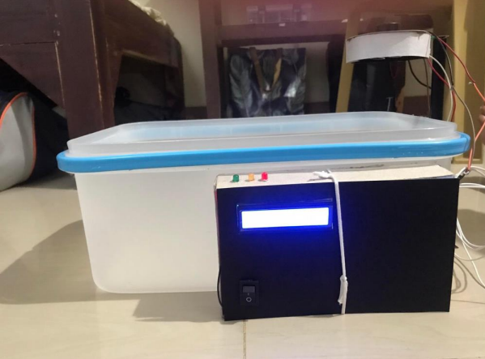
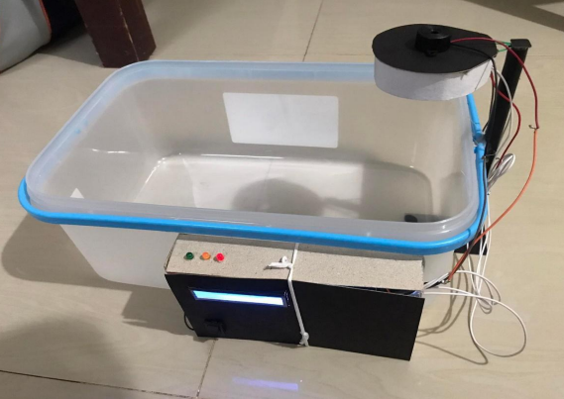
Prototype

Slide 13
Chapter 4
Tests
Results
Discussion

Slide 14
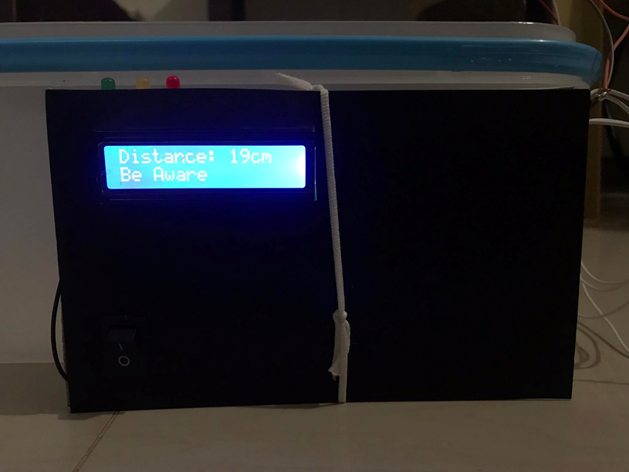
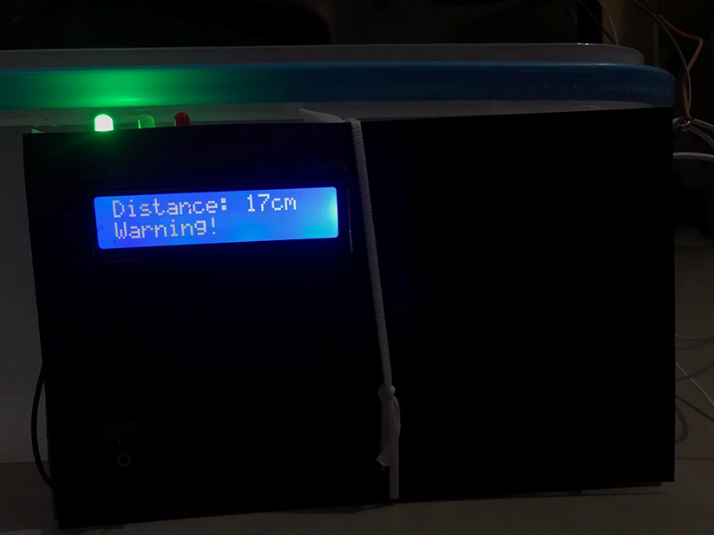
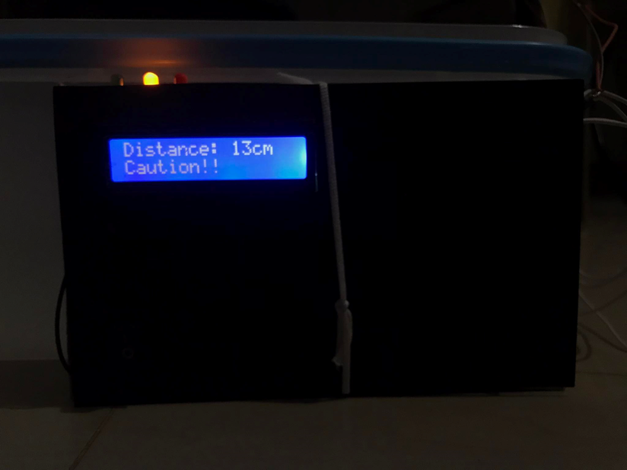
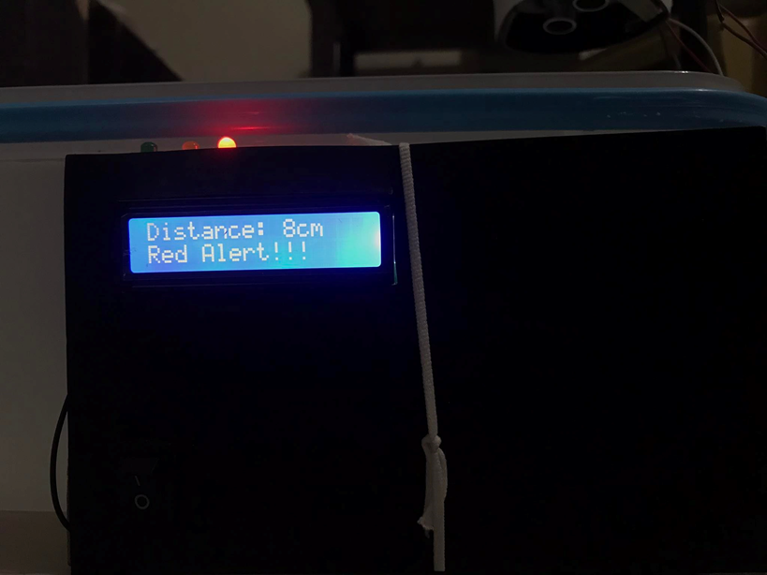
Tests
we scale our concept project, we tested it on a laboratory level by miniaturizing the project equipment's and design.

Slide 15
Results
When the system is on, the ultrasonic sensor starts to monitor the water level.
When container is empty LCD display 19cm, no lights or buzzer were triggered.
When water reaches height of 17 cm to 14 cm, alarm is activated, green LED turned on, buzzer set to intensity-1, LCD display “Warning” message.
When water reaches height of 13 cm to 10 cm, alarm is activated, yellow LED turned on, buzzer set to intensity-2, LCD display “Caution!!” message.
When water reaches height of 9 cm below, alarm is activated, red LED turned on, buzzer set to intensity-3, LCD display “Red Alert!!!” message.

Slide 16
Discussion
This prototype operates according to its pre-programmed instructions coded in the Arduino.
it detects various water levels and will trigger an alarm via a specified led and buzzer frequency or tone.
it is reading the water level on the LCD display.
After assembling all components, the prototype finally worked.

Slide 17
Chapter 5
Conclusion
Recommendation

Slide 18
Conclusion
Recommendations
In terms of functional testing of the prototype, it was found to be completely functional and capable of meeting the objectives of the study.
Adding more than one ultrasonic sensor will increase the accuracy of the results.
Internet of things or SMS, similar to the NDRRMC emergency alerts messages.
Considering different types of distance sensor (e.g TOF).
Consider a design in which no objects will block the ultrasonic sensor.

Slide 19
That would be all thanks

