Slide 1
ECE 721 Overview
Spring’23
Prof. Rotenberg

Slide 2
Performance Strategies
Application Class | Nature of Parallelism | Architecture Approach
sequential programs | Instruction-Level Parallelism (ILP) irregular and fine-grained | general-purpose superscalar or VLIW speculation is key theme
data-parallel programs | Data-Level Parallelism (DLP) regular and fine-grained | vector, SIMD, SIMT (GPGPU)
thread-parallel programs | Thread-Level Parallelism (TLP) regular and coarse-grained | parallel computers, multi-core
ECE 563
ECE 721
ECE 786
ECE 506
ECE 706

Slide 3
The Big Five ILP Techniques (ECE 463/563 Review)
Pipelining
Overlap instructions for higher throughput
Caches, prefetching
Bridge processor-memory speed gap
Branch prediction
Remove control dependencies for effective pipelining
Out-of-order execution
Tolerate long-latency instructions (multi-cycle instructions, cache-missed loads) by fetching and executing future independent instructions while dependent instructions wait
Expose adequate instruction-level parallelism to supply the parallel execution lanes of a superscalar processor (next bullet)
Superscalar
Exceed scalar (1 instr./cycle) performance via multiple-instruction issue (N instr./cycle)

Slide 4
ILP Scaling in Commercial Processors
Processor Generation | Pipeline Depth (fetch to execute) | Issue Width | In-flight Instructions
Pentium | 5 | 1 instr. | ~5
Pentium-III | 10 | 3 µ-ops | ~40
Pentium-IV | 20 | 3 µ-ops | 126
IBM Power4 | 12 | 5 instr. | 200
IBM Power8 |  | 10 (issue) 8 (retire) | 224

Slide 5
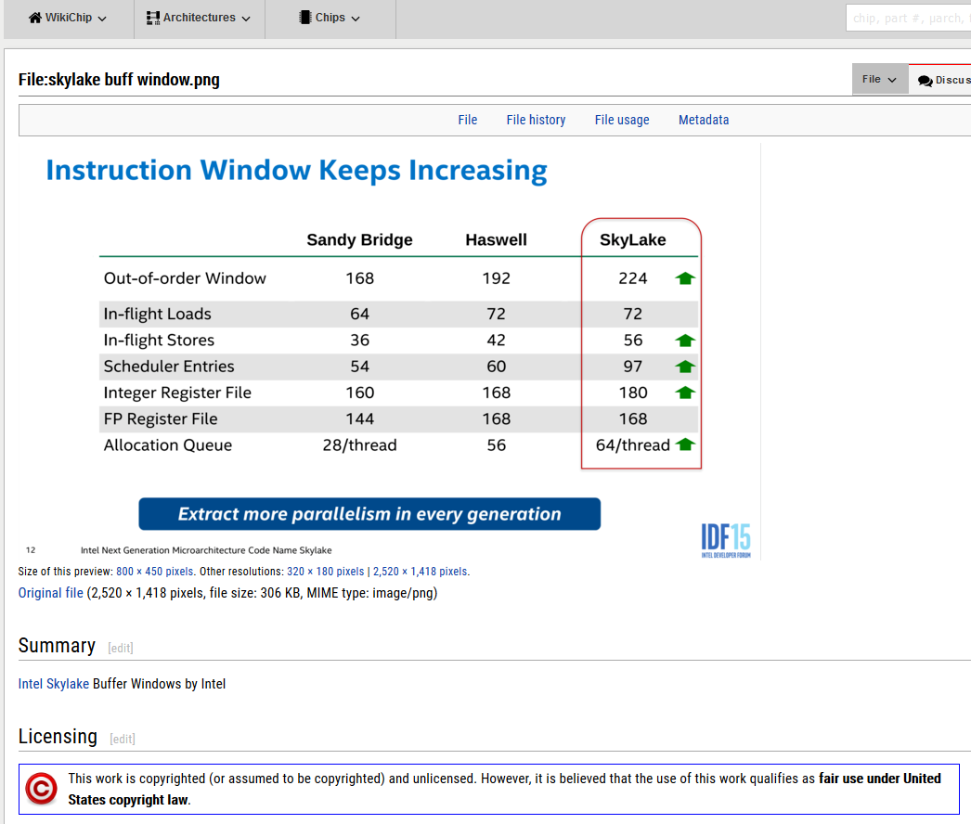
ECE 463/563: Reorder Buffer; ECE 721: Active List
Load Queue
Store Queue
Issue Queue, a.k.a. Reservation Stations, a.k.a. Scheduler
ECE 463/563: ARF+Reorder Buffer; ECE 721: Physical Register File
ECE 463/563: ARF+Reorder Buffer; ECE 721: Physical Register File

Slide 6
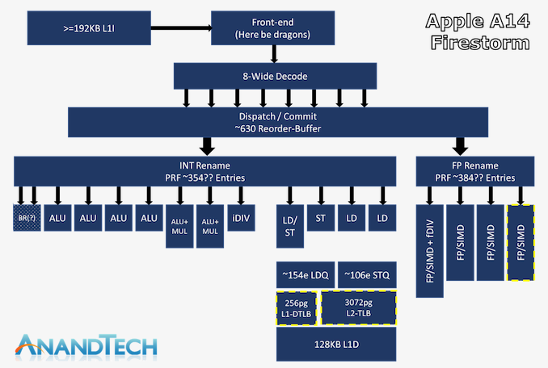
Source: https://www.anandtech.com/show/16226/apple-silicon-m1-a14-deep-dive/2
“Apple's Humongous CPU Microarchitecture”
Disclaimer:
Apple’s CPUs still pretty much remain a black box design given that the company doesn’t disclose any details, and the only publicly available resources on the matter date back to LLVM patches in the A7 Cyclone era, which very much aren’t relevant anymore to today’s designs. While we don’t have the official means and information as to how Apple’s CPU work, that doesn’t mean we cannot figure out certain aspects of the design. Through our own in-house tests as well as third party microbenchmarks (A special credit due for @Veedrac’s microarchitecturometer test suite), we can however unveil some of the details of Apple’s designs. The following disclosures are estimated based on testing the behavior of the latest Apple A14 SoC inside of the iPhone 12 Pro: Apple's Firestorm CPU Core: Even Bigger & Wider
…

Slide 7
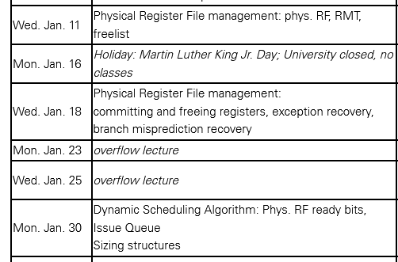
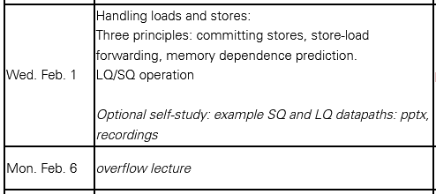
ECE 721 Topics
Two styles of OOO
563: ARF+ROB
721: PRF (Physical Register File)
0.5 lecture contrasting the two
4.5 lectures on PRF management
Handling loads and stores
Review from 563
Some additional depth

Slide 8
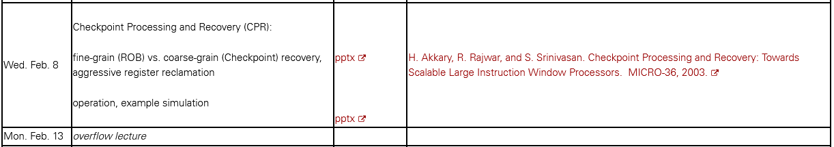
ECE 721 Topics (cont.)
How to scale the processor window to thousands of instructions?
More latency tolerance
Expose more ILP
Checkpoint Processing and Recovery (CPR)
Large virtual window (e.g., 2K in-flight instructions) with smaller PRF
Hierarchical SQ
Project 4 (final project): CPR

Slide 9
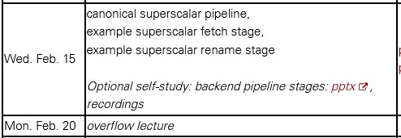
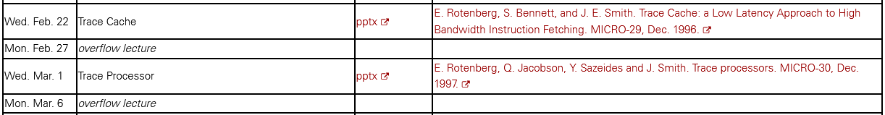
ECE 721 Topics (cont.)
Canonical superscalar pipeline
Example superscalar fetch stage
Example superscalar rename stage
Challenges to scaling superscalar width
Scaling superscalar width
Trace cache
Trace processor

Slide 10

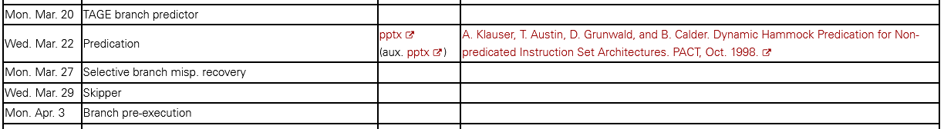
ECE 721 Topics (cont.)
Try to improve gshare accuracy with the TAGE predictor
Dealing with delinquent (hard-to-predict) branches
Major IPC bottleneck in some benchmarks
Don’t predict the branch: predication and skipper
Predict branch and exploit control independence for selective recovery
Improve branch prediction via branch pre-execution
About multipath execution: it is a hard-sell (see me for my perspective)
TAGE paper to be posted
A control-independence paper will be posted
Skipper paper to be posted
A branch pre-execution paper will be posted

Slide 11
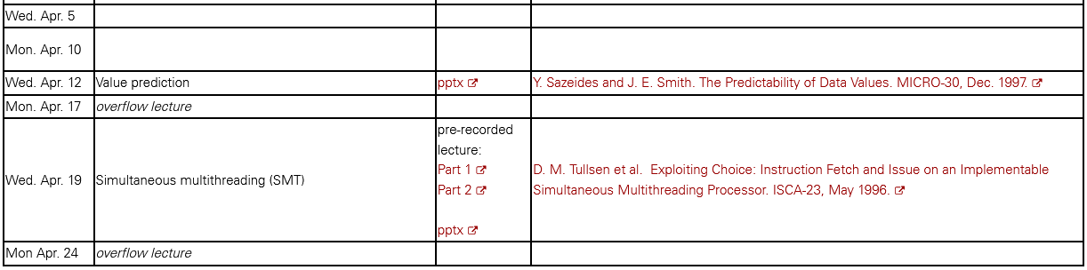
ECE 721 Topics (cont.)
Value prediction
Try to increase ILP by breaking true data dependencies
Improve load latency tolerance
Alternative to larger windows
Simultaneous Multithreading (SMT)
Intel’s implementation is called “hyperthreading”
Multiple threads share the superscalar processor
Increase utilization of the superscalar processor
More so-called ILP via TLP

Slide 12
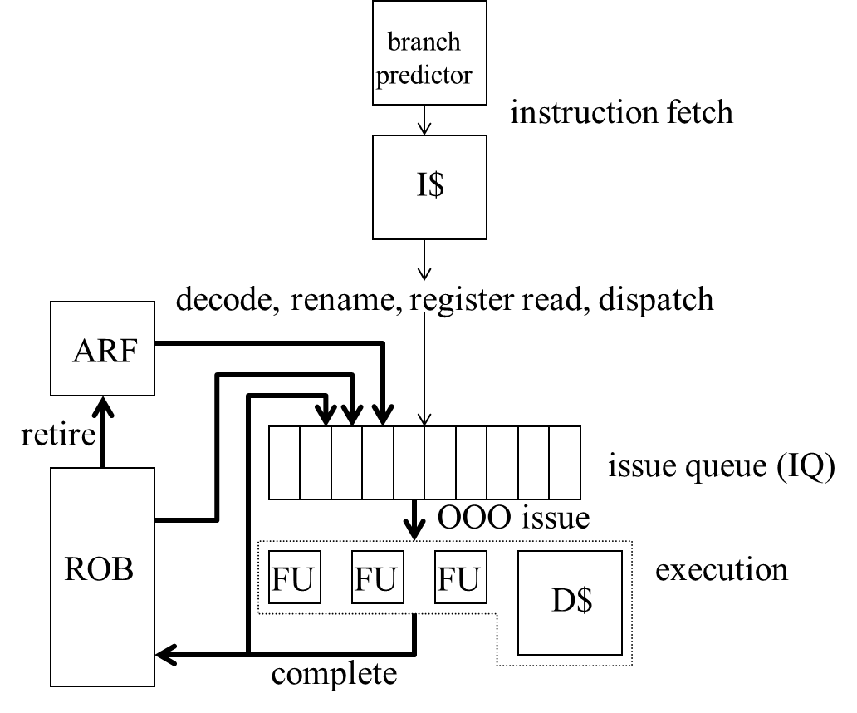
Style 1 (ECE 563)
execute
writeback

Slide 13
Style 2 (ECE 721)
branch
predictor
instruction fetch
Free list
I$
exception
recovery
Arch.
Map
Map
rename
decode, rename, dispatch
retire
misp.
recovery
branch
Issue
Queue
(IQ)
head
OOO issue
Shadow
Maps
register read
Physical
RF
execution
Function
Units (FUs)
tail
writeback
Active List

Slide 14
Project Framework and Projects 1-4
721sim (C++)
Cycle-level, execution-driven, execute-at-execute simulator of a superscalar processor
Actually two simulators: a functional-only simulator checks retired values of the functional-and-timing simulator
Project 1
ILP limit study (identify performance bottlenecks and opportunities in real benchmarks)
No coding. Use 721sim executable.
Learn how to run benchmark “SimPoints” on 721sim
Projects 2 and 3
Project 2: Implement centerpiece Renamer module (PRF management), plug into 721sim
Project 3: 721sim source code revealed, implement missing pieces that interface with the Renamer module
Projects 2 and 3 are training ground (reinforce concepts and get familiar with 721sim for Project 4)
Project 4
The current plan is for the whole class to implement CPR in 721sim
CPR’s PRF management, hierarchical SQ, and coarse-grain recovery
Address 721sim infrastructure aspects and CPR microarchitecture aspects
Validate performance across many configurations and multiple benchmarks (for grading and for gaining insights about CPR performance)

