Slide 1
Committing and freeing registers
Active list
Controls committing and freeing of physical registers
A single action does both: Committing a register means the previously-committed register can be freed (its value is no longer needed)

Slide 2
Two Different Approaches
Approach #1:
Architectural Map Table
Whereas Rename Map Table contains most recent versions of logical registers, Arch. Map Table contains committed versions of logical registers
Approach #2:
No Architectural Map Table

Slide 3
Approach #1
We’ll use our on-going example:
load r1, 16(r2)
load p67, 16(p11)
add r3, r1, #1
add p19, p67, #1
load r1, 20(r2)
load p27, 20(p11)
sub r4, r1, #1
sub p28, p27, #1

Slide 4
Active List (with AMT)
ACTIVE LIST
AMT: committed versions (“trailing edge” of core)
Entry | logical dest. | physical dest.: current mapping | exc. | comp. | PC
1
2
3
4
5
6
7
…
RMT: most recent versions (“leading edge” of core)
AMT
RMT
r0 | p10
r1 | p8
r2 | p11
r3 | p33
r4 | p46
…
r31 | p2
r0 | p10
r1 | p8
r2 | p11
r3 | p33
r4 | p46
…
r31 | p2
head
tail

Slide 5
Active List (with AMT)
ACTIVE LIST
Entry | logical dest. | physical dest.: current mapping | exc. | comp. | PC
1
2
3 | r1 | p67 | 0 | 0 | A
4
5
6
7
…
AMT
r0 | p10
r1 | p8
r2 | p11
r3 | p33
r4 | p46
…
r31 | p2
RMT
head
r0 | p10
r1 | p67
r2 | p11
r3 | p33
r4 | p46
…
r31 | p2
tail

Slide 6
Active List (with AMT)
ACTIVE LIST
Entry | logical dest. | physical dest.: current mapping | exc. | comp. | PC
1
2
3 | r1 | p67 | 0 | 0 | A
4 | r3 | p19 | 0 | 0 | B
5
6
7
…
AMT
r0 | p10
r1 | p8
r2 | p11
r3 | p33
r4 | p46
…
r31 | p2
head
RMT
r0 | p10
r1 | p67
r2 | p11
r3 | p19
r4 | p46
…
r31 | p2
tail

Slide 7
Active List (with AMT)
ACTIVE LIST
Entry | logical dest. | physical dest.: current mapping | exc. | comp. | PC
1
2
3 | r1 | p67 | 0 | 0 | A
4 | r3 | p19 | 0 | 0 | B
5 | r1 | p27 | 0 | 0 | C
6
7
…
AMT
r0 | p10
r1 | p8
r2 | p11
r3 | p33
r4 | p46
…
r31 | p2
head
RMT
r0 | p10
r1 | p27
r2 | p11
r3 | p19
r4 | p46
…
r31 | p2
tail

Slide 8
Active List (with AMT)
ACTIVE LIST
Entry | logical dest. | physical dest.: current mapping | exc. | comp. | PC
1
2
3 | r1 | p67 | 0 | 0 | A
4 | r3 | p19 | 0 | 0 | B
5 | r1 | p27 | 0 | 0 | C
6 | r4 | p28 | 0 | 0 | D
7
…
AMT
r0 | p10
r1 | p8
r2 | p11
r3 | p33
r4 | p46
…
r31 | p2
head
RMT
r0 | p10
r1 | p27
r2 | p11
r3 | p19
r4 | p28
…
r31 | p2
tail

Slide 9
Committing and freeing registers
ACTIVE LIST
Entry | logical dest. | physical dest.: current mapping | exc. | comp. | PC
1
2
3 | r1 | p67 | 0 | 1 | A
4 | r3 | p19 | 0 | 0 | B
5 | r1 | p27 | 0 | 0 | C
6 | r4 | p28 | 0 | 0 | D
7
…
Free List
p8
tail
“free”
AMT
r0 | p10
r1 | p8
r2 | p11
r3 | p33
r4 | p46
…
r31 | p2
head
“commit”
p67
RMT
r0 | p10
r1 | p27
r2 | p11
r3 | p19
r4 | p28
…
r31 | p2
tail

Slide 10
Active List Operation
Dispatch:
Reserve entry at tail, write the instruction’s logical and physical destination register specifiers, increment tail pointer
“Current mapping”: instruction’s physical destination register specifier

Slide 11
Active List Operation (cont.)
Retire:
Wait for head instruction to complete
Index Arch. Map Table using the head instruction’s logical destination register specifier
Free the “previous mapping” that is contained in the Arch. Map Table: push it onto the free list. Since we are about to commit a new version, the old committed version is no longer needed for possible recovery.
Physical register indicated by “current mapping” is committed by updating the Arch. Map Table with the current mapping.
Advance head pointer

Slide 12
Handling Exceptions
Set exception bit in active list
When posted exception reaches head of active list:
Flush active list: Set tail pointer equal to head pointer
Flush pipeline: Squash all instructions in frontend stages, issue queues, FUs, etc.
Restore rename map table to committed state: Copy architectural map table to rename map table
Restore free list: Push mappings of all instructions after the offending one back onto the free list
Save PC of offending instr. (gotten from head of active list)
E.g., MIPS ISA defines EPC register where handler will return to
EPC = AL[al_head].PC
Trap to the exception handler
PC = address of exception handler

Slide 13
Implementation Challenges (1)
Squashing instructions in pipeline
Global squash signal may be cycle time bottleneck
Extending to multiple cycles provides some relief
Still a routing bottleneck (physical design)
Alternative: wait for all in-flight instructions to “drain” from pipeline (i.e., wait for all of them to complete)
No global squash signal
Wait extra cycles as pipeline drains. Can overlap some cycles with restoring RMT from AMT if it takes multiple cycles to copy

Slide 14
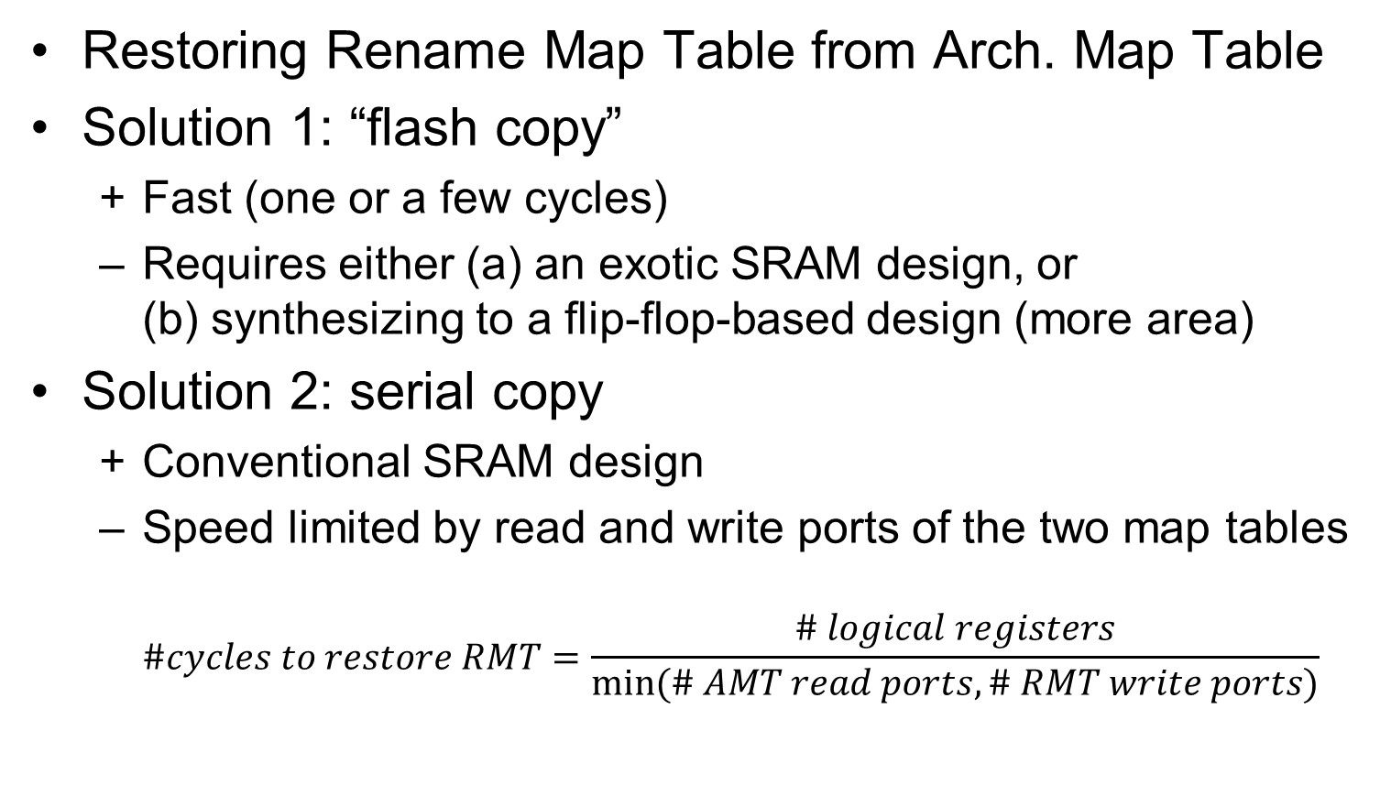
Implementation Challenges (2)
Restoring Rename Map Table from Arch. Map Table
Solution 1: “flash copy”
Fast (one or a few cycles)
Requires either (a) an exotic SRAM design, or (b) synthesizing to a flip-flop-based design (more area)
Solution 2: serial copy
Conventional SRAM design
Speed limited by read and write ports of the two map tables $\#cycles to restore RMT=\frac{\# logical registers}{min⁡(\# AMT read ports, \# RMT write ports)}$

Slide 15
Determining number of ports for renaming structures
Example:
4-way superscalar i.e., 4 instr. in rename bundle and 4 instr. in retire bundle
Assume maximum of 2 source registers and 1 destination register for an instruction
T
H
? W
Free List
? R
rename logical destination registers
? R
AMT
? W
? W
RMT
? R
RENAME
RETIRE
rename logical source registers
? R
Active List
? W
H
T

Slide 16
Aside: head/tail phase bits for circular FIFOs
For a circular FIFO, H==T can mean either empty or full
Distinguish empty vs. full using phase bits
A pointer’s phase bit toggles when it wraps around
Example:
empty = ((H==T) && (H_phase == T_phase));
H and T wrapped around same number of times.
full = ((H==T) && (H_phase != T_phase));
T wrapped around one more time than H did.
T++; // increment tail pointer
if (T == FIFO_size) { // wrap around scenario
T = 0; // force wrap around
T_phase = !T_phase; // toggle phase bit
}
uint64_t FIFO_size;
uint64_t H, T;
bool H_phase, T_phase;

Slide 17
Aside: head/tail phase bits for circular FIFOs
key:
H(H_phase)
T(T_phase)
a
b
c
d
pop a
H(0)
empty
T(1)
H(0)
T(0)
e
b
c
d
push e
a
push a
H(0)
full
H(0)
T(0)
T(1)
a
b
push b
e
b
c
d
pop b
H(0)
T(0)
T(1)
H(0)
a
b
c
push c
e
b
c
d
pop c
H(0)
T(0)
T(1)
H(0)
a
b
c
d
push d
e
b
c
d
pop d
H(0)
H(1)
T(1)
T(1)
full
e
b
c
d
pop e
H(1)
empty
T(1)

Slide 18
Implementation Challenges (3)
Two options for restoring free list
Slow and complex:
Scan active list between head and tail, push each instruction’s current mapping back onto free list
Fortunately there is a more clever way…
Fast and simple:
Observation about free list contents:
Between H and T: List of free physical registers
Between T and H: List of physical registers allocated to instructions between active list H and T
Popping mappings from free list merely advances its head pointer but does not destroy contents
Restore free list simply by rolling back head pointer to tail pointer (bulk-undo the speculative pops) and noting that the free list is full
head = tail
head_phase = !(tail_phase)

Slide 19
KEY:
r1
p8
committed registers
Architectural Map Table
speculative registers, free
speculative registers, allocated to active instructions
…
…
p67
p19
p27
p28
…
…
Free List
initial state: pipeline empty
head(0)
full
tail(1)
Active List
head(0)
empty
tail(0)
Note:
Free List size (max # free registers for speculation) = PRF size - # logical registers (committed state can’t be free)
Active List size >= Free List size AL typically larger than FL because not all active instructions have logical destination registers

Slide 20
KEY:
r1
p8
committed registers
Architectural Map Table
speculative registers, free
speculative registers, allocated to active instructions
…
…
p67
p19
p27
p28
…
…
Free List
tail(1)
head(0)
after dispatching instructions
Active List
r1: p67
r3:p19
branch
r1:p27
r4:p28
store
head(0)
tail(0)

Slide 21
KEY:
r1
p8
p67
committed registers
Architectural Map Table
speculative registers, free
speculative registers, allocated to active instructions
p8
…
…
…
…
p67
p19
p27
p28
Free List
tail(1)
head(0)
after retiring head instruction
Active List
r1: p67
r3:p19
branch
r1:p27
r4:p28
store
head(0)
tail(0)

Slide 22
KEY:
r1
p67
committed registers
Architectural Map Table
speculative registers, free
speculative registers, allocated to active instructions
…
…
p8
p19
p27
p28
…
…
Free List
tail(1)
head(0)
exception at head of Active List
Active List
r1: p67
r3:p19
branch
r1:p27
r4:p28
store
head(0)
tail(0)
completed =1 exception=1

Slide 23
KEY:
r1
p67
committed registers
Architectural Map Table
speculative registers, free
speculative registers, allocated to active instructions
…
…
p8
p19
p27
p28
…
…
Free List exception recovery logic:
head = tail
head_phase = !tail_phase
Free List
head(0)
full
after recovery
tail(1)
Active List
r1: p67
r3:p19
branch
r1:p27
r4:p28
store
head(0)
empty
Active List exception recovery logic:
tail = head
tail_phase = head_phase
tail(0)

Slide 24
Common Question from Students
Why not unify Active List and Free List?
Conceivable, but there is a drawback (1) or it’s not possible (2):
Unifying them wastes physical registers because not all active instructions need a physical register. If separate, Active List may be larger than Free List. (FYI: 563’s ARF+ROB wastes ROB registers, e.g., stores and branches in ROB.)
Not possible for Approach #2 (coming up) because Active List has previous mappings instead of current mappings.

Slide 25
Approach #2
We’ll use our on-going example:
load r1, 16(r2)
load p67, 16(p11)
add r3, r1, #1
add p19, p67, #1
load r1, 20(r2)
load p27, 20(p11)
sub r4, r1, #1
sub p28, p27, #1

Slide 26
Active List (without AMT)
ACTIVE LIST
Entry | logical dest. | physical dest.: previous mapping | exc. | comp. | PC
1
2
3 | r1 | p8 | 0 | 0 | A
4 | r3 | p33 | 0 | 0 | B
5 | r1 | p67 | 0 | 0 | C
6 | r4 | p46 | 0 | 0 | D
7
…
head
tail
By keeping the previous mapping, that was overwritten in the RMT by the instruction’s current mapping, the Active List serves as an “undo log”, i.e., we can rollback the RMT to the committed state (i.e., what the RMT was when the pipeline was empty) without an explicit AMT.

Slide 27
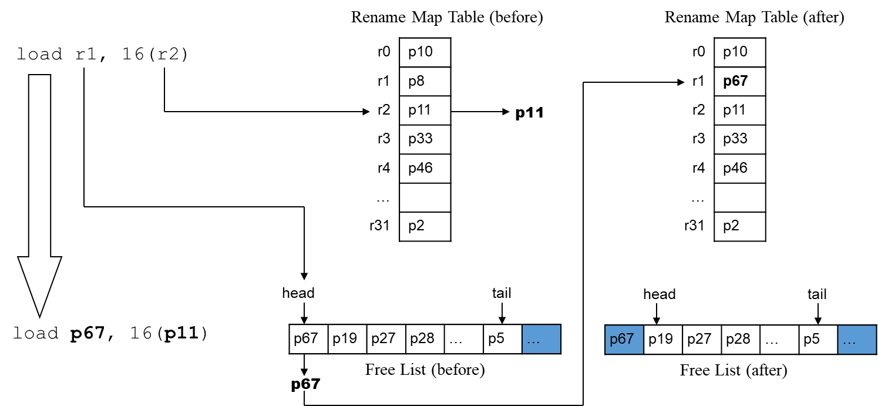
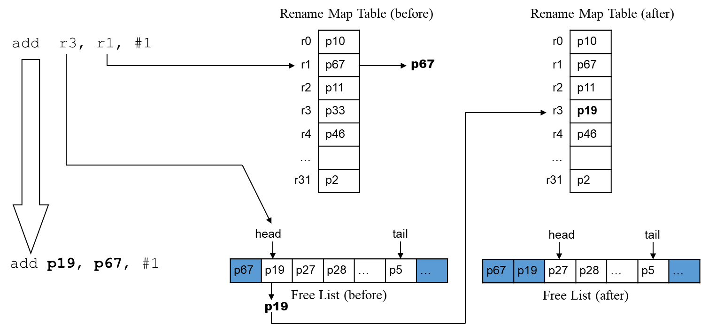
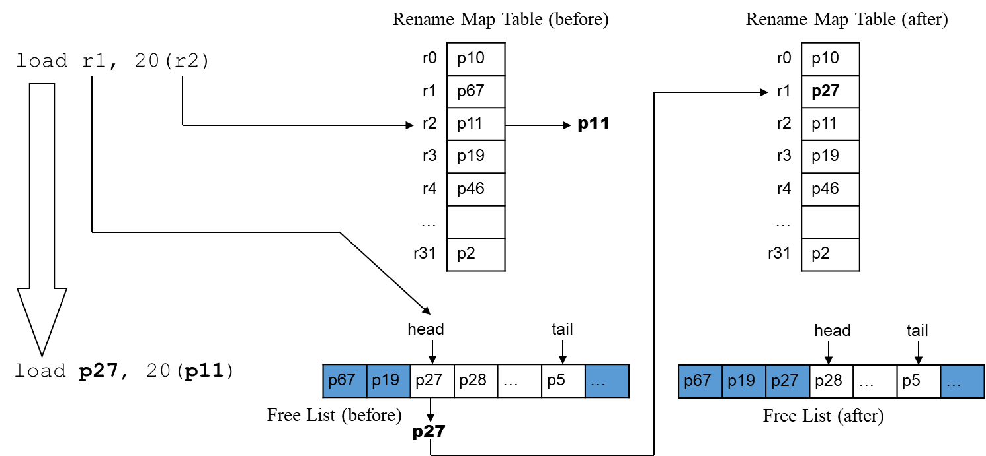
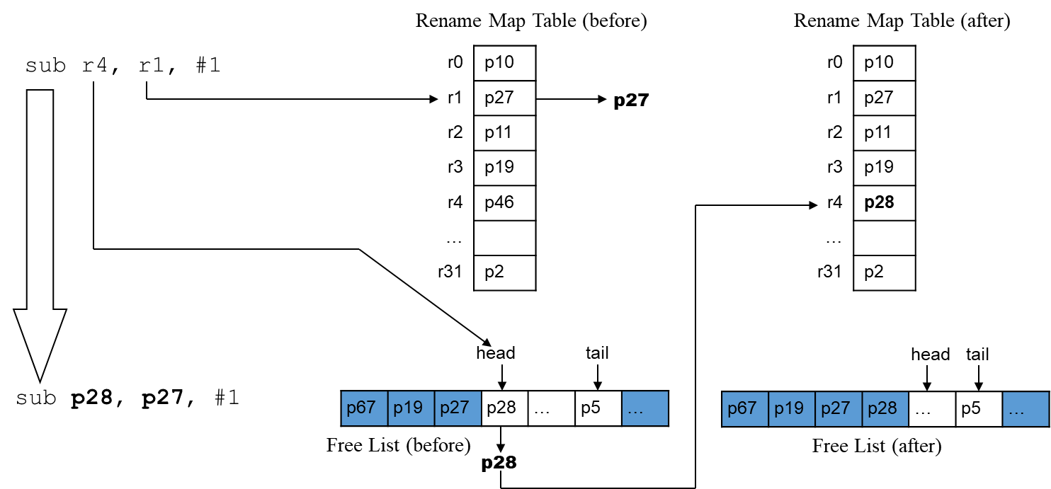
Active List (after)
Logical Dest. | Previous mapping
r1 | p8
H
T
Active List (after)
Logical Dest. | Previous mapping
r1 | p8
r3 | p33
H
T
Active List (after)
Logical Dest. | Previous mapping
r1 | p8
r3 | p33
r1 | p67
H
T
Active List (after)
Logical Dest. | Previous mapping
r1 | p8
r3 | p33
r1 | p67
r4 | p46
H
T

Slide 28
Committing and freeing registers
ACTIVE LIST
Entry | logical dest. | physical dest.: previous mapping | exc. | comp. | PC
1
2
3 | r1 | p8 | 0 | 1 | A
4 | r3 | p33 | 0 | 0 | B
5 | r1 | p67 | 0 | 0 | C
6 | r4 | p46 | 0 | 0 | D
7
…
Free List
p8
tail
“free”
head
“commit”:
This action implicitly commits the head instruction’s version of r1 (p67).
tail

Slide 29
Active List Operation
Rename:
Before updating the Rename Map Table with a new mapping for an instruction’s logical destination register, read out the previous mapping for that logical destination register
This requires an extra read port for the logical destination register of an instruction:
Approach #1 (with Arch. Map Table)
phys. source reg. 1 = RMT[logical source reg. 1] // RMT read port
phys. source reg. 2 = RMT[logical source reg. 2] // RMT read port
phys. dest. reg. = pop new mapping from free list
RMT[logical dest. reg.] = phys. dest. reg. // RMT write port
Approach #2 (without Arch. Map Table)
phys. source reg. 1 = RMT[logical source reg. 1] // RMT read port
phys. source reg. 2 = RMT[logical source reg. 2] // RMT read port
previous mapping = RMT[logical dest. reg.] // extra RMT read port
phys. dest. reg. = pop new mapping from free list
RMT[logical dest. reg.] = phys. dest. reg. // RMT write port

Slide 30
Active List Operation (cont.)
Dispatch:
Reserve entry at tail, write the instruction’s logical destination register specifier and the previous mapping of that logical register, increment tail pointer
Retire:
Wait for head instruction to complete
Push its previous mapping onto the free list. This has two implicit effects:
Frees the prior committed version of the instruction’s logical dest. register
Commits the instruction’s physical dest. register
Advance head pointer

Slide 31
Handling Exceptions
Set exception bit in active list
When posted exception reaches head of active list:
Flush pipeline: Squash all instructions in frontend stages, issue queues, FUs, etc.
Restore rename map table to committed state: Scan the active list backward from tail to head, restore previous mappings into rename map table
Restore free list: Either:
Easy: Restore head pointer as before (head=tail, head_phase=!tail_phase)
More complicated than needed: While restoring the rename map table, “undone” current mappings are pushed back onto free list
Save PC of offending instr. (gotten from head of active list)
Trap to the exception handler

Slide 32
Rename Map Table
Active List
r0 | p10
r1 | p27
r2 | p11
r3 | p19
r4 | p28
…
r31 | p2
Logical Dest. | Previous mapping
r1 | p8
r3 | p33
r1 | p67
r4 | p46
Initial: renamed four instr.
H
T
r0 | p10
r1 | p27
r2 | p11
r3 | p19
r4 | p28
…
r31 | p2
Logical Dest. | Previous mapping
r1 | p8
r3 | p33
r1 | p67
r4 | p46
After commit of oldest instr.
r1:p8 freed, implicitly committed r1:p67
H
T
Suppose second instr., now at head (H), posted an exception. Restore prev. mappings from T to H from AL to RMT.
Logical Dest. | Previous mapping
r1 | p8
r3 | p33
r1 | p67
r4 | p46
Logical Dest. | Previous mapping
r1 | p8
r3 | p33
r1 | p67
r4 | p46
Logical Dest. | Previous mapping
r1 | p8
r3 | p33
r1 | p67
r4 | p46
Original RMT (before instr. sequence)
H
r0 | p10
r1 | p8
r2 | p11
r3 | p33
r4 | p46
…
r31 | p2
H
H
T
T
T
r0 | p10
r1 | p27
r2 | p11
r3 | p19
r4 | p28 p46
…
r31 | p2
r0 | p10
r1 | p27 p67
r2 | p11
r3 | p19
r4 | p46
…
r31 | p2
r0 | p10
r1 | p67
r2 | p11
r3 | p19 p33
r4 | p46
…
r31 | p2
Final RMT (after recovery)
r0 | p10
r1 | p67
r2 | p11
r3 | p33
r4 | p46
…
r31 | p2

Slide 33
Branch Misprediction Recovery Approaches
These approaches wait for the mispredicted branch to reach the head of the active list (like an exception), before initiating recovery.
Handle like exception using approach #1
Handle like exception using approach #2
These approaches initiate recovery as soon as the misprediction is discovered (as soon as the branch instruction executes), from the middle of the active list.
Forward walk active list
Backward walk active list
Shadow Map Tables

Slide 34
Branch Misprediction Recovery Approaches 3, 4, & 5
Free List: For all three approaches, checkpoint the free list head pointer and head phase bit after* the branch is renamed. Restoring the checkpointed free list head pointer and head phase bit associated with the mispredicted branch causes mappings of instructions after the branch to be freed in bulk.
(* Some branch opcodes may have a logical destination register. If the branch was mispredicted, note that the branch itself is correct.)
Rename Map Table: Need to restore the RMT to what it was just after renaming the branch. The three approaches differ in this aspect. See following slides.

Slide 35
Approach #3: Forward walk active list
Same structures as Approach #1
Active List contains current mappings, which are used to update an Architectural Map Table
When misprediction is detected:
Restore RMT from AMT right away (either flash copy or serial copy)
Fast-forward the RMT to just after the branch in the active list, by walking the active list from head to branch (inclusive) and incrementally updating the RMT with the current mappings in the active list

Slide 36
Approach #3 (cont.)
Approach #3 and Approach #1 seem to be equal but opposite
Approach #1: Waits for branch to reach head of active list, then copy AMT to RMT
Approach #3: Immediately copy AMT to RMT, then walk forward from head to branch
So how is Approach #3 better?
Approach #1 is delayed by the time to execute and retire all instructions prior to the branch. E.g., what if there is an L2-cache-missed load stalling retirement for 100s of cycles?
Approach #3’s recovery latency only depends on the number of instructions prior to the branch, not the time to execute those instructions

Slide 37
Approach #4: Backward walk active list
Same structures as Approach #2
Active List contains previous mappings; no AMT
When misprediction is detected:
Roll-back the RMT to just after the branch in the active list, by walking the active list from tail to the entry just after the branch (inclusive) and incrementally restoring the RMT with the previous mappings in the active list

Slide 38
Approach #5: Shadow Map Tables
Checkpoint (create a copy of) the RMT after renaming a branch
Checkpoint RMT after branch is renamed, since state of RMT at this point reflects renaming all instructions up to and including the branch, and none after
Let’s call a checkpointed copy of the RMT a Shadow Map Table
When misprediction is detected:
Restore RMT from the mispredicted branch’s Shadow Map Table

Slide 39
Clarification about branch checkpoints
Approaches #3, #4, and #5 all use branch checkpoints
Contents of branch checkpoint (at a minimum)
Checkpointed free list head pointer and head phase bit: approaches #3, #4, and #5
Checkpointed GBM (see Project 2): approaches #3, #4, and #5
Checkpointed RMT, a.k.a., Shadow Map Table: approach #5 only

Slide 40
Recovery from branch mispredictions, for immediate recovery (#3, #4, #5)
Recovery steps for approaches #3, #4, and #5
Pipeline
Instruction fetch unit
Set PC to the correct target of the branch
Repair the global branch history register of the branch predictor (if applicable)
Frontend stages: fetch, decode, rename, dispatch
Squash all instructions in the frontend stages since these are by definition after the resolved branch
Backend stages: schedule, register read, execute, writeback
Selectively squash only those instructions in the backend stages that come after the mispredicted branch in program order
Each instruction inherits a branch dependence bit vector in the rename stage, with one bit per unresolved branch, indicating which unresolved branches are before the instruction in program order

Slide 41
Recovery from branch mispredictions, for immediate recovery (#3, #4, #5)
Recovery steps (cont.)
Renaming machinery
Active list
Restore active list tail to the entry just after the mispredicted branch (must restore tail pointer and tail phase bit)
Free list
Restore free list head to the checkpointed free list head (head pointer and head phase bit)
Rename map table
#3: forward walk; #4: backward walk; #5: shadow map
Reclaim the checkpoints of the mispredicted branch and all later branches. Also see next slide.

Slide 42
See Project 2 for efficient branch checkpoint management
Global branch mask (GBM)
Maintained in the Rename Stage
Allocating a free bit in the GBM for a just-renamed branch gives it a unique branch ID (bit position in the GBM) which is also its index into an array of checkpoints
bit in the GBM ⬄ branch ID ⬄ index into array of checkpoints
A renamed instruction knows which unresolved branches are prior to it in program order (whichever branch bits are set in the GBM when the instruction is renamed). Used for selective squashing of instructions in the backend stages.
Checkpointing the GBM in branch checkpoints, and later restoring it, yields implicit reclamation of checkpoints of branches after the mispredicted branch
Confused? Implement Project 2 (and 3) and it will help.

Slide 43
commit-and-free registers: Approach #1:
Active List has current mappings
AMT
commit-and-free registers: Approach #2:
Active List has previous mappings
no AMT
Exception recovery approach #1:
Wait until offending instr. is at AL head, don’t retire offending instruction
Full squash pipeline
RMT = AMT
fl_head = fl_tail, fl_head_phase = !fl_tail_phase
al_tail = al_head, al_tail_phase = al_head_phase
Save offending PC in EPC register, etc.
Fetch PC = PC of exception handler
Exception recovery approach #2:
Wait until offending instr. is at AL head, don’t retire offending instruction
Full squash pipeline
RMT: backward walk AL from tail to head, restore prev. mappings
fl_head = fl_tail, fl_head_phase = !fl_tail_phase
al_tail = al_head, al_tail_phase = al_head_phase
Save offending PC in EPC register, etc.
Fetch PC = PC of exception handler
Branch misprediction recovery approach #1:
Wait until misp. branch is at AL head, retire branch
Full squash pipeline
RMT = AMT
fl_head = fl_tail, fl_head_phase = !fl_tail_phase
al_tail = al_head, al_tail_phase = al_head_phase
Fetch PC = correct target of branch
Branch misprediction recovery approach #2:
Wait until misp. branch is at AL head, retire branch
Full squash pipeline
RMT: backward walk AL from tail to head, restore prev. mappings
fl_head = fl_tail, fl_head_phase = !fl_tail_phase
al_tail = al_head, al_tail_phase = al_head_phase
Fetch PC = correct target of branch
Branch misprediction recovery approach #3 (forward walk):
Initiate misp. recovery immediately
Full squash frontend, selective squash backend
RMT = AMT, forward walk AL from head to br. (inclusive)
Restore free list head and phase from checkpoint
Restore active list tail and phase to entry after branch
Fetch PC = correct target of branch
Branch misprediction recovery approach #4 (backward walk):
Initiate misp. recovery immediately
Full squash frontend, selective squash backend
RMT: backward walk AL from tail to br. (exclusive), restore prev. mappings
Restore free list head and phase from checkpoint
Restore active list tail and phase to entry after branch
Fetch PC = correct target of branch
Branch misprediction recovery approach #5 (shadow maps):
Initiate misp. recovery immediately
Full squash frontend, selective squash backend
Restore RMT from checkpoint
Restore free list head and phase from checkpoint
Restore active list tail and phase to entry after branch
Fetch PC = correct target of branch

Slide 44
Modern Superscalar Microarchitecture
fetch
Free List
tail
head
decode
exception
recovery
retire
AMT
RMT
rename
misp.
rec.
rename
head
Shadow
Maps
tail
dispatch
GBM
PRF ready bits
Active List
clr
complete
set
Issue
Queue
(IQ)
wakeup
schedule
register read
Physical
RF
execute
Function
Units (FUs)
writeback

