Slide 1

REST API C++
(ou algo do tipo)
Wanderley Caloni

Slide 2


Slide 3

INDUSTRY

Slide 4
Industry
Century
Ali
STI
NXP
Freescale
YouCast!

Slide 5
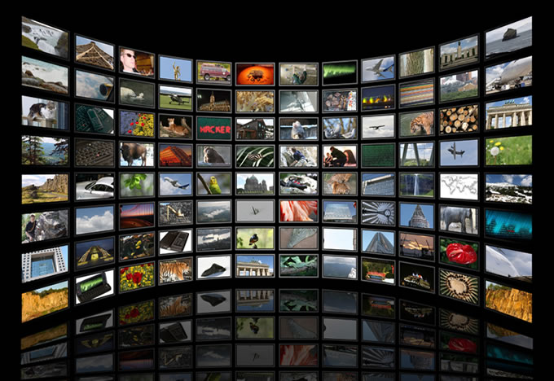
IPTV e Embedded

Slide 6
IPTV e Embedded
From head-end to set-top-box
  Apps/media distribution
Firmware
  Corporative Broadcasting
  Digital-Signaling

Slide 7
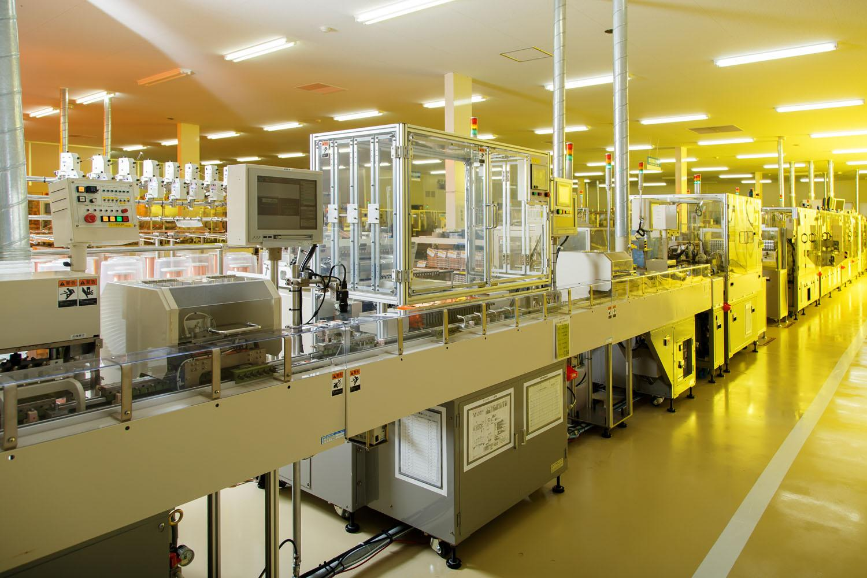
Automation

Slide 8
Automation
Industrial process proprietary framework (LogProd)
Full productive chain traceability
High performance (C++)
Intuitive portable interface (Qt)

Slide 9

SERVICES

Slide 10
Services
Scua Information Security
GAS
Easytech
Samsung
Bovespa
Intelitrader

Slide 11
Information Security
20+ years consulting in the market
Low level Windows (Services, API Hooks, Drivers, BIOS)
Intel technology from bare metal to cloud services

Slide 12
Mobile
Android development
Backend, cloud and app

Slide 13
Financial market
10+ years in the market
Order routing (FIX Protocol)
Pre-trade risk management
Market Data

Slide 14

SOFTWARE

Slide 15
Software on demand
20+ years in programming and software design
Conception
Requirements
PMF
QA process

Slide 16
Software on demand
Critical parts development and maintenance
Code review with detailed report
Production monitoring
Low level tools expertise

Slide 17
Software on demand
Formal process (Agile, Scrum)
Process improvement (adaptable to existing)
Internal team improvement (results in few months)

Slide 18
Software on demand
Integration (API, REST, SOAP, COM)
Communication protocols (FTP, HTTP)
Physical interfaces (USB, COM serial)

Slide 19
Software on demand
Mini-Courses
In-house technologies oriented
Short and concise lectures (minimum one hours) work oriented
Any day, hour, local (remoting included)
Discount for large groups

Slide 20
Software on demand
Startups accelerator
Low cost in the first prototype
Low cost MVPs available
From the draft to monetizing beta
Investment easing

Slide 21

Caloni
Programador C/C++ et all (Python/C#/JS/Pascal/Assembly/BAT)
Blogger: www.caloni.com.br
Vlogger: https://www.youtube.com/results?search_query=blogue+do+caloni
2013-2016

Slide 22
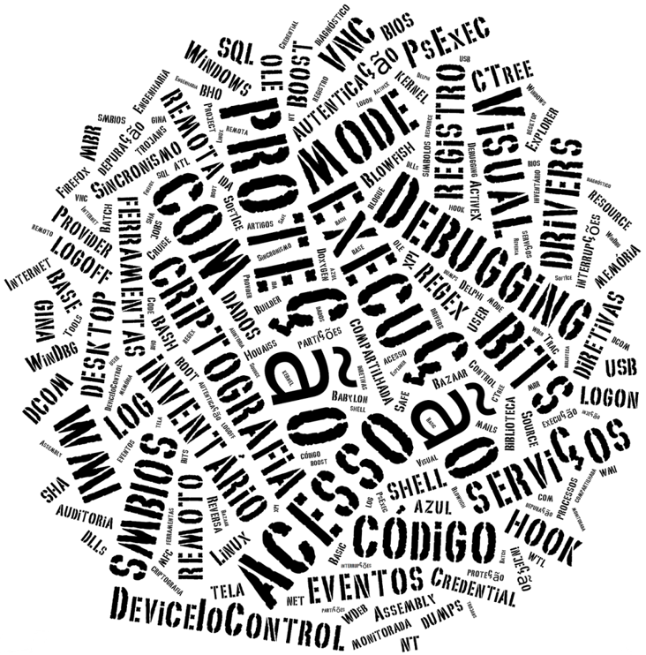

Slide 23
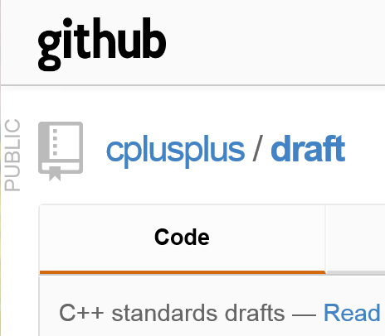
RESUMO

Slide 24

Resumo
Histórico C++
Evolução de Tecnologias
Internet (a rede mundial de computadores)
  C++ não é .NET
  A Net vive de C++
Use Case: tiodb

Slide 25
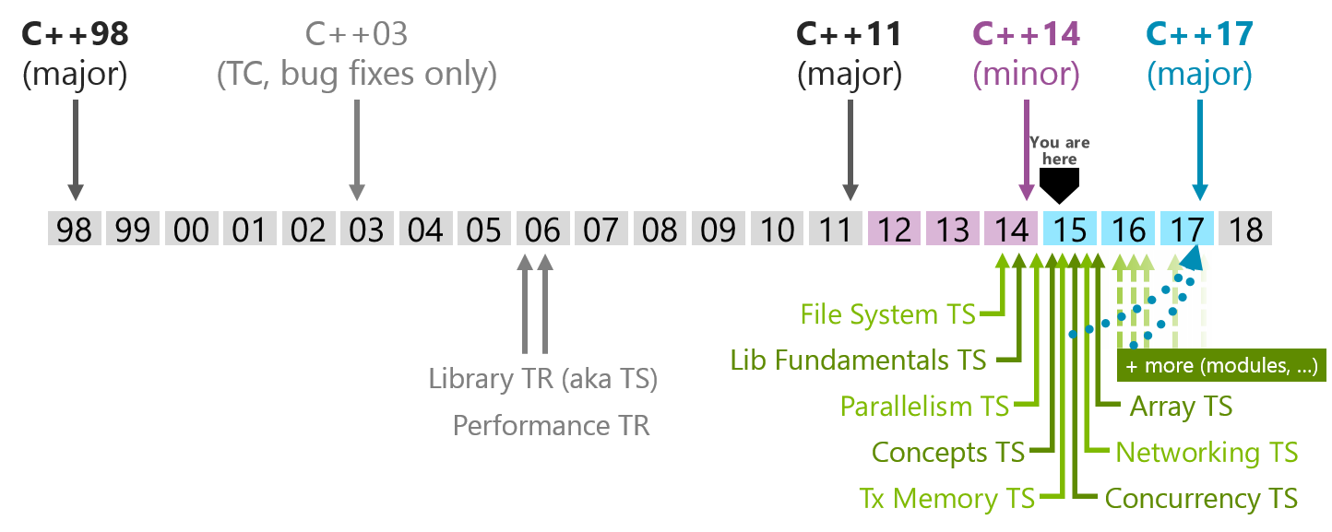
Histórico C++

Slide 26
Histórico C++
Lambdas
Threads
Async

Slide 27
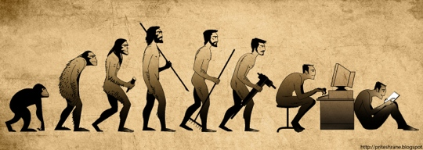
Evolução de Tecnologias

Slide 28
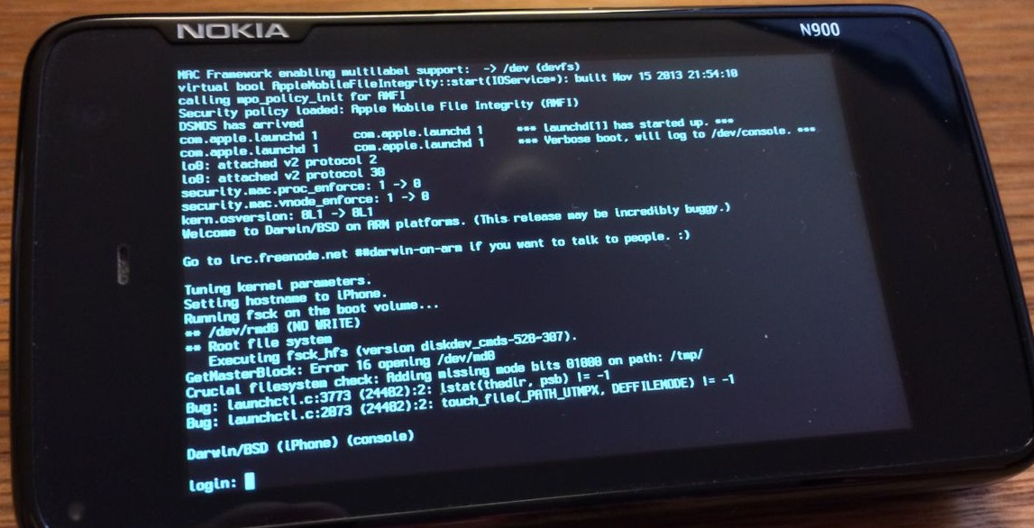
Evolução de Tecnologias: Apple

Slide 29
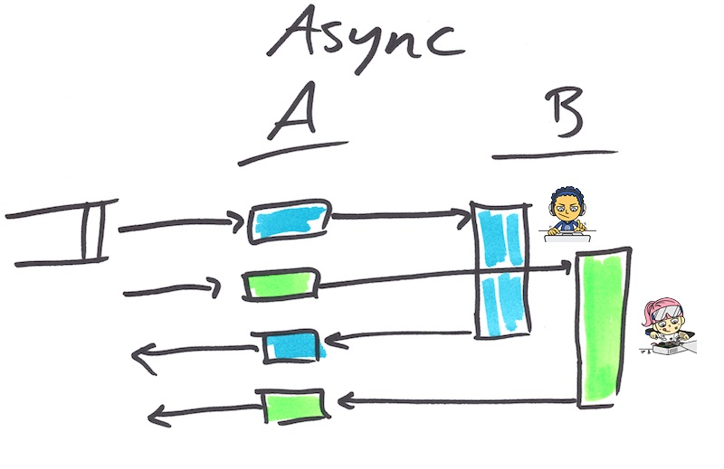

Evolução de Tecnologias: Facebook
https://code.facebook.com/posts/1661982097368498/futures-for-c-11-at-facebook/

Slide 30
Evolução de Tecnologias: Microsoft
Chutou o pau da barraca
.NET, Python, TypeScript, Xamarin (Android, iOS), LLVM, Linux…
C++ https://blogs.msdn.microsoft.com/vcblog
CppRestSDK
C++/WinRT
CMake

Slide 31
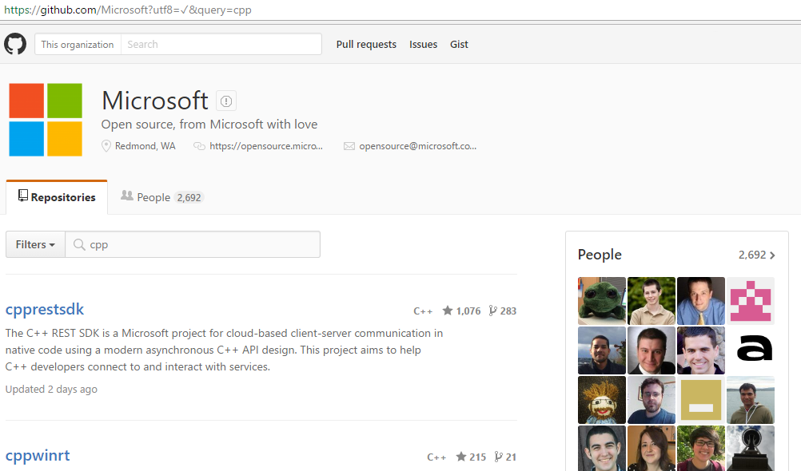
Evolução de Tecnologias: Microsoft

Slide 32
Internet: a rede mundial de computadores
Sockets
HTTP
NodeJS
REST API
.NET

Slide 33
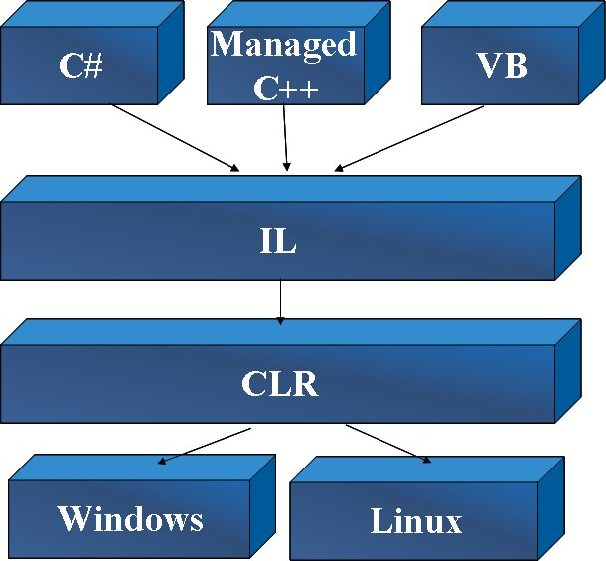
.NET != C++

Slide 34
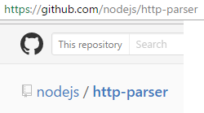
C++ > interNET
Sockets: Posix (Unix/Linux), WinSock, Boost ASIO (C++)
HTTP:
NodeJS:

Slide 35
C++ > interNET
Applications
Python
TypeScript
Protocols
Ruby
NodeJS
Sockets
REST API
Operating System
C++
Hardware

Slide 36
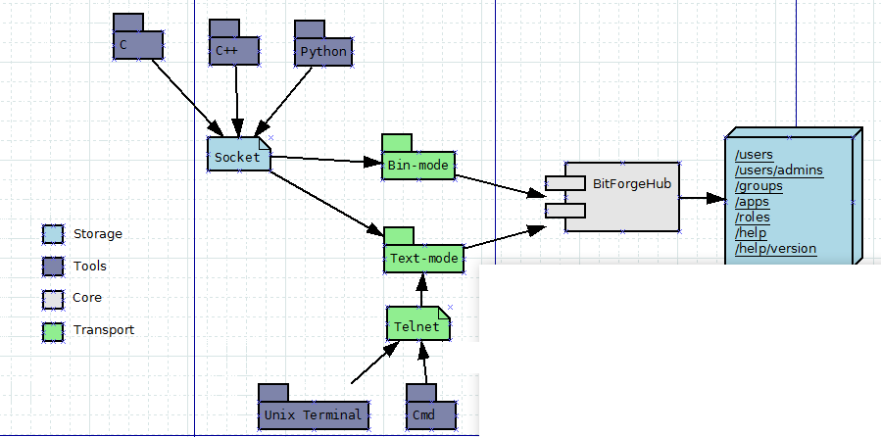
Use Case: tiodb

Slide 37
Dúvidas?
wanderley.caloni@bitforge.com.br
www.caloni.com.br

