Slide 1
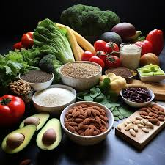
CalorieCalc
FRANCISCO BURGOS,
VALERY LOUIS,
TEGHPREET SINGH,
AFAQ WARIS

Slide 2
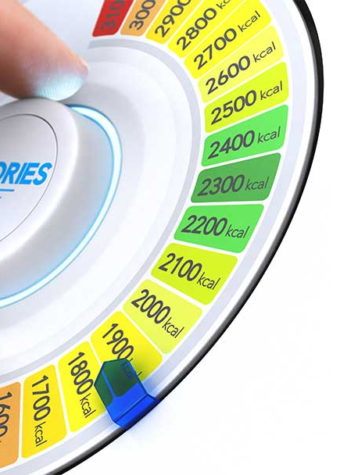
The Problem
In our hectic lives, it's easy to lose track of what we eat, making it challenging to maintain a balanced and healthy diet. Traditional calorie-counting methods can be tedious and often lead to abandoned health goals. This is where CalorieCalc steps in!

Slide 3
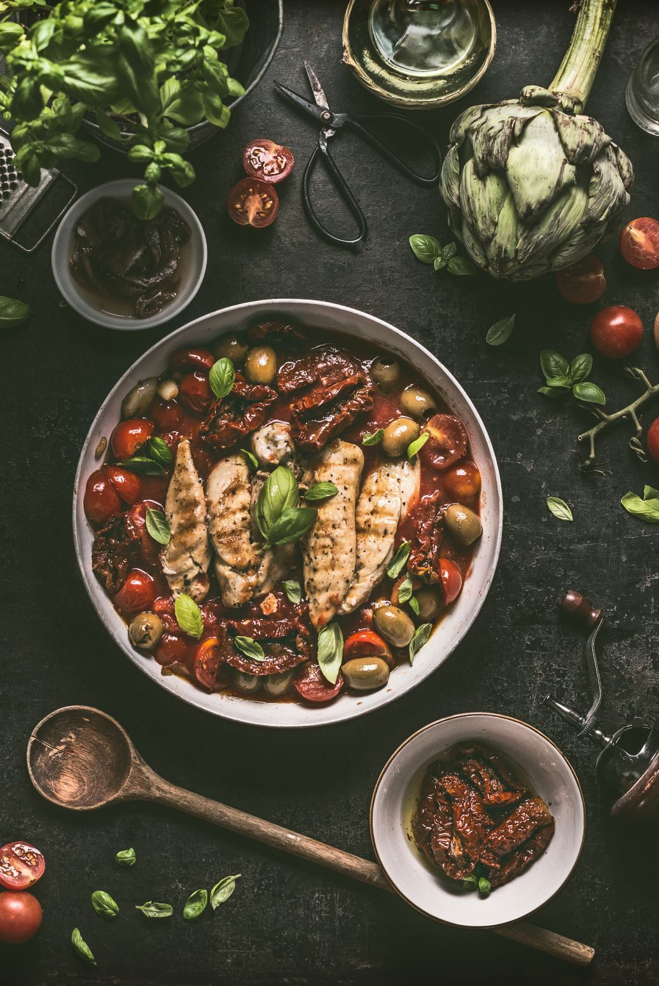
CalorieCalc!!
CalorieCalc is not just an app; it's your personal health companion. Imagine effortlessly logging your meals, receiving instant insights, and staying motivated on your health journey—all in one place!
Whether you're looking to maintain a healthy lifestyle, lose weight, or gain muscle, CalorieCalc provides real-time feedback on your calorie consumption, helping you stay on track with your nutrition goals.

Slide 4
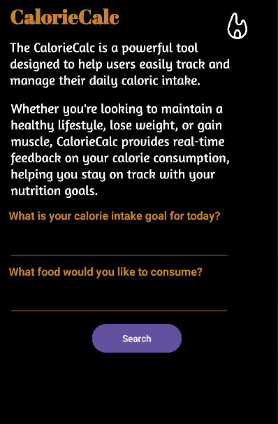
First Page: Main Page
First User Interaction has a brief description about CalorieCalc
User is asked ”What is your calorie intake goal for today?” The purpose of this feature is for the user to add as much food as he/she would like until his/her calorie intake goal is reached
User encounters another question, “What food would you like to consume” and is provided a section to type the desired food to search for it

Slide 5
Main Page:
Functionalities Implemented
Functionality implemented so user must enter a value in both EditText in order to proceed
Toast displays message to “Please enter values in both fields” if user did not enter a value in both fields
Functionality implemented so user is not able to change the calorie goal. The calorie goal value is set to user’s initial input and remains constant
Functionality implemented to take user’s calorie goal input in EditText, turns it into Text and then converts to Double

Slide 6
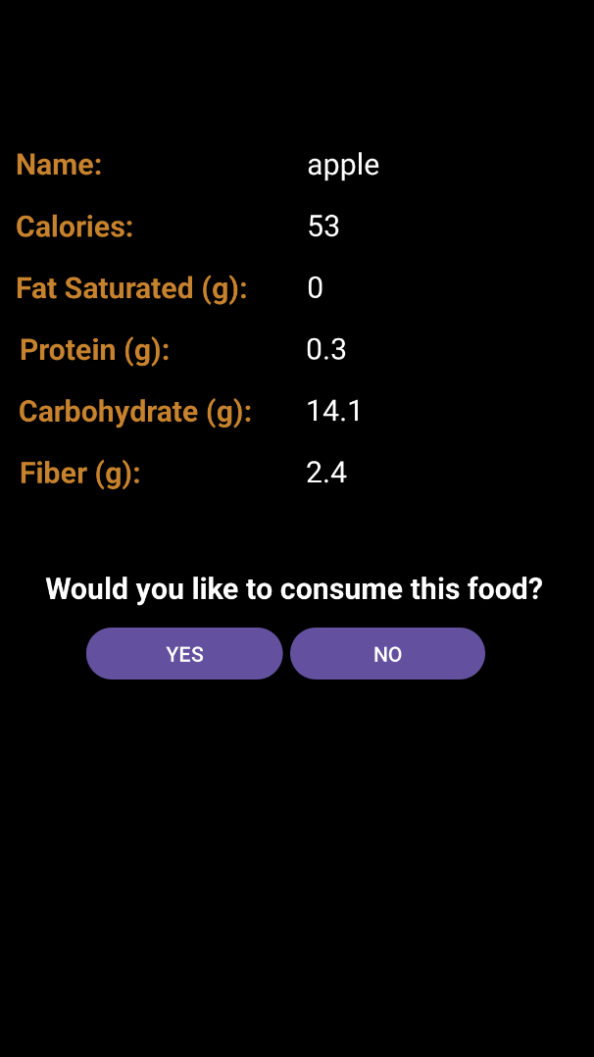
Second Page:
Displays Food Info
CalorieCalc takes user’s input to make API calls
Application fetches data from Nutrition API
Data fetched is displayed in a Fragment
User is asked ”Would you like to consume this food?” and provided two buttons to choose between“YES” or “NO”

Slide 7
Second Page:
Functionalities Implemented
If user clicks “YES”, food is added to RecyclerView and returns to Main Page so user can enter another food
Functionality implemented to keep calorie count as food is added
Functionality implemented for user to continue adding food until until reaching the calorie goal
Functionality implemented for Toast to display a message stating “Food can’t be added since the calorie goal has been reached” once the calorie goal is reached
If user clicks “NO”, application returns to Main Page

Slide 8
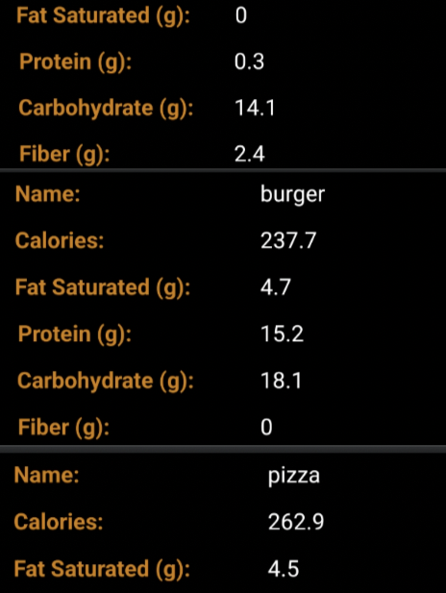
Thrid Page: Food List
Third Interaction depends on the user's answer to the question "Would you like to consume this food?"
If the user clicks “NO”, CalorieCalc takes user back to the main page, so he/she can search for another food item
If the user clicks “YES” button, the food is added to the RecyclerView first and then returns to the main page
The user will be able add food to the list until his/her calorie intake goal for the day is reached. Then, the recyclerview will display the list of the food chosen by the user.

Slide 9
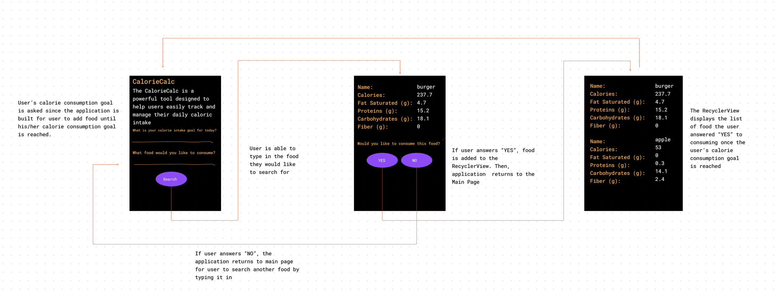

Slide 10
CalorieCalc Narrated Demo Video
Click link below:
CalorieCalc Narrated Demo Video - Watch Video

Slide 11
Next Steps: Enhancing CalorieCalc
User Authentication and Profiles:
Implement user authentication to create personalized profiles.
Allow users to set individualized calorie goals based on their health objectives.
Integration with Fitness Apps:
Collaborate with fitness apps or wearables to sync data seamlessly.
Community and Social Features:
Celebrate milestones and achievements to boost motivation.
Develop a visual representation of users' progress over time.
Progress and Achievement Tracking:
Provide a holistic view of both calorie intake and expenditure for a more accurate health analysis.
Create a community space for users to share tips, recipes, and success stories.
Incorporate social features for users to connect, compete, and support each other.

