Slide 1
pynga: A python package for the Next Generation Attenuation relations
Feng Wang
Oct. 12th, 2012

Slide 2
Package components
Python Classes
Returning:
Median
Inter-event standard deviation
Intra-event standard deviation
total standard deviation
Features:
Easy to install and less dependence on other packages
Capable to input updated coefficients and keep using the same model functionals
Capable of adding new NGA models
Build-in utilities to compute unknown parameters, such as Rjb, Rrup, and Rx based on fault geometry
Output results can be easily saved as Mat-style for further usages
AS08.py
Python utilities
utils.py
BA08.py
Python Package
pynga/
__init__.py
CB08.py
CY08.py
Validation & Application
SC08.py
Download:
The package is version-controlled at GitHub, so you can clone the package using "git clone"
git clone git@github.com:fengw/pynga.git

Slide 3
Validation of NGA models
Compare median and total standard deviation with those calculated using OpenSHA
Results are presented in
https://github.com/fengw/pynga/tree/master/Validation/plots/ValidationNGAs
RMS is within 0.02% for PGA, PGV, and SA at various periods
Differences in scatter are due to the float points in the results, and pynga has longer float points.

Slide 4
Distance calculations
UCERF-type fault geometry
Basic inputs:
1.Surface projection of top rupture edges
(single and/or multiple fault traces, long/lat)
2.Average upper seismogenic depth (km)
3.Average lower seismogenic depth (km)
4.Average dip angle (degree)
utils.py provides functions to generate fault surface and discretize the surface by specifying down-dip and along-strike grid spaces, and then to compute distance parameters (Rjb, Rrup, Rx) given site location.

Slide 5
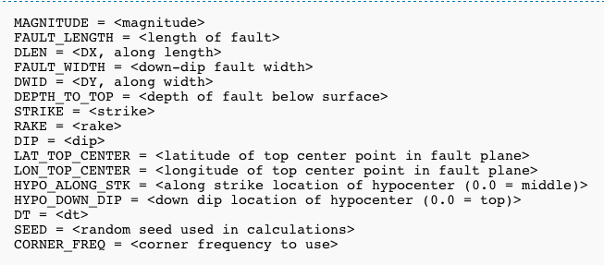
BBP-type fault geometry
A simple source description shown in *.src file
For more complicated source descriptions (in *.srf, discretized points are explicitly presented on the fault plane, just like rupture variations used in CyberShake which are similar to *.srf)
utils.py provides functions to generate fault surface (different choices) and discretize the surface by specifying down-dip and along-strike grid spaces, and then to compute distance parameters (Rjb, Rrup, Rx) given site location.

Slide 6
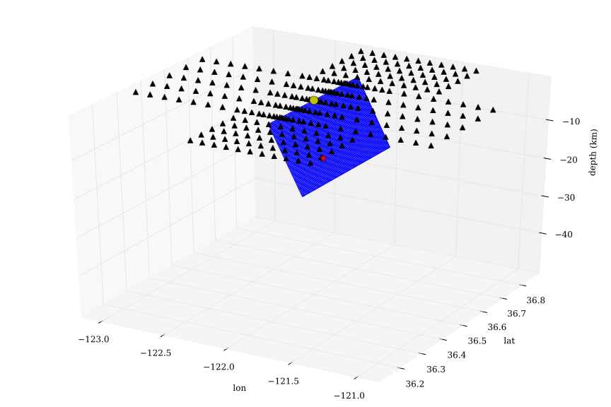
Examples
BBP-type fault geometry
A simple source
from Fling
study

Slide 7
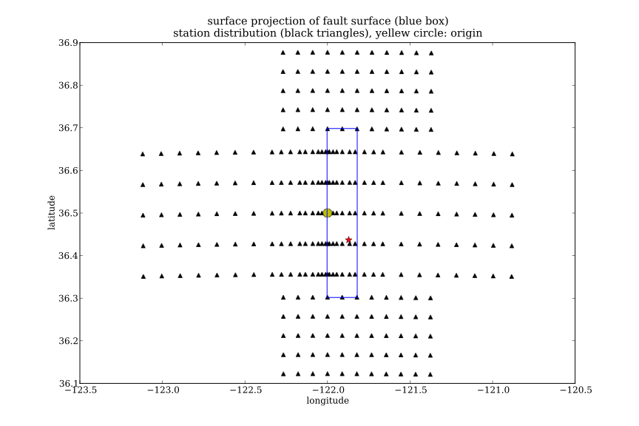
Examples

Slide 8
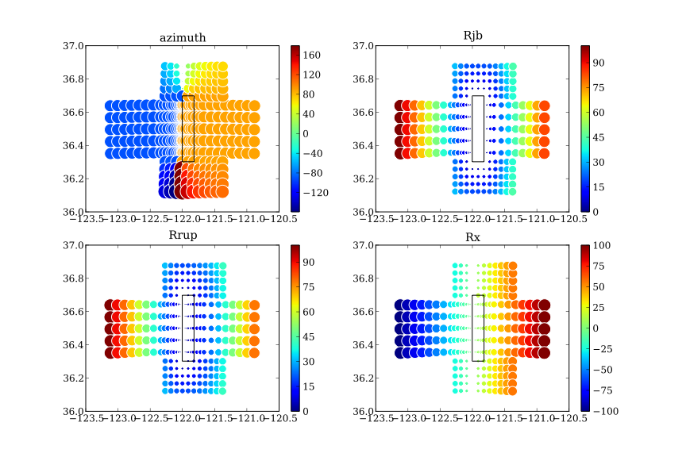
Examples

Slide 9
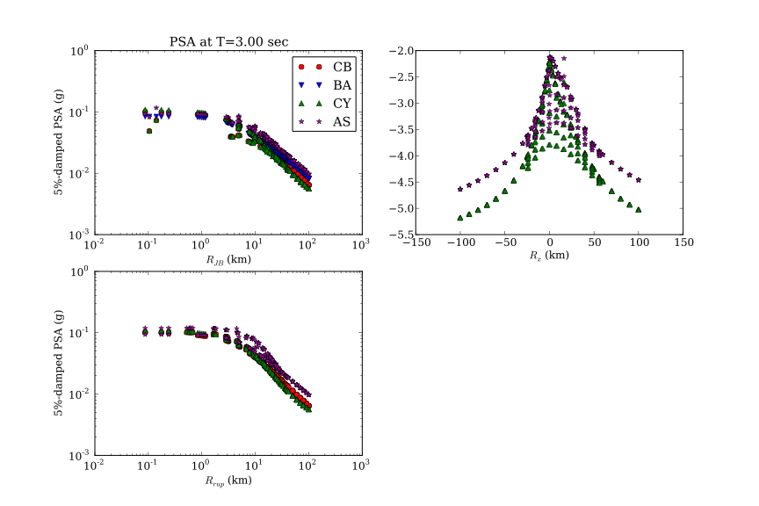
Examples

Slide 10
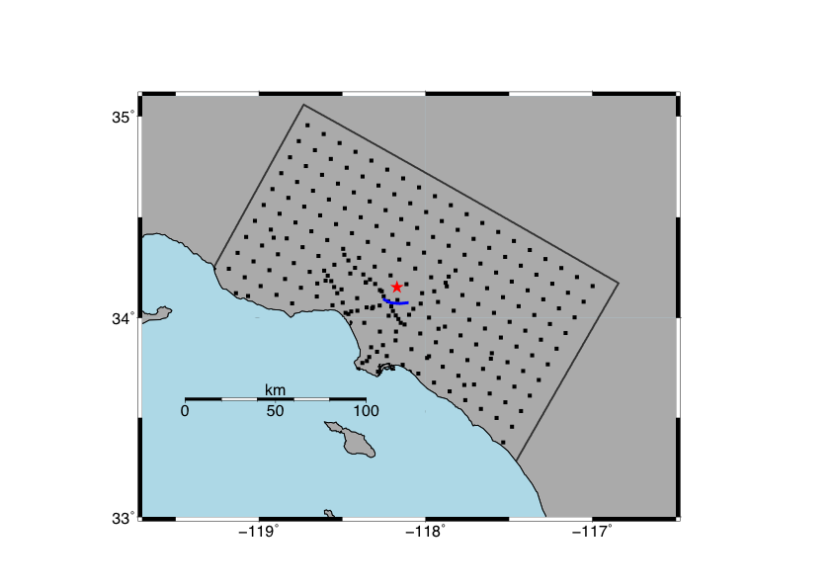
Examples
SRF-type fault geometry
Site locations (black square) and fault surface trace (blue line)

Slide 11
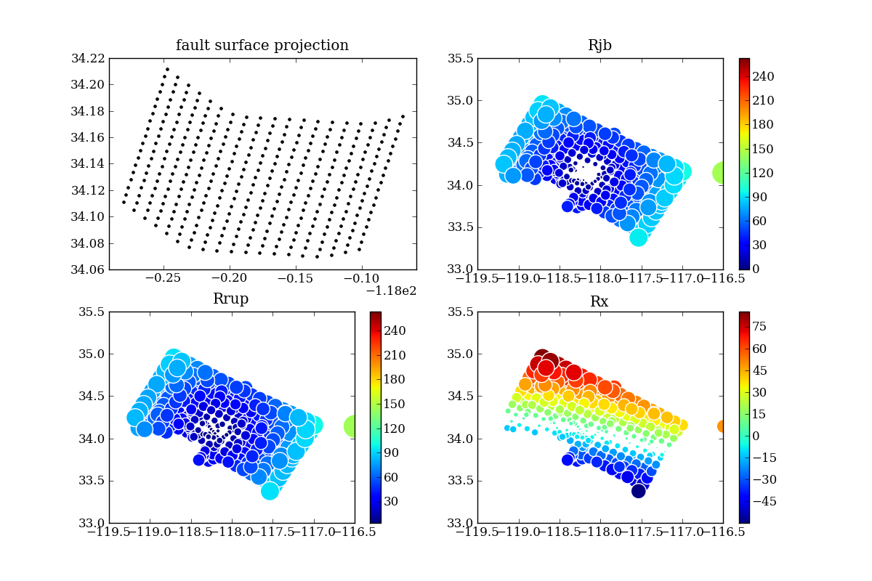
Examples
SRF-type fault geometry
Calcluated by OpenSHA
Elysian Park (Upper)

Slide 12

Examples
SRF-type fault geometry
Calcluated by utils.py in pynga

Slide 13
