Slide 1
Wavgen.py: part of COO’s waveform definition language (WDL)
Peter Mao

Slide 2
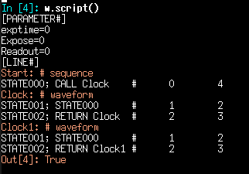
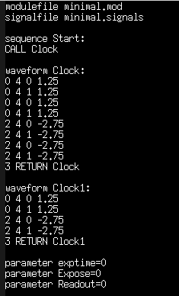
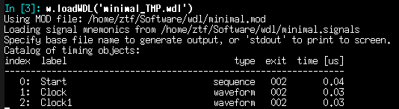
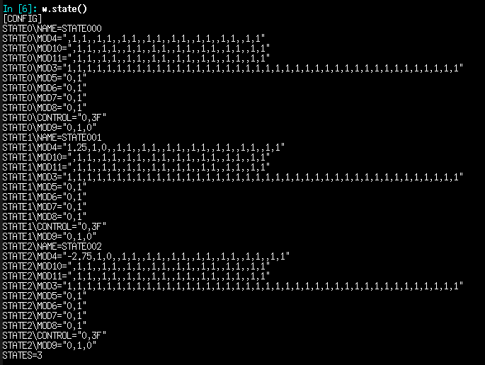
Wavgen.py converts waveforms defined by (time, board, channel, value) tuples into states and calls.
file_TMP.wdl
Given the timing information, wavgen determines the minimum set of machine states and the ACF script with which to call the states.
Sequences, which call waveforms or other sequences are also parsed.
For reasons lost to time, ACF parameters are also carried along.
The output of wavgen is ALMOST ACF-ready, with only the enumeration of tags missing.

Slide 3
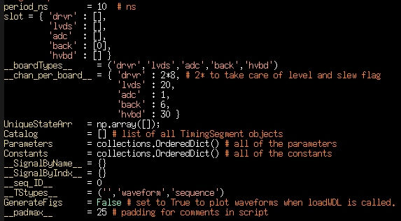
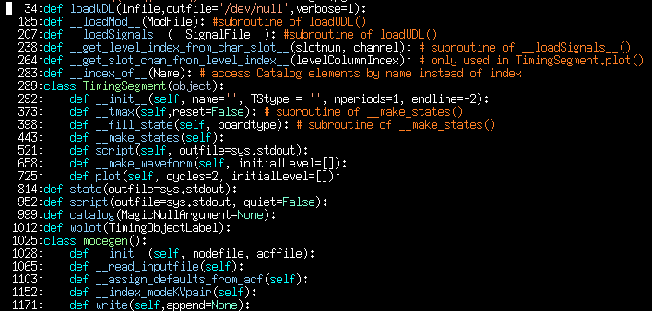
Global variables and “def” and “class” definitions in wavgen.py.
A user only needs to know how to call loadWDL().
The important global variables are UniqueStateArr and Catalog
UniqueStateArr is an (# states)x(# channels) array, where each row is a unique state that the controller takes on.
Catalog is a python list of TimingSegment objects
After a TimingSegment is initialized (for example, as TS), and its events are defined, a call to TS.script() or TS.plot() generates an internal call to TS.__make_states(), which determines unique controller states and adds them to UniqueStateArr.
After all TimingSegments are defined, the functions state() and script() are used to generate the proto-ACF texts.

Slide 4
loadWDL(infile.wdl)
Comment, blank or .mod file
Get .mod file from infile.wdl to fill slot (arrangement of boards in controller)
Read in infile.wdl line-by-line
Signals filename
Store signal filename
Parameters or Constants
Store name and value in corresponding variable
EOF
Continued on next page
SEQUENCE or WAVEFORM
Initialize a TimingSegment and set TStype (local var) to ”sequence” or “waveform”
Sequence or waveform body line (all other lines)
Python command?
no
TStype = “waveform”
yes
Time <string>
Store python call in user commands (local var)
Time,board,chan,value
Store time in thisTS.nperiods
TStype = “sequence”
Store sequence call in thisTS.sequenceDef
Store (time,value) in thisTS.events[board][chan]

Slide 5
loadWDL(infile.wdl)
EOF
Output may be /dev/null, stdout,
or a user-specified file
Load information from the SignalFile [relates (board,chan) pairs to human-readable names]
Print catalog info to stdout with wavgen.catalog()
Call wavgen.script()
Call wavgen.state()
Run user-specified python commands from usercommands
Generate figures

Slide 6
UniqueStateArr
UniqueStateArr
driver DAC
driver DAC
DAC
000 | 0 | 0 | 0 | 0 | 0 | 0 | 0 | 0 | 0 | 0
001 | 1 | 1 | 0 | 1 | 0 | 0 | 0 | 0 | 2.3 | 1
002 | 0 | 1 | 1 | 1 | 0 | 0 | 0 | 0 | 0 | 1
003
004
005
006
etc
2D array of floats (# states) x (2 x # channels)
For everything EXCEPT the DRIVER board, each DAC channel is represented by 2 columns of the USA.
Even columns represent DAC values
The +1 odd column represents the change flag
For the DRIVER board, each DAC channel is represented by 4 columns of the USA:
(mod 4) = 0 columns represent the DAC value
The +1 and +3 odd columns represent the change flag
The +2 even column represents the FAST/SLOW flag
STA Archon driver boards have 8 DACs – in wavgen, they are represented as having 16 channels, with the even channels being DACS and the +1 odd channels being the corresponding FAST/SLOW flags.
Most of the work of filling the USA happens in TimingSegment.__make_states().
State000, the top row of the USA is the “do nothing” state.
value
value
value
“fast” flag
“fast” flag
change flag
change flag
change flag
change flag
change flag
The information here is duplicated for ease of programming.

Slide 7
class TimingSegment
Variables:
Defined in self.__init__():
endline: integer indicating what to do at the end of this TimingSegment
label: integer index location of this TimingSegment in Catalog. defined to be the current value of the global variable __seq_ID__
name: This is unique in the Catalog. wavgen will overwrite Catalog entries without complaining.
tstype: ‘’, ‘sequence’ or ‘waveform’
nperiods: # clock cycles assuming every call is one clock cycle.
sequenceDef: sequence events (t, call). Filled by loadWDL.
events: waveform events (t,board,chan,value). Filled by loadWDL.
Consts: empty placeholder.
Defined in self.__make_states():
do_anything_tt: integer time when any event happens, including the start of the TimingSegment.
do_anything_dt: diff of do_anything_tt with a 0 at the end (zero time between the end of the TimingSegment and the end of the TimingSegment.)
unique_state_ID: 1xnperiods sparse array specifying the state of the system at every time point.
sequence_times: (for sequences) 1x#calls array indicating times at which call are made.
Defined in self.script():
time: # clock cycles to complete this TimingSegment.
Params: Dict of params and values. Used to track decrementing counters for time calculations and plotting
ExitState: Initialized to state000 in __init__(), set to the last state called in waveform or sequence.
ExitLevel: Initialized to state000’s levels in __init__(), set to the levels defined after two passes through the TimingSegment.

Slide 8
class TimingSegment
Methods:
__init__(self, name='', TStype = '', nperiods=1, endline=-2):
__tmax(self,reset=False): # subroutine of __make_states()
__fill_state(self, boardtype): # subroutine of __make_states()
__make_states(self):
script(self, outfile=sys.stdout):
generates the script
(if necessary) calls __make_states() to populate the UniqueStateArr
__make_waveform(self, initialLevel=[]):
plot(self, cycles=2, initialLevel=[]):
generates waveform plots using __make_waveform()
(if necessary) calls __make_states() to populate the UniqueStateArr

