Slide 1
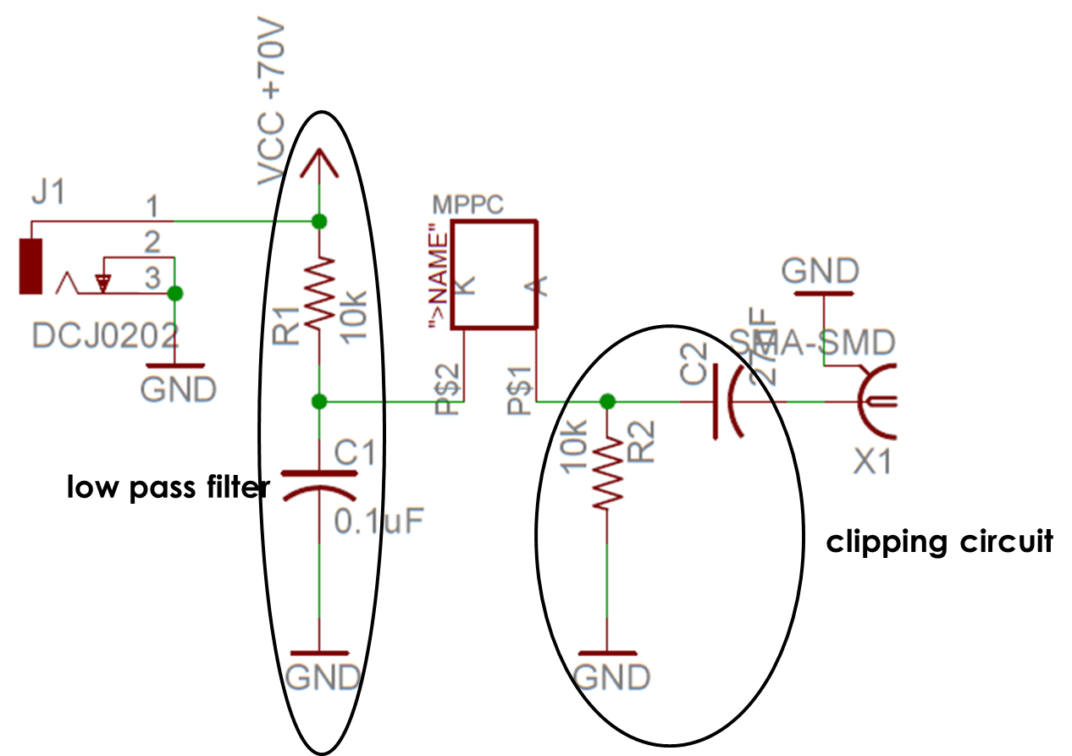
low-pass filter
high-pass filter

