Slide 1
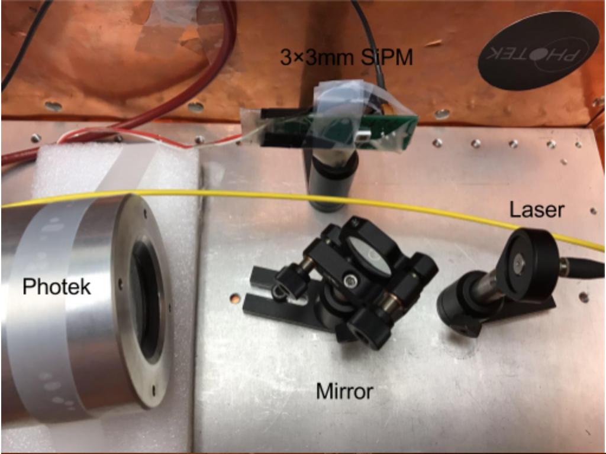
SiPM
Laser Fiber
Photek 240
MCP-PMT
Beam Splitter

