Slide 1
SH TB Setup

Slide 2
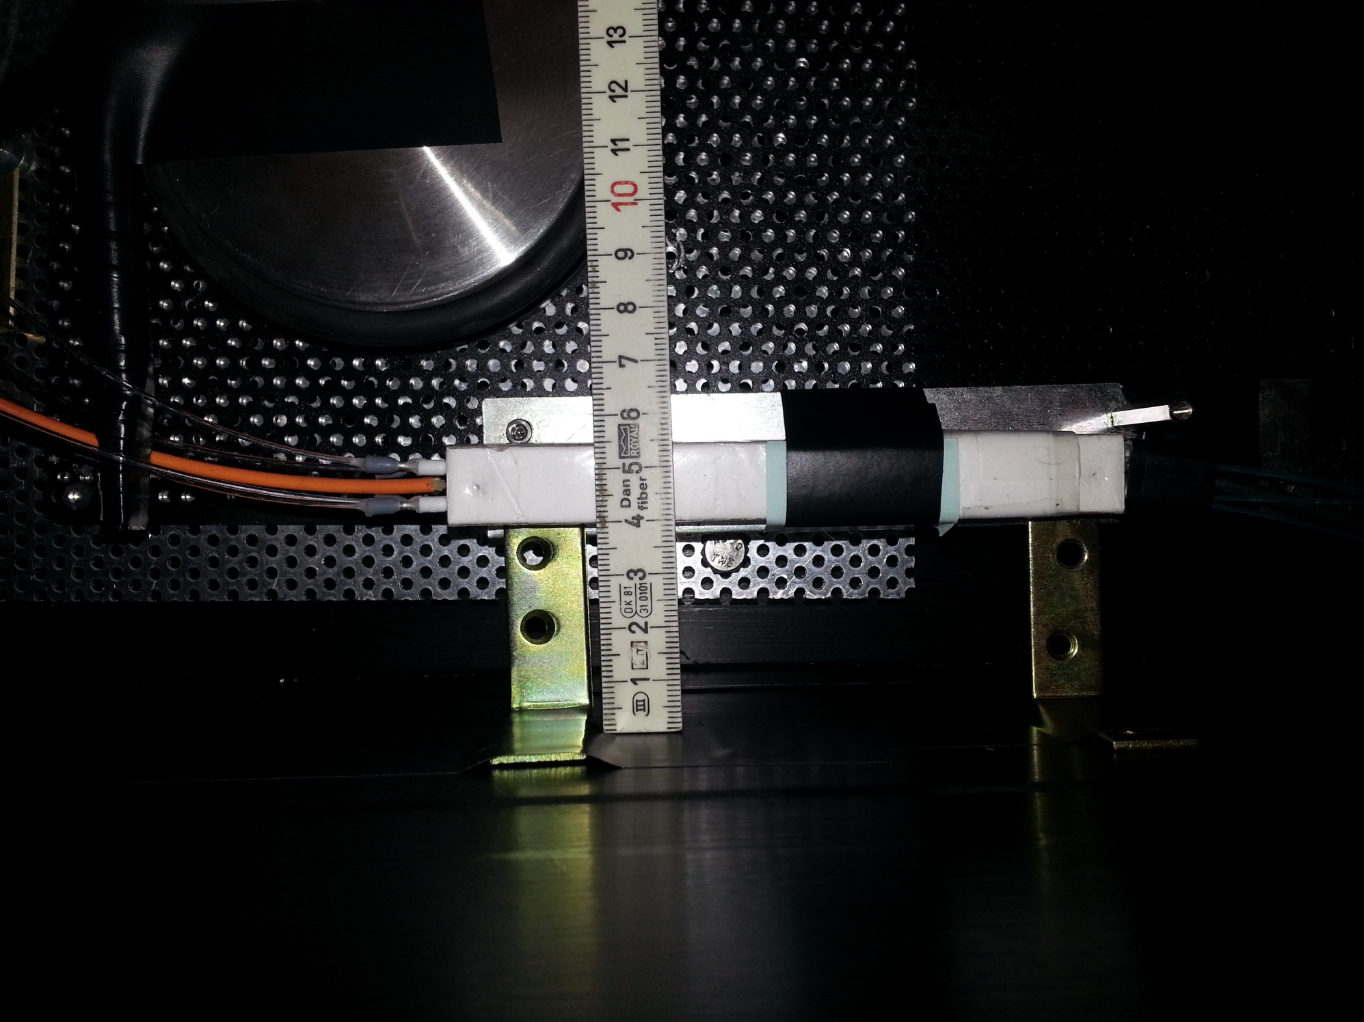
Trigger counter
Capillary to clear fiber coupling
LYSO/W SH cell with capillary readout
Beam
Clear fiber to SiPM
Laser light injection (orange)

Slide 3
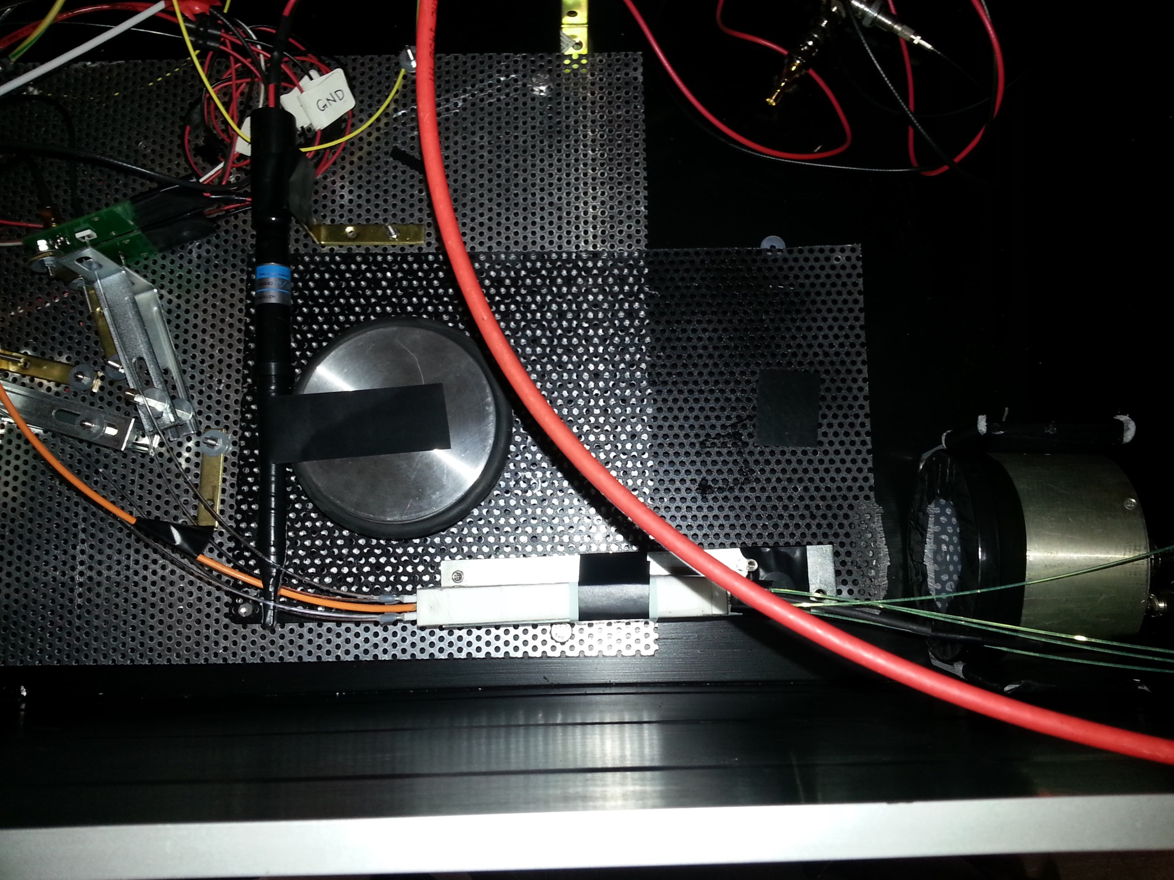
Clear fiber to SiPM coupling
Trigger counter
MCP Reference
Capillary to clear fiber coupling
LYSO/W SH cell with capillary/WLS fiber readout
Beam
Clear fiber to SiPM
Laser light injection (orange)

