Slide 1
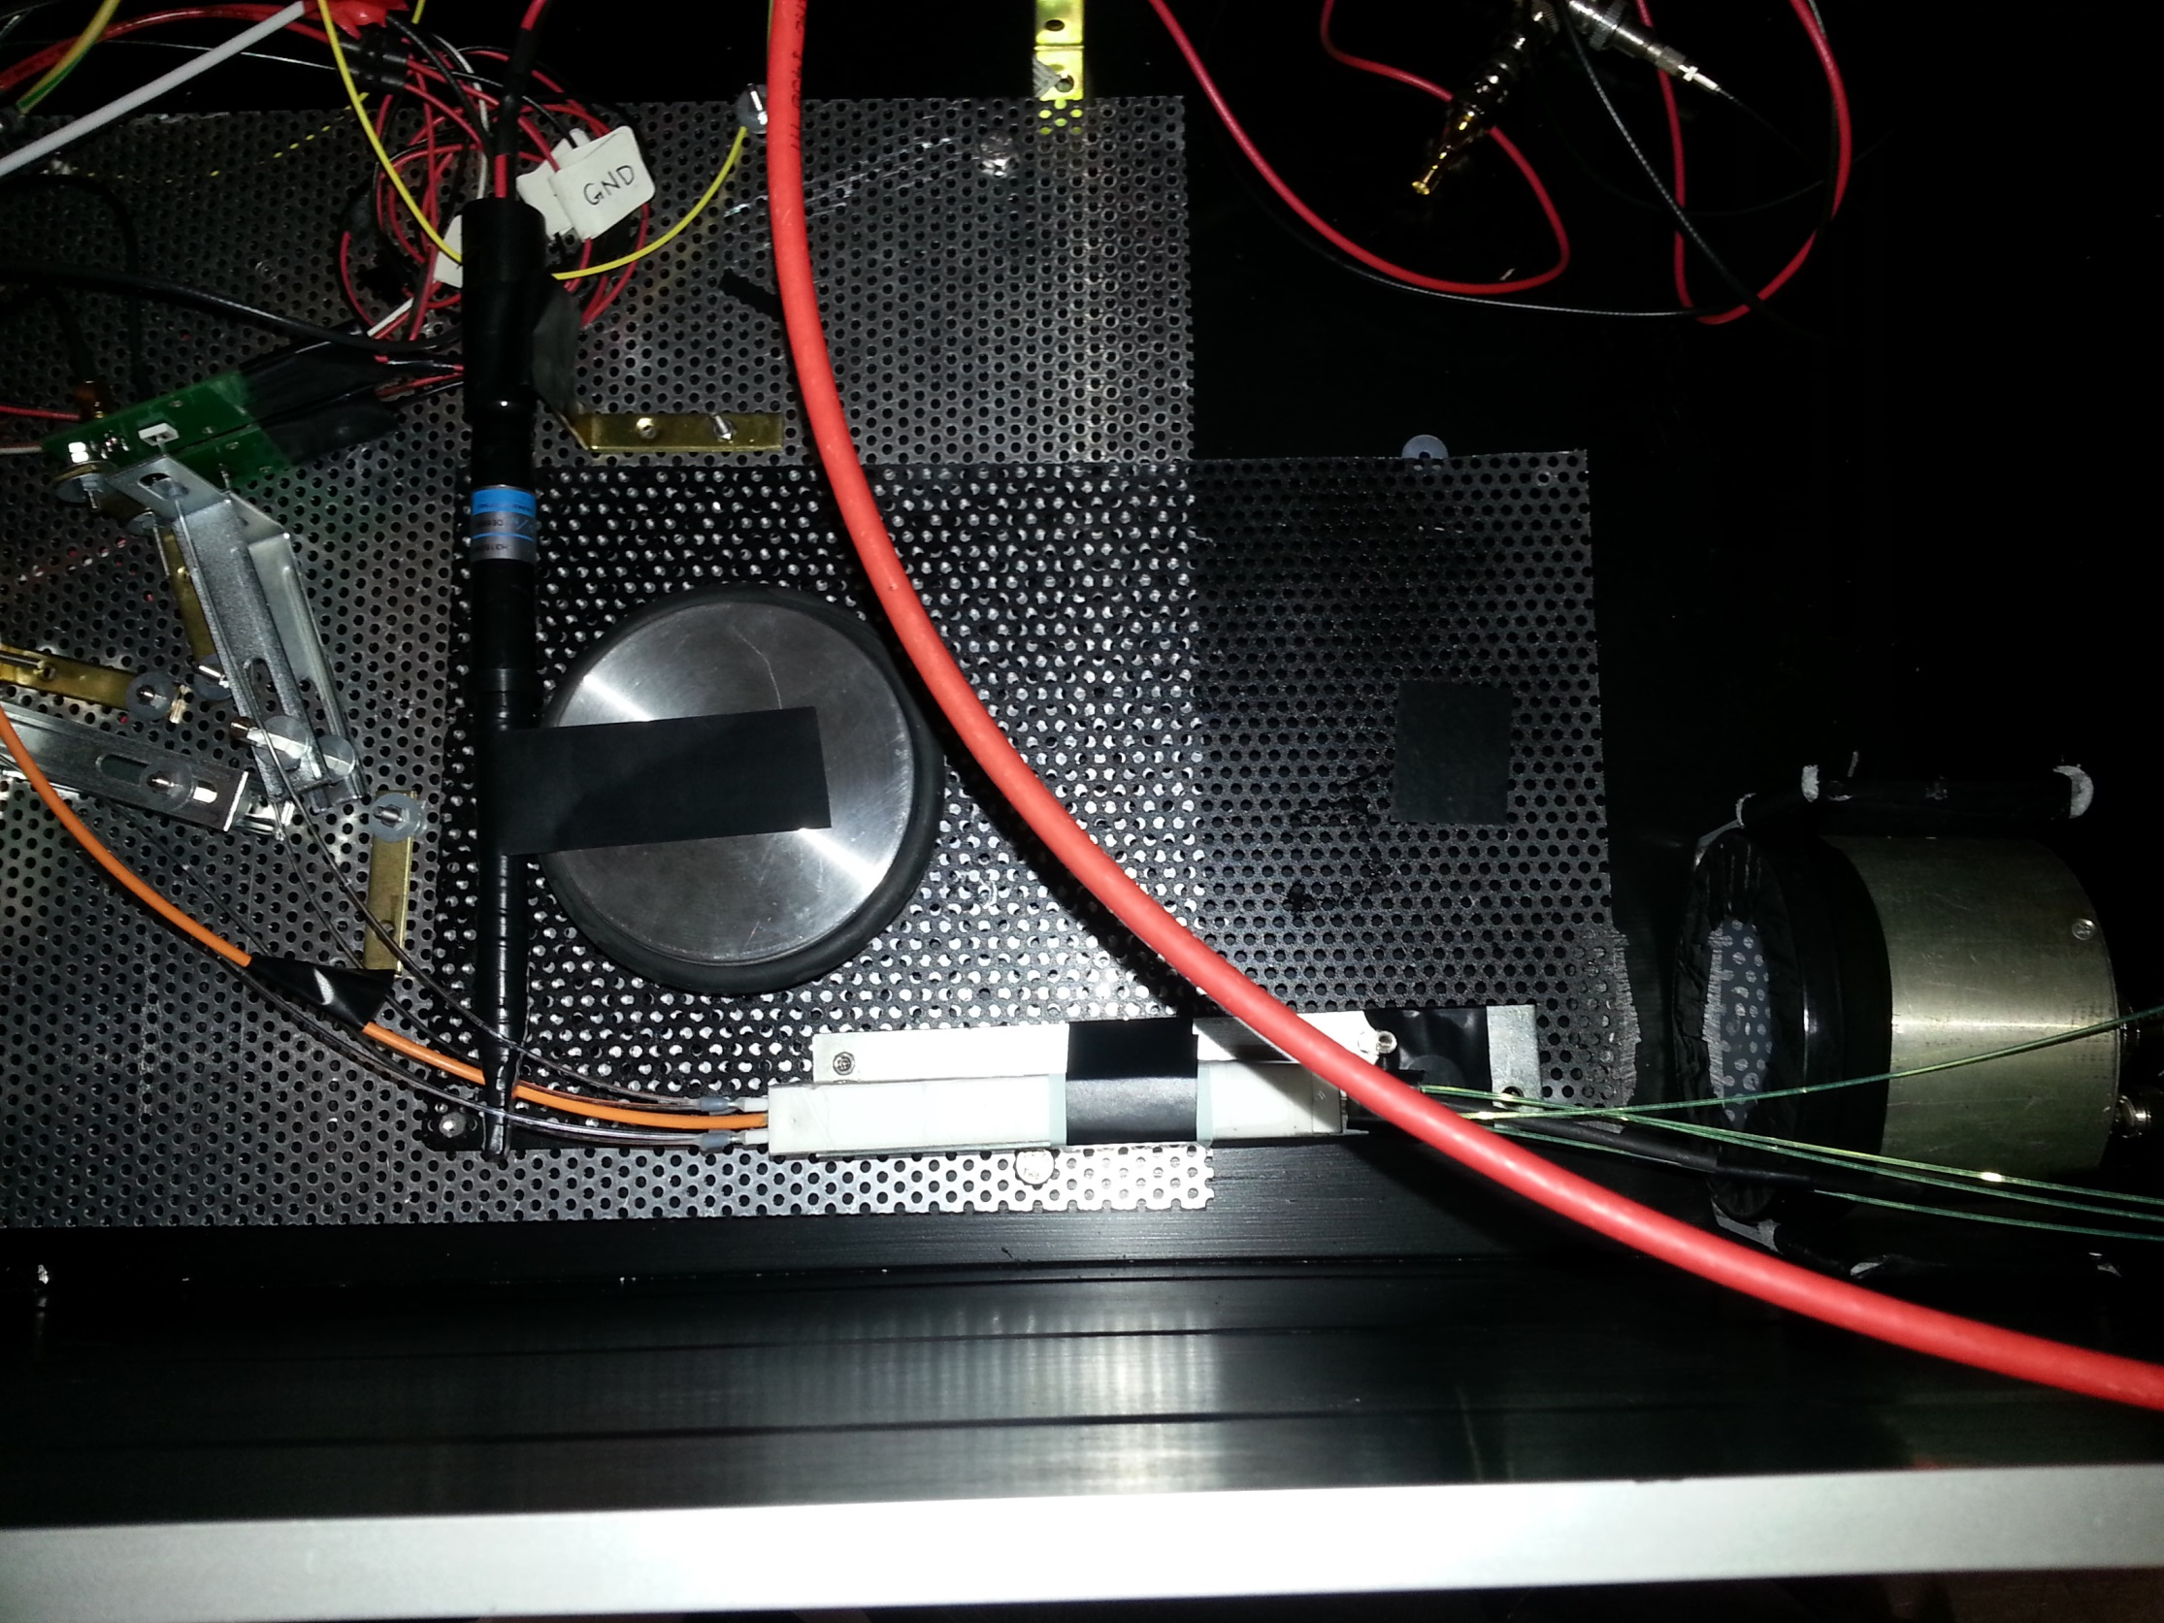
Clear fiber to SiPM coupling
Trigger counter
MCP Reference
Capillary to clear fiber coupling
LYSO/W SH cell with capillary/WLS fiber readout
Beam
Clear fiber to SiPM

