Slide 1
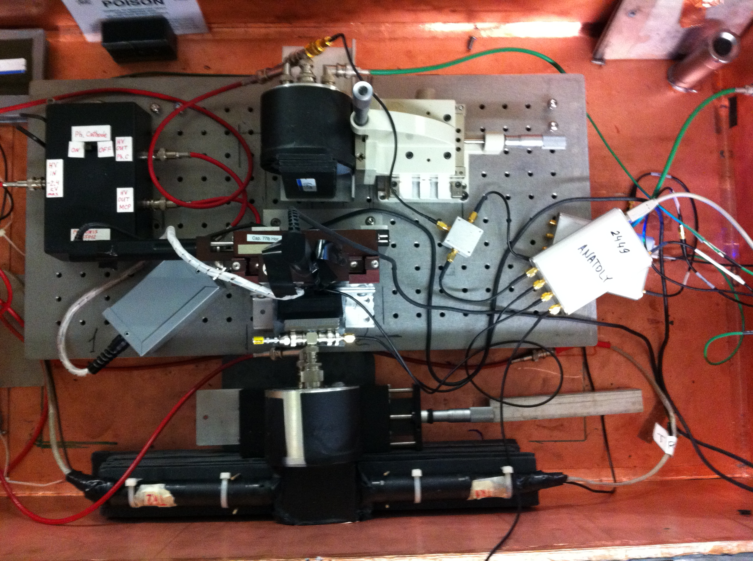
Back Photek 240 MCP-PMT
X-Y Stage
Tungsten Absorber
Photonis 85012
Reference Photek 240 MCP-PMT
2x2 mm² Trigger

