Slide 1
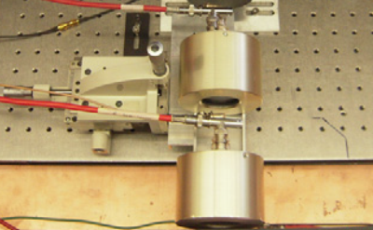
Stop Counter 240 MCP-PMT
Start Counter 240 MCP-PMT

