Slide 1
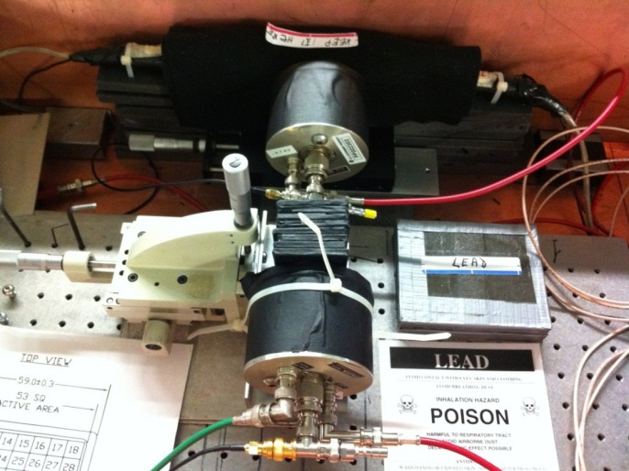
2x2 mm² Trigger
Start Counter Photek 240 MCP-PMT
Stop Counter Photek 240 MCP-PMT
Lead or Tungsten Absorber

