Slide 1
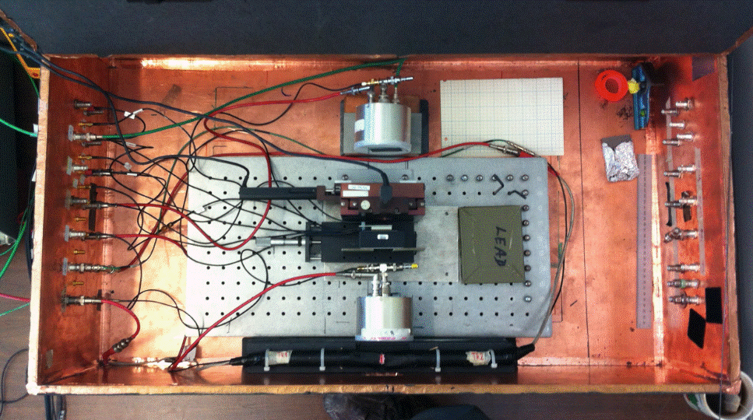
X-Y Stage
Photonis 85012
Reference Photek 240 MCP-PMT
2x2 mm² Trigger

