Slide 1
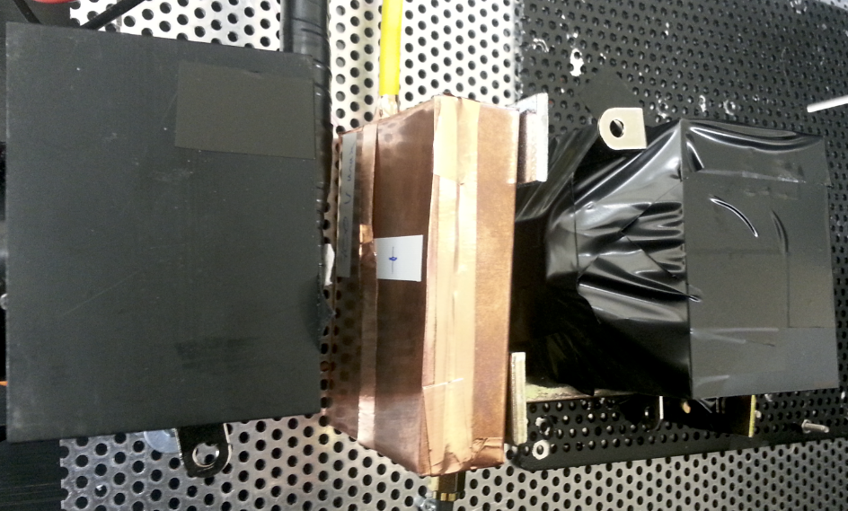
CdTe Sensor
Enclosure
MCP-PMT Optically Coupled to LYSO Cube
MCP-PMT
Reference Time
Detector

