Slide 1
Investigation and Analysis of Phenomena in the Far-Infrared Region
VIVA Presentation
Calum Towler, MChem

Slide 2
Project Aims
To improve the interpretation of THz-TD spectra of crystalline materials, particularly at room temperature.
Particularly to focus on αLM which is a common THz standard
Construct a compact THz-TDS ATR system using LT-GaAs emitters.

Slide 3
Project Aims
My focus switched to improving the correlation between experimental and calculated spectra and understanding the underlying phenomena.
This was primarily with organic crystals, specifically αLM, but investigations into other types of systems were attempted.
Additionally, owing to the constraints on the new THz-TDS system, the gap-sizes of PC emitters were optimised for lower laser powers.

Slide 4
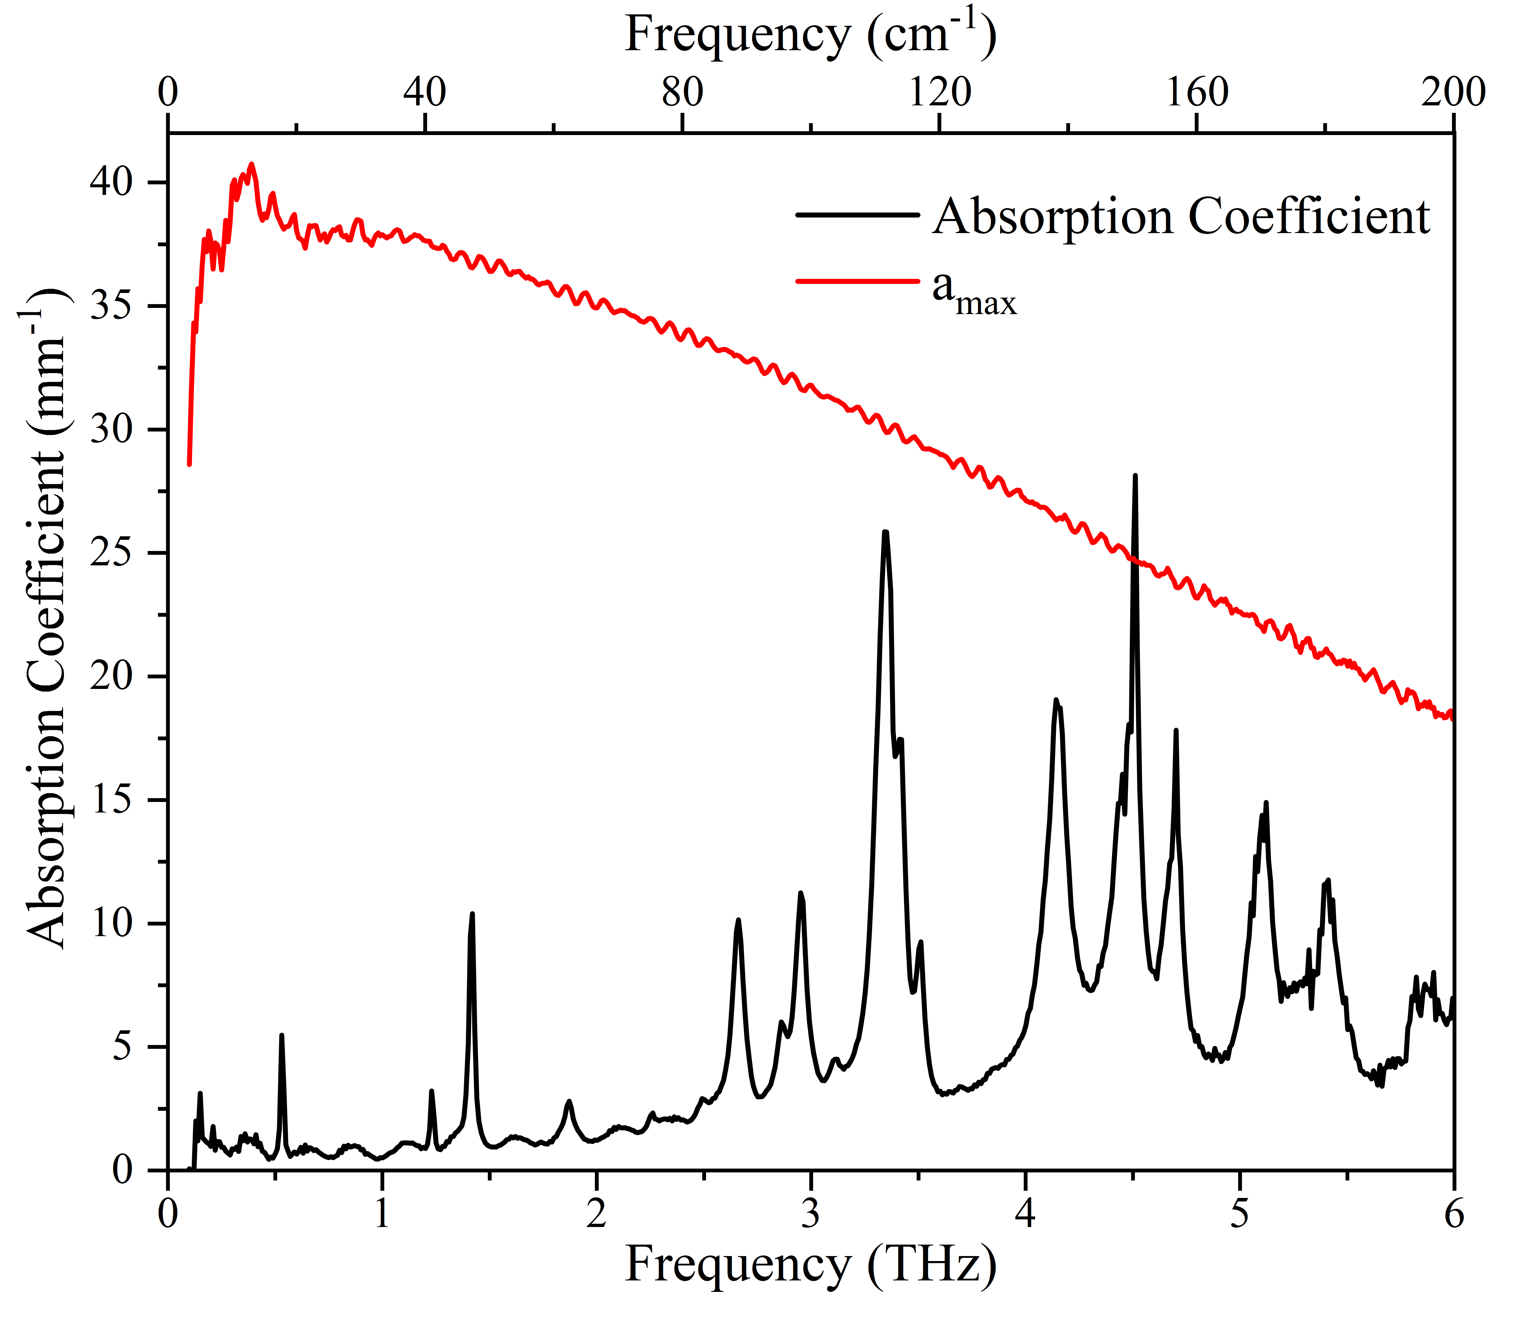
α-Lactose Monohydrate
αLM was focused on in this work because of its sharp peak at 0.52 GHz.
This peak does not shift with temperature which is unusual for phonon modes.
4 simple reasons why this is a good standard

Slide 5
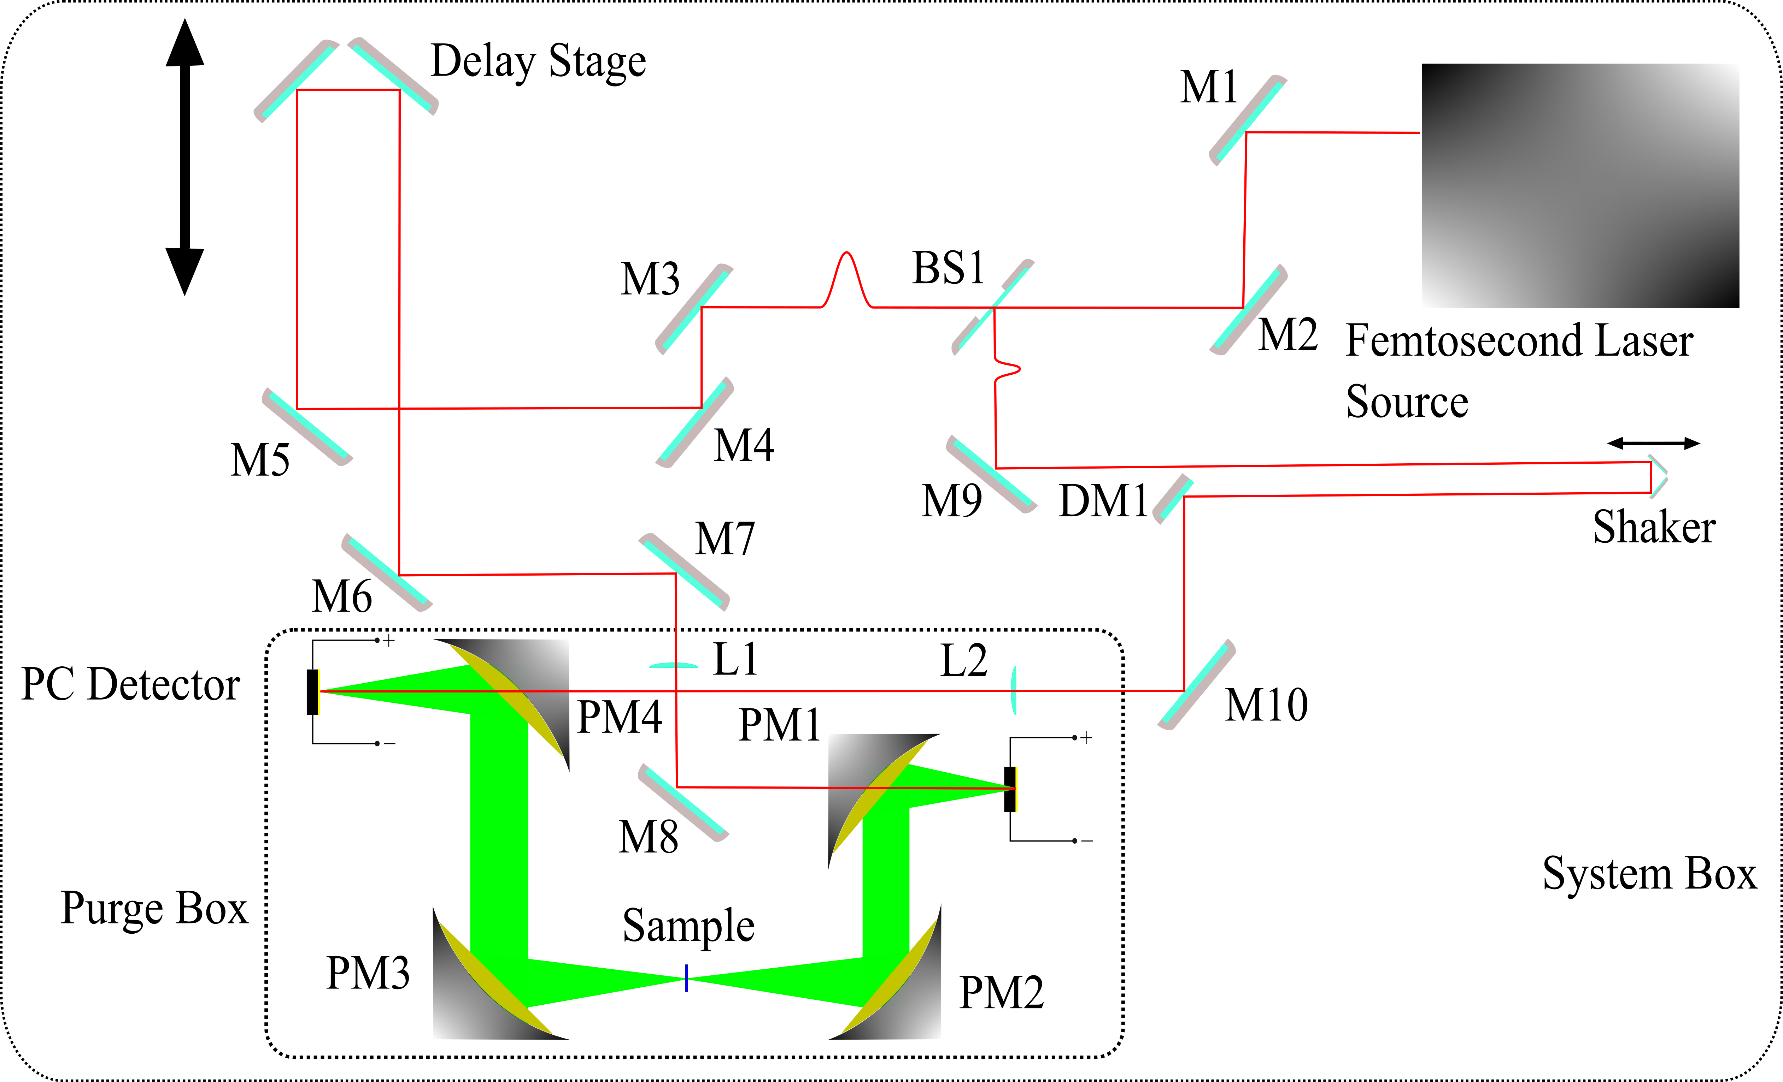
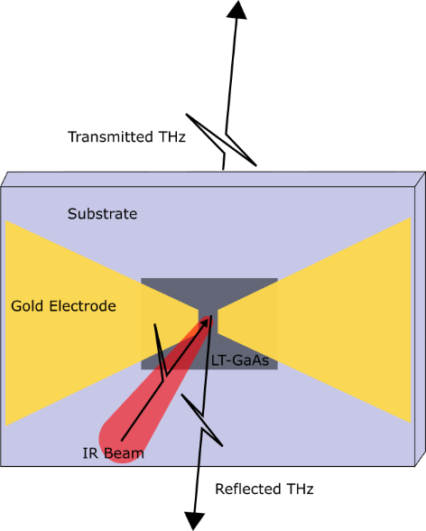
Experimental Methods
THz-TDS was performed on two systems.
Primarily using PC antennas but EO crystals were also used.
Room-temperature and low-temperature measurements were performed.
PC antennas with gap sizes of 5, 10, 20 and 40 µm were tested using varying incident laser powers.

Slide 6
Computational Methods
DFT (VASP) was used throughout to calculate the phonon modes.
PDielec was used to construct a THz absorption spectrum from the DFT calculation to compare with experiment.
An investigation into dispersion corrections, which account for non-local bonding, was undertaken as these are vital for systems such as αLM.
The Quasi-Harmonic Approximation was used to calculate the thermal properties of αLM, which were used to calculate a room-temperature THz absorption spectrum.

Slide 7
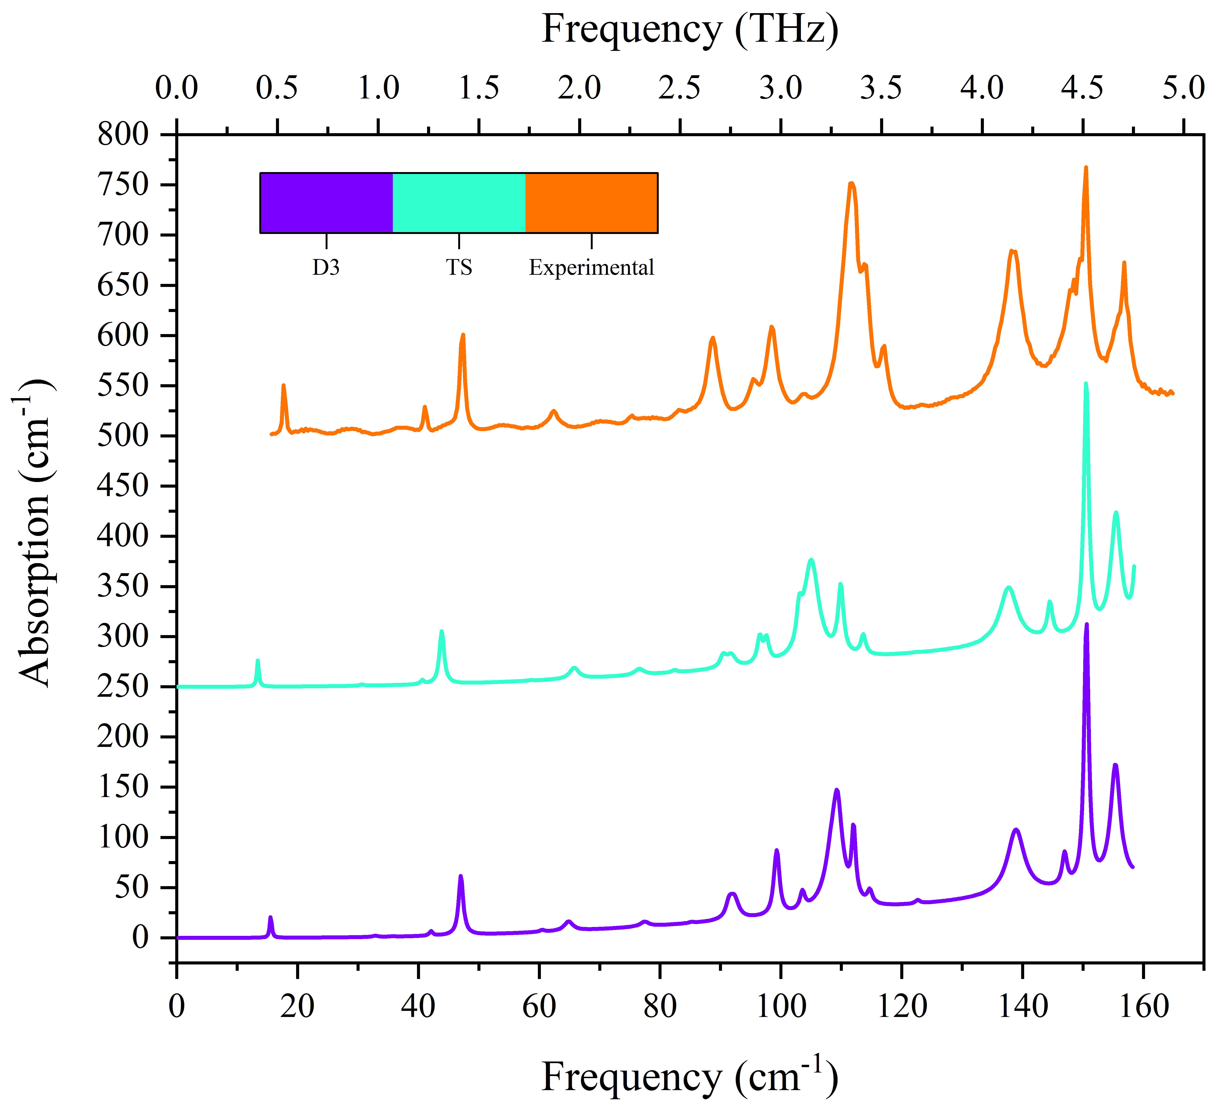
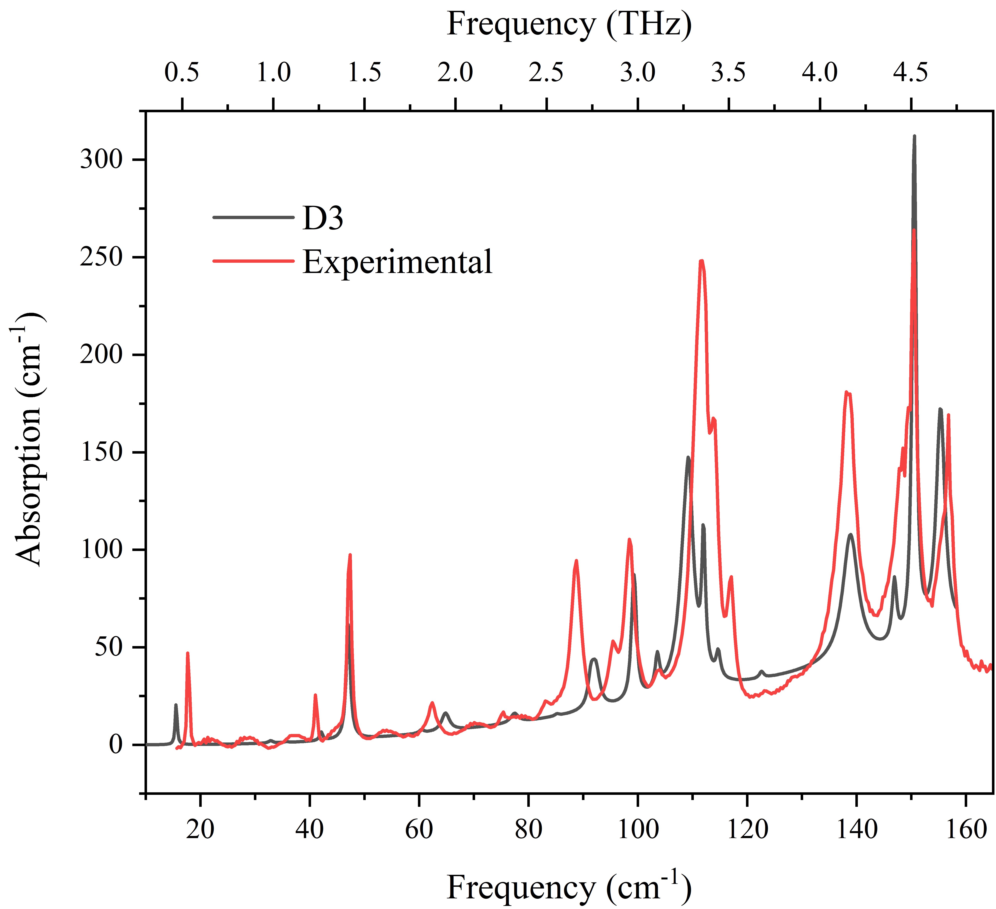
Key Results – Dispersion Corrections
A number of dispersion corrections were tested.
Comparing spectra is hard
Explored a number of ways to systematically compare experiment and calculation
Using PDielec, the calculated spectra with the highest correlation and lowest RMS error when compared to experiment was the D3 correction.

Slide 9
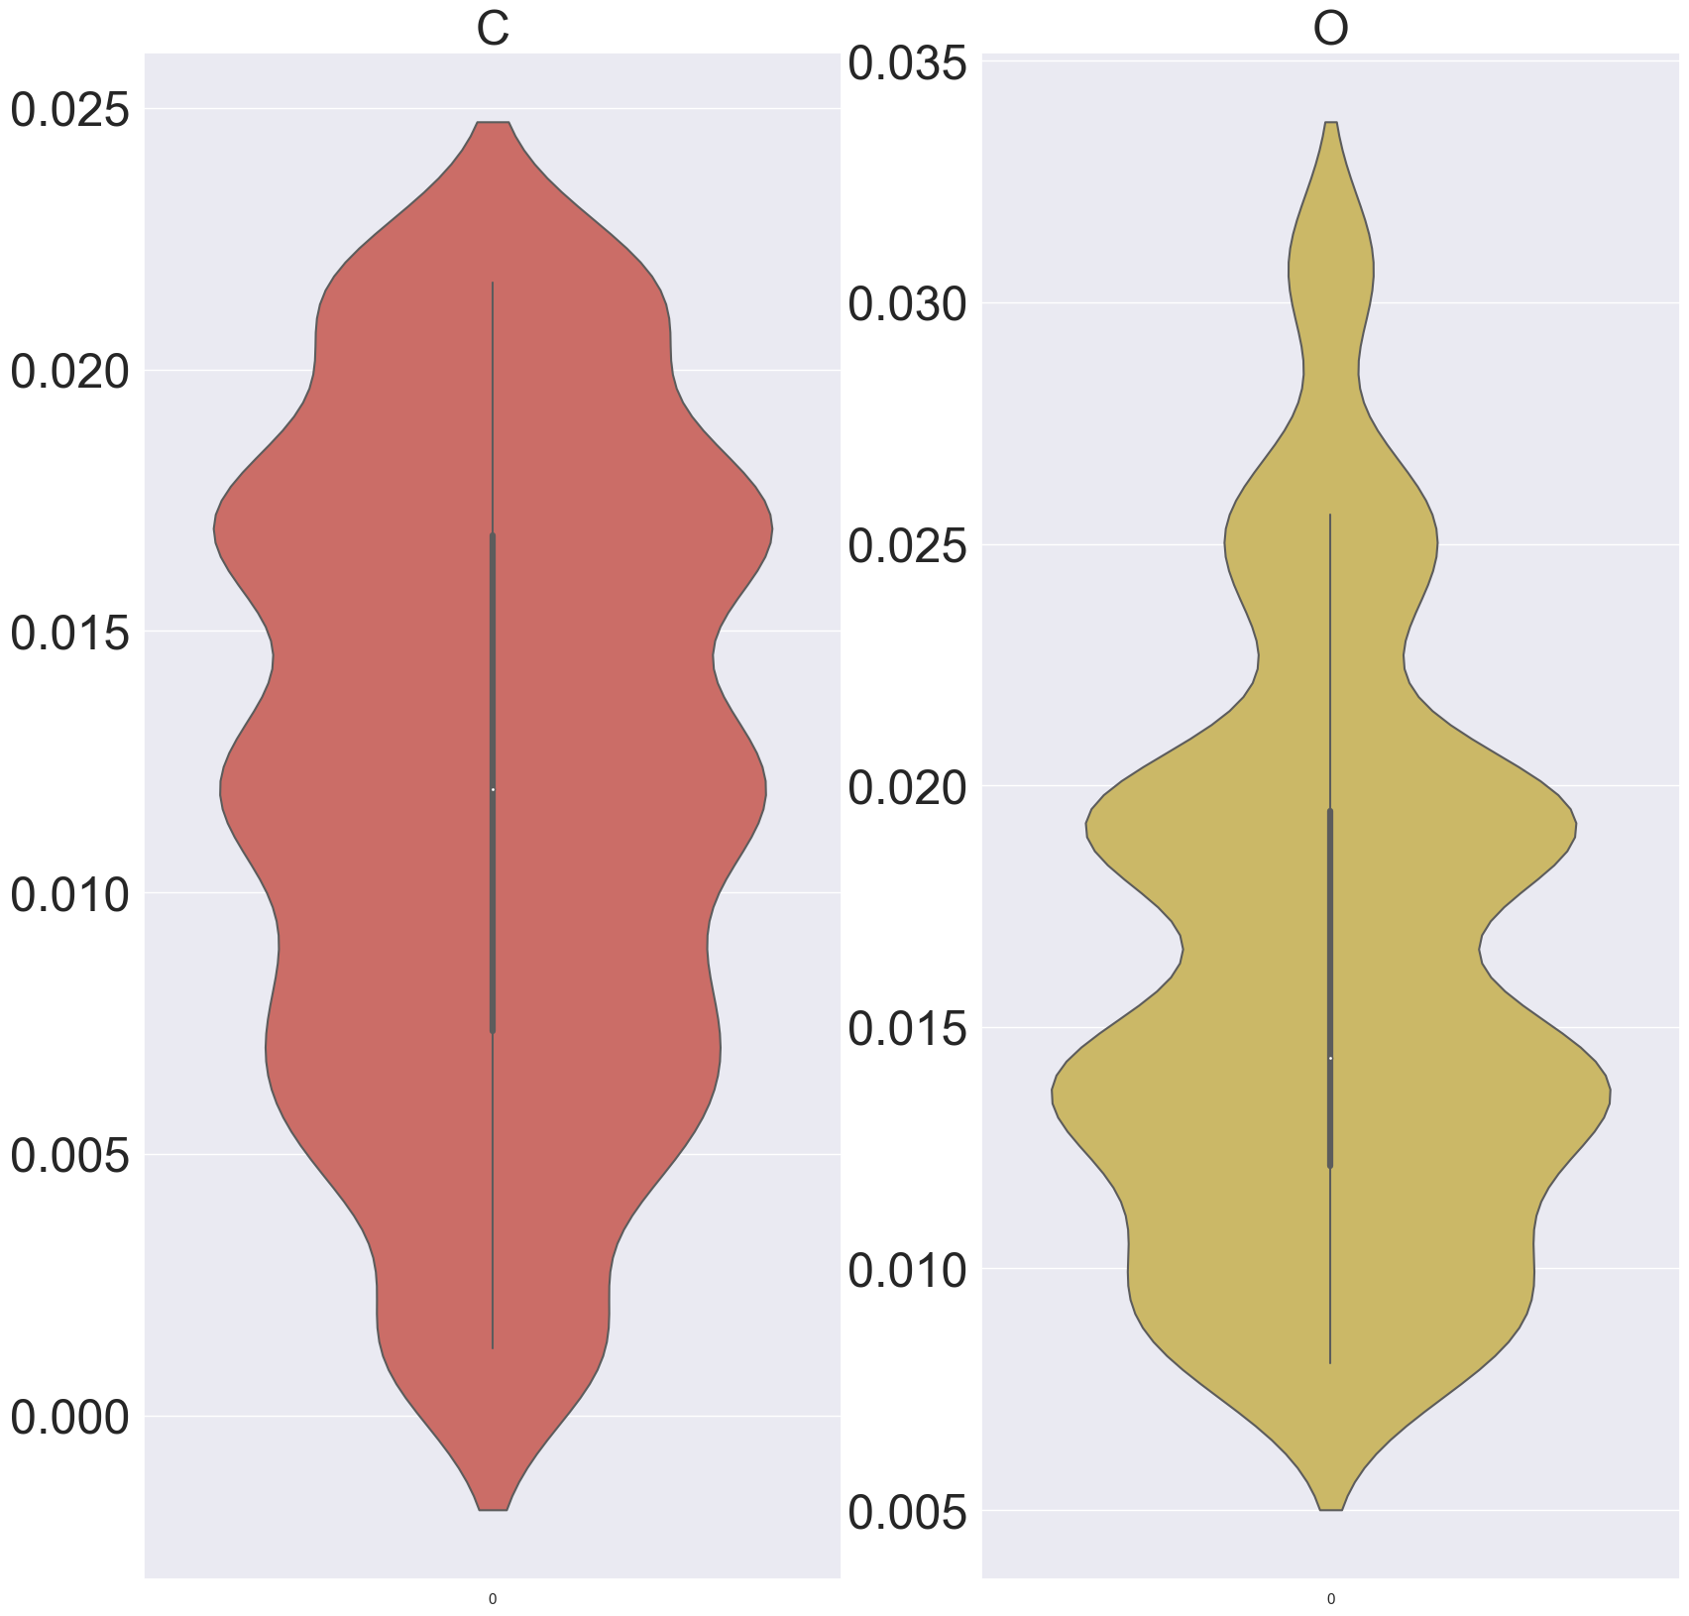
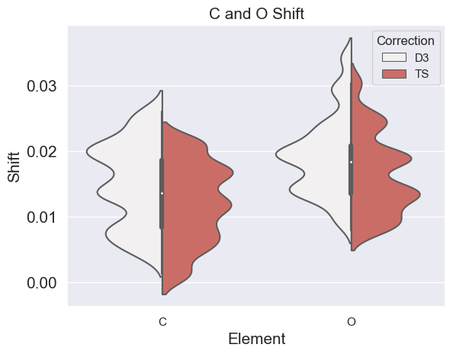
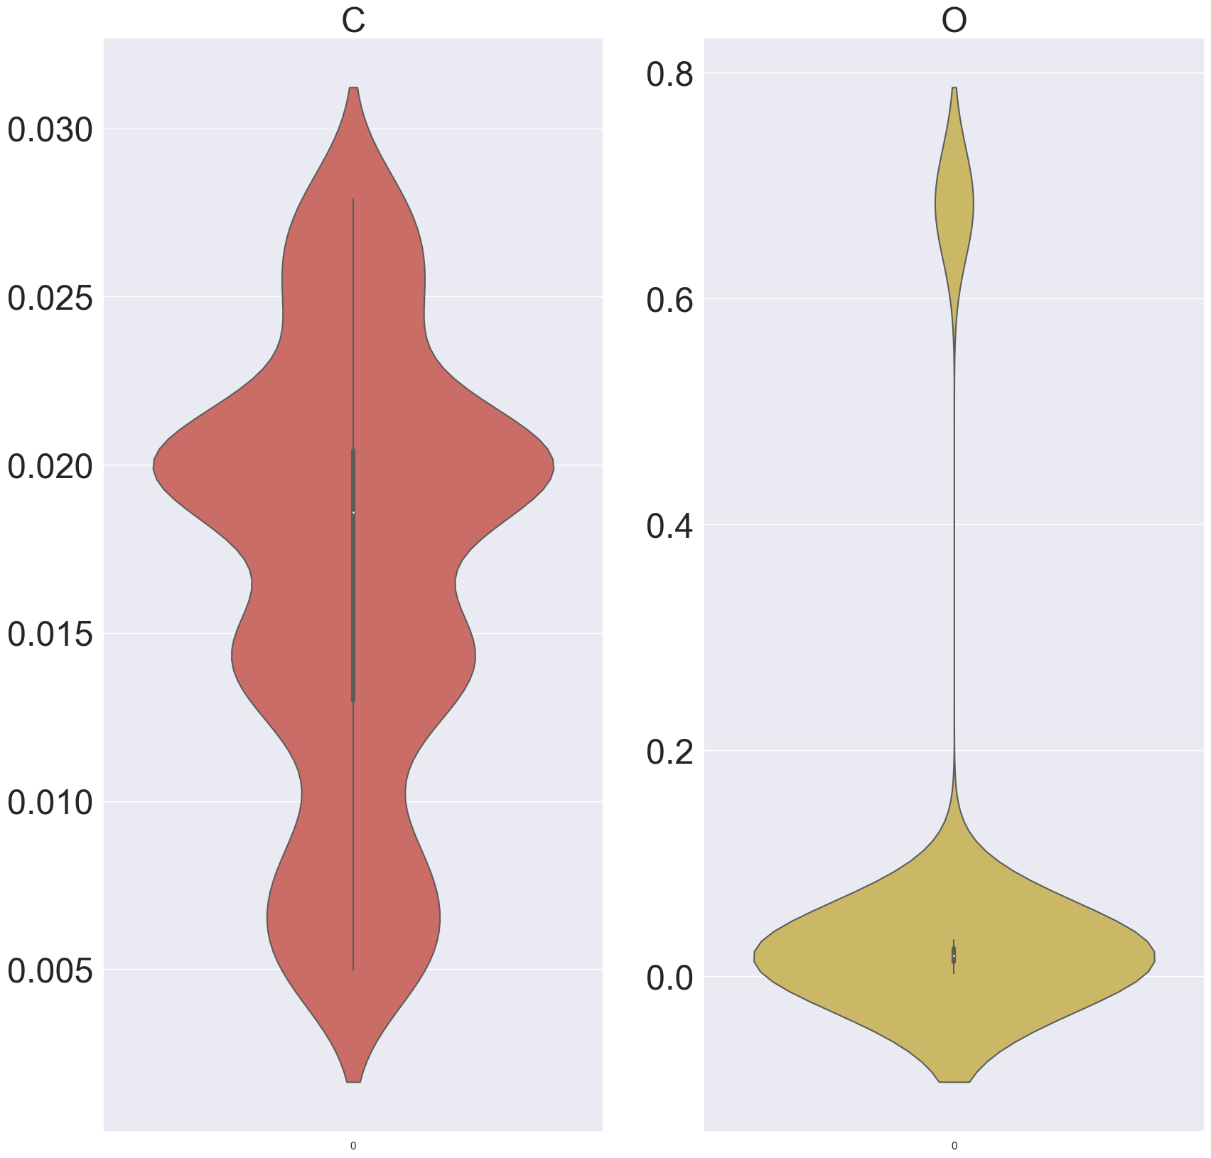
Key Results – Dispersion Corrections
Difficult to link structural change to spectral change.
Developed ways to make this comparison easier
Trends were very similar for nearly all calculations with the exception of D2.
This shows the sensitivity of these calculated spectra to ionic positions.

Slide 10
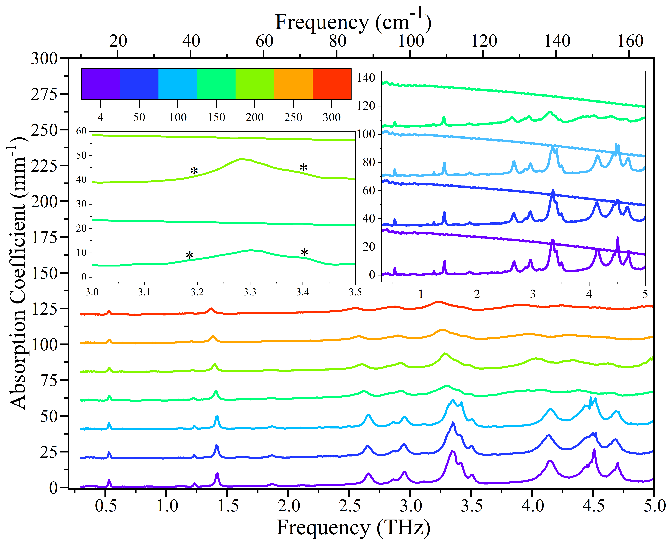
Key Results – Quasi-Harmonic Approximation
Experimental spectra were measured between 4 and 300 K in 50 K increments.
Modes follow expected trend of red-shifting with temperature except 1st mode.

Slide 11
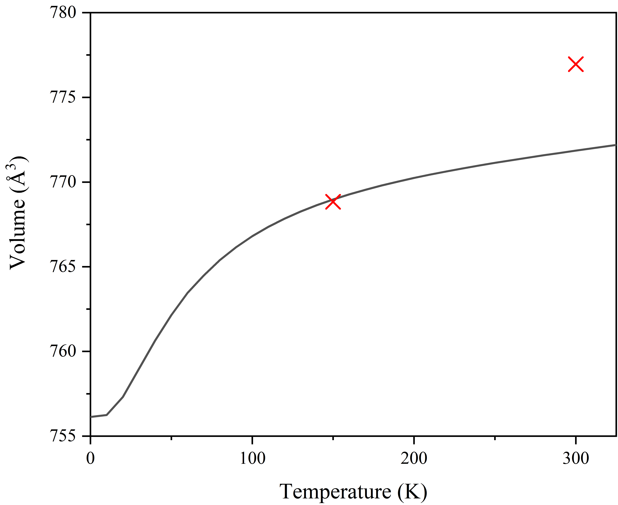
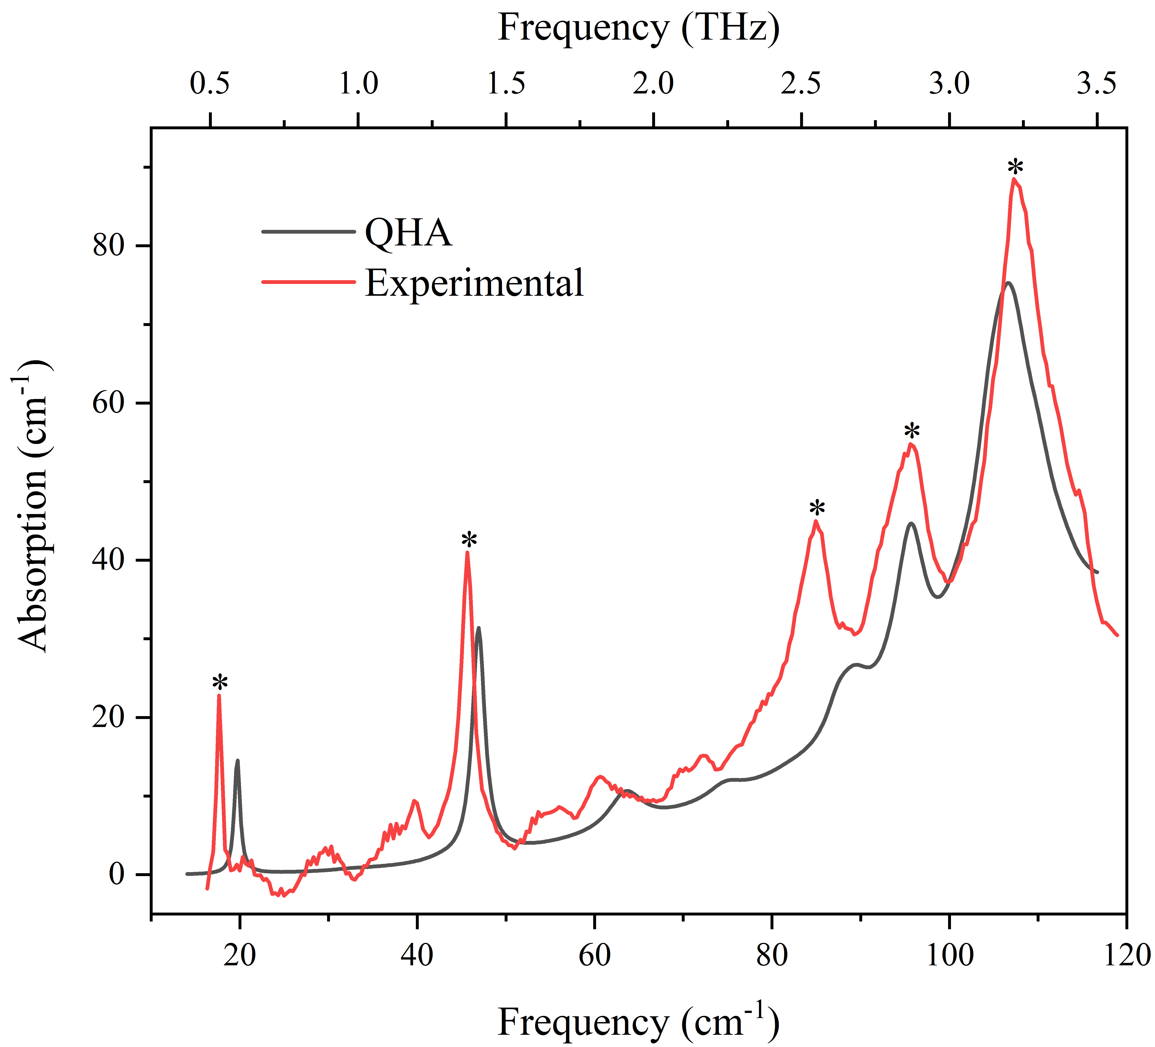
Key Results – Quasi-Harmonic Approximation
Using the QHA, the volume-temperature relationship was established.
This matched reasonably well but some discrepancy at 300 K.
Unit cell with calculated volume at 300 K was used to produce a calculated THz absorption spectrum at 300 K.
This matched well with experiment.

Slide 12
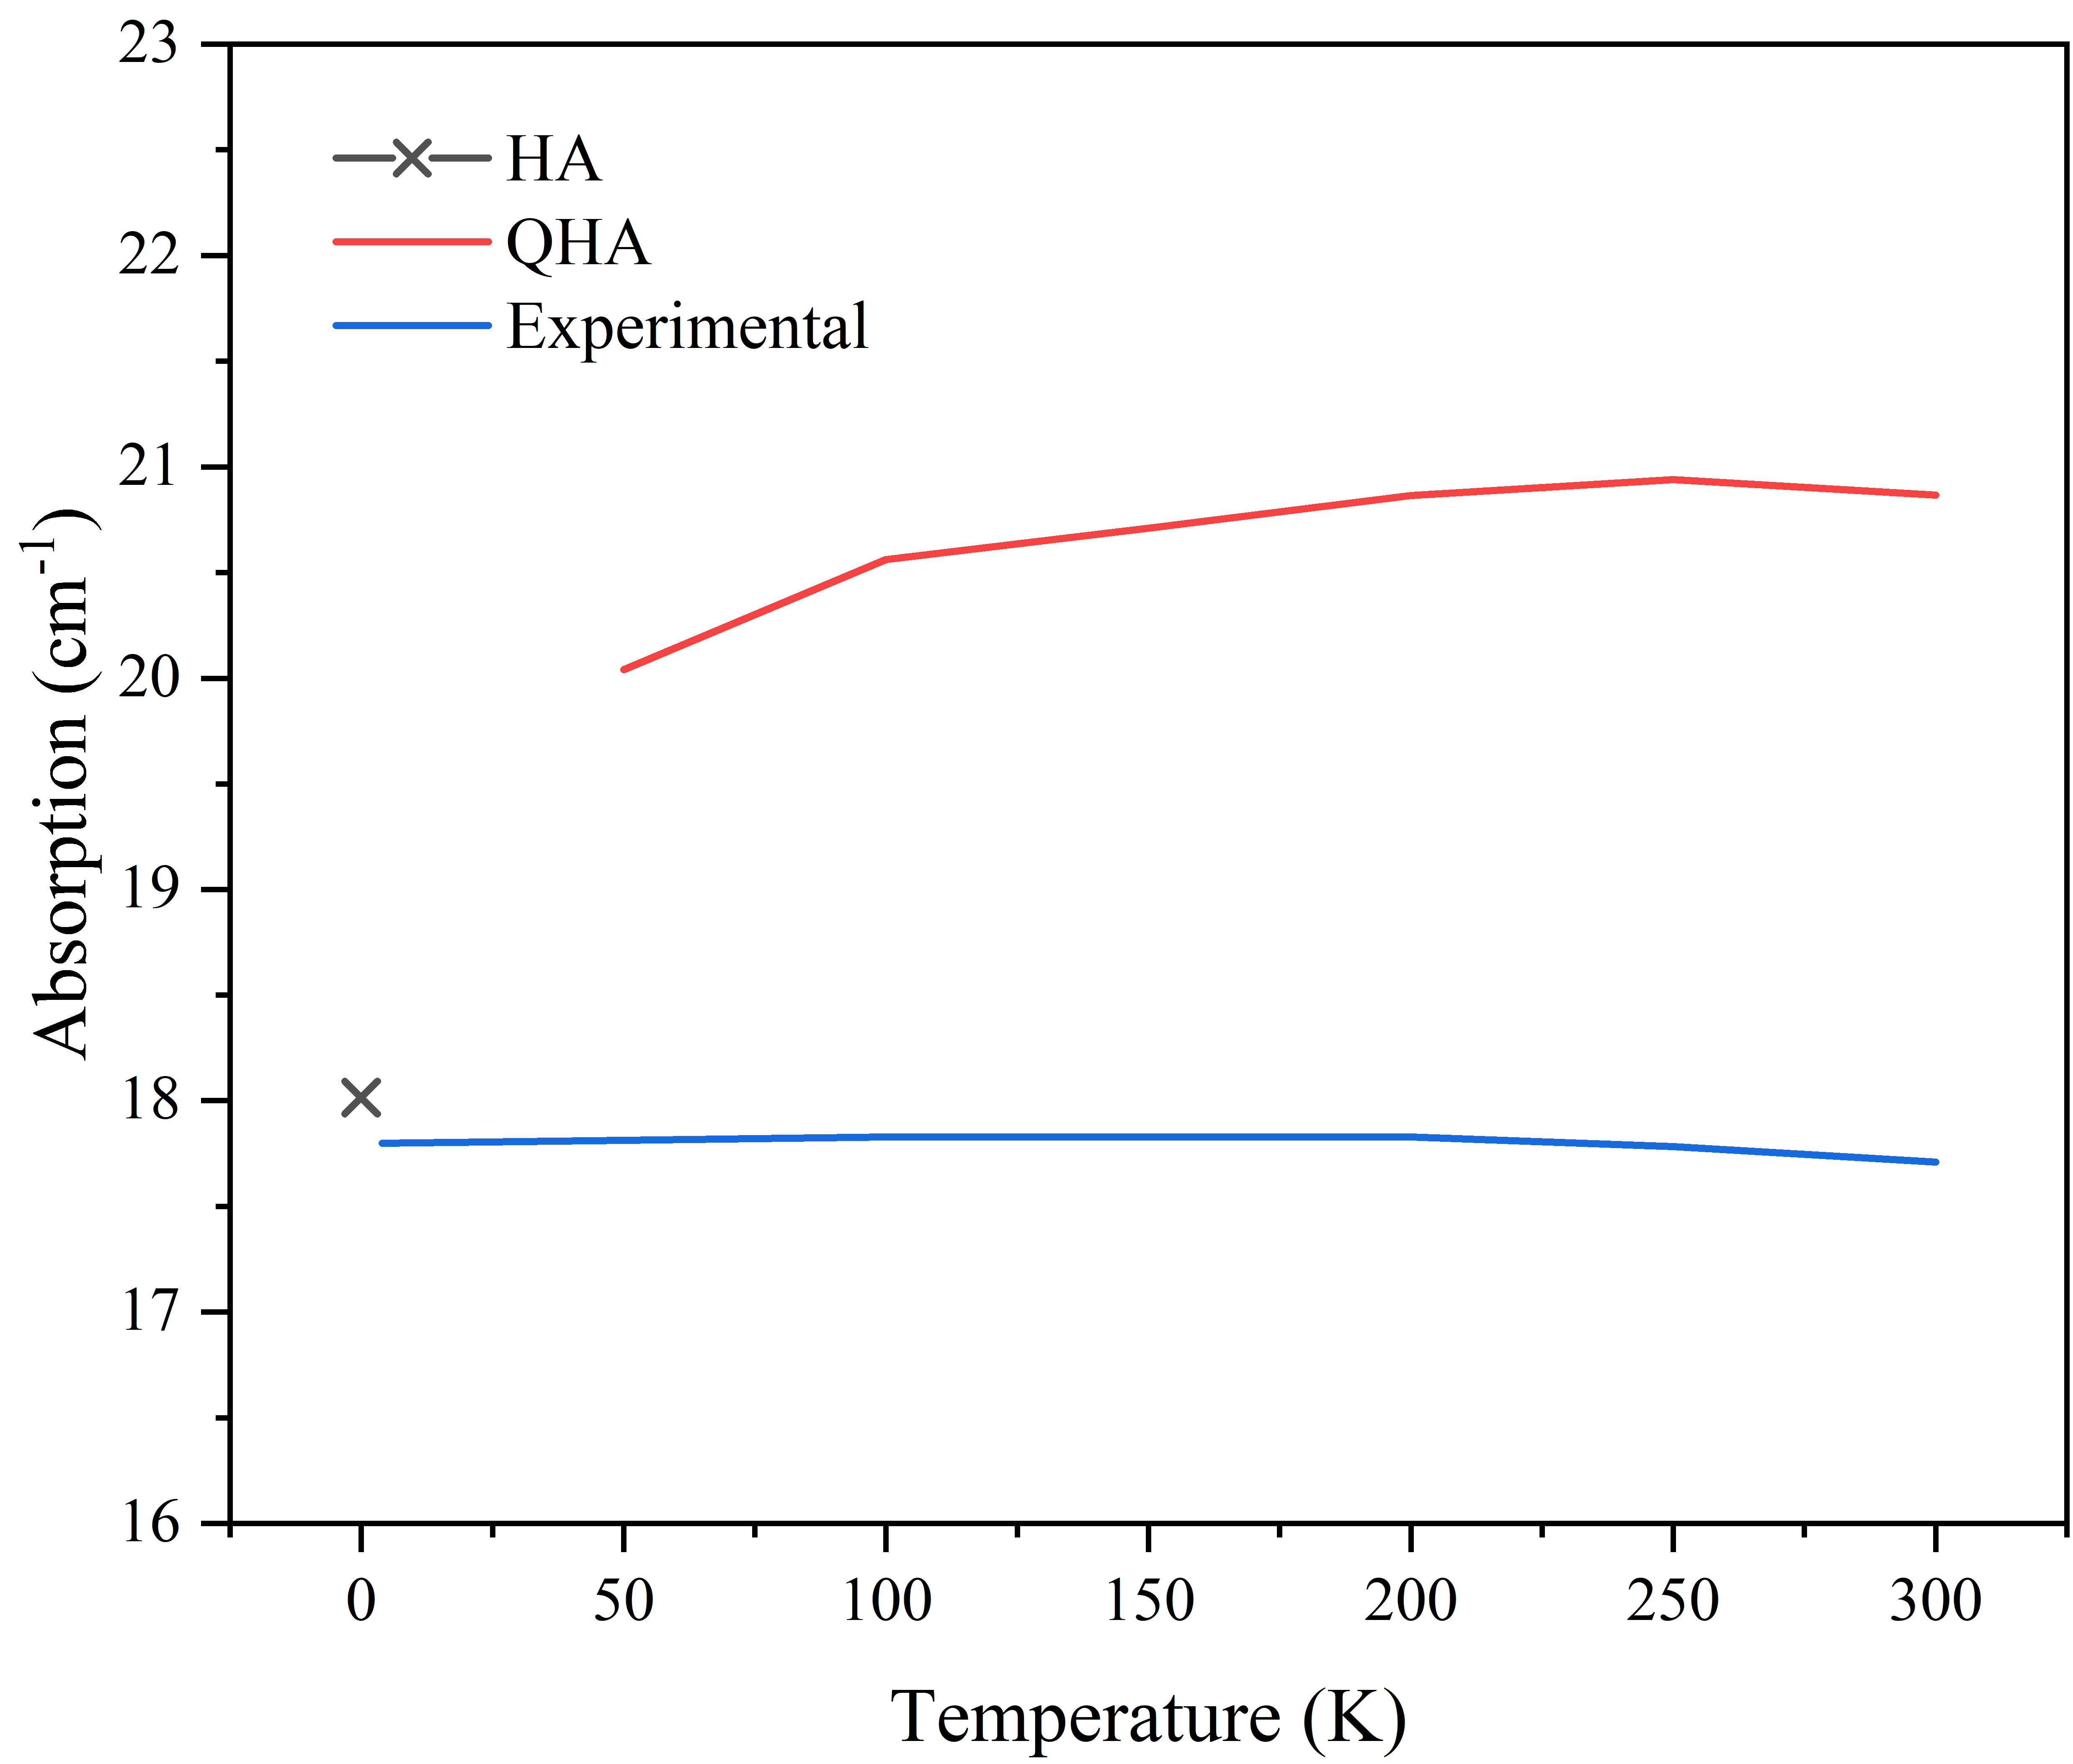
Key Results – Quasi-Harmonic Approximation
Using the QHA, the volume-temperature relationship was established.
This matched reasonably well but some discrepancy at 300 K.
Unit cell with calculated volume at 300 K was used to produce a calculated THz absorption spectrum at 300 K.
This matched well with experiment.

Slide 13
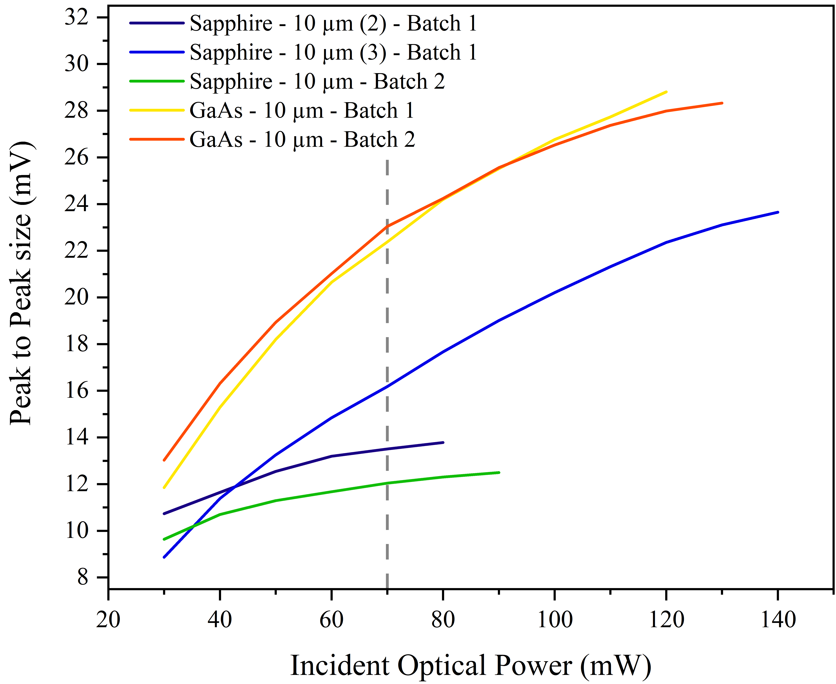
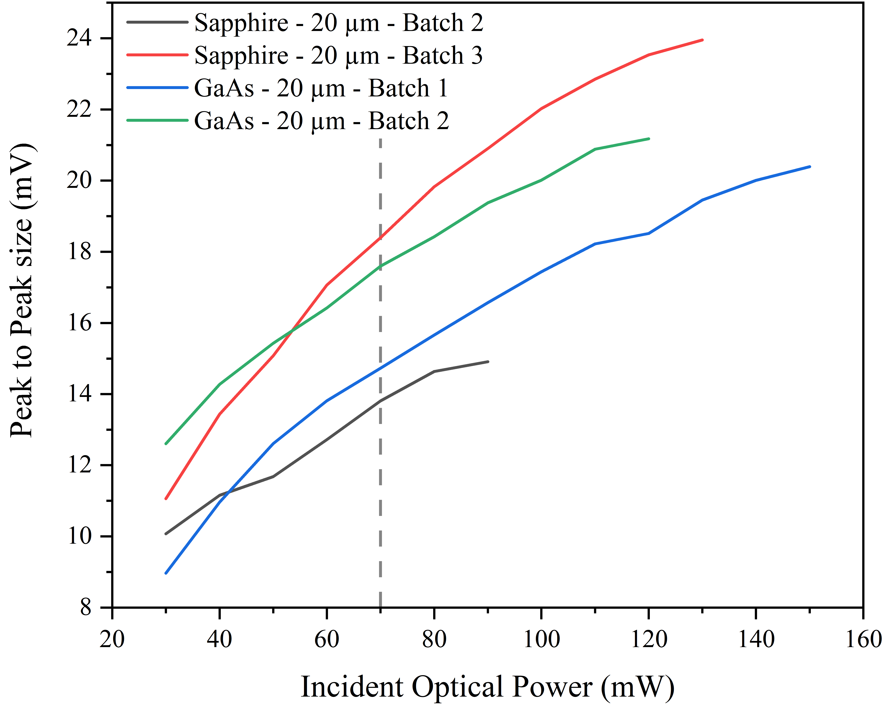
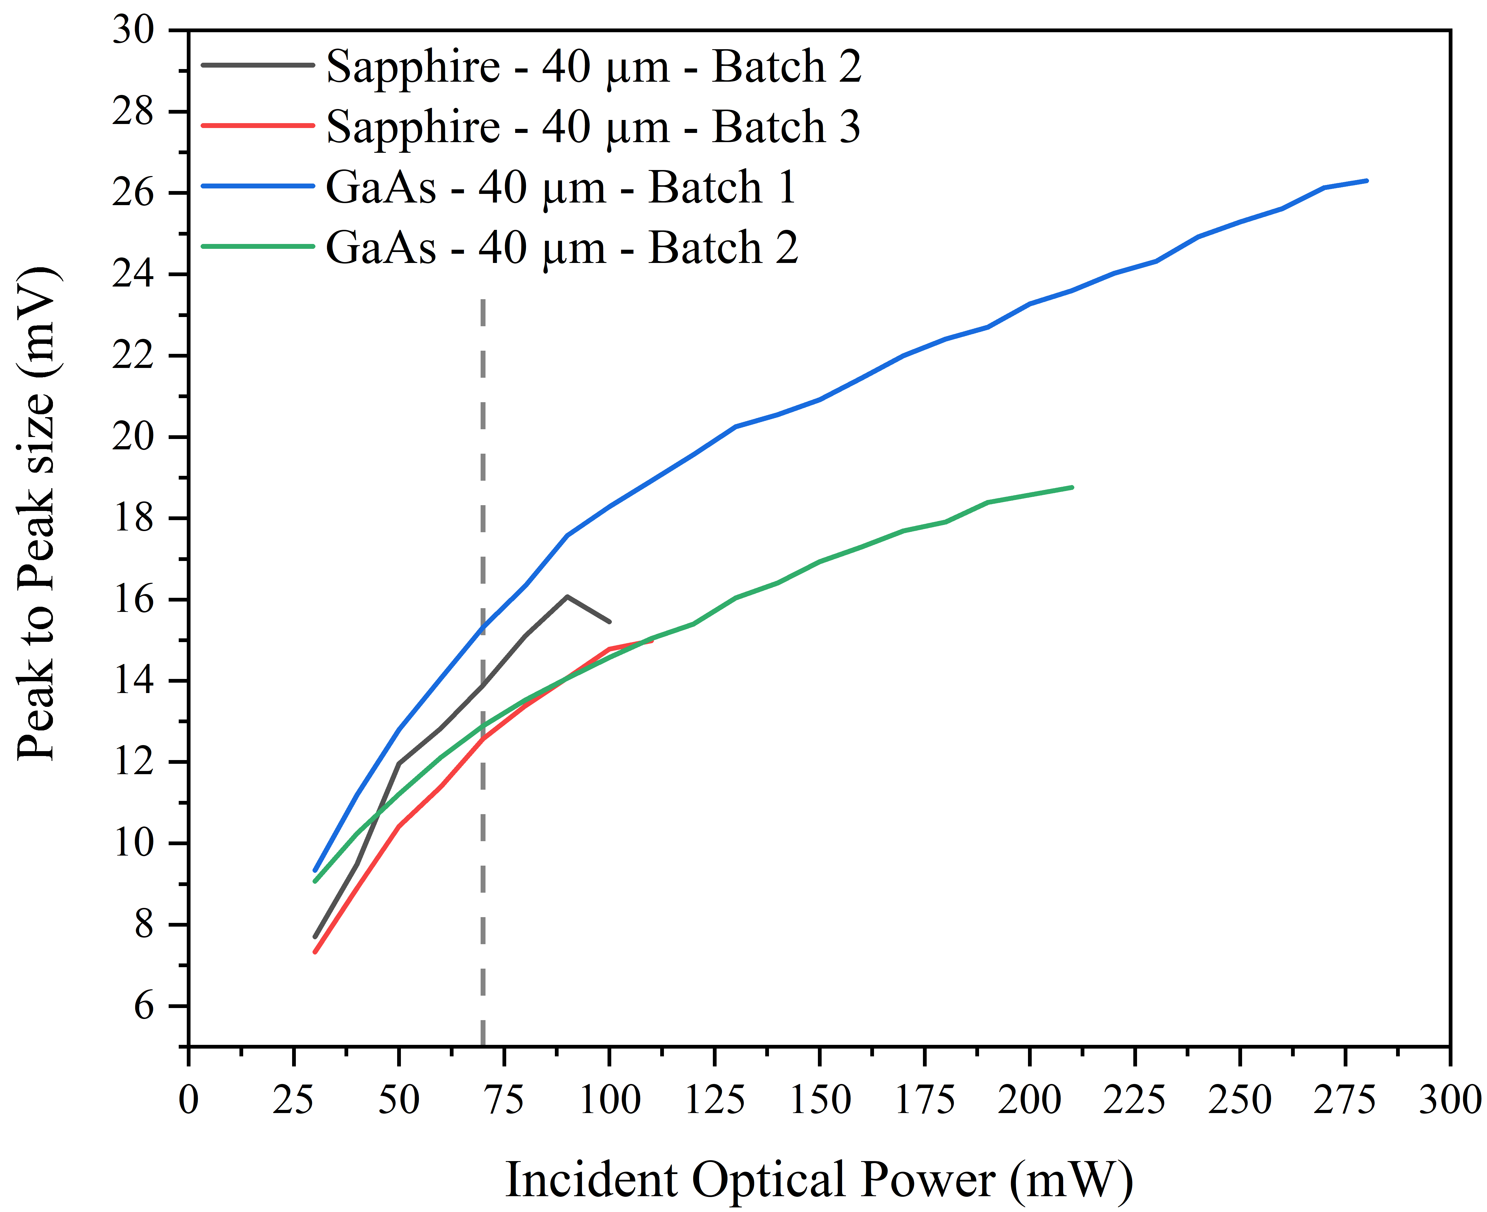
Key Results – Photoconductive Emitters
It was found that a 20 µm gap size was the optimal choice for an incident laser power of 70 mW.
Devices on a GaAs substrate performed better than sapphire counterparts at times.
This is attributed to less complex fabrication and ease of alignment.

Slide 14
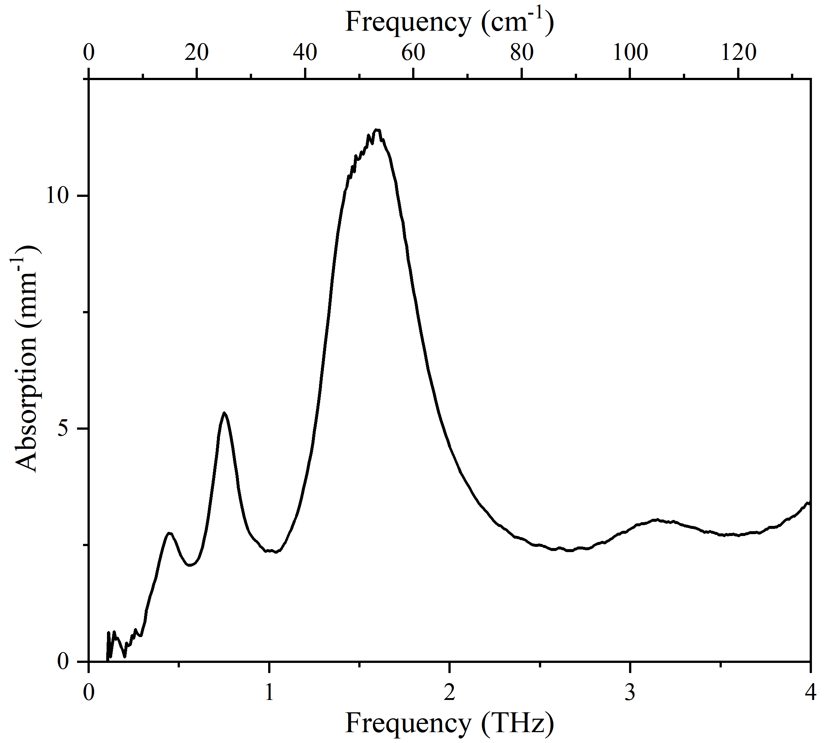
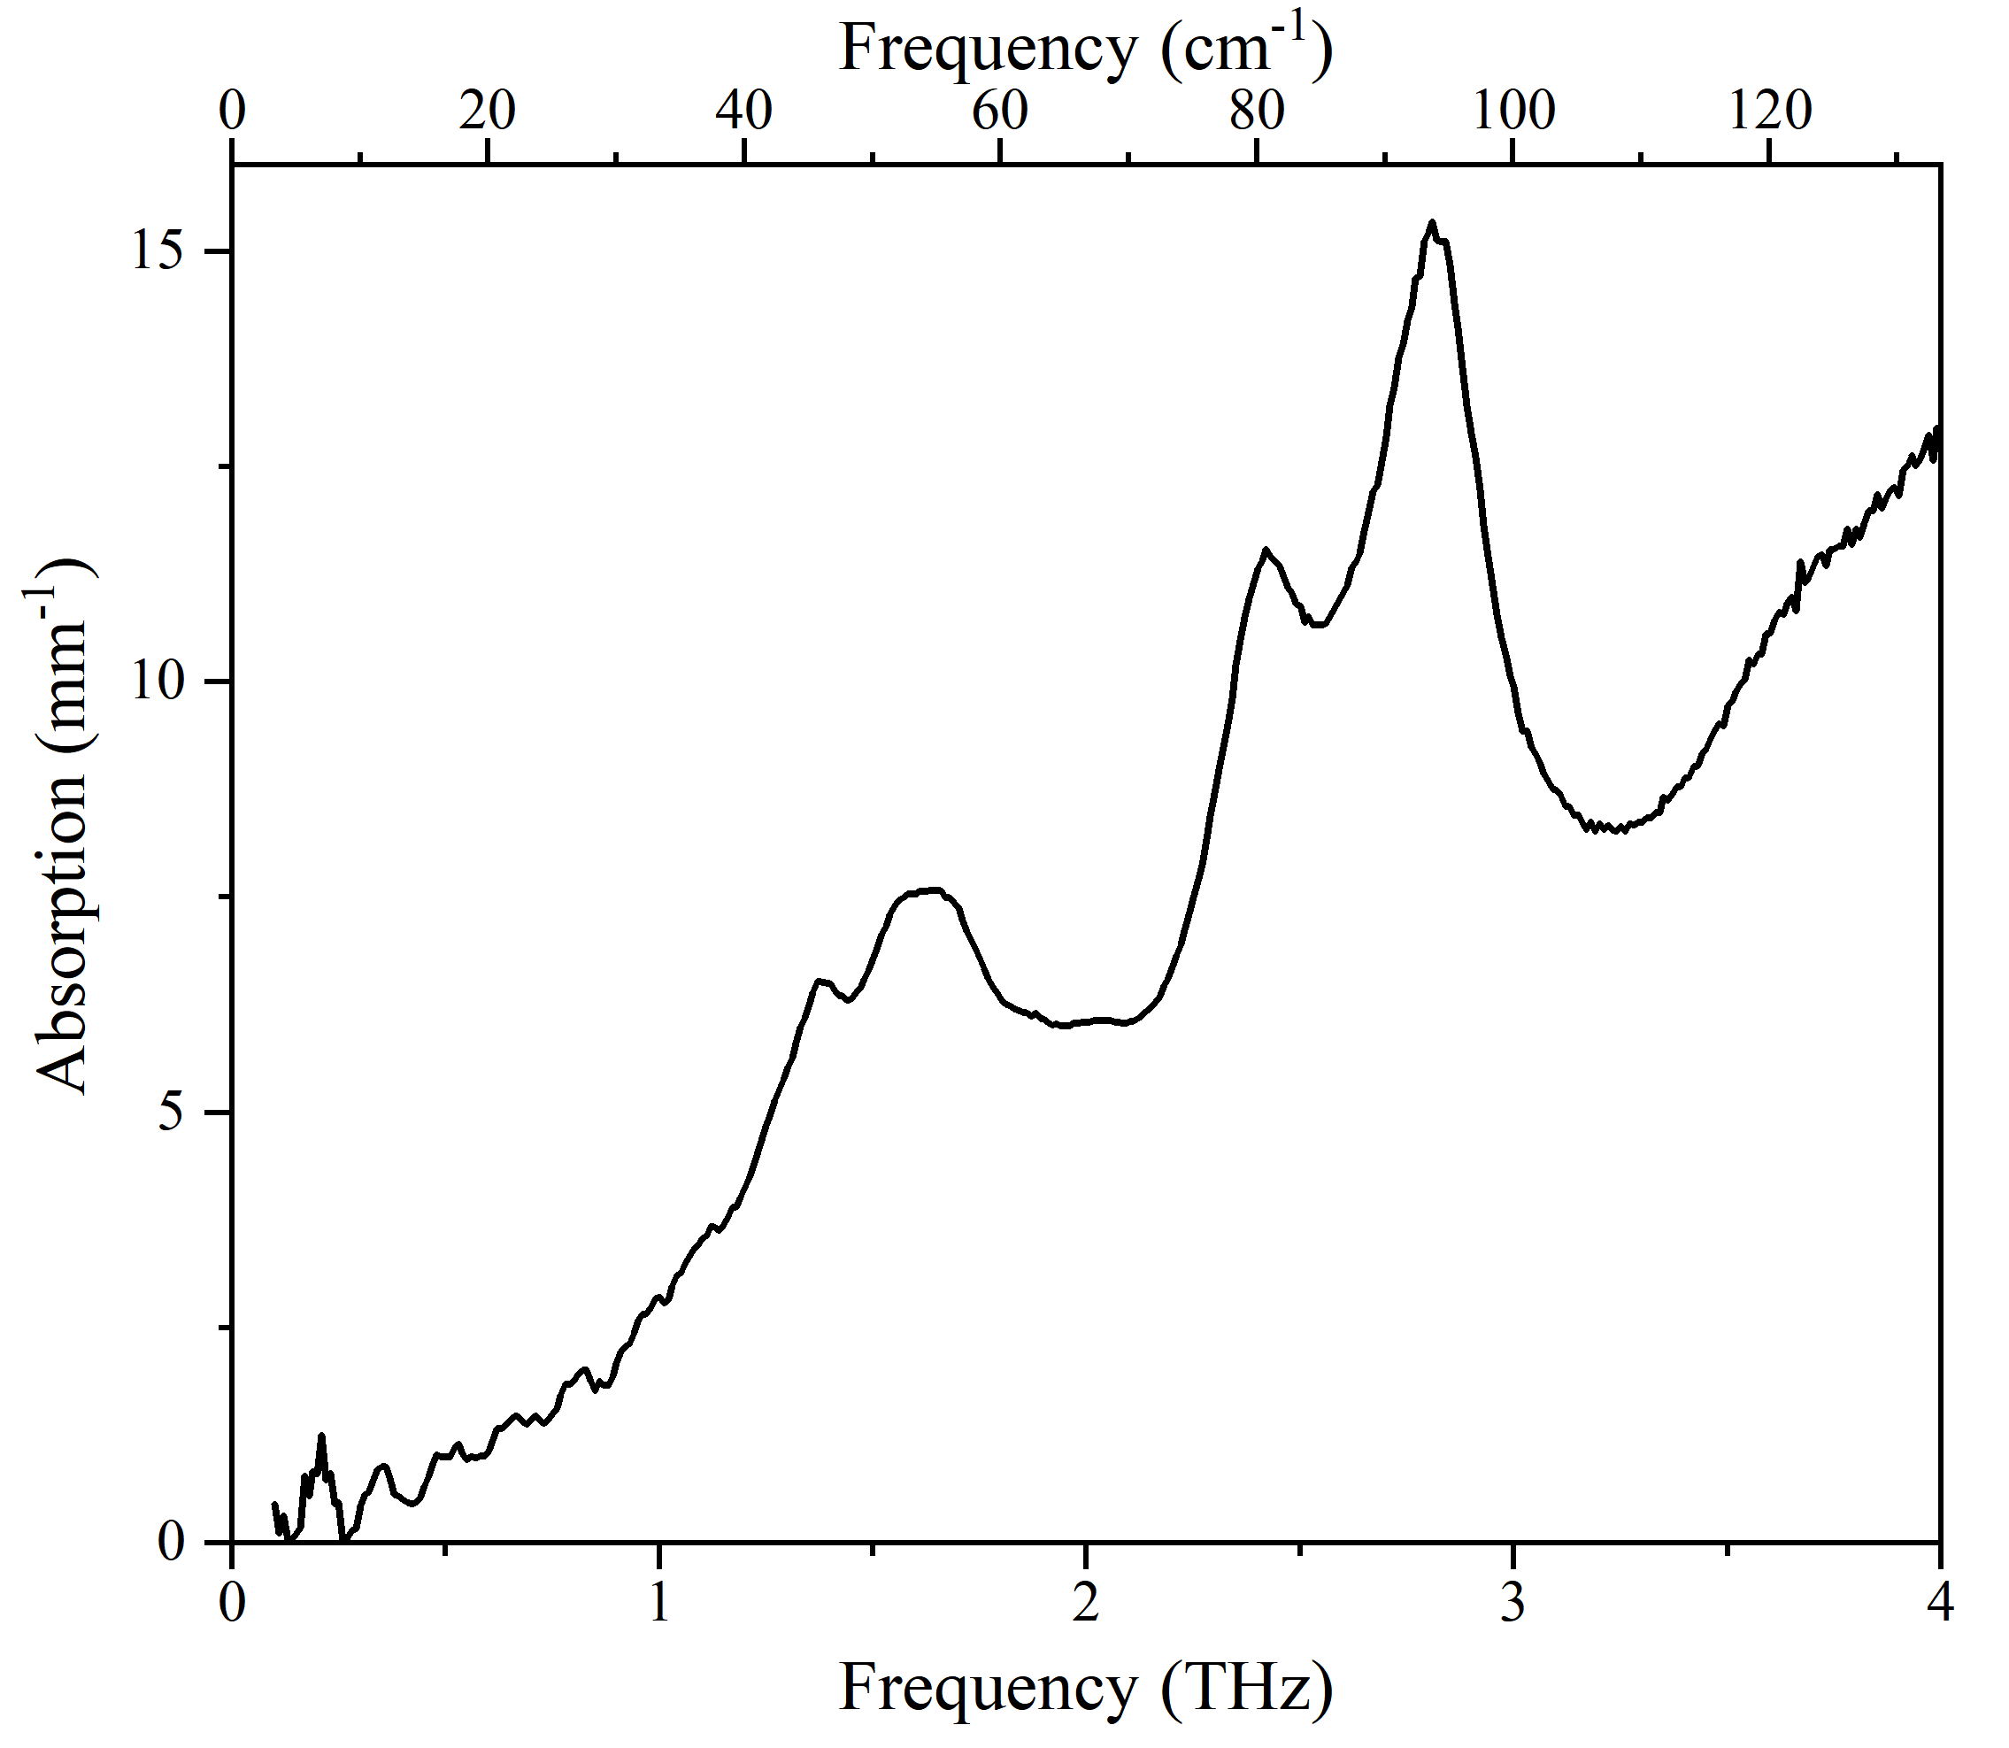
Other Investigations
Other systems were investigated but these were not finished owing either to computational resources or work being halted for COVID.
The THz absorption of Cysteine was measured but calculation proved challenging.
Fe(acac)₃ was measured but owing to the Fe centre and large ligands, this was unfeasible to calculated using DFT at present.

Slide 15
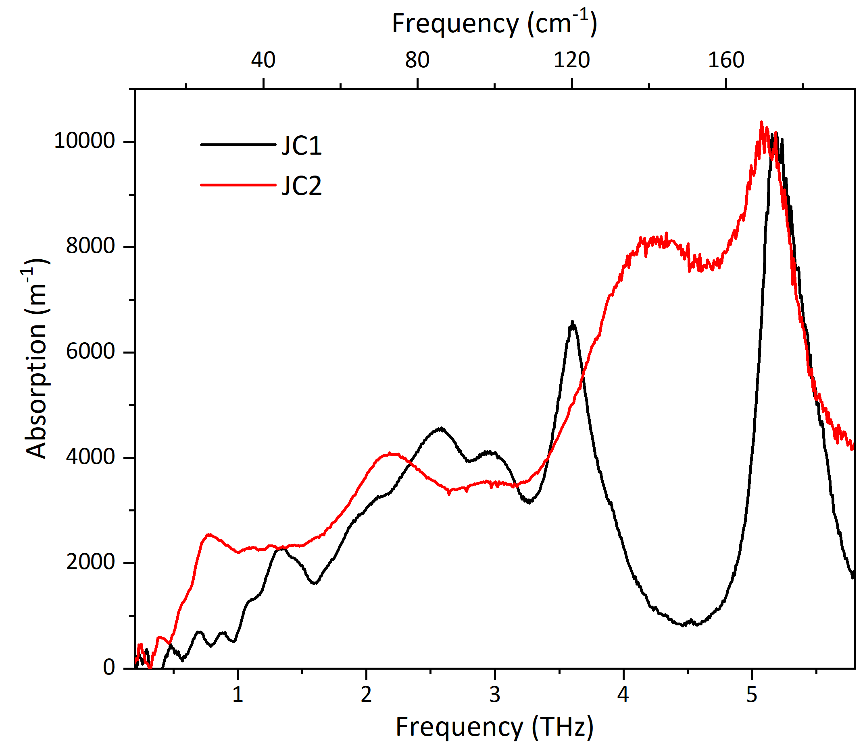
Other Investigations
JC1 is an organic molecule used as a ligand and JC2 is a Pt compound with a ligand similar to JC1.
This would have been a collaboration with Sheffield University but was halted owing to COVID.

Slide 16
Conclusions
It was found that the D3 correction was the most suitable for αLM, which would suggest that it should be used for further study of organic crystals.
The calculated spectrum at 300 K showed excellent correlation with experiment but some thermodynamic properties were not accurately calculated.
A 20 µm gap size was deemed as optimal for an incident laser power of 70 mW. Whilst GaAs devices are easier to align and have similar THz outputs, their transparency of sapphire devices is a key factor for future work.

