Slide 1
Coursework 2 – COMP0248

Slide 2
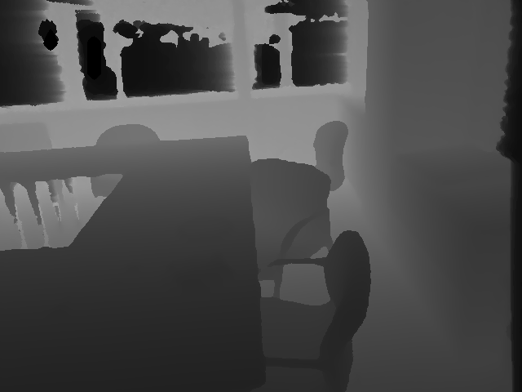
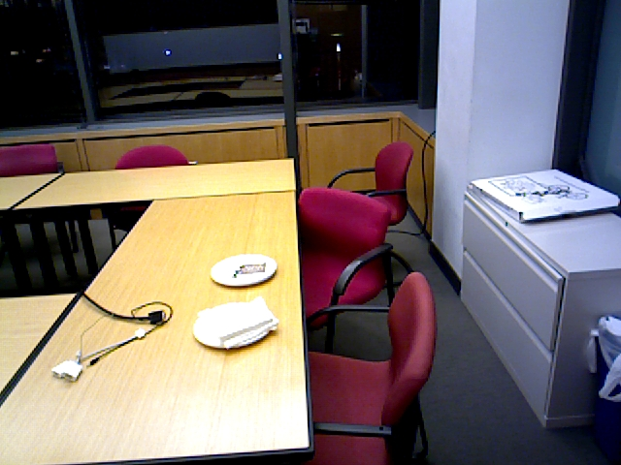
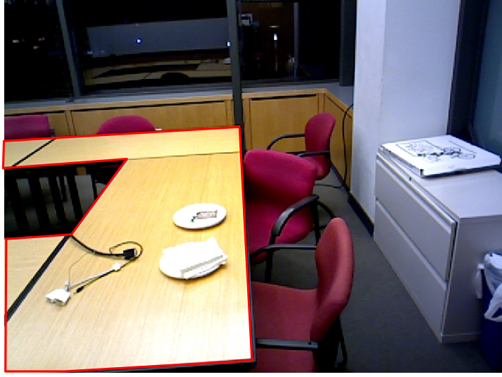
Dataset
Selected data from Sun 3D
Table Polygon
Annotations
Depth
RGB

Slide 3
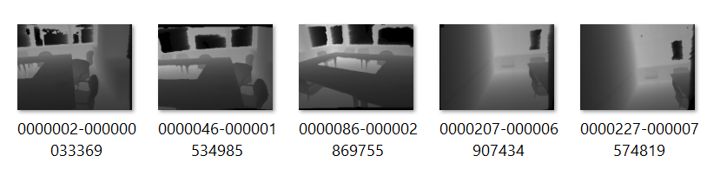
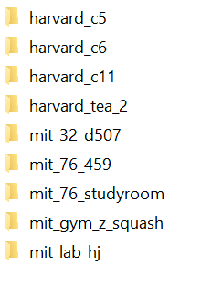
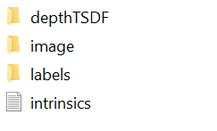

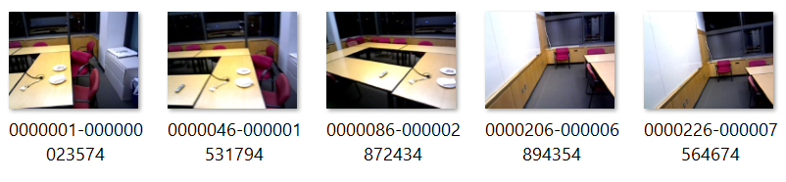
Dataset
File name: frame-timestamp
Depth and RGB frames are paired by closest timestamp, not frame number (files are already in the correct order).
Sample scrip to overlay labels on RGB frames

Slide 4
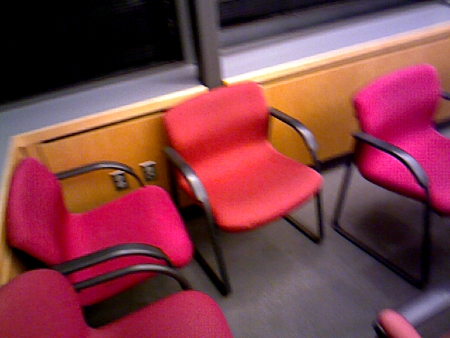
Tasks: Binary classification (Is there a Table in the image?)
Table
No Table
The following labels from Sun3D were grouped under a single “table” class: “table top”, “dining table”, “desk”, “coffee table”
Does not include: cabinets, kitchen counter

Slide 5
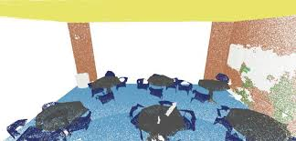
Tasks: Binary Point Cloud Segmentation
Classify each point as Table or Background
Background
Table

Slide 6
Implement 3 different pipelines
Pipeline A: Convert a depth input to a point cloud, then a classifier takes a point cloud as input
Pipeline B: First a model estimates depth from a 2D RGB image, then a classifier takes the estimated depth map as input
Pipeline C: Convert a depth input to point cloud, then a segmentation model takes a point cloud as input
Input Data
Your Work
Depth
Image
Point Cloud
Classification Model
Table /
No Table
Pipeline A
RGB
Image
Monocular Depth Estimation Model
Classification Model
Table /
No Table
Pipeline B
Depth Image
Point Cloud
Segmentation Model
Table /
No Table
Pipeline C

Slide 7
Model Implementation and Training
Overall:
You can re-use/import existing models, without implementing their architecture from scratch.
You need to explicitly state and cite the works you are using in your report.
For full marks, use models different from tutorial examples (vanilla PointNet, MonoDepth2 pre-trained on KITTI, etc).
Monocular Depth:
You can use off-the-shelf pre-trained models if they work reasonably well on the test data (no penalty on marks).
You will need to explicitly state and cite the works you are using in your report.
Classification/Segmentation:
You can use pre-trained models as initialisation (cite on report), but you need to train them on the CW2 dataset

Slide 8
Coursework2 Dataset - Data Split
Training Data:
MIT sequences
mit_32_d507, mit_76_459, mit_76_studyroom, mit_gym_z_squash, mit_lab_hj
Total 290 RGBD frames
Test Data 1:
Harvard sequences
harvard_c5, harvard_c6, harvard_c11, harvard_tea_2
Total 98 RGBD frames
Test Data 2:
UCL sequence: capture your test data with an Intel RealSense Camera
Select a maximum of 50 RGBD frames from any video captures
Quantitative classification/depth evaluation
Qualitative segmentation evaluation (no need to annotate point clouds)

Slide 9
Other dataset details
Sequences with no labels / no tables (negative samples):
mit_gym_z_squash
harvard_tea_2
Detected missing table labels:
76-1studyroom2 - 0002111-000070763319.jpg
mit_32_d507 - 0004646-000155745519.jpg
harvard_c11 - 0000006-000000187873.jpg
mit_lab_hj - 0001106-000044777376.jpg
mit_lab_hj - 0001326-000053659116.jpg
Depth maps have been pre-processed by DepthTSDF for improved quality, except for harvard_tea_2, which contains raw depth maps from camera. Raw data acquired with RealSense will be more similar to harvard_tea_2 data than the other sequences

Slide 10
Report Sections [maximum 6 pages + references]
Introduction / Problem Statement [~0.5 pages]
Precisely define the problem you are solving, detailing any assumptions you are making about the data when designing your models
Cite the works you use as inspiration for your models, explaining why you chose them (pre-trained weights, architecture, training methodology, etc)
Data processing [~1 page]
Describe how you processed data to generate groundtruth classification/segmentation labels from polygon labels
Describe any pre-processing steps
Describe how you convert between different data types (e. g. from depth to point clouds, etc)
Methods [~2 pages]
Pipeline A
Pipeline B
Pipeline C

Slide 11
Report Sections [maximum 6 pages + references]
Results [~1.5 pages]
Classification performance for Pipeline A, Pipeline B
Depth Estimation performance for Pipeline B
Segmentation performance for Pipeline C
Describe and justify the metrics you use and any other evaluation related processing steps
Discussion [~0.75 pages]
Compare performance of Pipelines A/B, describe and justify relative strengths/weaknesses based on obtained results
Identify Pipeline C strengths and weaknesses based on obtained results
Conclusions [~0.25 pages]
What are the limitations of the explored approaches?
How could the methods be improved?
References [use as much space as you need]

Slide 12
Marking [total 100]
[16]: Good understanding of the problem
Report: “Introduction”, “Discussion”, “Conclusions”
[15]: Data processing
Code
Report: “Data Processing”
[36]: Model Implementation
Code
Report: “Methods”
[12] for each pipeline
Up to [8] for each pipeline if you use exact same model as tutorials (vanilla PointNet, MonoDepth2 pre-trained on KITTI, etc)
[20]: Evaluation on CW2 dataset
Code
Report: “Results”
Maximum [10] if only 1 pipeline is evaluated
Maximum [15] if only 2 pipelines are evaluated
[10]: Capture and evaluation on RealSense data
Code
Report: “Results”
Except for references, anything beyond the page limit (6 pages) will be ignored for marking

Slide 13
Marking – General guidelines
Justify your implementation choices (what favours them compared to alternatives?)
There is no strict minimum model performance you need to achieve. For results, focus on rigorous, fair, and well justified evaluation. If your model fails sometimes, explain what do you think the reasons are in the discussion section.
Use figures/diagrams if it makes explanations clearer
Clearly label plots and tables.
Clearly define symbols/variables if you write equations
For discussion/conclusions, avoid generic statements. Write based on your own obtained results.

Slide 14
Marking – General guidelines
Equal marking for all group members, unless exceptional circumstances (e. g. a group member did not work and did not contribute to the coursework submission).
If you have any issues during coursework period, communicate with staff (Sophia, Francisco) as soon as possible.

Slide 15
Submitting your report
Use the latex template IEEE Conference template
https://www.overleaf.com/latex/templates/ieee-conference-template/grfzhhncsfqn

Slide 16
Submitting your code
Code/
├── src/
│ ├── pipelineA/ # organise how you want, but
│ ├── pipelineB/ # keep a modular structure and
│ └── pipelineC/ # clearly explain in README.md
├── data/
│ ├── CW2-Dataset # delete for submission
│ └── RealSense # include in submission
├── results/ # predictions, logs, plots
├── weights/ # delete in submission
├── requirements.txt
└── README.md
coursework2_groupXX.pdf

