Slide 1
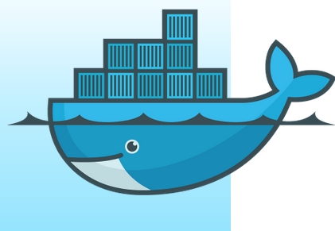
Programming Languages
Calvin Liu
804182525
~Docker~

Slide 2
Docker
An open platform for distributed applications
A container similar to a linux container that contains components that can be quickly assembled.
Eliminates the friction between development, QA, and production environments
Can run anywhere
Workload deployment is less constrained by infrastructure

Slide 3
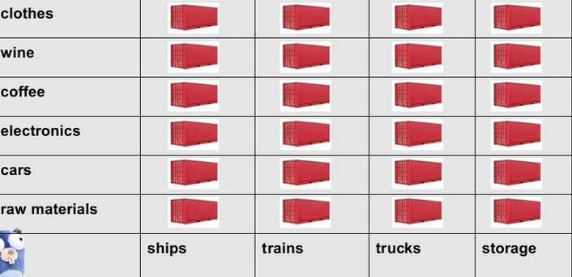
Containerization
The main thing about Docker:
DataBase

Slide 4
Java Implementation
Java is a compiler object oriented programming language
Has its own garbage collection
Types must match or will invoke an error
Does not have much flexibility in containers as python
Still has a dictionary class that can map keys to values
Has a vast amount of APIs and 3-5 times faster than python

Slide 5
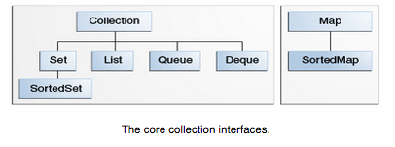
Java Implementation
There is actually a collections framework
http://docs.oracle.com/javase/tutorial/collections/intro/index.html
Think about collections as a poker hand, a mail folder, a telephone directory.

Slide 6
Java Conclusion
Although java is a fast object oriented programming language with its own memory management, APIs, and collections, I don’t believe it to be the best framework to use because you want something dynamic and I feel that working with a compiler language isn’t the best option for containers.

Slide 7
Python Implementation
Python already supports containers such as tuples and dictionaries
Implicit type casting
Has object oriented aspects
Supports outside APIs and can override necessary functions

Slide 8
Python Conclusion
Python would be a suitable way to implement Docker due to the fact that Python has:
Good memory management
Allows threading and good speed
Implicit type casting allows deployment and containment of objects to be easier
Already implemented containers that store different types
Has own garbage collection

Slide 9
Julia Implementation
Julia is a language like python:
Similar to R and used a lot for statistics and math

Slide 10
Julia Implementation
("a", 1) # two element tuple
(’a’, false)::(Char, Bool) # tuple type assertion
x = (1, 2, 3)
x[1] # 1 (element)
x[1:2] # (1, 2) (tuple)
x = Dict{Float64, Int64}() # empty dictionary mapping floats to integers
x = (Int64=>Int64)[1=>1, 2=>2] # literal syntax creation, optional type information
y = {"a"=>1, (2,3)=>true} # dictionary with type Dict(Any, Any)
y["a"] # element retrieval
y["b"] # error
y["b"] = ’b’ # added element
haskey(y, "b") # check if y contains key "b"
keys(y), values(y) # tuple of iterators returing keys and values in y
delete!(y, "b") # delete key from a collection, see also: pop!
get(y,"c","default") # return y["c"] or "default" if not haskey(y,"c")

Slide 11
Julia Conclusion
https://www.chrisstucchio.com/blog/2014/deploying_julia_servers_with_docker.html
Basically tells why Julia is not a good fit for deploying servers

