Slide 1
Picross Puzzle Solver
COS429
Calvin Lee
Michael Bailey
Jane E

Slide 2
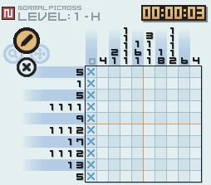
Nonograms

Slide 3
Project flow
GetPicture – reads image from file, does preprocessing
AntiSkew – rotates image such that grid lines align with horizontal and vertical axes
DetectGrid – detects grid lines
FindNumbers – determines if grid cells contain numbers
OCRNumbers – determines values of numbers in grid cells
PicrossSolver – solve Picross puzzle*
DisplayPuzzle – displays solution
*work in progress

Slide 4
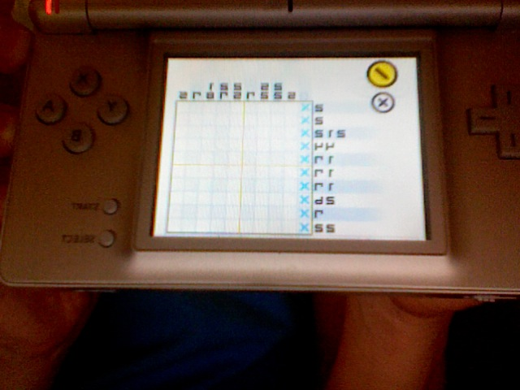
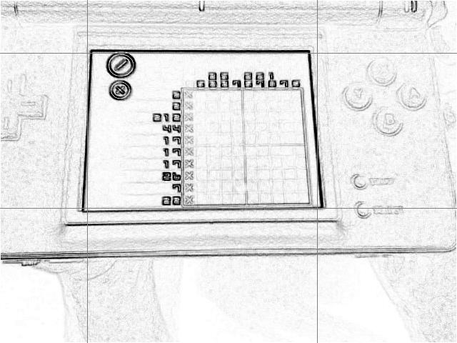
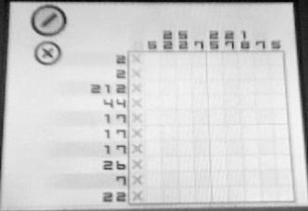
Get Picture
steps:
flip across vertical axis
find strong borders using neighborhood voting system
crop (with buffer)

Slide 5
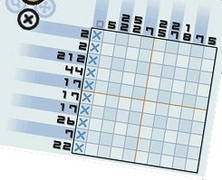
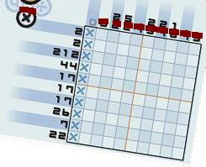
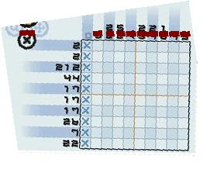
Anti-SKew
steps:
for each “black” pixel, vote for lines
pick most voted and rotate accordingly

Slide 6
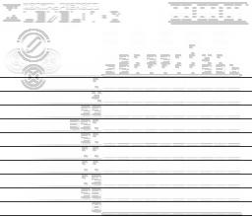
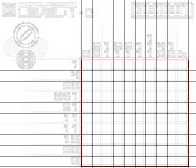
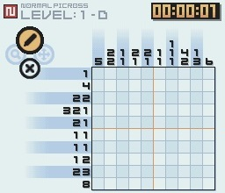
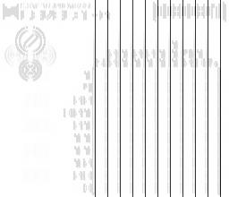
Detect Grid
steps:
run horizontal and vertical filters to detect lines
look for and vote on line candidates in each
heuristics for even spacing and removing outliers

Slide 7
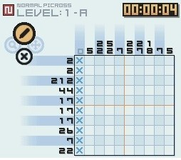
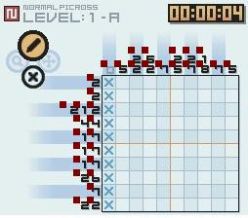
Find Numbers
steps:
for each possible grid cell, find average intensity and variance
if variance over threshold, mark as number

Slide 8
OCR Numbers
steps:
for each “black” pixel, vote for lines
pick most voted and rotate accordingly

Slide 9
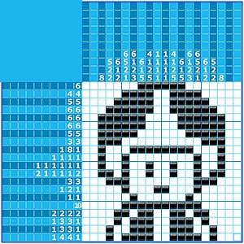
Picross Solver

Slide 10
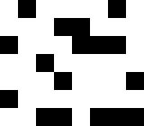
Display Puzzle
[[0, 1, 0, 0, 0, 0, 1, 0],
[0, 0, 0, 1, 1, 0, 0, 0],
[0, 1, 1, 1, 0, 0, 0, 1],
[0, 0, 0, 0, 0, 1, 0, 0],
[1, 0, 0, 0, 1, 0, 0, 0],
[0, 0, 0, 0, 0, 0, 0, 1],
[1, 1, 1, 0, 1, 1, 0, 0]]
steps:
takes in 2D boolean solution array
make a new image, setting pixels as black or white according to the provided array

Slide 11
To do
finish puzzle solving step
integrate webcam real-time photo taking
understanding intermediate solutions

