Slide 1
Viewer4D
Han.peng@physics.ox.ac.uk

Slide 2
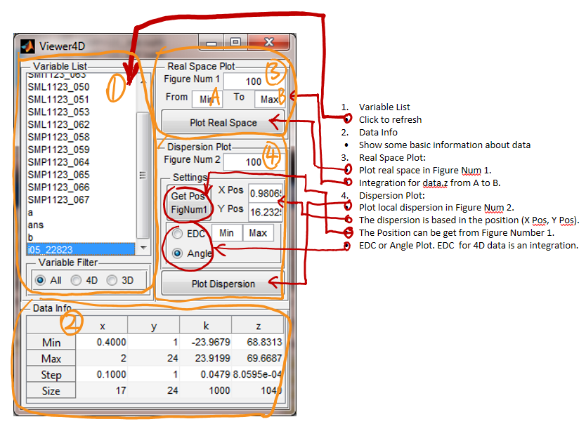

Slide 3
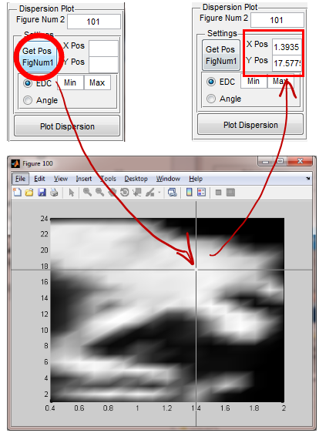

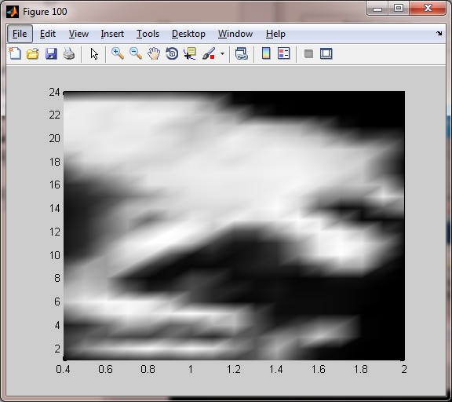

Slide 4
