Slide 1
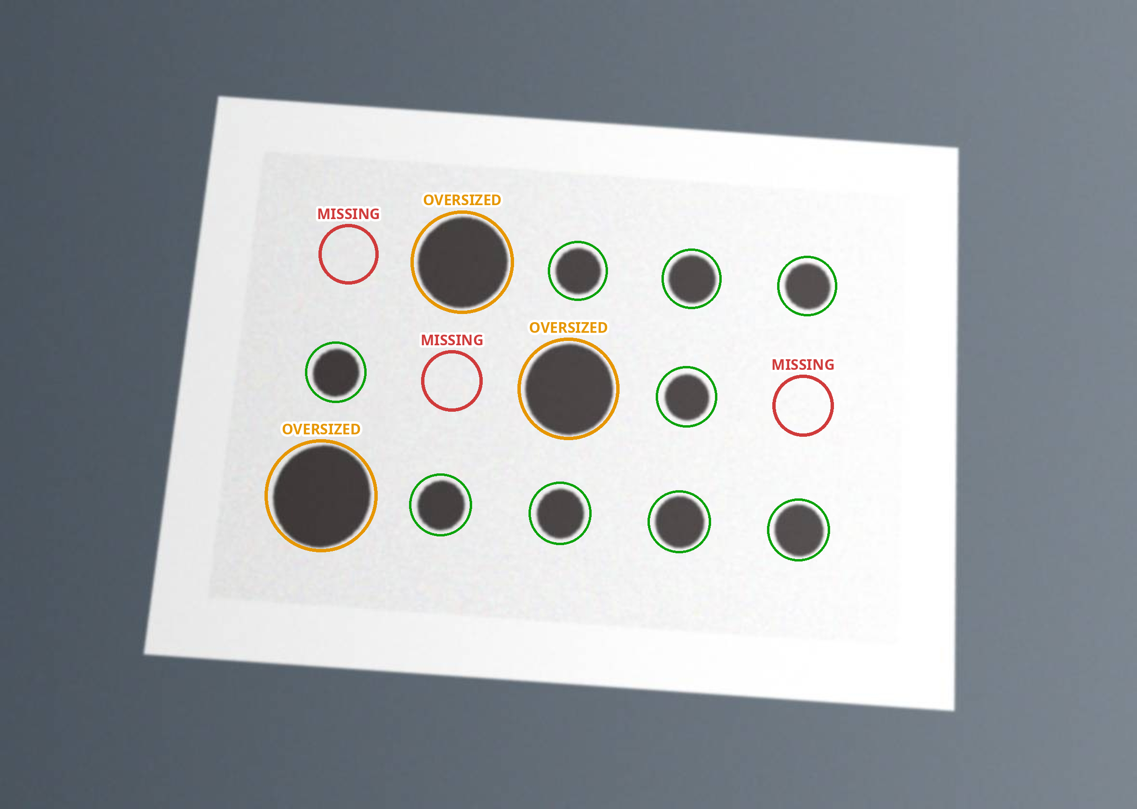
AI HORIZON 2026 · CHALLENGE 2 · NSW AUTOMATION
AI Dispensing
Defect Detective
A phone photo and five questions → the likely cause, the reasons behind it, and what to check first.
And a case history that only learns from fixes that were proved.
All 5 steps · dynamic questions · all 4 bonus challenges
A phone photo of a printed sample card, lying on a desk. Each missing deposit is followed by an oversized one: the system reads carryover, p = 0.010.
Team Lithium · Universiti Sains Malaysia
Notes:
~18 s. Good morning. We're Team Lithium, three of us from Universiti Sains Malaysia, and we took NSW Automation's challenge all the way: the five core steps, the dynamic-questions bonus, and all four bonus challenges. That's a phone photo of a part lying on a desk. The system lines the recipe up with it and reads the pattern: three missing deposits, each one followed by an oversized one. That's carryover.

Slide 2




THE PROBLEM
Dispensing defects are diagnosed by experience — and experience doesn't scale
New technicians guess
Three changes at once
Knowledge walks out
A score nobody can check
Inconsistent size alone has five plausible causes. The first check becomes a hunch — and a wrong strip-down costs a shift.
Re-prime, raise the pressure, swap the needle. The defect goes away, and nobody can say which change did it.
What the senior engineer knows is written down nowhere the next case can reach.
An engineer who can't see why a number says 85% won't act on it. Black-box confidence gets ignored on the line.
NSW Automation's brief: help engineers and technicians perform faster preliminary troubleshooting — not replace them.
Notes:
~26 s. When dots come out wrong, an experienced engineer knows where to look. A new technician doesn't — inconsistent size alone has five plausible causes, and a wrong guess can mean stripping a valve for a whole shift. So people change three things at once. The defect goes away, and nobody can say which change fixed it — the next case starts from zero. Meanwhile what the senior engineer knows is written down nowhere the next case can reach. And a confidence score an engineer can't check is a score they'll ignore.

Slide 3










THE SOLUTION
One guided session, from a phone photo to a proved fix
1 Photograph
2 Interview
3 Rank
4 Check
5 Verify
6 Learn
Measures size spread, shape and missing dots — however the photo is framed
Five questions, then follow-ups picked because their answer changes the ranking
Seven causes from the manual — every % built from cited reasons
Look first, then change one thing; the ranking updates live
Re-photograph: in spec on every check, held 20+ shots
Only proved fixes become precedent for the next case
WHAT IT ENABLES
A technician's first check, ranked with reasons
An audit-ready PDF on every case
Only proved fixes become precedent
Offline on a line PC — a phone is enough
Notes:
~42 s. One guided session does the whole thing. The operator photographs the deposits — any framing, phone in hand. Five questions. Then up to two follow-ups, and each follow-up is chosen because its answer would move the ranking most. Seven causes come back ranked, every percentage built from reasons you can read. The operator looks first, changes one thing, and the ranking updates live. A fresh photo verifies the fix. What that enables: a new technician's first check is ranked, with reasons, instead of a hunch. Every case leaves an audit-ready PDF. Only fixes that were actually proved become precedent. And it runs offline on a line PC — a phone camera is enough.

Slide 4



THE AI
Two brains that are allowed to disagree — over a manual you can audit
Knowledge database
Dual-brain ranking
Senior-engineer loop
Seven causes and 42 weighted rules, every one citing NPL's Best Practice Guide by section and page. Past confirmed cases are counted as precedent: “similar problems occurred 12 times; in 8, the cause was trapped air.”
Pass 1 — a deterministic rule engine does the arithmetic in log-odds and sets every percentage. Pass 2 — an LLM critic reads the same evidence and can disagree. Disagreement lowers the tier and says so. The model never sets a number.
The operator escalates mid-case; the senior answers inside the case, logs the check that settles it, and can change a rule's weight — with a reason. It learns from people, not only from data.
96%
66% vs 14%
108
top cause correct when three or more reasons back it — 48% on one reason. The operator can count them on screen.
correct from one photo and five answers, with a quarter of the answers wrong — against a chance baseline of 14%.
automated checks: 79 backend tests, 27 measurement oracles, 2 end-to-end golden cases.
Precedent can lower confidence, never raise it — so the system cannot talk itself into being right.
Notes:
~50 s. Three parts make that work. A knowledge database — seven causes and forty-two weighted rules, every one citing NPL's Best Practice Guide by section and page. A dual-brain ranking system: pass one is a deterministic rule engine that does the arithmetic in log-odds and sets every percentage; pass two is an LLM critic that reads the same evidence and can disagree. When they disagree we drop the confidence tier and say so, instead of hiding the split — the language model never sets a number. And a senior-engineer feedback loop: the operator escalates, the senior answers inside the case and can change a rule's weight, with a reason. We measured this rather than asserting it: with three or more reasons behind it the top cause is right 96 percent of the time; with one, 48 — a coin flip. And precedent can only lower confidence, never raise it, so the system can't talk itself into being right.

Slide 5
RULE c.2 · THIRD-PARTY DECLARATION
What we built, and what we used
Our own work
Third-party, declared
The fault tree and its weighted, cited rules
Two-pass ranking, the chance and precedent gates, tiers T1–T4
The five-condition close rule and the verdicts
Five-axis interview and the follow-up selection
Retrieval and precedent counting
Photo registration, desk masking, all metrology
The synthetic defect generator and the evaluation
NPL Report MATC(A)82 — Best Practice for Electronic Materials Dispensing (2001), © Crown copyright, cited on screen
NSW Automation challenge brief — rules citing “NSW brief p.N”
Groq API, openai/gpt-oss-20b — optional critic, free-text mapping, written explanation
FastAPI, Pydantic, SQLAlchemy, Alembic · OpenCV, NumPy
Next.js, React, Tailwind, shadcn/ui, Base UI, lucide
Dev only: pytest, Playwright, matplotlib
No model was trained or fine-tuned, and the vision uses no training data — it is classical OpenCV, reproducible by an engineer with a microscope.
Notes:
~16 s. Declared under rule c.2. The knowledge is NPL Report MATC(A)82, Crown copyright, cited on screen wherever it's used. Groq runs the optional LLM. FastAPI, Next.js, OpenCV. Everything else is ours — the fault tree, the two-pass ranking, the gates, the close rule, the photo registration, the metrology. No model was trained or fine-tuned, and the vision uses no training data at all.

Slide 6

LIMITATIONS
What it doesn't do — stated before you have to find it
No real production photos
NSW had none to give us, so every threshold is tuned on synthetic images. Validating on real NSW photos is step one of a pilot. This is our biggest gap.
Seven causes
Stringing, smearing and satellites (up height, NPL §3.3) have no cause yet. They're reported as “no cause ahead” and escalated — not guessed.
Busy boards
A trace touching a deposit can read as a distorted shape: 9% false alarms under light clutter. The fix is a bare-board reference photo.
Pixels, not microns
Everything is relative to the recipe; absolute volume needs a scale reference or a known pitch.
The LLM isn't reproducible
Critic and explanation can vary between runs — which is exactly why neither is allowed to change a likelihood.
The measurement oracle deliberately includes cases the system fails, asserted as failures rather than hidden.
Notes:
~22 s. What it doesn't do. NSW had no production photos to give us, so every threshold is tuned on synthetic images — validating on real ones is step one of a pilot. That's our biggest gap, and we'd rather say it than have you find it. Seven causes: anything outside them is reported as 'no cause ahead' and escalated, not guessed. On a busy board, a trace touching a deposit can still read as a bad shape. And measurements are in pixels, not microns.

Slide 7
Faster first checks.
An auditable record.
A history that only learns from proved fixes.
Live demo →
Team Lithium · Universiti Sains Malaysia · AI Dispensing Defect Detective
Notes:
~8 s. That's the system. Let me show you one case, from a phone photo to a confirmed fix. [Switch to the browser — don't read this slide out.]

Slide 8
BACKUP · EVIDENCE
The more reasons behind it, the more often it's right
66%
top cause right from one photo and five answers, with an operator whose answers are only 75% reliable — chance is 14%
6,600
synthetic photos and 420 simulated cases through the real code, in every evaluation run (about a minute)
108
automated checks — 79 backend tests, 27 measurement oracles, 2 golden cases — plus a browser run of the whole wizard
Photo + answers · 420 simulated cases at three answer-reliability levels · chance = 14%
All test images are synthetic — NSW provided no production photos. Method, limits and every table: evaluation/README.md.
Notes:
Backup for 'how accurate is it?'. Three or more reasons → 96% correct; one reason → 48%, a coin flip.

Slide 9
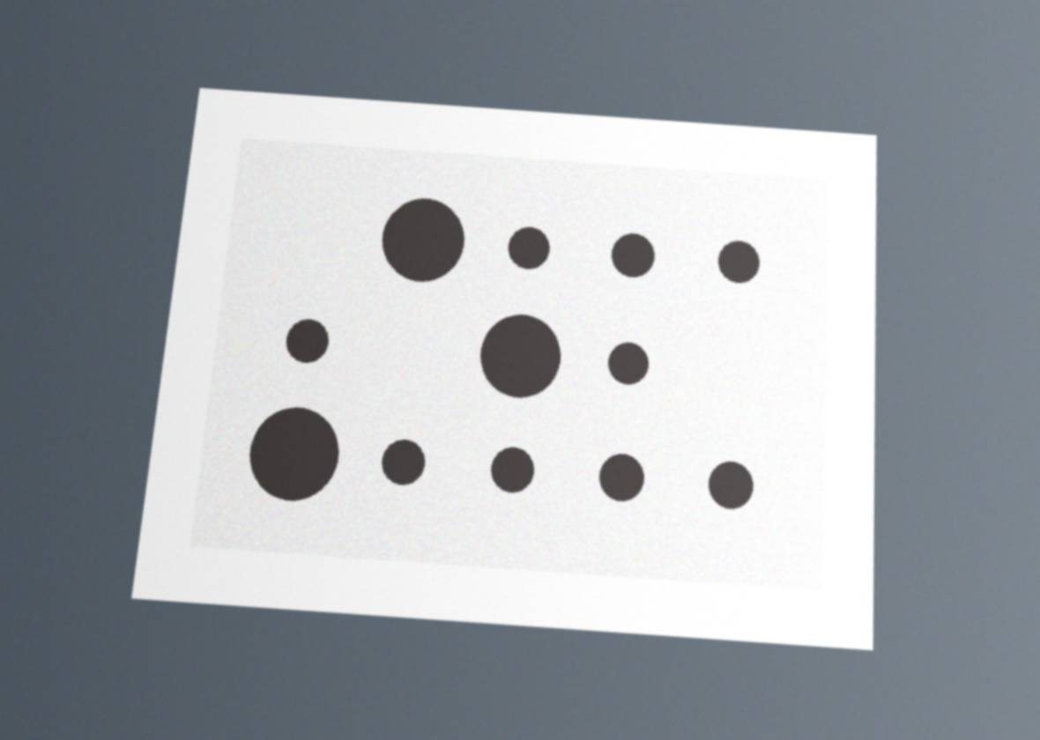
BACKUP · FEASIBILITY
Works on the photo an operator actually takes
0% → 89%
of phone-style photos measured correctly, before → after registration — the same as perfectly framed ones
0
false alarms from zoom, framing, tilt or a desk in shot
Phone photo: card on a desk, camera tilted and off-centre
Recipe lined up (scale, rotation, perspective), then measured: 3 missing, 3 oversized, carryover p = 0.010
Photo simulated from a printed sample card (the evaluation's 'on desk' condition). Validating on real NSW photos is step one of the pilot.
Notes:
Backup for 'does it work on a real photo?'. Our own stress test found it only measured recipe-framed photos; registration fixed that.

Slide 10
BACKUP · TRUST
Closing a case is not the same as fixing it
CONFIRMED
PLAUSIBLE
UNVERIFIED
All five proved
Some proved
Nothing proved
a check confirmed one cause
exactly one change, aimed at it
re-measured against a 'before' photo
in spec on every check
held 20+ shots
e.g. cause certain (tier T1) — but one deposit is still missing after the fix
filed with the gaps named — e.g. '3 things changed at once: no way to say which one worked'
The only cases future rankings learn from
Shown as context; adjusts nothing
Adjusts nothing
T1 says how sure the ranking is. CONFIRMED says the fix was proved.
Notes:
Backup for 'how do you know a fix worked?'. When a case closes it gets a verdict. CONFIRMED needs all five: a check confirmed one cause, exactly one change was made and aimed at it, the photo was re-measured against a before photo, it came back in spec, and it held for twenty shots. Anything less is PLAUSIBLE or UNVERIFIED, and the record names what's missing, like 'three things changed at once, no way to say which one worked'. Only CONFIRMED cases become precedent, so a guess never gets taught to the system. T1 is how sure the ranking is; CONFIRMED is proof the fix worked.

Slide 11

BACKUP · CONFIDENCE TIERS
Four confidence tiers — and agreement never raises one
First: did a check on the machine confirm the top cause? Then it's T1, whatever the brains or gates say.
→ T1
Measured pattern beats chance
Gate A · small-then-big pattern, p < 0.05
Nothing measured decides
a size spread alone is shared by several causes
Brain 2: no objection
agrees, isn't sure,
or has no LLM key
T1
Strong
T2
Provisional
Plus 3+ matching confirmed cases, none disagreeing (Gate B). Otherwise T2.
Shows: one lead cause, with its evidence
No measurement singles the lead out.
Shows: the lead, marked provisional, and the check to confirm it
Brain 2 objects
a clear, different top pick
T3
Disagreement
T4
Don't force it
The measurement still backs Brain 1's cause.
Shows: both candidates, Brain 1's on top
Nothing measured separates the two causes.
Shows: no lead cause, just the check that settles it
Every tier says why on screen: “Provisional: fewer than 3 matching confirmed cases back it. A check that confirms it would settle it.”
Notes:
Backup for 'how is confidence decided?' and 'what if the AI disagrees?'. The tier tells the operator how far to trust the ranking. First: if a check on the machine confirmed the top cause, it's T1, because a test outweighs a reading of the evidence. Otherwise T1 needs three things: Brain 2 has no objection, the measured pattern beats chance, and at least three matching confirmed cases back it, with none disagreeing. If anything is missing it's T2, provisional, and the screen says what's missing. If Brain 2 objects, it's T3 when the measurement still backs Brain 1, or T4 when nothing separates the two, and then it shows the check that settles it instead of picking one. Agreement never raises a tier: two readers can make the same mistake. No LLM key means Brain 2 doesn't run, which counts as no objection, not agreement. Gate B can also lower the leader's score, by up to 0.4 log-odds, when more than half of the matching confirmed cases disagree; it never raises one.

Slide 12
BACKUP · EVALUATION
The photo matters most when the answers are worst
57% vs 40%
top cause right when half the answers are guesses — with the photo, and without it.
● With the photo: 81% → 66% → 57%
● Questions only: 71% → 54% → 40%
Chance is 14% (one in seven). 420 simulated cases per point; answers from scenario cards written from the NPL guide, not from the rules.
Notes:
Backup for 'what does the photo add?' and 'what if the operator answers badly?'.

Slide 13
BACKUP · EVALUATION
It refuses rather than misleads
9%
false alarms under light board clutter — the only tested fault that misleads. The fix is a bare-board reference photo.
Everything else measures correctly or is refused with a reason. 'Missed' is the dispense-order pattern found in about half of carryover photos — the interview then carries it.
Notes:
Backup for 'what if the photo is bad?'. 20 images per condition per level, 6,000 damaged photos in all.

Slide 14

BACKUP · INDUSTRY IMPACT
Ready to pilot on an NSW line
Value on day one
Pilot plan
A new technician's first check — ranked, with reasons
1
Validate on 50–100 real NSW photos per product
An audit-ready report for every case, printable as PDF
2
Subtract a bare-board reference photo to remove clutter false alarms
A troubleshooting history that only keeps proved fixes
3
Rules as data: engineers add causes (e.g. up height, NPL §3.3) without code
Runs offline on a line PC; a phone camera is enough
4
Predict: open a case automatically when a line's size spread starts drifting
Notes:
Backup for 'could NSW actually deploy this?' and feasibility questions.

Slide 15
BACKUP · WHAT THE NUMBERS MEAN
Score, tier, verdict: three different questions
AFTER THE PHOTO
AFTER EVERY RANKING
WHEN THE CASE CLOSES
Quality score
Confidence tier
Verdict
How good are the dots?
How far can I trust the ranking?
Was the fix proved?
20/100
T1
T2
T3
T4
CONFIRMED
PLAUSIBLE
UNVERIFIED
size, 3 of 15
Decided by: Counts of dots that pass four checks: present, size, shape, position
Decided by: The two brains and two gates, or a check that confirmed the cause
Decided by: Five conditions, read from the check log and a re-measured photo
Detail: B9
Detail: B4
Detail: B3
Separate answers: the quality score never sets the tier, and T1 is not CONFIRMED.
Notes:
Backup for 'is that score how sure it is?' and 'what's the difference between the score, the tier and the verdict?'. Three different questions. The quality score rates the dots in the photo. The tier says how far to trust the ranking. The verdict says whether the fix was proved when the case closed. None is computed from another, and T1 is not CONFIRMED.

Slide 16
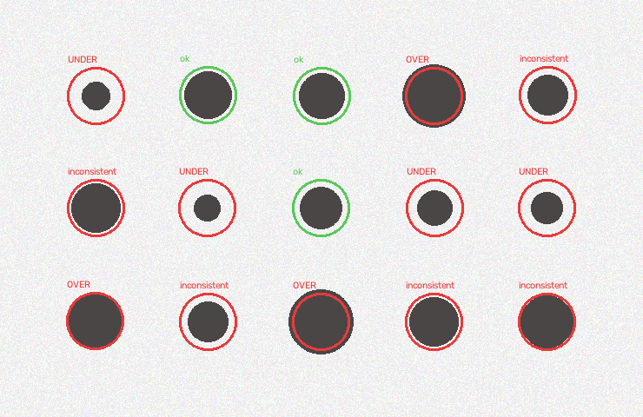



BACKUP · BONUS 2 · DISPENSING QUALITY
A quality score you can check by counting the dots
20/100
Dispensing quality
3 of 15 dots pass all four
Completeness
15 of 15 deposits present
Size consistency
3 of 15 within 15% of the nominal size
Shape consistency
15 of 15 round
Dispensing position
15 of 15 where the recipe puts them
Real output on a test photo with scattered sizes: the 3 green rings are the only dots within 15% of the nominal size.
Stars = share passed × 5, rounded down, so one failure always costs a star
Overall = dots passing all four ÷ all dots: 3 of 15 → 20/100
Rates the dots, not the diagnosis: how far to trust the ranking is the tier's job
Shown when the photo passes the quality check and the job has a recipe; without the expected dot positions there is nothing to rate.
Notes:
Backup for Bonus 2 and 'why don't I see the quality score?'. It rates the dots in the photo on four things: present, right size, round, in the right place. Each gets stars, and a single failure always costs a star. The overall score is the share of dots that pass all four: here 3 of 15, so 20 out of 100. Every number is a count you can check on the annotated photo: count the green rings. It rates the dispensing, not the diagnosis; how far to trust the diagnosis is the tier's job. It only shows when the photo passes the quality check and the job has a recipe.

