Slide 1
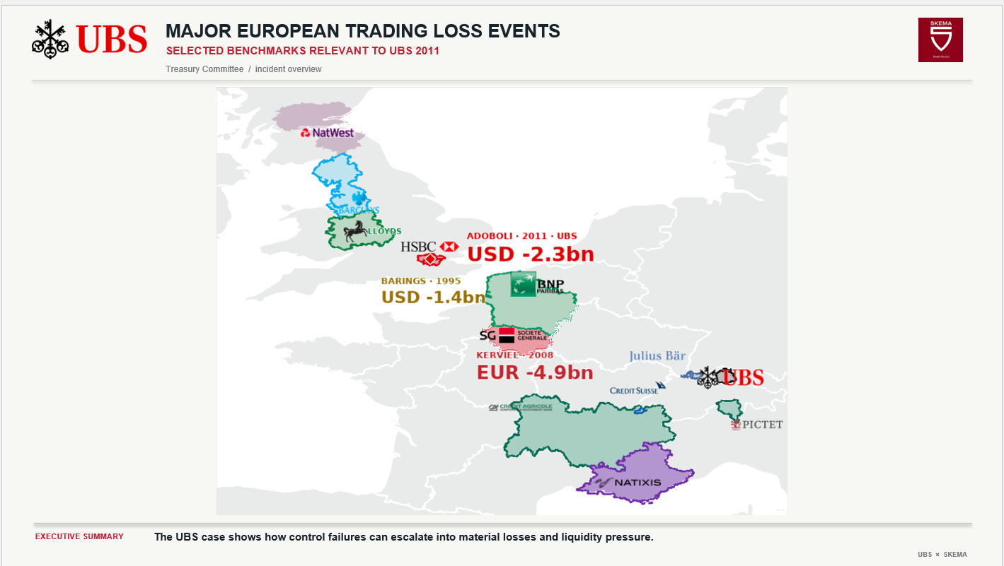

Slide 2


HOW HIDDEN POSITIONS ESCAPED CONTROLS
SECTION 1.2 · CONCEALMENT MECHANISM
REAL FUTURES EXPOSURE VS THE APPARENT INTERNAL RISK VIEW
RELATIVE EXPOSURE · SCHEMATIC, NOT TO SCALE
WHAT HAPPENED
01
REAL POSITION
REAL LONG INDEX FUTURES
Long index futures remained open in the market.
02
FALSE HEDGE
Unseen exposure
Fictitious deferred-settlement ETF entries were booked internally as offsets.
03
APPARENT RISK
Risk reports appeared limited while real exposure kept growing.
Reported risk appears limited
04
DISCOVERY
14 September 2011 · reported loss USD 2.3bn.
Positions build
14 SEP 2011 · DISCOVERY
Sources: FINMA 2012 §§11–18; FSA 2012 §§23–25. The chart is conceptual; it is not a historical exposure series.
UBS × SKEMA / 02

Slide 3
FROM CONTROL FAILURE TO TREASURY IMPACT
SECTION 1.3 · OPERATIONAL RISK → CASH → FUNDING
FOLLOW THE EXPOSURE AS IT SPLITS INTO SETTLEMENT AND COLLATERAL NEEDS
A process map: one control failure creates market exposure, then two cash channels converge on liquidity.
4A
SETTLEMENT
1
2
3
Cash due
5
6
CONTROL FAILURE
HIDDEN POSITIONS
TRADING LOSS
LIQUIDITY PRESSURE
TREASURY RESPONSE
Verification gap
False offsets
USD 2.3bn
4B
Buffer at risk
Funding action
COLLATERAL
Calls / delayed returns
ENHANCED CONTROLS & MONITORING
A trading loss becomes a Treasury issue only when it generates cash obligations through settlements, collateral requirements or funding constraints.
UBS × SKEMA / 03

Slide 4

INCIDENT TIMELINE
SECTION 1.2 · DISCOVERY, DISCLOSURE & RESPONSE
THE POSITIONS ACCUMULATED BEFORE THE SEPTEMBER DISCOVERY
14 SEP
15 SEP
FOLLOWING DAYS
FOLLOWING WEEKS
DISCOVERY
PUBLIC DISCLOSURE
CONTAINMENT
INVESTIGATION
Unauthorised positions identified.
UBS announces an initial loss estimate.
Positions reviewed; hedging and risk reduction actions.
Control failures analysed; remediation launched.
ILLUSTRATIVE CARTOON
Hidden positions accumulated before being uncovered in September 2011.
TREASURY TAKEAWAY
The discovery date starts the response horizon; it does not make prior losses a same-day cash payment.
14 Sep 2011
Three-month Treasury response horizon
SMALL
GROWING
LARGER
DISCOVERY
FINMA 2012; FSA 2012; UBS disclosures. The Dalton image is illustrative, not an incident photograph.
UBS × SKEMA / 04

Slide 5
TREASURY LIQUIDITY EVOLUTION
SECTION 2.2 · CASH BRIDGE
ILLUSTRATIVE USDm SCENARIOS · NOT HISTORICAL UBS TREASURY CASH
NO INCIDENT
INCIDENT BASE
COMBINED STRESS
Normal receipts and payments keep modeled cash above the assumed $700m buffer; minimum $984m.
Additional settlement and collateral needs reduce headroom; minimum $765m, no modeled breach.
Withdrawals and delayed collateral returns push cash below buffer on 30 Nov; peak gap $176m by 14 Dec.
Cash bridge formula: opening accessible cash + receipts − payments − settlement outflow + signed collateral movement − costs. Funding gap = max(0, buffer − cash before funding).
UBS × SKEMA / 05

Slide 6
STRESS TEST: WHEN DOES CASH FALL BELOW THE BUFFER?
SECTION 2.3 · COMBINED SCENARIO
ILLUSTRATIVE USDm · STRESS INPUTS ARE ASSUMPTIONS, NOT UBS ACTUAL CASH FLOWS
$849m − $50m − $100m − $100m − $50m = $549m
900
$849m
−$50m
30 NOVEMBER
−$100m
$549m
800
−$100m
vs. $700m buffer
700
$151m
shortfall
−$50m
14 DECEMBER
600
$549m
$524m cash · $176m peak funding need
500
ASSUMED FUNDING TIMING
INCIDENT BASE
SETTLEMENT
COLLATERAL
WITHDRAWALS
ROLLOVER
STRESS CLOSE
Assumed $200m T+2 source
25 NOV
29 NOV
30 NOV
Trigger
Arrival
First breach
If the source arrives after the breach, it cannot prevent the first shortfall. Verify facility access, collateral eligibility and settlement dates.
UBS × SKEMA / 06

Slide 7
RISK MATRIX
SECTION 3.1 · LIKELIHOOD × IMPACT
RESIDUAL RATINGS ARE ANALYST JUDGEMENTS FOR THE THREE-MONTH HORIZON
LIKELIHOOD
3
6
9
PRIORITY EXPOSURES
LIKELY
01
OPERATIONAL
Unreconciled breaks can hide open positions.
2
4
6
Market · 4
Counterparty · 4
Legal / regulatory · 4
Operational · 6
Liquidity · 6
Funding · 6
02
LIQUIDITY
POSSIBLE
Dated settlement and collateral needs can breach the buffer.
03
FUNDING
1
2
3
Maturing sources may not roll before cash is due.
Reputational · 2
UNLIKELY
No risk is currently scored likely in the base assessment.
LOW
MEDIUM
HIGH
Lower
Monitor
IMPACT
Priority
Score = likelihood × impact (1–3). Analyst ratings, not UBS / regulator scores; calibrate impact to the approved buffer and re-score after containment.
UBS × SKEMA / 07

Slide 8
CFO ACTION PLAN
SECTION 3.2 · THREE PILLARS
SEQUENCE ACTIONS FROM CASH VISIBILITY TO LASTING CONTROL
IMMEDIATE
WITHIN 24h
CONTAINMENT
DAYS
PREVENTION
3 MONTHS
LIQUIDITY ASSESSMENT
POSITION RECONCILIATION
GOVERNANCE UPGRADE
Owner · Group Treasurer
Owner · COO + Risk + Treasury
Owner · CRO
Build a dated cash view; confirm accessible liquidity and funding arrival.
Independently match positions, settlements and collateral; track unresolved breaks daily.
Strengthen independent verification, exception escalation and control ownership.
Benefit · No unexpected cash breach
Benefit · Reduce uncertainty
Benefit · Prevent recurrence
Fallback · use only confirmed, accessible funding.
Fallback · retain a conservative overlay until breaks close.
Fallback · manual dual sign-off until controls are live.
OBJECTIVE
Maintain liquidity above the minimum buffer throughout the Treasury horizon.
Count funding only when availability, collateral and arrival time are verified.
UBS × SKEMA / 08

