Slide 1


UBS Group
UBS 2011 Rogue Trading Scandal
Treasury Risk Analysis
Paul Alain Diouf · Calvin Minang · Jules Métayer · Elias Abou-Tayeh
Professor Jamil Chaftar

Slide 2
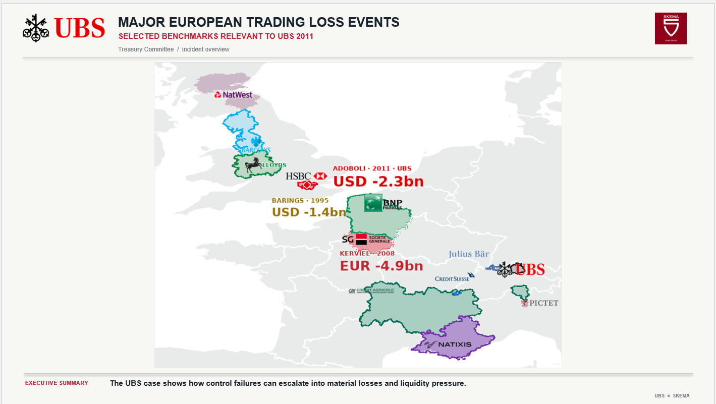

Slide 3

HOW HIDDEN POSITIONS ESCAPED CONTROLS
SECTION 1.2 · CONCEALMENT MECHANISM
REAL FUTURES EXPOSURE VS THE APPARENT INTERNAL RISK VIEW
RELATIVE EXPOSURE · SCHEMATIC, NOT TO SCALE
WHAT HAPPENED
01
REAL POSITION
REAL LONG INDEX FUTURES
Long index futures remained open in the market.
02
FALSE HEDGE
Unseen exposure
Fictitious deferred-settlement ETF entries were booked internally as offsets.
03
APPARENT RISK
Risk reports appeared limited while real exposure kept growing.
Reported risk appears limited
04
DISCOVERY
14 September 2011 · reported loss USD 2.3bn.
Positions build
14 SEP 2011 · DISCOVERY
Sources: FINMA 2012 §§11–18; FSA 2012 §§23–25. The chart is conceptual; it is not a historical exposure series.
UBS × SKEMA / 03

Slide 4
FROM CONTROL FAILURE TO TREASURY IMPACT
SECTION 1.3 · OPERATIONAL RISK → CASH → FUNDING
THE CASH CONSEQUENCE DEPENDS ON DUE DATES, COLLATERAL AND HEADROOM
CONTROL FAILURES
HIDDEN POSITIONS
Operational
Concealed
MARKET LOSSES
Trading P&L
ENHANCED CONTROLS
A trading loss becomes a Treasury issue only when it generates cash obligations through settlements, collateral requirements or funding constraints.
Settlement cash · collateral calls · delayed receipts · accessible funding
TREASURY FUNDING
RESPONSE
COLLATERAL &
SETTLEMENT
Cash sources
Cash due
LIQUIDITY PRESSURE
Buffer at risk
Central question: preserve liquidity and meet payments throughout the three-month response horizon.
UBS × SKEMA / 04

Slide 5

INCIDENT TIMELINE
SECTION 1.2 · DISCOVERY, DISCLOSURE & RESPONSE
THE POSITIONS ACCUMULATED BEFORE THE SEPTEMBER DISCOVERY
14 SEP
15 SEP
FOLLOWING DAYS
FOLLOWING WEEKS
DISCOVERY
PUBLIC DISCLOSURE
CONTAINMENT
INVESTIGATION
Unauthorised positions identified.
UBS announces an initial loss estimate.
Positions reviewed; hedging and risk reduction actions.
Control failures analysed; remediation launched.
ILLUSTRATIVE CARTOON
Hidden positions accumulated before being uncovered in September 2011.
TREASURY TAKEAWAY
The discovery date starts the response horizon; it does not make prior losses a same-day cash payment.
14 Sep 2011
Three-month Treasury response horizon
FINMA 2012; FSA 2012; UBS disclosures. The Dalton image is illustrative, not an incident photograph.
UBS × SKEMA / 05

Slide 6
TREASURY LIQUIDITY EVOLUTION
SECTION 2.2 · CASH BRIDGE
ILLUSTRATIVE USDm SCENARIOS · NOT HISTORICAL UBS TREASURY CASH
NO INCIDENT
INCIDENT BASE
COMBINED STRESS
Normal receipts and payments keep modeled cash above the assumed $700m buffer; minimum $984m.
Additional settlement and collateral needs reduce headroom; minimum $765m, no modeled breach.
Withdrawals and delayed collateral returns push cash below buffer on 30 Nov; peak gap $176m by 14 Dec.
Cash bridge formula: opening accessible cash + receipts − payments − settlement outflow + signed collateral movement − costs. Funding gap = max(0, buffer − cash before funding).
UBS × SKEMA / 06

Slide 7
WHAT IF THE SITUATION WORSENS?
SECTION 2.3 · STRESS TEST
COMBINED SCENARIO INPUTS ARE ASSUMPTIONS, NOT HISTORICAL OUTCOMES
30 NOVEMBER CASH BRIDGE · USDm
$849m
−
−$50m
−
−$100m
−
−$100m
−
−$50m
−
$549m
Incident-base
November close
Settlement
accelerated
Collateral
return delayed
Additional
withdrawals
Rollover not
renewed
Stress cash
30 November
BUFFER / FUNDING TEST
$700m
minimum buffer
$151m
700 buffer
30 Nov shortfall
$524m on 14 Dec → $176m peak funding need
BASE
SETTLEMENT
COLLATERAL
WITHDRAWALS
ROLLOVER
T+2 liquidity source: trigger 25 Nov → arrival 29 Nov → first breach 30 Nov. If late, it cannot prevent the breach.
Assumed $200m line and timing; verify availability, eligible collateral and actual settlement dates. Stress inputs are scenario shocks, not actual UBS cash flows.
UBS × SKEMA / 07

Slide 8
RISK ASSESSMENT
SECTION 3.1 · LIKELIHOOD AND IMPACT
RESIDUAL RATINGS ARE ANALYST JUDGEMENTS FOR THE THREE-MONTH HORIZON
RISK
LIKELIHOOD
IMPACT
SCORE
PRIORITY RISKS
Operational
Possible
High
6
01
Operational
Liquidity
Possible
High
6
Unreconciled breaks may hide open positions.
Funding
Possible
High
6
02
Liquidity
Market
Possible
Medium
4
Dated settlement / collateral needs can breach buffer.
Counterparty
Possible
Medium
4
03
Funding
Legal / regulatory
Possible
Medium
4
Maturing sources may not roll before cash is due.
Reputational
Unlikely
Medium
2
Other exposures: market · counterparty · reputational · legal / regulatory.
Score = likelihood × impact (1–3). Illustrative analyst ratings, not UBS / regulator scores; calibrate impact to the approved buffer and re-score after containment.
UBS × SKEMA / 08

Slide 9
CFO ACTION PLAN
SECTION 3.2 · THREE PILLARS
SEQUENCE ACTIONS FROM CASH VISIBILITY TO LASTING CONTROL
IMMEDIATE
WITHIN 24h
CONTAINMENT
DAYS
PREVENTION
3 MONTHS
LIQUIDITY ASSESSMENT
POSITION RECONCILIATION
GOVERNANCE UPGRADE
Owner · Group Treasurer
Owner · COO + Risk + Treasury
Owner · CRO
Build a dated cash view; confirm accessible liquidity and funding arrival.
Independently match positions, settlements and collateral; track unresolved breaks daily.
Strengthen independent verification, exception escalation and control ownership.
Benefit · No unexpected cash breach
Benefit · Reduce uncertainty
Benefit · Prevent recurrence
Fallback · use only confirmed, accessible funding.
Fallback · retain a conservative overlay until breaks close.
Fallback · manual dual sign-off until controls are live.
OBJECTIVE
Maintain liquidity above the minimum buffer throughout the Treasury horizon.
Count funding only when availability, collateral and arrival time are verified.
UBS × SKEMA / 09

Slide 10
UBS Group
Thank you
Sources
FINMA, Summary Report: Investigation into UBS London Trading Losses, 21 November 2012.
FSA, Final Notice to UBS AG, 25 November 2012.
UBS, Supplement No. 2, 11 October 2011.
UBS, Third-quarter 2011 results and presentation materials, 25 October 2011.

