Slide 1


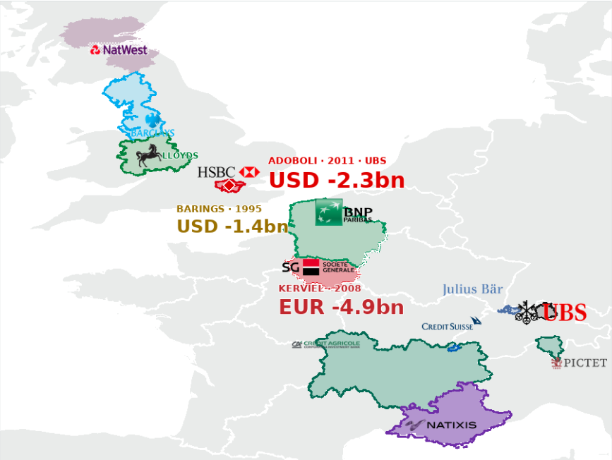
UBS INVESTMENT BANK | 2011
EUROPEAN TRADING-LOSS BENCHMARKS
Treasury Committee / incident overview
EUROPEAN LOSS EVENTS / MAP & BENCHMARKS
HISTORICAL CASES · LOSS FIGURES AS LABELLED
BENCHMARK LOSS EVENTS
Selected European trading-loss cases
BARINGS
1995
USD -1.4bn
KERVIEL
2008
EUR -4.9bn
Société Générale
ADOBOLI
2011
USD -2.3bn
UBS
LOCATION NOTE
Adoboli's trading desk: London
UBS Group headquarters: Zurich
EXECUTIVE SUMMARY
The UBS case shows how control failures can escalate into material losses and liquidity pressure.
UBS × SKEMA

