Slide 1
PIN-2023
Group 14 : Alan, Andrea, Calvin, Dylan et Justin

Slide 2
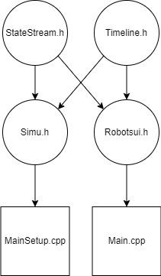
Organisation of the code

Slide 3
Work sharing
User interface : Alan and Calvin
Setup : Dylan and Lucas
Common code between user interface and setup : Andrea and Justin

Slide 4
Decontamination strategy
Particle attribution
The furthest robot takes its nearest particle
Each robot has the nearest possible particle attributed
Collisions between robots
After a robot collision one of them goes backward
Robots movement
After a particle is attributed to a robot, the robot rotates to get inlined
Robots always move in a straight line

Slide 5
Pros and cons
+
–
Task sharing
Git organisation
Good code practices (exception handling, recursion, and genercity)
Smooth robot animations
Creating a visual application in C++ for the first time
The setup group had to wait for the UI before testing
Strategy is not working well
Code quality could be improved

Slide 6
Thank you for your attention

