Slide 1
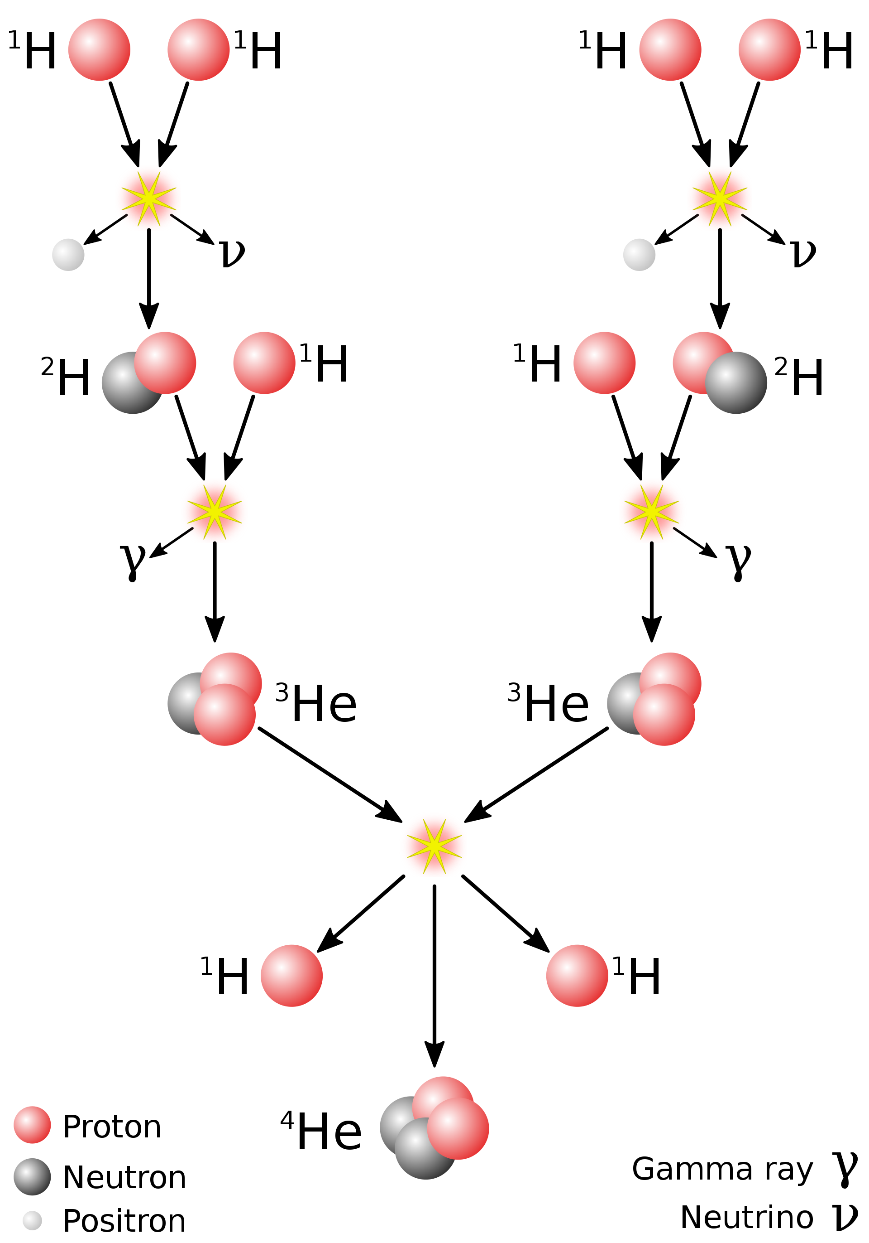
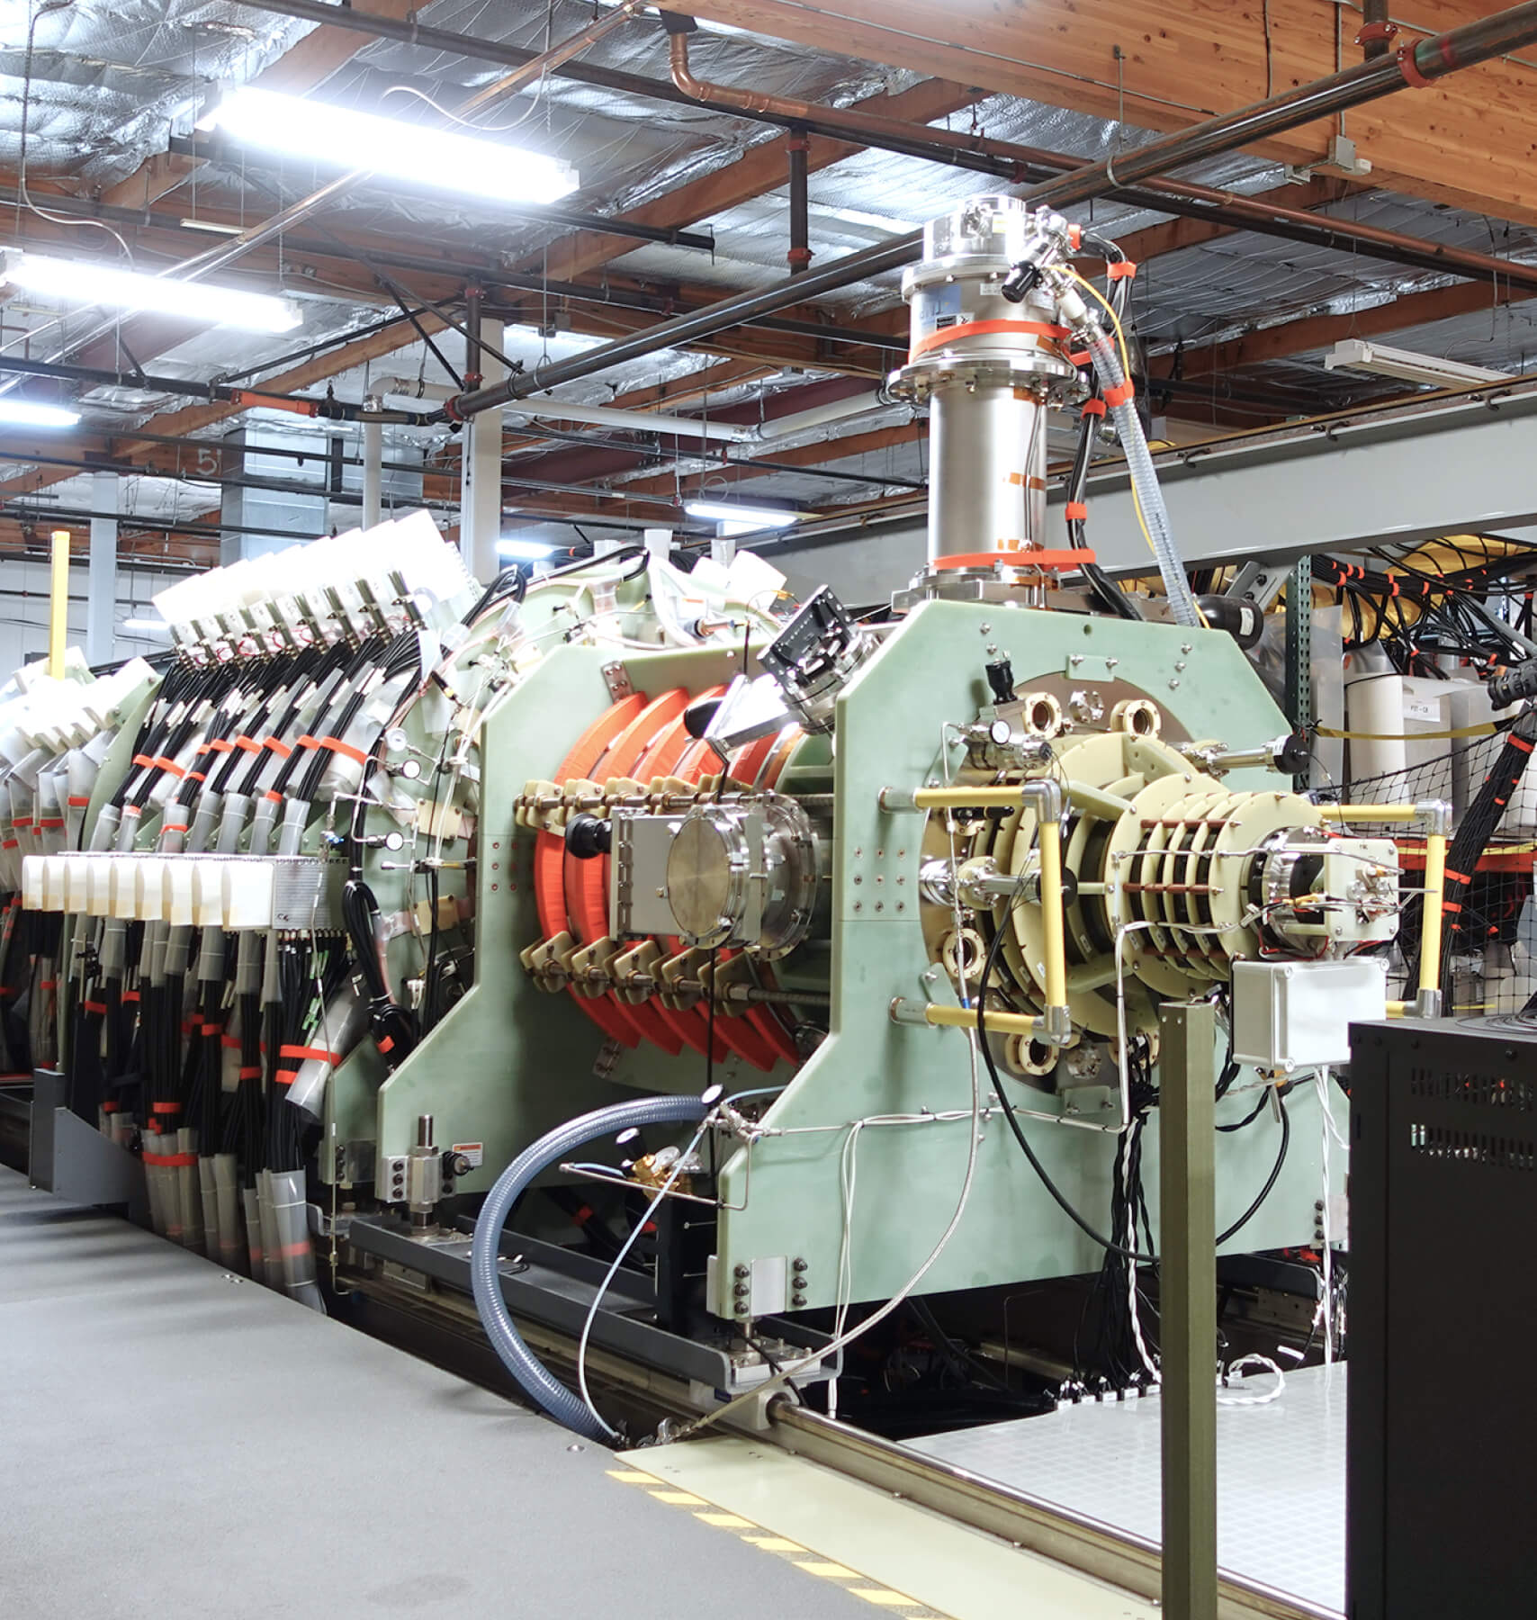
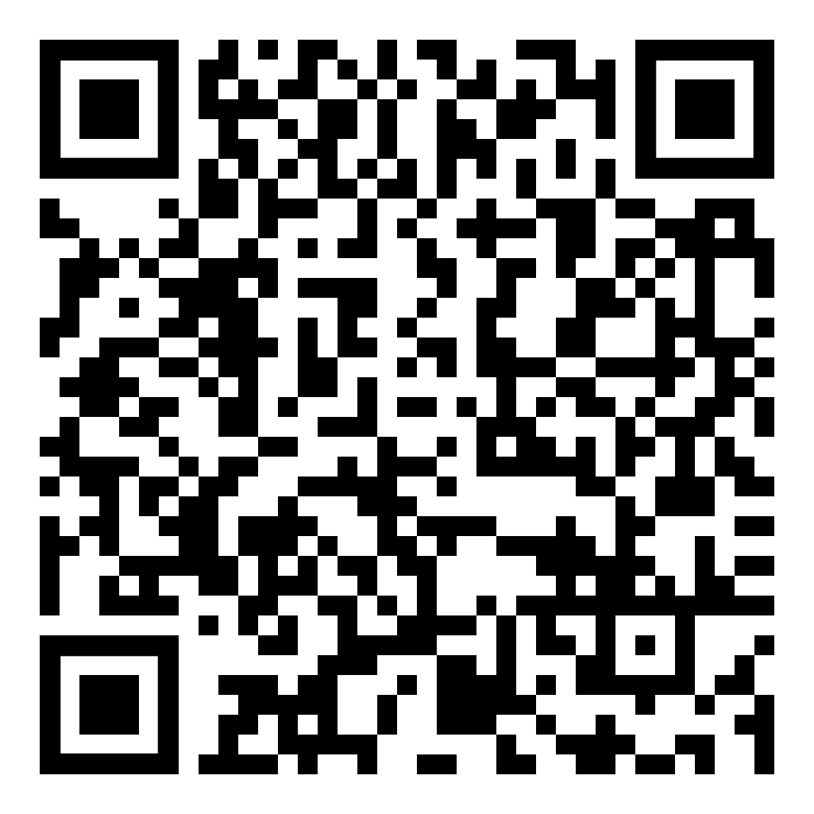
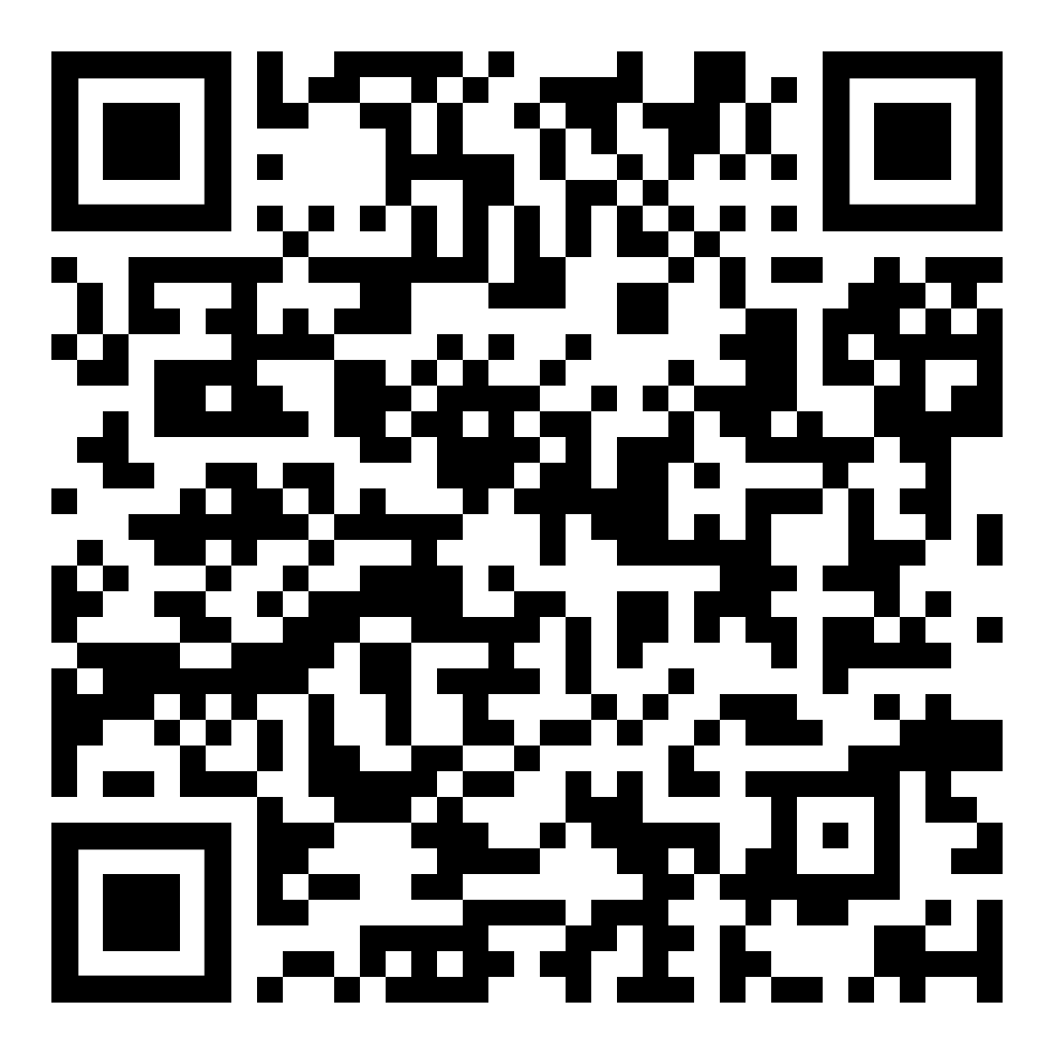
Nuclear Fusion Physicist
Imagine a world where energy is derived from the safest and most potent source—nuclear fusion. As a nuclear engineer, you have the opportunity to contribute to the realization of this groundbreaking technology. Fusion, when achieved, promises a future where energy production is not only efficient but also environmentally friendly.
Safety First
Unlike traditional nuclear power, fusion produces no long-lived radioactive waste. You'll be part of a movement towards a cleaner future. Your work in nuclear fusion will play a crucial role in mitigating environmental impacts and ensuring the well-being of generations to come.
Choose from Hundreds
From established research institutions to dynamic startups, the choices are vast. Joining a startup means being at the forefront of innovation, tackling challenges with fresh perspectives and contributing to groundbreaking solutions that can reshape the energy landscape.
Helion, with their Trenta reactor pictured left, is just one of these companies. They are located in Everette and looking to do Fusion different. Their job listings include AI developers, engineers, physicists, project managers, public outreach experts, and more!
Salary
Entry-Level Positions: $60,000 to $80,000.
Mid-Level Positions: $80,000 to $120,000.
Senior-Level Positions: $150,000 and more.
Fusion experiments
Job listings

