Slide 1
Research Sprint
Junior McGhie, Ian Wright, Paige Tyler, Russell Couch, Calvin Tourand

Slide 2
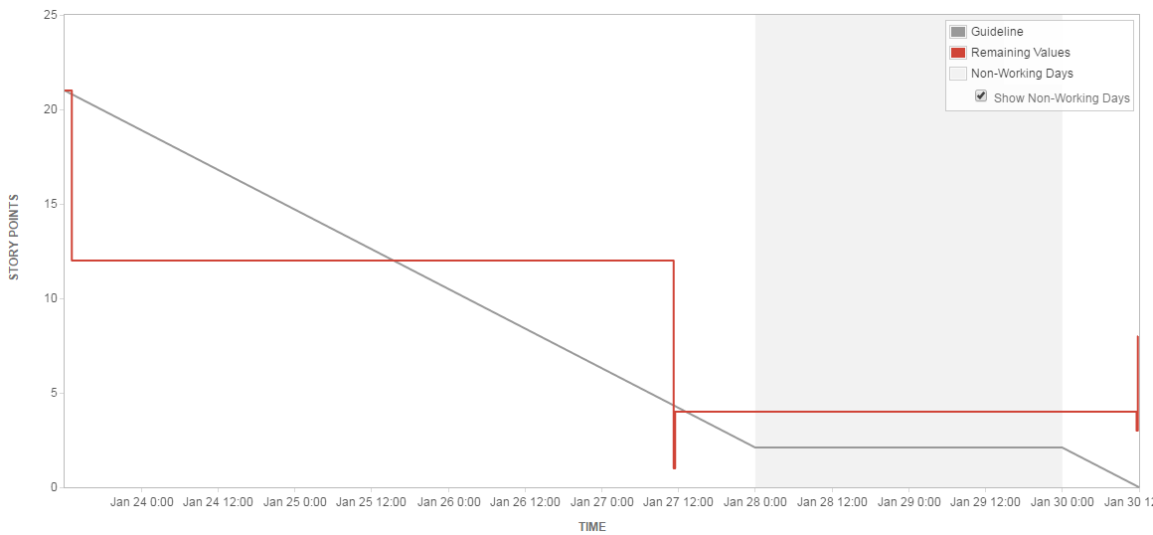
Sprint Burndown Chart

Slide 3
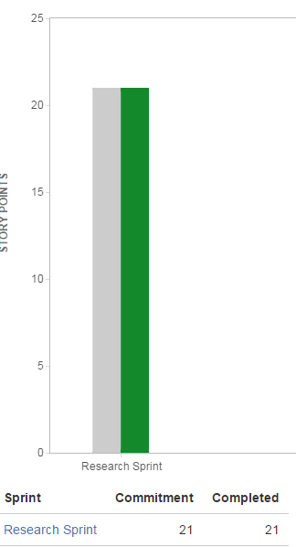
Velocity Chart

Slide 4
Retrospective
What could be done better
Hard to complete tasks for a research sprint
More effort discussing tasks that we need to do (task someone may have put up that someone else already knew how to do)
Too ugly, not pretty
Completed to-do list (bad at estimating time)
What we did well
Everyone present for client meetings
Completed To-do list
Good communication
Enthusiastic

