Slide 1
MTBLS242 · 12-MONTH METABOLIC FORECAST
What the controls found
A reported PR-AUC of 0.671 turned out to be regression to the mean.
This is how it was caught, and what the corrected analysis says.

Slide 2
SETUP
The question
Can a pre-operative serum ¹H-NMR profile forecast what happens to a
bariatric surgery patient 12 months later?
71
21
31
subjects with paired
preop + 12-month samples
quantified metabolites
(serum ¹H-NMR)
labelled strong responders
(43.7% prevalence)
MetaboLights MTBLS242. Sample IDs encode a stable subject code, which is what makes a genuine
longitudinal pairing possible. No clinical outcome exists in the public metadata — no weight loss, no remission.

Slide 3
THE CLAIM
The result that was reported
0.671
0.437
1.54×
held-out PR-AUC
prevalence baseline
reported lift
Read as: pre-operative NMR carries signal about who will respond.
It does not. Four things were wrong, and three of them are invisible to the checks people normally run.

Slide 4
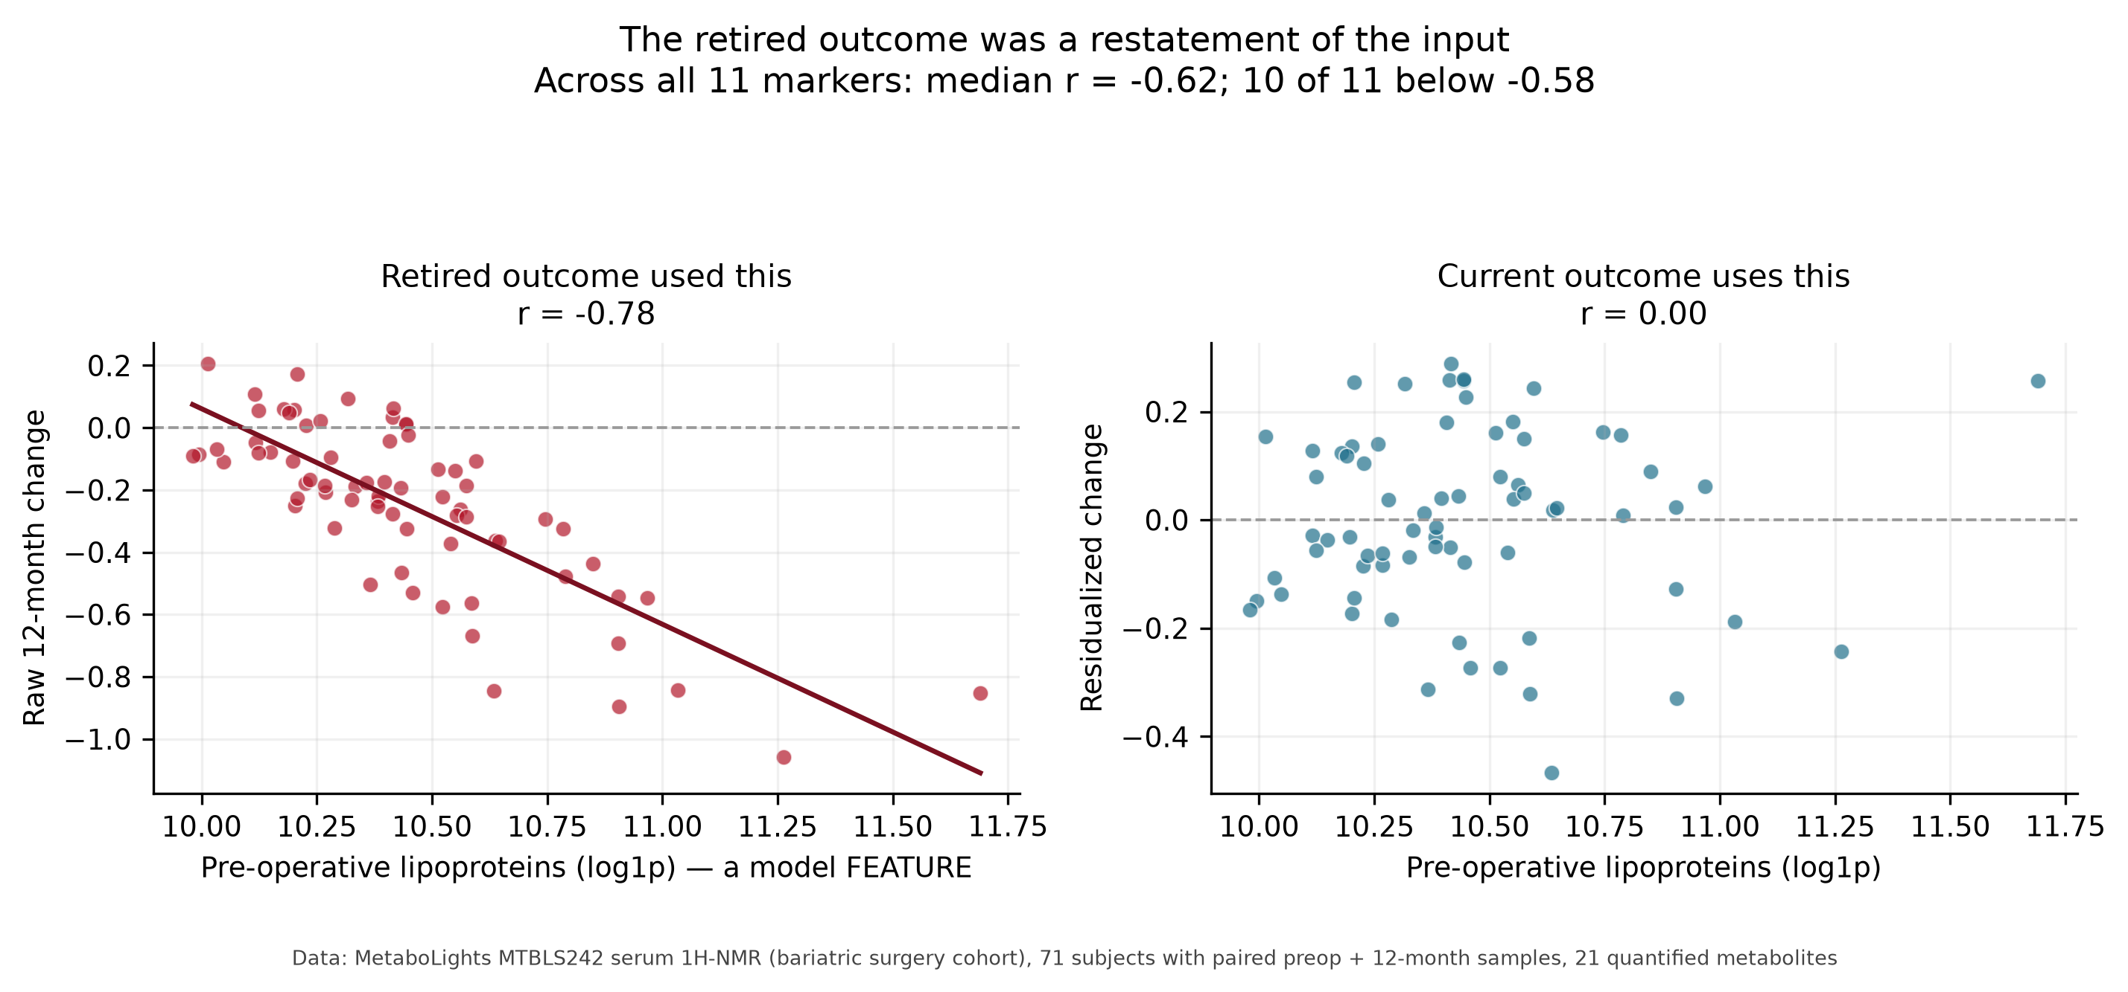
WHY IT WAS WRONG
Defect 1 — the outcome was built from the features
A responder was defined as “≥9 of 11 markers moved in the healthy direction”, measured as 12-month minus pre-operative —
on the same 11 metabolites the model was given as inputs.
An extreme baseline falls back toward the mean whether or not anything biological happened. The model was graded on something it was handed.

Slide 5
WHY IT WAS WRONG
Defect 2 — it scored below its own no-signal null
Shuffle which 12-month profile belongs to which subject, then rebuild the outcome from scratch.
No forecastable signal can survive that — every real subject-level relationship is destroyed.
1.57×
2.04×
2.51×
observed lift
null median lift
null 95th percentile
The real data scored below the middle of a distribution in which
no forecastable signal can exist.

Slide 6
THE METHODOLOGICAL POINT
Defect 3 — a permutation test would have waved it through
On the retired outcome, the standard label-permutation test returns
p = 0.002
It is not malfunctioning. The baseline genuinely does rank those labels better than chance.
But it holds the outcome fixed, so it cannot see that the outcome was manufactured from the
features in the first place.
A permutation test cannot validate a change-score outcome when the baseline is also a feature.
Only destroying the pairing can.

Slide 7
WHY IT WAS WRONG
Defect 4 — the model had never converged
0.018
0.653
0.653
largest standardized
coefficient
PR-AUC of the
“trained” model
PR-AUC of a scorer
that fits nothing
Fixed-step projected gradient descent, capped at 6000 iterations, against a penalty that was not
scaled to sample size. It stopped as a near-constant model.
Its ranking coincided exactly with an unweighted sum of the markers — which is why summing signed
baseline z-scores reproduces its score to three decimals. Every “monotonic constraint” it reported
was vacuous: the coefficients had barely left zero.

Slide 8
THE FIX
What replaced it
 | Retired | Current
Outcome | ≥9/11 markers move in the literature direction | ≥6/11 improve MORE than their own baseline predicts
Residualization | none | change regressed on baseline, fitted inside each fold
Prevalence | 0.437 (31/71) | 0.437 (31/71) — held constant
Solver | projected gradient, unconverged | L-BFGS-B box constraints, 100%
Features | 21, incl. 3 exogenous artifacts | 18, artifacts quarantined
Evaluation | one 5-fold draw, seed 42 | 20 repeats × 5-fold
Controls | none | 3 controls + bootstrap intervals
The threshold moved from 9 to 6 because residualization halves the per-marker improvement rate by construction.
It was fixed before any model was fitted, as the value that reproduces the original prevalence exactly — so the
corrected number stays directly comparable rather than confounded by a shift in base rate.

Slide 9
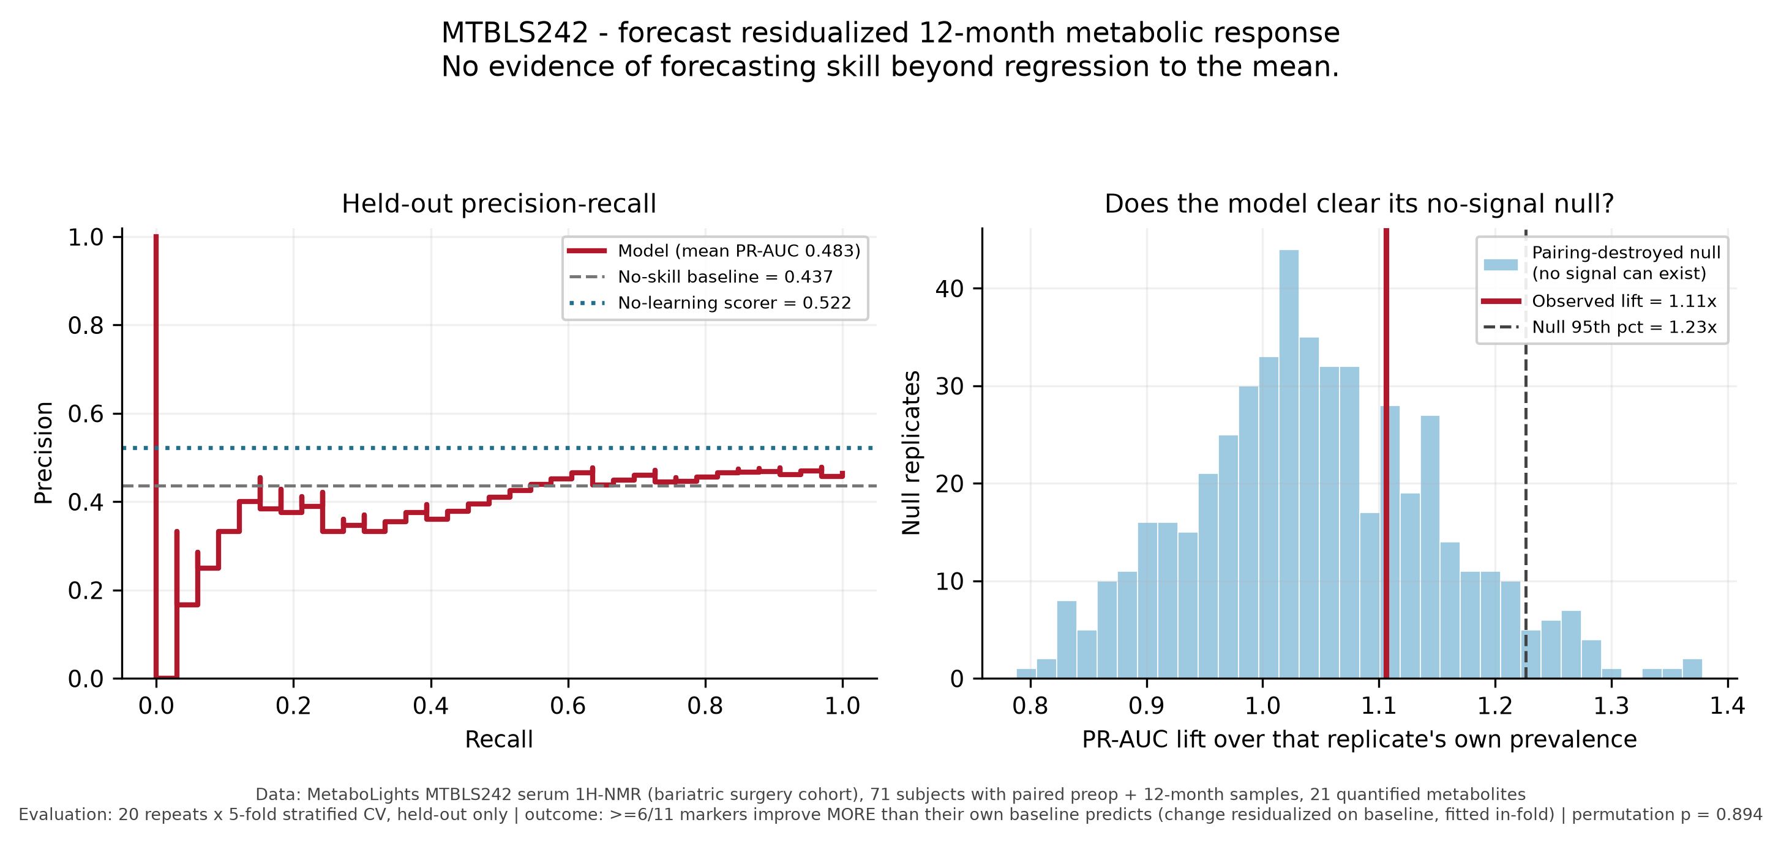
WHAT IT ACTUALLY SAYS
The corrected result
0.483
0.522
0.894
model PR-AUC
(20 × 5-fold)
no-learning scorer
— beats the model
permutation
p-value
No evidence of forecasting skill beyond regression to the mean.

Slide 10
WHAT IT ACTUALLY SAYS
Three independent controls agree
1
Observed lift 1.11× sits INSIDE the no-signal null
null median 1.04×, 95th percentile 1.24× — it does not clear it
2
The trained model is WORSE than a scorer that fits nothing
gap −0.039, 95% CI [−0.058, −0.023] — the interval excludes zero
3
Permutation p = 0.894
against the corrected outcome, the ranking is indistinguishable from chance
8 of 11 literature constraints are binding — pinned at exactly 0.0 because this cohort pulls the other way.
Obesity-status directions largely do not transfer to forecasting 12-month change here.

Slide 11
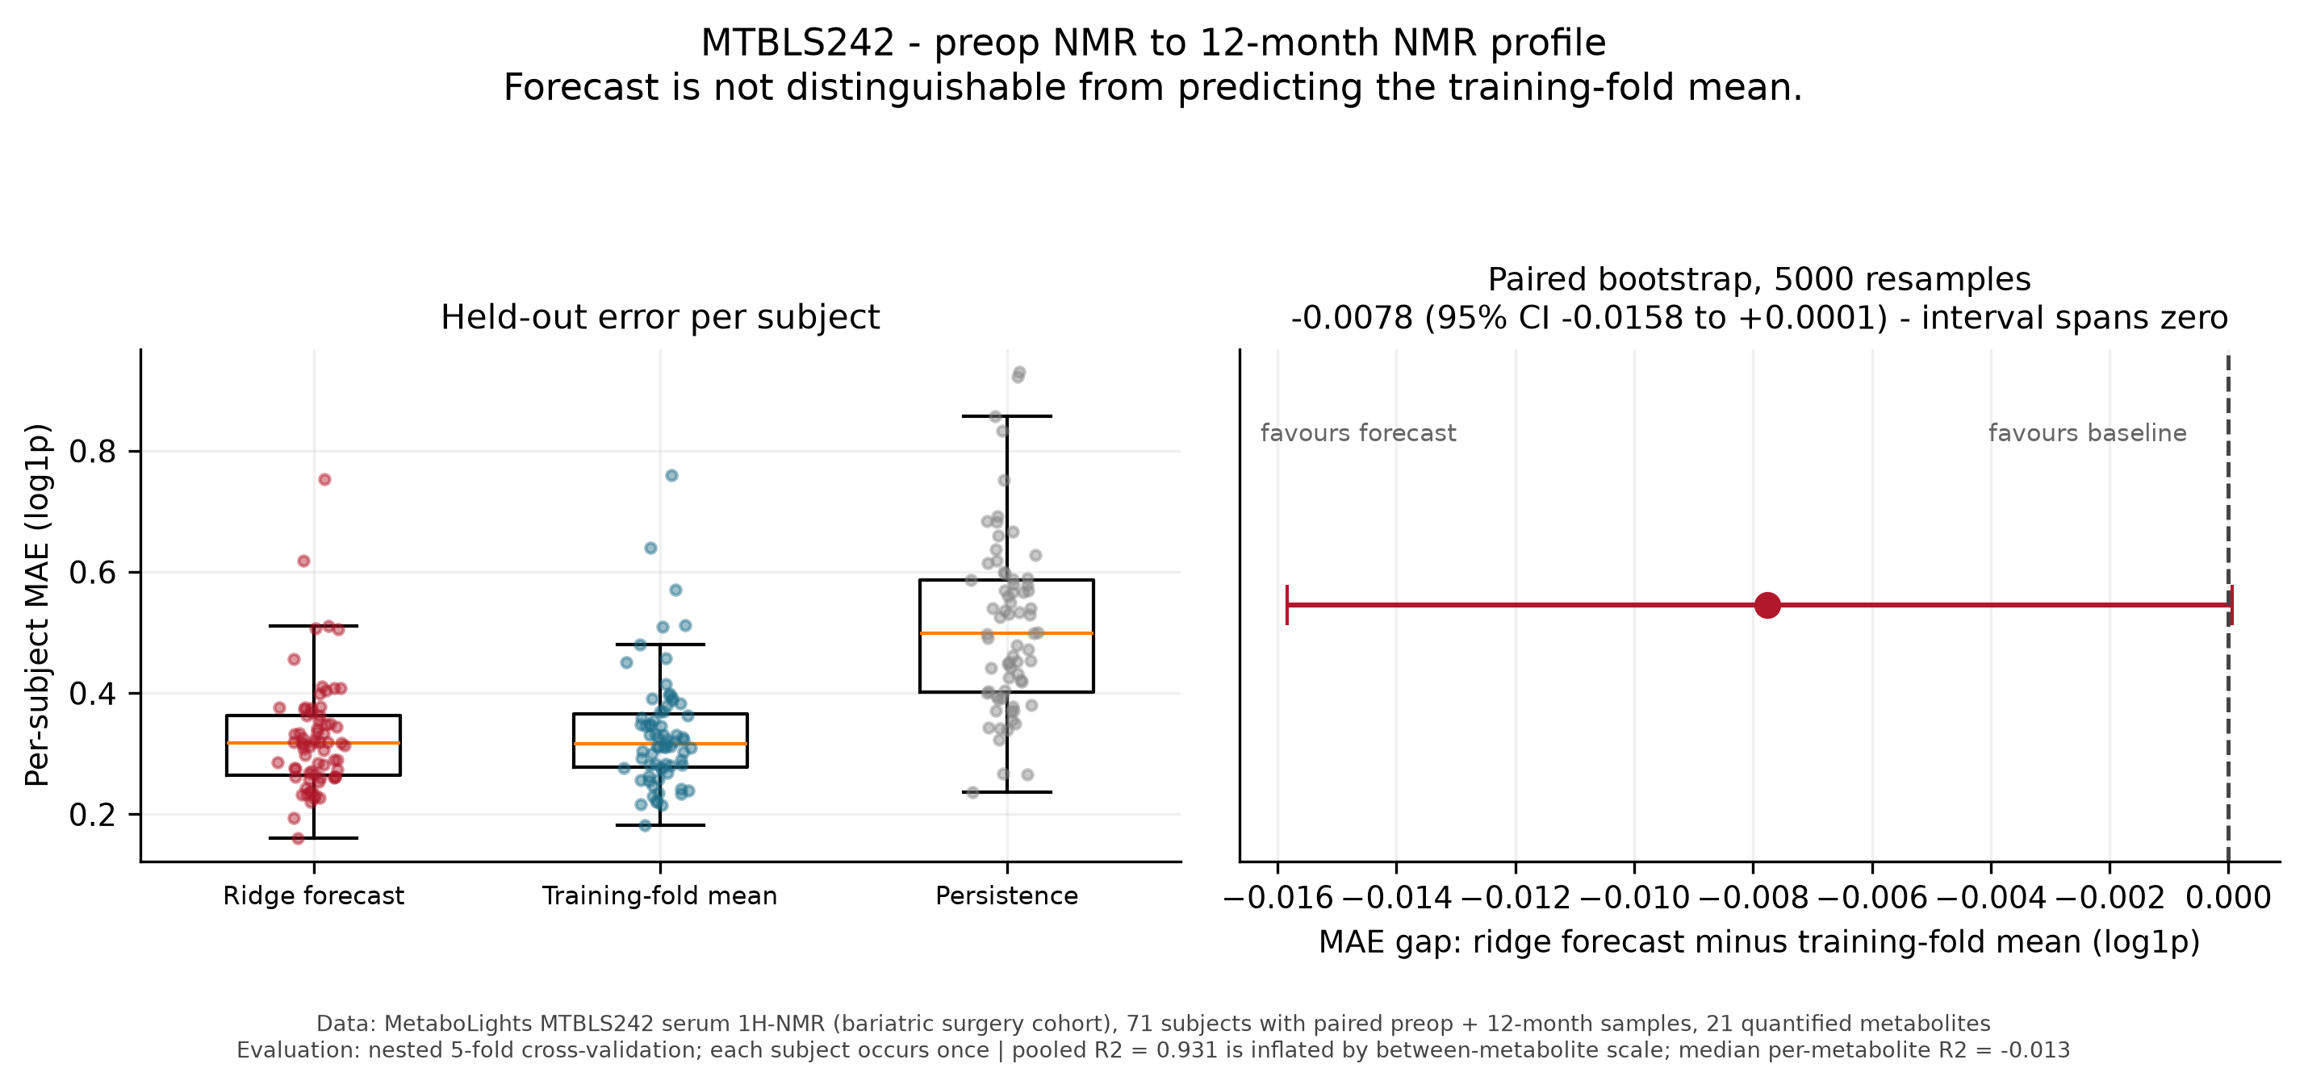
THE OTHER EXPERIMENT
The continuous forecast, same treatment
Forecasting the 12-month profile beats predicting the training-fold mean by 0.0078 MAE — but the 95% interval
spans zero, so it is not distinguishable from noise at n=71. It does clearly beat persistence.
The pooled R² of 0.931 is not performance: it is driven by scale differences between metabolites. Median per-metabolite R² is -0.013.

Slide 12
TAKEAWAY
The controls, reusable
No-learning scorer
Sum of signed, z-scored baseline markers. Catches a model that has not converged or has learned nothing its inputs did not already say. Every trained model is reported next to it.
Pairing-destroyed null
Shuffle which future belongs to which subject, then rebuild the outcome from scratch. Catches an outcome manufactured from the features. This is the one that mattered.
Label-permutation test
Necessary, and demonstrably not sufficient — it returned p = 0.002 on the broken setup.
Paired bootstrap intervals
On every model-versus-baseline gap, resampling subjects together. A 2.4% edge without an interval is not a result.
Reach for the pairing-destroyed null in any longitudinal change-score analysis where baseline is also a feature.

Slide 13
HONEST SCOPE
What this does not say
It does not say pre-operative NMR cannot forecast metabolic response.
It says this cohort, at n=71, with this outcome, does not demonstrate that it does.
A cohort with linked clinical outcomes — weight loss, remission, treatment type — and enough
subjects to estimate a small effect could still find one. MTBLS242's public metadata has none.
Also unresolved: (R)-3-Hydroxybutyric acid is 45% zeros — below-detection readings that log1p maps to exactly 0.
Bariatric patients only, so nothing about the general population or about outcomes without surgery.
A metabolite profile is not a clinical outcome.

