Slide 1
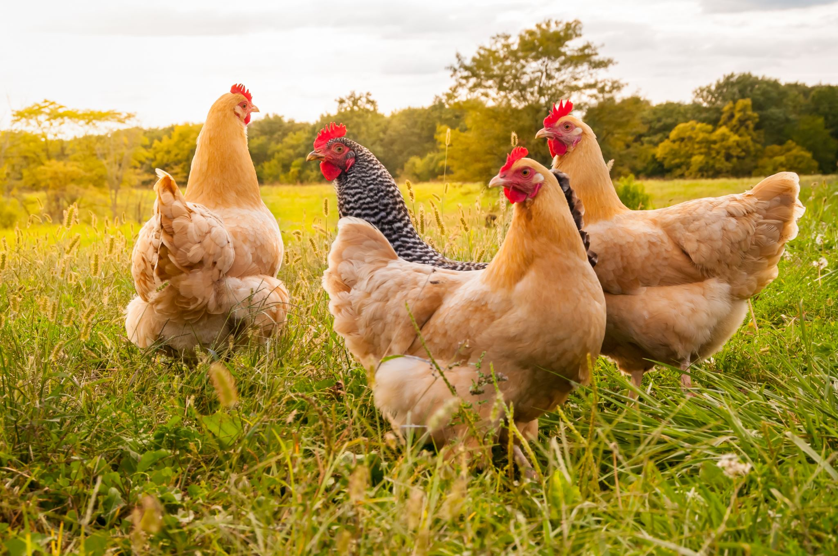
BIO_AFYA
PRESENTATION
VOL…01

Slide 2
BIO_AFYA
BIO_AFYA
PRESENTATION
VOL…01
COVER
WELCOME
Bio_Afya is an innovative system that combines AI and IoT to provide real-time health monitoring, early disease detection, and automated diagnosis for livestock. By analyzing symptoms, sensor data, and images, it delivers instant feedback, treatment recommendations, and outbreak alerts, ensuring healthier animals, reduced losses, and smarter farming.

Slide 3
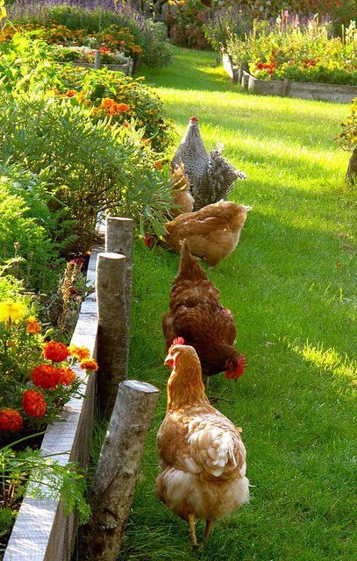
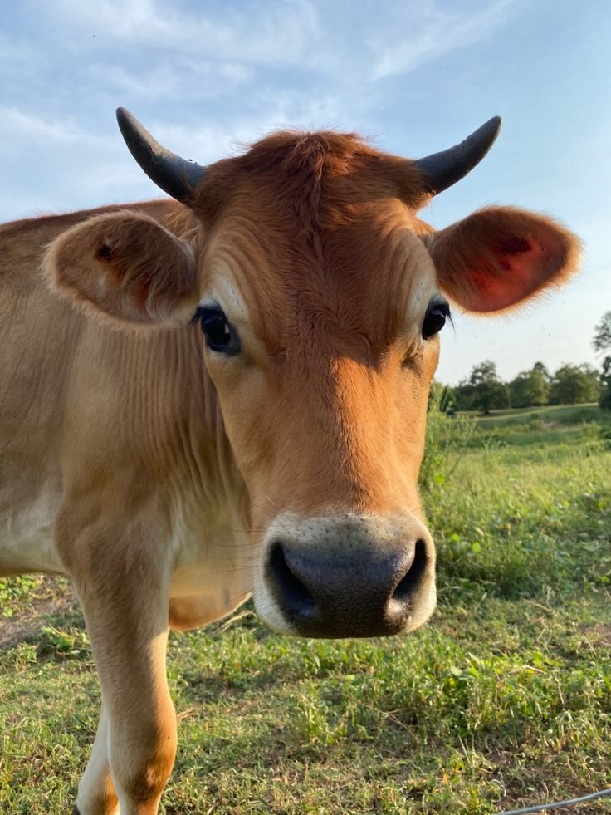
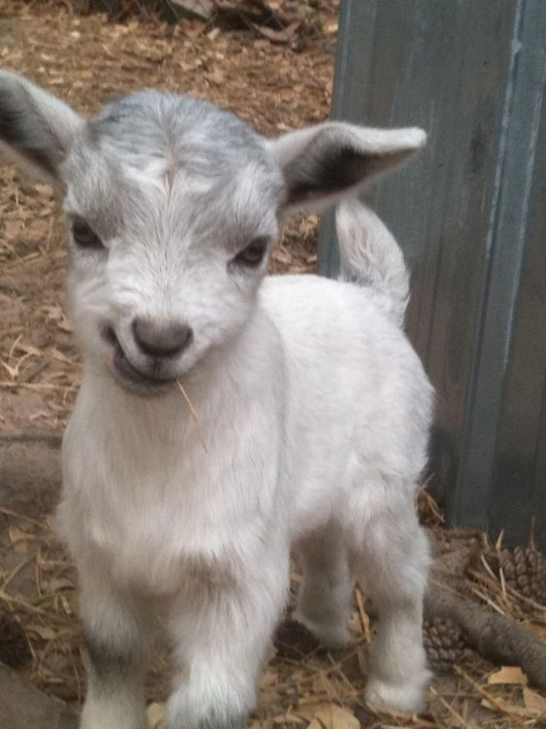
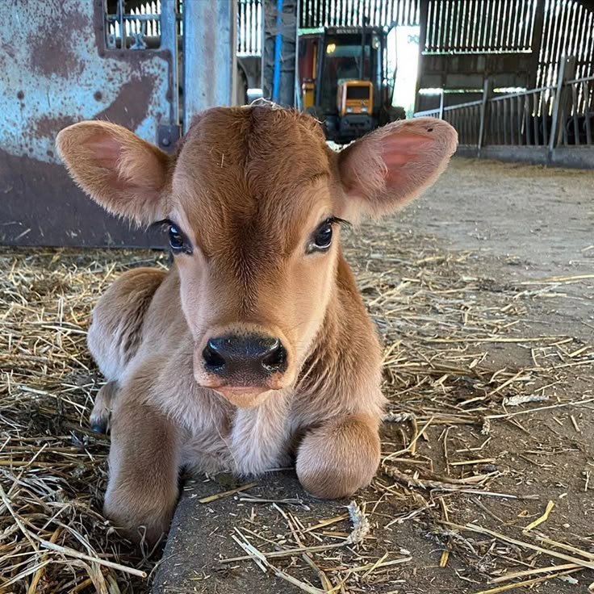
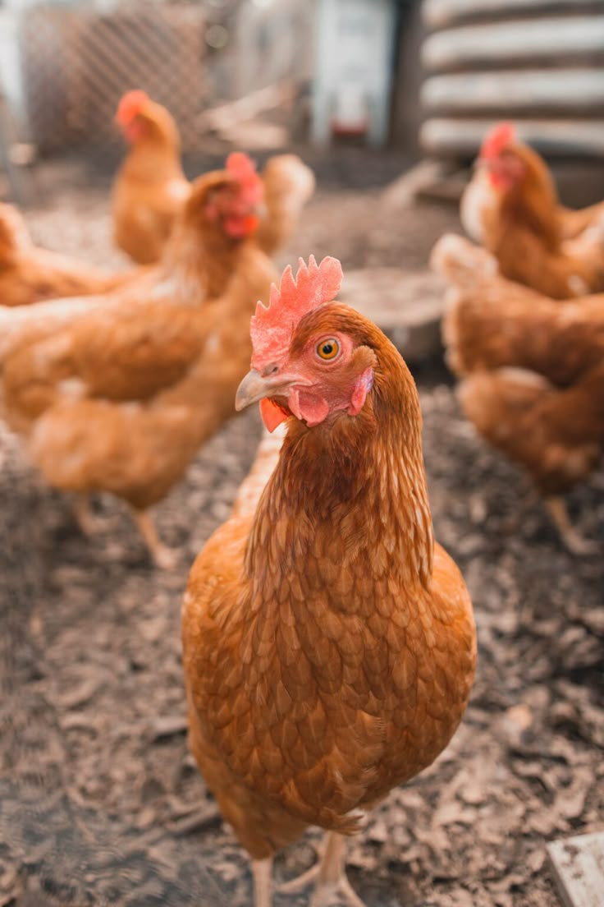
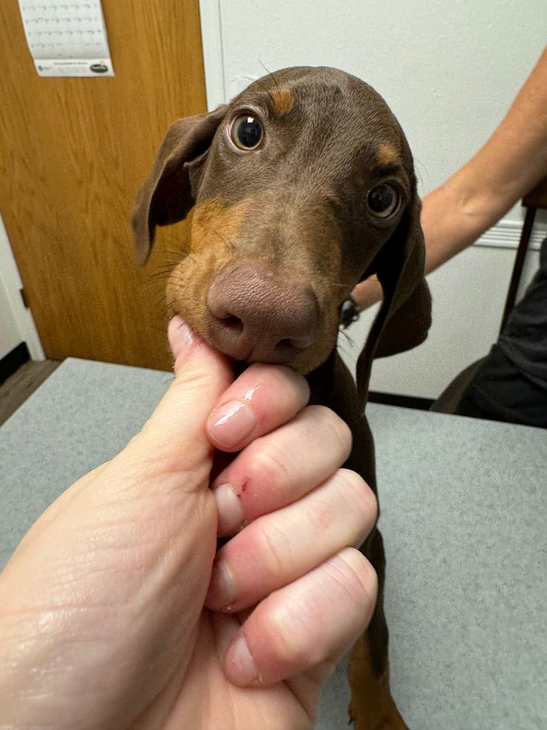
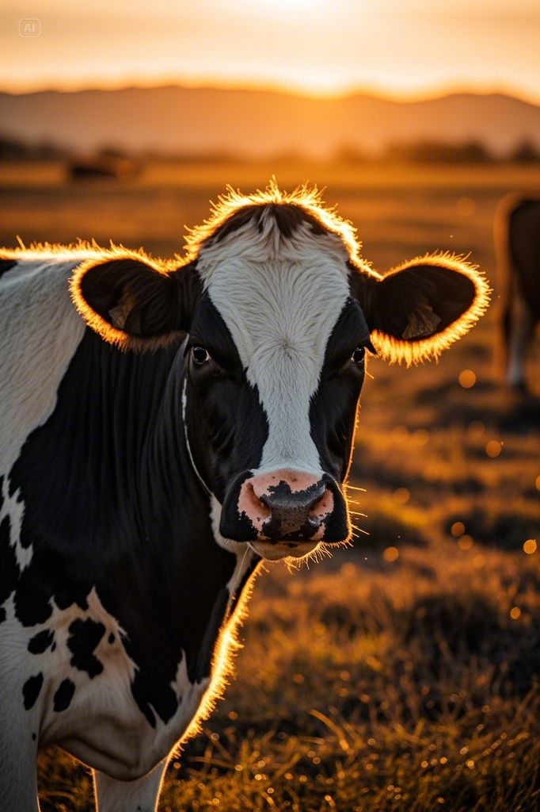


BIO_AFYA
PRESENTATION
VOL…01
BIO_AFYA
BIO_AFYA
WELCOME
PRESENTATION
LOADING
VOL…01
Bio_Afya is an innovative system that combines AI and IoT to provide real-time health monitoring, early disease detection, and automated diagnosis for livestock. By analyzing symptoms, sensor data, and images, it delivers instant feedback, treatment recommendations, and outbreak alerts, ensuring healthier animals, reduced losses, and smarter farming.
HELLO
THE PROBLEM STATEMENT
INTRO
The Challenge in Livestock Health Management
THE PROBLEM STATEMENT
15%
Growth
15
Points
Our Solution
Livestock diseases cause significant losses due to late detection, slow diagnosis, and limited veterinary access, especially in rural areas. Farmers rely on manual observation, which is often inaccurate and inefficient, leading to misdiagnosis, delayed treatment, and outbreaks that threaten food security and the economy. Without real-time monitoring and automated diagnosis, preventing and controlling diseases remains a major challenge.
SmartLivestock: AI & IoT-Powered Livestock Health Monitoring
20%
Growth
20
Points
How It Works
01
AI and IoT for Real-Time Livestock Health Monitoring
15%
Growth
15
Points
Key Features
Revolutionizing Livestock Health with Smart Technology
10%
Growth
10
Points
Expected Outcomes & Impact
Transforming Livestock Farming for a Better Future
01
10%
Growth
10
Points
Technology Stack
The Power Behind SmartLivestock
8%
Growth
8
Points
Market Potential & Scalability
The Future of AI-Driven Livestock Management
10%
Growth
10
Points
Conclusion & Call to Action
Shaping the Future of Livestock Farming
5%
Growth
5
Points
Final Remark & Closing Statement
SmartLivestock: Transforming Agriculture with Innovation
2%
Growth
2
Points

Slide 4
WELCOME
Bio_Afya is an innovative system that combines AI and IoT to provide real-time health monitoring, early disease detection, and automated diagnosis for livestock. By analyzing symptoms, sensor data, and images, it delivers instant feedback, treatment recommendations, and outbreak alerts, ensuring healthier animals, reduced losses, and smarter farming.
BIO_AFYA
THE PROBLEM STATEMENT
THE PROBLEM STATEMENT
WELCOME
The Challenge in Livestock Health Management
Livestock diseases cause significant losses due to late detection, slow diagnosis, and limited veterinary access, especially in rural areas. Farmers rely on manual observation, which is often inaccurate and inefficient, leading to misdiagnosis, delayed treatment, and outbreaks that threaten food security and the economy. Without real-time monitoring and automated diagnosis, preventing and controlling diseases remains a major challenge.
15%
Bio_Afya is an innovative system that combines AI and IoT to provide real-time health monitoring, early disease detection, and automated diagnosis for livestock. By analyzing symptoms, sensor data, and images, it delivers instant feedback, treatment recommendations, and outbreak alerts, ensuring healthier animals, reduced losses, and smarter farming.
Growth
15
Points
Our Solution
01
SmartLivestock: AI & IoT-Powered Livestock Health Monitoring
OUR SOLUTION
20%
Growth
20
Points
How It Works
To tackle the challenges in livestock health management, Bio_Afya leverages Artificial Intelligence (AI) and Internet of Things (IoT) to provide real-time health monitoring, early disease detection, and automated diagnosis. By analyzing symptoms, sensor data, and images, the system delivers instant feedback, treatment recommendations, outbreak alerts, and predictive insights—empowering farmers to take immediate action, reduce losses, and ensure healthier livestock.
AI and IoT for Real-Time Livestock Health Monitoring
15%
Growth
15
Points
Key Features
01
Revolutionizing Livestock Health with Smart Technology
10%
Growth
10
Points
Expected Outcomes & Impact
Transforming Livestock Farming for a Better Future
10%
Growth
10
Points
Technology Stack
01
The Power Behind SmartLivestock
8%
Growth
8
Points
Market Potential & Scalability
The Future of AI-Driven Livestock Management
10%
Growth
10
Points
Conclusion & Call to Action
Shaping the Future of Livestock Farming
5%
Growth
5
Points
Final Remark & Closing Statement
SmartLivestock: Transforming Agriculture with Innovation
2%
Growth
2
Points

Slide 5
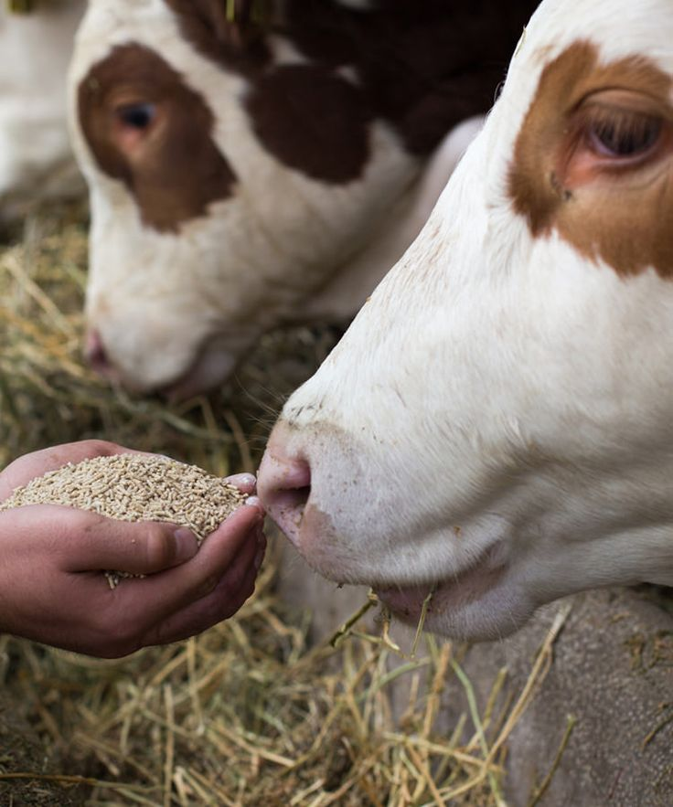
THE PROBLEM STATEMENT
Livestock diseases cause significant losses due to late detection, slow diagnosis, and limited veterinary access, especially in rural areas. Farmers rely on manual observation, which is often inaccurate and inefficient, leading to misdiagnosis, delayed treatment, and outbreaks that threaten food security and the economy. Without real-time monitoring and automated diagnosis, preventing and controlling diseases remains a major challenge.
THE PROBLEM STATEMENT
The Challenge in Livestock Health Management
BIO_AFYA
15%
Growth
15
Points
OUR SOLUTION
Our Solution
THE PROBLEM STATEMENT
SmartLivestock: AI & IoT-Powered Livestock Health Monitoring
To tackle the challenges in livestock health management, Bio_Afya leverages Artificial Intelligence (AI) and Internet of Things (IoT) to provide real-time health monitoring, early disease detection, and automated diagnosis. By analyzing symptoms, sensor data, and images, the system delivers instant feedback, treatment recommendations, outbreak alerts, and predictive insights—empowering farmers to take immediate action, reduce losses, and ensure healthier livestock.
20%
Livestock diseases cause significant losses due to late detection, slow diagnosis, and limited veterinary access, especially in rural areas. Farmers rely on manual observation, which is often inaccurate and inefficient, leading to misdiagnosis, delayed treatment, and outbreaks that threaten food security and the economy. Without real-time monitoring and automated diagnosis, preventing and controlling diseases remains a major challenge.
Growth
20
Points
How It Works
02
AI and IoT for Real-Time Livestock Health Monitoring
HOW IT WORKS
15%
Growth
15
Points
Bio_Afya integrates AI and IoT to provide an automated livestock health monitoring system. Farmers start by inputting observed symptoms, while IoT sensors continuously track vital signs such as temperature, heart rate, and movement patterns. The system’s AI then analyzes symptoms, sensor data, and images to detect potential diseases, offering instant feedback, treatment recommendations, and preventive measures. If a contagious disease is identified, automatic alerts are sent to relevant authorities, helping to prevent outbreaks. Additionally, all data is stored for trend analysis and long-term disease prevention, ensuring smarter and more efficient livestock management.
Key Features
Revolutionizing Livestock Health with Smart Technology
10%
Growth
10
Points
Expected Outcomes & Impact
01
Transforming Livestock Farming for a Better Future
10%
Growth
10
Points
Technology Stack
The Power Behind SmartLivestock
8%
Growth
8
Points
Market Potential & Scalability
01
The Future of AI-Driven Livestock Management
10%
Growth
10
Points
Conclusion & Call to Action
Shaping the Future of Livestock Farming
5%
Growth
5
Points
Final Remark & Closing Statement
SmartLivestock: Transforming Agriculture with Innovation
2%
Growth
2
Points

Slide 6
THE PROBLEM STATEMENT
The Challenge in Livestock Health Management
OUR SOLUTION
15%
Growth
15
Points
To tackle the challenges in livestock health management, Bio_Afya leverages Artificial Intelligence (AI) and Internet of Things (IoT) to provide real-time health monitoring, early disease detection, and automated diagnosis. By analyzing symptoms, sensor data, and images, the system delivers instant feedback, treatment recommendations, outbreak alerts, and predictive insights—empowering farmers to take immediate action, reduce losses, and ensure healthier livestock.
Our Solution
SmartLivestock: AI & IoT-Powered Livestock Health Monitoring
BIO_AFYA
20%
Growth
20
Points
HOW IT WORKS
How It Works
OUR SOLUTION
AI and IoT for Real-Time Livestock Health Monitoring
Bio_Afya integrates AI and IoT to provide an automated livestock health monitoring system. Farmers start by inputting observed symptoms, while IoT sensors continuously track vital signs such as temperature, heart rate, and movement patterns. The system’s AI then analyzes symptoms, sensor data, and images to detect potential diseases, offering instant feedback, treatment recommendations, and preventive measures. If a contagious disease is identified, automatic alerts are sent to relevant authorities, helping to prevent outbreaks. Additionally, all data is stored for trend analysis and long-term disease prevention, ensuring smarter and more efficient livestock management.
To tackle the challenges in livestock health management, Bio_Afya leverages Artificial Intelligence (AI) and Internet of Things (IoT) to provide real-time health monitoring, early disease detection, and automated diagnosis. By analyzing symptoms, sensor data, and images, the system delivers instant feedback, treatment recommendations, outbreak alerts, and predictive insights—empowering farmers to take immediate action, reduce losses, and ensure healthier livestock.
15%
Growth
15
Points
Key Features
03
Revolutionizing Livestock Health with Smart Technology
KEY FEATURES
10%
Growth
10
Points
The system provides real-time health monitoring using IoT sensors that track temperature, heart rate, and movement, ensuring early detection of abnormalities. Farmers can input symptoms manually, while the AI-powered diagnosis system analyzes sensor data and images to identify diseases, suggest treatments, and recommend preventive measures. In cases of contagious diseases, the system automatically alerts veterinary authorities with location details, enabling quick response and outbreak control. Additionally, a disease database keeps track of past infections, helping in trend analysis and future prevention strategies, ultimately reducing livestock losses and improving productivity.
Expected Outcomes & Impact
Transforming Livestock Farming for a Better Future
10%
Growth
10
Points
Technology Stack
01
The Power Behind SmartLivestock
8%
Growth
8
Points
Market Potential & Scalability
The Future of AI-Driven Livestock Management
10%
Growth
10
Points
Conclusion & Call to Action
01
Shaping the Future of Livestock Farming
5%
Growth
5
Points
Final Remark & Closing Statement
SmartLivestock: Transforming Agriculture with Innovation
2%
Growth
2
Points

Slide 7
THE PROBLEM STATEMENT
The Challenge in Livestock Health Management
15%
Growth
15
Points
Our Solution
HOW IT WORKS
SmartLivestock: AI & IoT-Powered Livestock Health Monitoring
20%
Growth
Bio_Afya integrates AI and IoT to provide an automated livestock health monitoring system. Farmers start by inputting observed symptoms, while IoT sensors continuously track vital signs such as temperature, heart rate, and movement patterns. The system’s AI then analyzes symptoms, sensor data, and images to detect potential diseases, offering instant feedback, treatment recommendations, and preventive measures. If a contagious disease is identified, automatic alerts are sent to relevant authorities, helping to prevent outbreaks. Additionally, all data is stored for trend analysis and long-term disease prevention, ensuring smarter and more efficient livestock management.
20
Points
How It Works
AI and IoT for Real-Time Livestock Health Monitoring
BIO_AFYA
15%
Growth
15
Points
KEY FEATURES
HOW IT WORKS
Key Features
Revolutionizing Livestock Health with Smart Technology
Bio_Afya integrates AI and IoT to provide an automated livestock health monitoring system. Farmers start by inputting observed symptoms, while IoT sensors continuously track vital signs such as temperature, heart rate, and movement patterns. The system’s AI then analyzes symptoms, sensor data, and images to detect potential diseases, offering instant feedback, treatment recommendations, and preventive measures. If a contagious disease is identified, automatic alerts are sent to relevant authorities, helping to prevent outbreaks. Additionally, all data is stored for trend analysis and long-term disease prevention, ensuring smarter and more efficient livestock management.
The system provides real-time health monitoring using IoT sensors that track temperature, heart rate, and movement, ensuring early detection of abnormalities. Farmers can input symptoms manually, while the AI-powered diagnosis system analyzes sensor data and images to identify diseases, suggest treatments, and recommend preventive measures. In cases of contagious diseases, the system automatically alerts veterinary authorities with location details, enabling quick response and outbreak control. Additionally, a disease database keeps track of past infections, helping in trend analysis and future prevention strategies, ultimately reducing livestock losses and improving productivity.
10%
Growth
10
Points
Expected Outcomes & Impact
04
Transforming Livestock Farming for a Better Future
EXPECTED OUTCOMES & IMPACT
10%
Growth
10
Points
Bio_Afya aims to revolutionize livestock farming by enabling early disease detection, reducing losses, and improving overall productivity. With real-time monitoring and AI-driven diagnostics, farmers can take immediate action, preventing outbreaks and ensuring healthier livestock. The system will also enhance veterinary efficiency by providing accurate disease reports and reducing the burden of manual diagnosis. Additionally, by storing historical disease data, Bio_Afya supports long-term analysis and policy-making for better disease management. Ultimately, this innovation will increase food security, reduce economic losses, and create a smarter, data-driven approach to livestock farming.
Technology Stack
The Power Behind SmartLivestock
8%
Growth
8
Points
Market Potential & Scalability
01
The Future of AI-Driven Livestock Management
10%
Growth
10
Points
Conclusion & Call to Action
Shaping the Future of Livestock Farming
5%
Growth
5
Points
Final Remark & Closing Statement
01
SmartLivestock: Transforming Agriculture with Innovation
2%
Growth
2
Points

Slide 8
THE PROBLEM STATEMENT
The Challenge in Livestock Health Management
15%
Growth
15
Points
Our Solution
SmartLivestock: AI & IoT-Powered Livestock Health Monitoring
20%
Growth
20
Points
How It Works
KEY FEATURES
AI and IoT for Real-Time Livestock Health Monitoring
15%
Growth
The system provides real-time health monitoring using IoT sensors that track temperature, heart rate, and movement, ensuring early detection of abnormalities. Farmers can input symptoms manually, while the AI-powered diagnosis system analyzes sensor data and images to identify diseases, suggest treatments, and recommend preventive measures. In cases of contagious diseases, the system automatically alerts veterinary authorities with location details, enabling quick response and outbreak control. Additionally, a disease database keeps track of past infections, helping in trend analysis and future prevention strategies, ultimately reducing livestock losses and improving productivity.
15
Points
Key Features
Revolutionizing Livestock Health with Smart Technology
BIO_AFYA
10%
Growth
10
Points
EXPECTED OUTCOMES & IMPACT
Expected Outcomes & Impact
KEY FEATURES
Transforming Livestock Farming for a Better Future
Bio_Afya aims to revolutionize livestock farming by enabling early disease detection, reducing losses, and improving overall productivity. With real-time monitoring and AI-driven diagnostics, farmers can take immediate action, preventing outbreaks and ensuring healthier livestock. The system will also enhance veterinary efficiency by providing accurate disease reports and reducing the burden of manual diagnosis. Additionally, by storing historical disease data, Bio_Afya supports long-term analysis and policy-making for better disease management. Ultimately, this innovation will increase food security, reduce economic losses, and create a smarter, data-driven approach to livestock farming.
The system provides real-time health monitoring using IoT sensors that track temperature, heart rate, and movement, ensuring early detection of abnormalities. Farmers can input symptoms manually, while the AI-powered diagnosis system analyzes sensor data and images to identify diseases, suggest treatments, and recommend preventive measures. In cases of contagious diseases, the system automatically alerts veterinary authorities with location details, enabling quick response and outbreak control. Additionally, a disease database keeps track of past infections, helping in trend analysis and future prevention strategies, ultimately reducing livestock losses and improving productivity.
10%
Growth
10
Points
Technology Stack
05
The Power Behind SmartLivestock
TECHNOLOGY STACK
8%
Growth
8
Points
The system utilizes IoT sensors to collect real-time data on livestock health, including temperature, heart rate, and movement patterns. AI-powered machine learning models analyze this data along with user-input symptoms and images to detect diseases and suggest treatments. A cloud-based database stores disease records for historical analysis and trend prediction. The platform is accessible via a user-friendly web and mobile application, allowing farmers to receive instant feedback and alerts. For connectivity, the system integrates wireless networks (LoRa, Wi-Fi, GSM) to ensure real-time data transmission, even in remote areas.
Market Potential & Scalability
The Future of AI-Driven Livestock Management
10%
Growth
10
Points
Conclusion & Call to Action
01
Shaping the Future of Livestock Farming
5%
Growth
5
Points
Final Remark & Closing Statement
SmartLivestock: Transforming Agriculture with Innovation
2%
Growth
2
Points
01

Slide 9
THE PROBLEM STATEMENT
The Challenge in Livestock Health Management
15%
Growth
15
Points
Our Solution
SmartLivestock: AI & IoT-Powered Livestock Health Monitoring
20%
Growth
20
Points
How It Works
AI and IoT for Real-Time Livestock Health Monitoring
15%
Growth
15
Points
Key Features
EXPECTED OUTCOMES & IMPACT
Revolutionizing Livestock Health with Smart Technology
10%
Bio_Afya aims to revolutionize livestock farming by enabling early disease detection, reducing losses, and improving overall productivity. With real-time monitoring and AI-driven diagnostics, farmers can take immediate action, preventing outbreaks and ensuring healthier livestock. The system will also enhance veterinary efficiency by providing accurate disease reports and reducing the burden of manual diagnosis. Additionally, by storing historical disease data, Bio_Afya supports long-term analysis and policy-making for better disease management. Ultimately, this innovation will increase food security, reduce economic losses, and create a smarter, data-driven approach to livestock farming.
Growth
10
Points
Expected Outcomes & Impact
Transforming Livestock Farming for a Better Future
BIO_AFYA
10%
Growth
10
Points
TECHNOLOGY STACK
Technology Stack
EXPECTED OUTCOMES & IMPACT
The Power Behind SmartLivestock
Bio_Afya aims to revolutionize livestock farming by enabling early disease detection, reducing losses, and improving overall productivity. With real-time monitoring and AI-driven diagnostics, farmers can take immediate action, preventing outbreaks and ensuring healthier livestock. The system will also enhance veterinary efficiency by providing accurate disease reports and reducing the burden of manual diagnosis. Additionally, by storing historical disease data, Bio_Afya supports long-term analysis and policy-making for better disease management. Ultimately, this innovation will increase food security, reduce economic losses, and create a smarter, data-driven approach to livestock farming.
The system utilizes IoT sensors to collect real-time data on livestock health, including temperature, heart rate, and movement patterns. AI-powered machine learning models analyze this data along with user-input symptoms and images to detect diseases and suggest treatments. A cloud-based database stores disease records for historical analysis and trend prediction. The platform is accessible via a user-friendly web and mobile application, allowing farmers to receive instant feedback and alerts. For connectivity, the system integrates wireless networks (LoRa, Wi-Fi, GSM) to ensure real-time data transmission, even in remote areas.
8%
Growth
8
Points
Market Potential & Scalability
06
The Future of AI-Driven Livestock Management
MARKET POTENTIAL & SCALABILITY
10%
Growth
10
Points
Conclusion & Call to Action
The global livestock industry faces billions of dollars in losses annually due to preventable diseases, making Bio_Afya a highly scalable and impactful solution. With the increasing adoption of smart farming and precision agriculture, the demand for AI and IoT-driven livestock monitoring systems is rapidly growing.
Shaping the Future of Livestock Farming
5%
Growth
5
Points
Final Remark & Closing Statement
01
SmartLivestock: Transforming Agriculture with Innovation
2%
Growth
2
Points
01

Slide 10
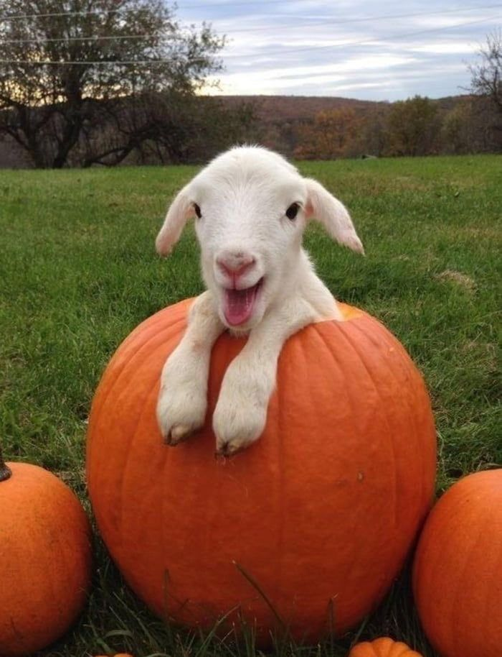
THE PROBLEM STATEMENT
The Challenge in Livestock Health Management
15%
Growth
15
Points
Our Solution
SmartLivestock: AI & IoT-Powered Livestock Health Monitoring
20%
Growth
20
Points
How It Works
AI and IoT for Real-Time Livestock Health Monitoring
15%
Growth
15
Points
Key Features
Revolutionizing Livestock Health with Smart Technology
10%
Growth
10
Points
Expected Outcomes & Impact
TECHNOLOGY STACK
Transforming Livestock Farming for a Better Future
10%
Growth
The system utilizes IoT sensors to collect real-time data on livestock health, including temperature, heart rate, and movement patterns. AI-powered machine learning models analyze this data along with user-input symptoms and images to detect diseases and suggest treatments. A cloud-based database stores disease records for historical analysis and trend prediction. The platform is accessible via a user-friendly web and mobile application, allowing farmers to receive instant feedback and alerts. For connectivity, the system integrates wireless networks (LoRa, Wi-Fi, GSM) to ensure real-time data transmission, even in remote areas.
10
Points
Technology Stack
The Power Behind SmartLivestock
BIO_AFYA
8%
Growth
8
Points
MARKET POTENTIAL & SCALABILITY
Market Potential & Scalability
TECHNOLOGY STACK
The Future of AI-Driven Livestock Management
The global livestock industry faces billions of dollars in losses annually due to preventable diseases, making Bio_Afya a highly scalable and impactful solution. With the increasing adoption of smart farming and precision agriculture, the demand for AI and IoT-driven livestock monitoring systems is rapidly growing.
The system utilizes IoT sensors to collect real-time data on livestock health, including temperature, heart rate, and movement patterns. AI-powered machine learning models analyze this data along with user-input symptoms and images to detect diseases and suggest treatments. A cloud-based database stores disease records for historical analysis and trend prediction. The platform is accessible via a user-friendly web and mobile application, allowing farmers to receive instant feedback and alerts. For connectivity, the system integrates wireless networks (LoRa, Wi-Fi, GSM) to ensure real-time data transmission, even in remote areas.
10%
Growth
10
Points
Conclusion & Call to Action
07
Shaping the Future of Livestock Farming
5%
CONCLUSION & CALL TO ACTION
Growth
5
Points
Final Remark & Closing Statement
Bio_Afya is a game-changing innovation that combines AI, IoT, and real-time analytics to revolutionize livestock health management. By enabling early disease detection, automated diagnosis, and real-time monitoring, our system helps reduce losses, improve productivity, and enhance food security. With a scalable and data-driven approach, Bio_Afya is poised to transform the future of livestock farming.
SmartLivestock: Transforming Agriculture with Innovation
2%
Growth
2
Points
01
01

Slide 11
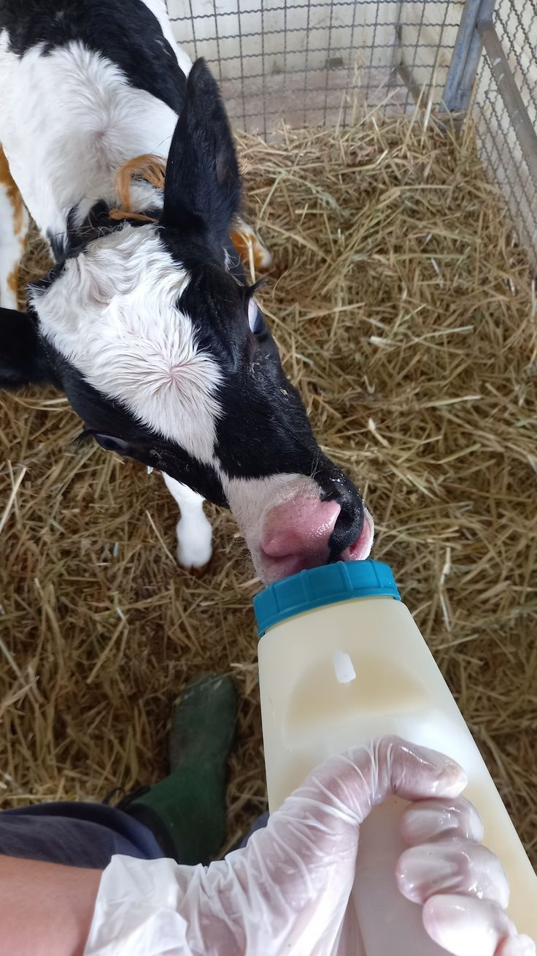
THE PROBLEM STATEMENT
The Challenge in Livestock Health Management
15%
Growth
15
Points
Our Solution
SmartLivestock: AI & IoT-Powered Livestock Health Monitoring
20%
Growth
20
Points
How It Works
AI and IoT for Real-Time Livestock Health Monitoring
15%
Growth
15
Points
Key Features
Revolutionizing Livestock Health with Smart Technology
10%
Growth
10
Points
Expected Outcomes & Impact
Transforming Livestock Farming for a Better Future
10%
Growth
10
Points
Technology Stack
The Power Behind SmartLivestock
MARKET POTENTIAL & SCALABILITY
8%
Growth
8
Points
The global livestock industry faces billions of dollars in losses annually due to preventable diseases, making Bio_Afya a highly scalable and impactful solution. With the increasing adoption of smart farming and precision agriculture, the demand for AI and IoT-driven livestock monitoring systems is rapidly growing.
Market Potential & Scalability
The Future of AI-Driven Livestock Management
BIO_AFYA
10%
Growth
10
Points
CONCLUSION & CALL TO ACTION
MARKET POTENTIAL & SCALABILITY
Conclusion & Call to Action
Shaping the Future of Livestock Farming
Bio_Afya is a game-changing innovation that combines AI, IoT, and real-time analytics to revolutionize livestock health management. By enabling early disease detection, automated diagnosis, and real-time monitoring, our system helps reduce losses, improve productivity, and enhance food security. With a scalable and data-driven approach, Bio_Afya is poised to transform the future of livestock farming.
The global livestock industry faces billions of dollars in losses annually due to preventable diseases, making Bio_Afya a highly scalable and impactful solution. With the increasing adoption of smart farming and precision agriculture, the demand for AI and IoT-driven livestock monitoring systems is rapidly growing.
5%
Growth
5
Points
Final Remark & Closing Statement
08
SmartLivestock: Transforming Agriculture with Innovation
FINAL REMARK & CLOSING STATEMENT
2%
Growth
2
Points
The future of livestock farming depends on innovation, data-driven insights, and real-time action. With Bio_Afya, we are not just solving a problem—we are empowering farmers, protecting livelihoods, and securing food supply chains. By leveraging cutting-edge technology, we can reduce livestock losses, improve productivity, and create a smarter, healthier agricultural ecosystem.
01
01

Slide 12
THE PROBLEM STATEMENT
The Challenge in Livestock Health Management
15%
Growth
15
Points
Our Solution
SmartLivestock: AI & IoT-Powered Livestock Health Monitoring
20%
Growth
20
Points
How It Works
AI and IoT for Real-Time Livestock Health Monitoring
15%
Growth
15
Points
Key Features
Revolutionizing Livestock Health with Smart Technology
10%
Growth
10
Points
Expected Outcomes & Impact
Transforming Livestock Farming for a Better Future
10%
Growth
10
Points
Technology Stack
The Power Behind SmartLivestock
8%
Growth
8
Points
Market Potential & Scalability
The Future of AI-Driven Livestock Management
CONCLUSION & CALL TO ACTION
10%
Growth
10
Points
Bio_Afya is a game-changing innovation that combines AI, IoT, and real-time analytics to revolutionize livestock health management. By enabling early disease detection, automated diagnosis, and real-time monitoring, our system helps reduce losses, improve productivity, and enhance food security. With a scalable and data-driven approach, Bio_Afya is poised to transform the future of livestock farming.
Conclusion & Call to Action
Shaping the Future of Livestock Farming
BIO_AFYA
5%
Growth
5
Points
FINAL REMARK & CLOSING STATEMENT
Final Remark & Closing Statement
CONCLUSION & CALL TO ACTION
SmartLivestock: Transforming Agriculture with Innovation
Bio_Afya is a game-changing innovation that combines AI, IoT, and real-time analytics to revolutionize livestock health management. By enabling early disease detection, automated diagnosis, and real-time monitoring, our system helps reduce losses, improve productivity, and enhance food security. With a scalable and data-driven approach, Bio_Afya is poised to transform the future of livestock farming.
The future of livestock farming depends on innovation, data-driven insights, and real-time action. With Bio_Afya, we are not just solving a problem—we are empowering farmers, protecting livelihoods, and securing food supply chains. By leveraging cutting-edge technology, we can reduce livestock losses, improve productivity, and create a smarter, healthier agricultural ecosystem.
2%
Growth
2
Points
09
BIO_AFYA
THANKYOU
🌱 Bio_Afya – Smarter Farming, Healthier Livestock! 🌱
📌 Presented by: [Your Team Name]
📧 Contact Us: [Email Address]
🔹 Let’s work together to revolutionize livestock farming!
🚀 Thank you for your time and attention! 🚀
01
01

Slide 13

FINAL REMARK & CLOSING STATEMENT
The future of livestock farming depends on innovation, data-driven insights, and real-time action. With Bio_Afya, we are not just solving a problem—we are empowering farmers, protecting livelihoods, and securing food supply chains. By leveraging cutting-edge technology, we can reduce livestock losses, improve productivity, and create a smarter, healthier agricultural ecosystem.
BIO_AFYA
FINAL REMARK & CLOSING STATEMENT
BIO_AFYA
THANKYOU
🌱 Bio_Afya – Smarter Farming, Healthier Livestock! 🌱
📌 Presented by: [BIO_Afya.team]
📧 Contact Us: [bioafya@gmail.com]
Let’s work together to revolutionize livestock farming!
🚀 Thank you for your time and attention! 🚀
WE ARE THANKFUL
The future of livestock farming depends on innovation, data-driven insights, and real-time action. With Bio_Afya, we are not just solving a problem—we are empowering farmers, protecting livelihoods, and securing food supply chains. By leveraging cutting-edge technology, we can reduce livestock losses, improve productivity, and create a smarter, healthier agricultural ecosystem.
END

