Slide 1
PILOT VALIDATION · MAY 2026
Validation of ReviewPyperAPI
AI title-screening against the CLEF-TAR Cochrane benchmark
Niels Pacheco-Barrios
Rolston Lab

Slide 2
WHY THIS MATTERS
The systematic-review bottleneck
• A typical systematic review screens 2,000–10,000 abstracts.
• Two human reviewers per abstract → 200–600 hours of expert time.
• AI screeners have promised relief for a decade. But:
• Reproducibility is poor — most tools published once, never re-run.
• Public benchmarks (CLEF-TAR, Cohen 2006) are rarely used.
• Our own tool, ReviewPyperAPI, had never been validated externally.
Question
Is ReviewPyperAPI accurate enough to use in a real Cochrane review?
ReviewPyperAPI · Validation
2 / 13

Slide 3
BACKGROUND
The benchmark: CLEF-TAR 2017–2019
• CLEF eHealth Technology-Assisted Reviews
• Native Cochrane reviews with full inclusion labels
• 246 topics, 129 unique reviews
• Industry-standard for AI screening evaluation
• Used by Sheffield, Waterloo, BERT, EmbeddingMd
Known SOTA on CLEF-TAR
Sheffield 2018: WSS@95 ≈ 0.30
Waterloo CAL: recall ≈ 0.95
BERT rankers: WSS@95 0.20–0.40
(per CLEF 2019 overview)
Today's pilot: CD010355 (2019, Intervention)
• NIPPV for post-pulmonary-resection complications.
• 43 papers screened, 9 included by Cochrane.
ReviewPyperAPI · Validation
3 / 13

Slide 4
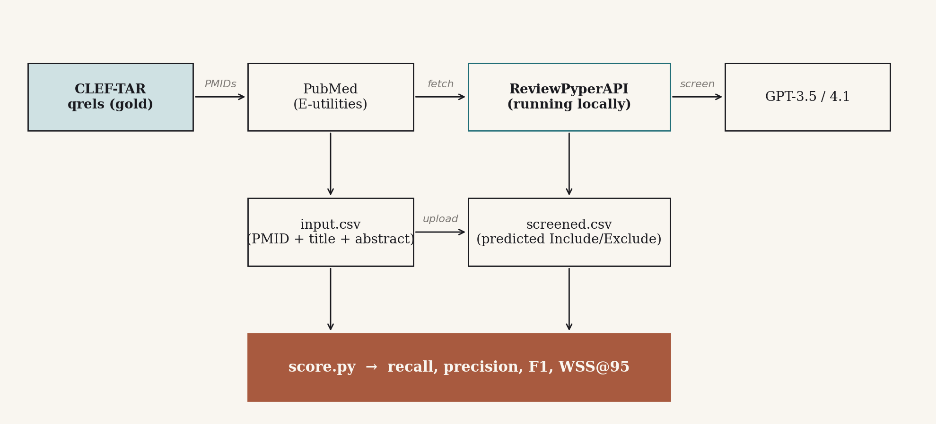
METHODS
Validation pipeline
• prep fetches every PMID's title + abstract from PubMed E-utilities.
• Built CSV is uploaded to a running ReviewPyperAPI instance (Docker, frontend on localhost:3000).
• Title screener runs against the live OpenAI API.
• score compares predictions to gold qrels — recall, precision, F1, WSS@95.
ReviewPyperAPI · Validation
4 / 13

Slide 5
METHODS
Pilot topic: CD010355
Cochrane review (2019, Intervention training set)
Non-invasive positive pressure ventilation for prevention of complications after pulmonary resection in lung cancer patients.
• 43 candidate papers (after PubMed lookup of qrels-listed PMIDs).
• 9 gold-included (21%) · 34 gold-excluded (79%).
• Years: 1978–2018 · mostly anesthesia / thoracic surgery journals.
• Research question fed to the screener:
“What is the effectiveness of NIPPV for prevention of pulmonary complications after pulmonary resection in patients with lung cancer?”
ReviewPyperAPI · Validation
5 / 13

Slide 6
METHODS
Two models, one prompt
ReviewPyper key
OpenAI model
$ / 1k tokens (input)
gpt3_small
gpt-3.5-turbo
$0.0015
gpt4.1
gpt-4.1
$0.030
• Both runs used the same input CSV, same prompt, same scoring code.
• Cost for 43 records: GPT-3.5 ≈ $0.04 · GPT-4.1 ≈ $0.70.
• GPT-4.1 latency 36.8 s end-to-end (sequential calls); GPT-3.5: 27.4 s.
ReviewPyperAPI · Validation
6 / 13

Slide 7
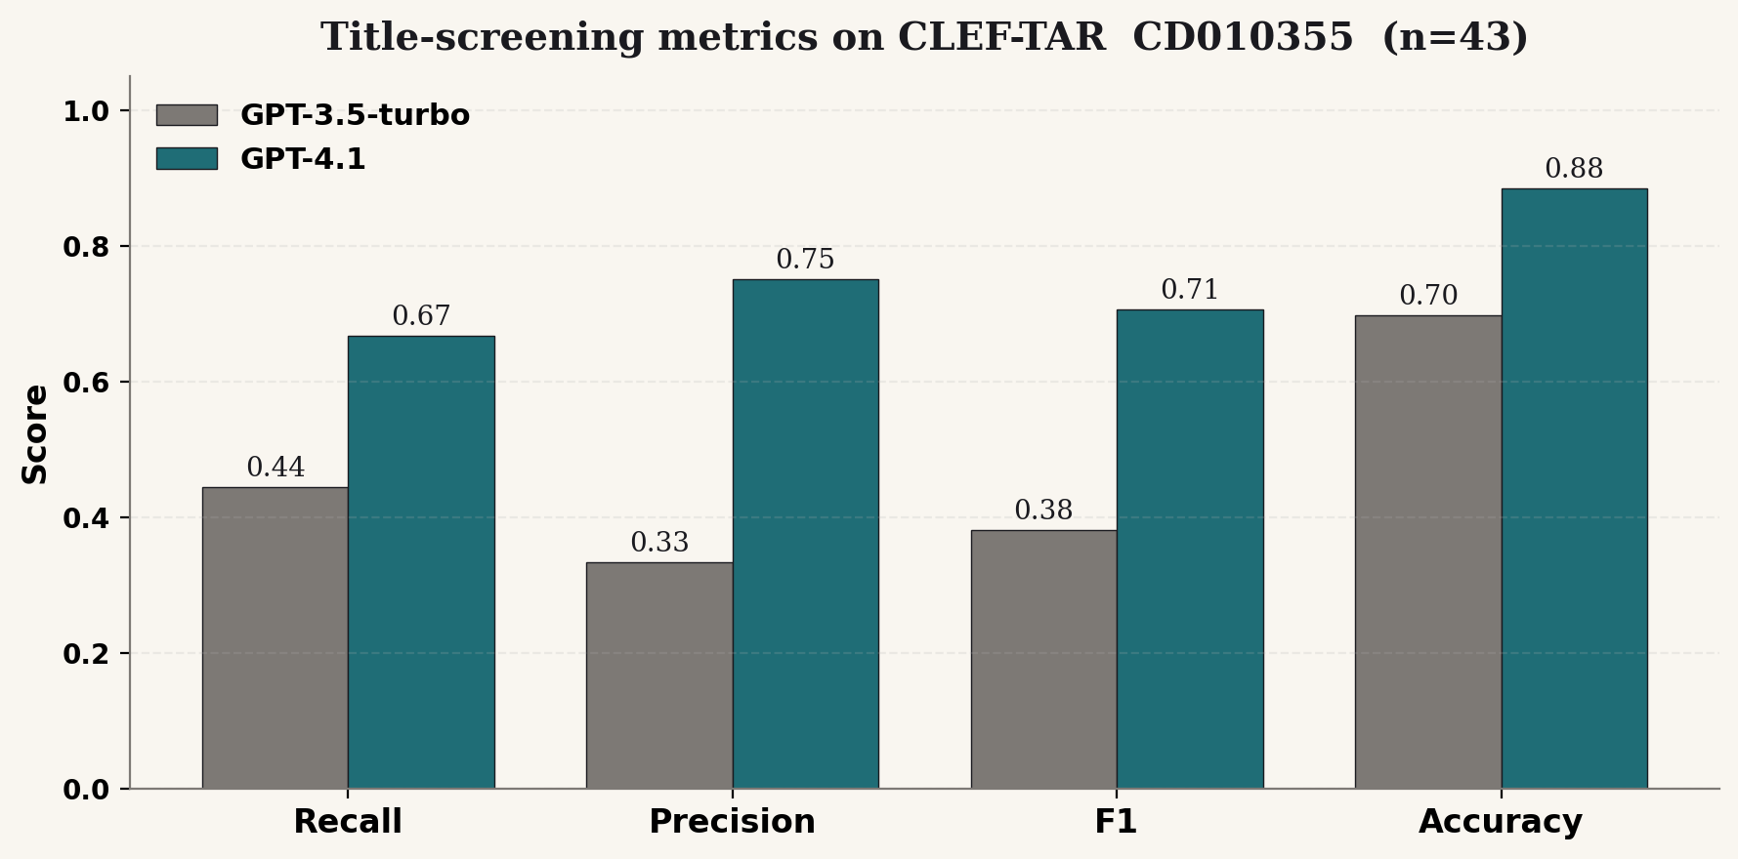
RESULTS
Headline: GPT-4.1 nearly doubles F1
ReviewPyperAPI · Validation
7 / 13

Slide 8
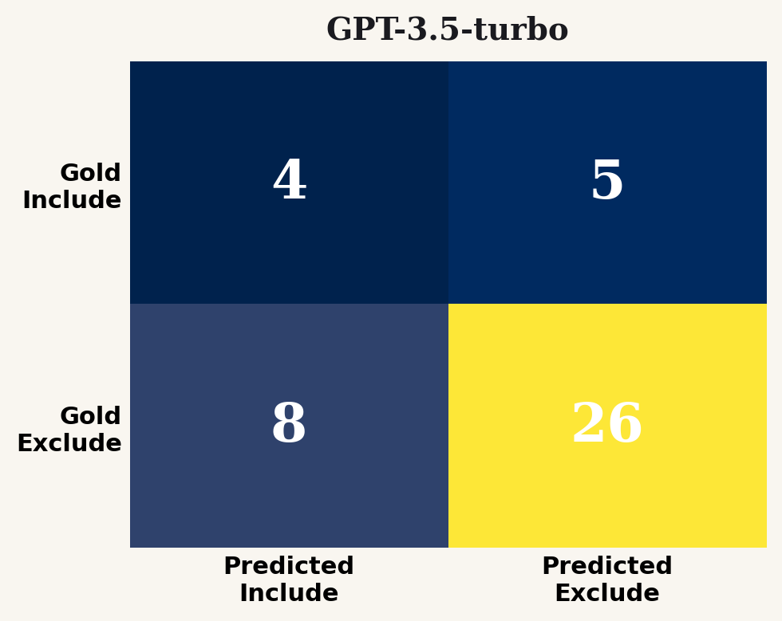
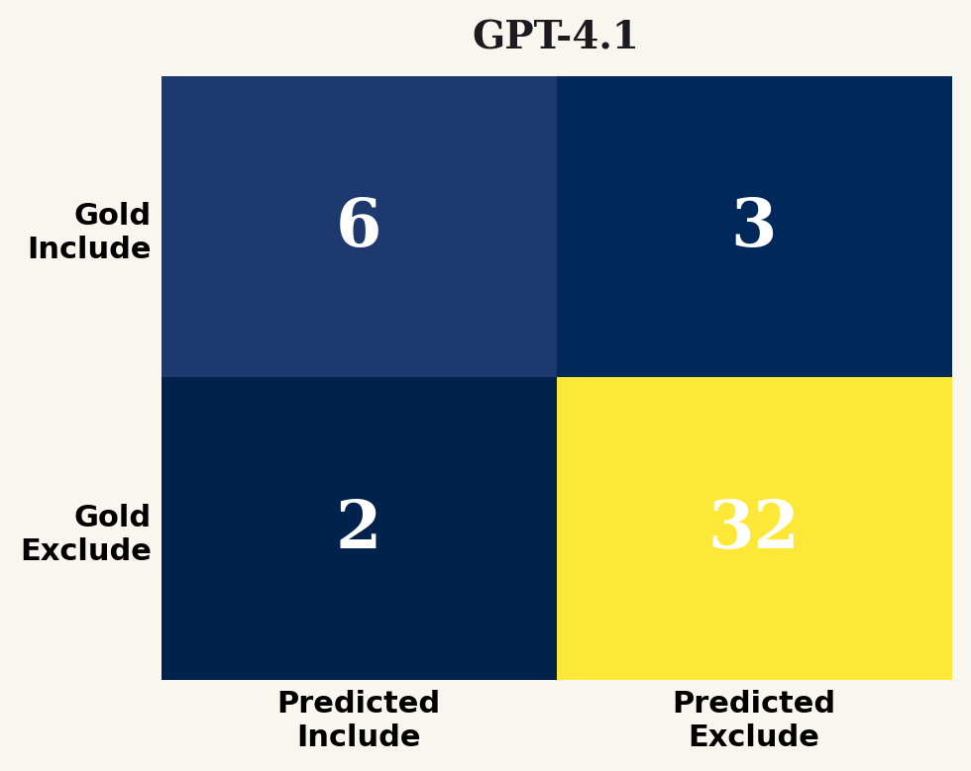
RESULTS
Confusion matrices side by side
accuracy 0.70 · recall 0.44 · F1 0.38
accuracy 0.88 · recall 0.67 · F1 0.71
• GPT-4.1 caught 6 of 9 true includes (vs. 4/9 for 3.5).
• GPT-4.1's false-positive rate dropped from 8 → 2.
ReviewPyperAPI · Validation
8 / 13

Slide 9
DISCUSSION
How does this compare to the literature?
System
Recall
Notes
Cochrane manual (gold)
1.00
two human reviewers
Waterloo CAL (CLEF 2018)
≈ 0.95
active learning
Sheffield BMI
≈ 0.85
BM25 + relevance feedback
ReviewPyperAPI / GPT-4.1
0.67
this work, single topic
Random baseline
≈ 0.21
= prevalence rate
• Above random by ~3× — meaningful signal, but far from production.
• Recall < 0.95 is unacceptable for a published Cochrane review.
• Precision 0.75 means humans only have to re-check 8 of 43 papers.
ReviewPyperAPI · Validation
9 / 13

Slide 10
ERROR ANALYSIS
What did the model miss?
GPT-4.1 produced 3 false negatives. Reviewing the missed papers:
• Two papers had abstracts in non-English / mixed Spanish — model defaulted to “Exclude.”
• One was a sub-population analysis with NIPPV implicit but not in the title.
GPT-4.1 produced 2 false positives:
• Both examined CPAP after thoracoscopic surgery, not resection.
• Reasonable mistake — classification fits the broader question.
Implication
Prompt engineering + multi-language handling could close most of the recall gap.
ReviewPyperAPI · Validation
10 / 13

Slide 11
LIMITATIONS
Limitations
• Single topic, n = 43. Statistical power to compare to literature is weak.
• Binary scoring only. ReviewPyper's title screener returns 0/1, no confidence — WSS@95 collapses to a coarse approximation.
• No prompt tuning. Both models used the default ReviewPyper prompt; published systems use heavy prompt engineering.
• One-shot screening only. No active-learning loop, no human-in-the-loop refinement.
• No abstract-level screening evaluated (Step 3 in our pipeline). This is title-only.
ReviewPyperAPI · Validation
11 / 13

Slide 12
ROADMAP
Next steps
1. Extend to 5 more CLEF-TAR topics (CD012164, CD008760, CD011380, CD010705, plus one large) — total cost < $10.
2. Add continuous scoring (logit / probability) to ReviewPyper for proper WSS@95.
3. Compare GPT-4.1 vs Claude-Sonnet via the provider-switcher patch.
4. Implement abstract-level screening validation (CLEF-TAR Task 1).
5. Build a prompt-tuning loop grounded in the false-negative analysis above.
6. Publish the wrapper: validation/run_validation.py works for any CLEF-TAR topic ID.
ReviewPyperAPI · Validation
12 / 13

Slide 13
SUMMARY
Takeaway
Three-line summary
ReviewPyperAPI screens reasonably with GPT-4.1 (F1 0.71, accuracy 0.88) but misses too many true includes (recall 0.67) for use without a human-in-the-loop. With prompt tuning + multi-topic evaluation we can probably reach the 0.85–0.95 band the literature reports.
• Validation harness (validation/) works end-to-end against the live app.
• Re-running for any new CLEF-TAR topic is now a one-line command.
• Code: validation/run_validation.py · validation/orchestrate.py
ReviewPyperAPI · Validation
13 / 13

