Slide 1
托福强化阶段
——Mary

Slide 2
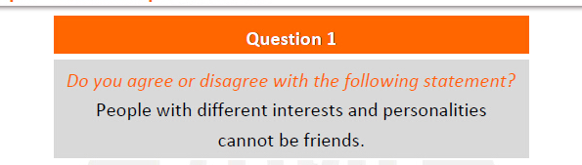
剖题技巧6——tips6

Slide 3
剖题技巧6——tips6
tips6：找两个key words 并列词（同是n，adj，v，用and或or并列）
然后从两个key words 出发

Slide 4
剖题技巧6——tips6
agree
1.兴趣不同，没有共同话题
2.性格不同，造成矛盾对立
disagree
1.兴趣不同，产生更多话题
2.性格不同，促进彼此的进步

Slide 5
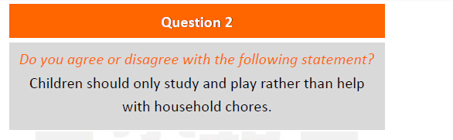
剖题技巧6——tips6
tips6：找两个key words 并列词（同是n，adj，v，用and或or并列）
然后从两个key words 出发

Slide 6
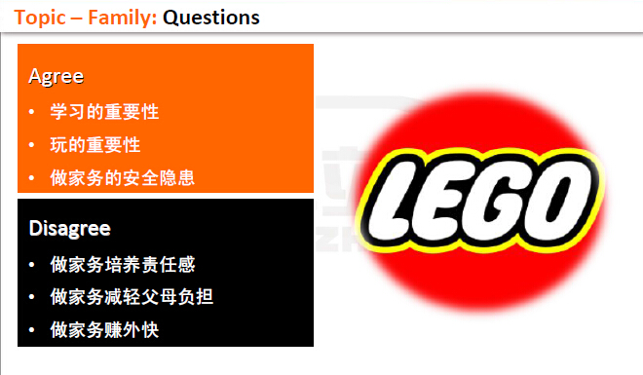
剖题技巧6——tips6
tips6：找两个key words 并列词（同是n，adj，v，用and或or并列）
然后从两个key words 出发

Slide 7
Main body

Slide 8
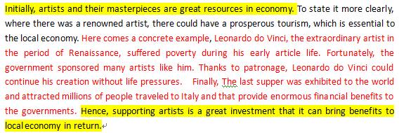
文章结构
论点+论据+论证+小总结

Slide 9
main body
多点并列
举例子
列数据
说道理
对比论证
好处：保Good
坏处：难
好处：冲高分
坏处：有时未必能想到
好处：用数据说话
坏处：数据列的不好就好假
好处：常用
坏处：太空，太范
好处：两边观点都能提及到，比较全面
坏处：题目中的对比题不一定都能正反对比到

Slide 10
Introduction
让步对立面观点正确性 undoubtedly…….
转折however/nevertheless……..
表自己观点I could hardly agree more with the statement that……
我的理由如下 ，the merits of which will be illustrated as follows.
Main body1-3
论点（言简意赅）
论据（解释说明论点）
论证（举例论证、对比论证、列数据、道理论证）
小总结（装逼句型）
Conclusion

Slide 11
举例论证

Slide 12

Do you agree or disagree with the following statement?
Government should spend more money
on arts or artists than space exploration

Slide 13

Do you agree or disagree with the following statement?
Government should spend more money
on arts or artists than space exploration
Agree
艺术提高国民品味
艺术可以成为旅游采点
艺术家起初需要政府的赞助
Disagree
地球人口爆炸寻找新居住地
空间探索展现国家实力
空间探索经济效应

Slide 14
Main Body Skill 1: Giving examples
议论文中最常见的论证手法是列举(确凿)，充分.或有代表性的事例来证明论点。
Example Patterns
Personal experience
Describing celebrities
Grouping personal experience

Slide 15
Main Body Skill 1: Giving examples
Do you agree or disagree with the following statement?
Government should spend more money
on arts or artists than space exploration
Three Steps
1.明确论点
Agree: At the start of career, artists need governmental patronage for survival.
2.选择案例类型 (personal experience)
My friend Wang Xiao er
3.案例联系论点(重述论点）
According to this case, we can clearly understand the importance of government to artists.

Slide 16
Sample-Personal experience
(step 1) At the start of career, artists need governmental patronage for survival.(step 2) For example, a friend of mine, Wang Xiao er who pretty loves making sculptures, did not fight for his dream of being a great artist until he succeeded to apply the governmental financial assistance that allowed him to buy many requisite tools and books for sculpture.(step 3) Of course, it is true that without paid from selling works, artists can be considered unemployed. Therefore, to decrease rate of unemployment, government ought to offer more financial help to artists.

Slide 17
Main Body Skill 1: Giving examples
Do you agree or disagree with the following statement?
Government should spend more money
on arts or artists than space exploration
Three Steps 1.明确论点
Agree: Government can develop tourism through sponsoring artists.
2.选择案例类型(Describing celebrities)
Leonardo Da Vinci
3.案例联系论点(重述论点）
According to this case, we can clearly catch the point why government should spend more money on arts.

Slide 18
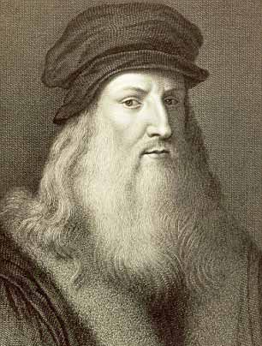
Sample-Describing celebrities
(step1)Government can develop tourism through sponsoring artists.(step2)For instance ,in the period of Renaissance， government sponsored many artists such as Leonardo Da Vinci. thanks to its patronage, Leonardo da Vinci could create “the last supper” that attract millions of visitors to Italy and that provide huge financial benefits to its government.(step3) Therefore, spending more money on art is an insightful strategy not only for artists themselves but also for the national economy.

Slide 19
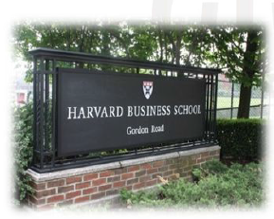
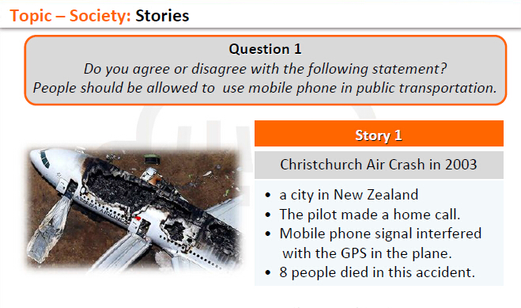
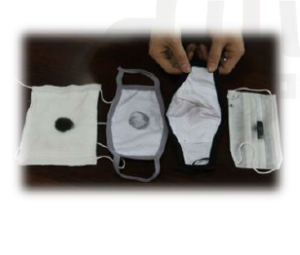
例子
教育
科技
环境
文化——钱

Slide 20
Main Body Skill 1: Giving examples
Do you agree or disagree with the following statement?
Government should spend more money
on arts or artists than space exploration
Three Steps
1.明确论点
Agree: At the start of career, artists need governmental patronage for survival.
2.选择案例类型(Grouping personal experience)
My friend Wang Xiao er ——a fresh artist
3.案例联系论点(重述论点）:
According to this case, we can clearly catch the point why government should spend more money on arts.

Slide 21
Sample - Grouping personal experience
(step 1) Government can develop tourism through sponsoring artists. (step 2) That is, a fresh artist who pretty loves making sculptures, usually did not fight for his dream of being a great artist until he succeeded to apply the governmental financial assistance that allowed him to buy many requisite tools and books for sculpture, (step 3) Of course, it is true that without paid from selling works, artists can be considered unemployed. Therefore, to decrease rate of unemployment, government ought to offer more financial help to artists.

Slide 22
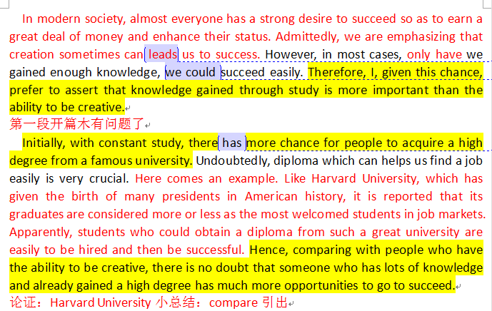
学生杰作：

Slide 23
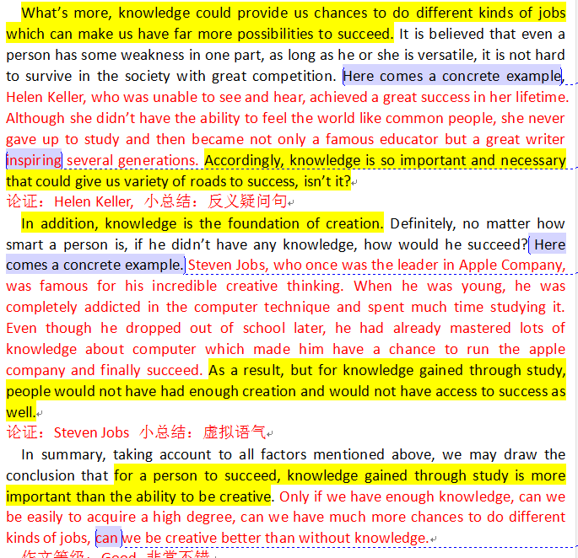

Slide 24
举例子——最special的用法：类比
类比——类同的例子进行比较

Slide 25
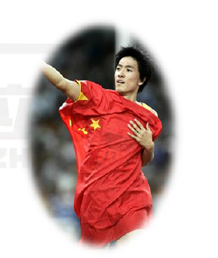
举例子——最special的用法：类比
类比——类同的例子进行比较
Do you agree or disagree with the following statement?
Professional players deserve high salary.

Slide 26
举例子——最special的用法：类比
类比——类同的例子进行比较
Do you agree or disagree with the following statement?
Professional players deserve high salary.
Agree
运动员很辛苦，值得高工资
Eg. 刘翔。。。。。。。Likewise/similarly，科比。。。。。。。

Slide 27
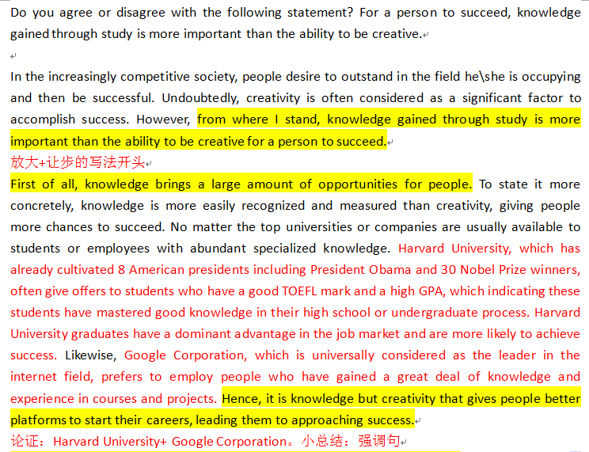
学生杰作：

Slide 28
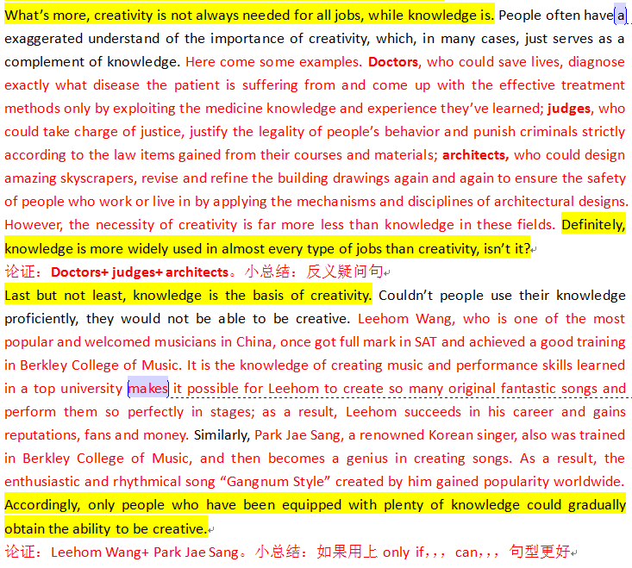

Slide 29
对比论证

Slide 30
Main Body Skill 2: showing contrast
对比论证——是指在议论文中使用两个对象各自特征，作用或者定义作对比来证明论点
正反论证： 对比两个对象正反面特征，即用优点对比缺点
A>B
双正论证：对比两个对象的证明特征，并说明其中一个对象的证明特征在特定条件下的优势更大。
A>B

Slide 31
Main Body Skill 2: showing contrast
Do you agree or disagree with the following statement?
The influence from classmates is
more important than that from parents.

Slide 32
Main Body Skill 2: showing contrast
Do you agree or disagree with the following statement?
The influence from classmates is
more important than that from parents.
Three Steps
1.明确论点
Agree: The influence from classmates is more positive than that from parents.
2.选择对比论证类型(正反论证）
influence from classmates: friendship
influence from parents: bad habits
3.案例联系论点(重述论点）
Classmates provide better environment than parents.

Slide 33
Sample-正反论证
(step 1) The influence from classmates is more positive than that from parents. (step 2) That is, when we study with our classmates, we always build friendship. We always help with each other on solving academic problems as well as on social activity. In this situation, we gain confidence and feel happy if classmates appreciate our assistance. On the contrary, in daily life, many parents who have bad habits such as smoking and dirty words make their innocent children inadvertently pick up them. (step 3) As a result, classmates provide better environment than parents.

Slide 34
Main Body Skill 2: showing contrast
Do you agree or disagree with the following statement?
The influence from classmates is
more important than that from parents.
Three Steps
1.明确论点
Disagree: The influence from parents often determines children’s future.
2.选择对比论证类型(双正论证）
influence from parents: interest and career
influence from classmates: friendship
3.案例联系论点(重述论点）
After all, parents are children's first and most important guider.

Slide 35
Sample-双正论证
(step 1) The influence from parents often determines children's future. (step 2) As we all know, before accepting education in school, children definitely learn many things from parents, which may determine the future of their children. To state it more clearly, if parents always watch football matches when their children are present, those little boys or girls are more likely to generate curiosity and then interest in football. Consequently, they often want to be professional players. In contrast, our classmates do influence us in many aspects through friendship, such as improving team spirit and sense of responsibility, but such gains cannot lead a clear career inclination.(step 3) After all, parents are children’s first and most important guider.

Slide 36
which one should we choose？
正反论证：
优: 思维有拓展，显示你的水平
缺: 不是每个题目都能写到，但是“古今对比”的题目绝对可以
双正论证：
优：万能，每一个题目都能用到
缺：一不小心会偏题

Slide 37
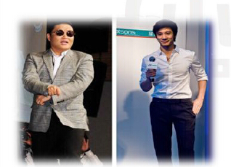
Do you agree or disagree with the following statement?
It is more important for a teacher to help students
gain self-confidence than to teach them specific knowledge.

Slide 38
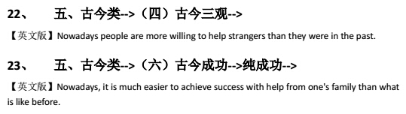

古今对比类题目：

Slide 39
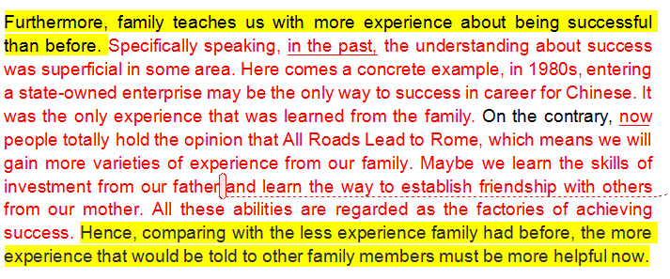
学生杰作：

Slide 40
列数据

Slide 41
Main Body Skill 3: Using data
引用论证——是指在议论文中使用引用权威数据来证明观点。

Slide 42

Main Body Skill 3: Using data
Data Elements
Source of data
Sum of sample
Duration of research, survey, or vote.
Relevance of content

Slide 43
Main Body Skill 3: Using data
Source of Data
US National Bureau of Statistics
Harvard/Stanford/Princeton Yale/Columbia/Duke University
《TIME》 《ESPN》 《science》 《U.S. News &World Report》 《Business Week》 《Forbes》 《Newsweek》 《Nature》
《The Economist》 《Vogue》
Nielsen Holdings N.V. Gallup, Inc.尼尔森控股NV盖洛普公司

Slide 44
Main Body Skill 3: Using data
Do you agree or disagree with the following statement?
Young people enjoy life better than older people.
Three Steps
1.明确论点
Agree: Young people now experience many more patterns of entertainment.
2.确定引用论证的四要素
Source: 《Vogue》；Duration: 3 months Sample: 10,000 young and 10,000 old
Relevance: over 70% young experience nearly 50 ways of diversion while over 80% old can only list 10 patterns of entertainment
3.数据联系论点(重述论点）
Thus, it is true that the young's life is much more wonderful.

Slide 45
Sample-列数据
(step l) Young people now experience many more patterns of entertainment. (step 2) According to a 3-months survey conducted by Vogue, among 10,000 young people and 10,000 old ones, over 70% of the involved young experience nearly 50 ways of diversion while over 80% of the involved old can only list 10 patterns of entertainment. (step 3) That is to say, the young always own more choices and then are more likely to get more fun from new types of diversion. Thus, it is true that the young's life is much more wonderful.

Slide 46
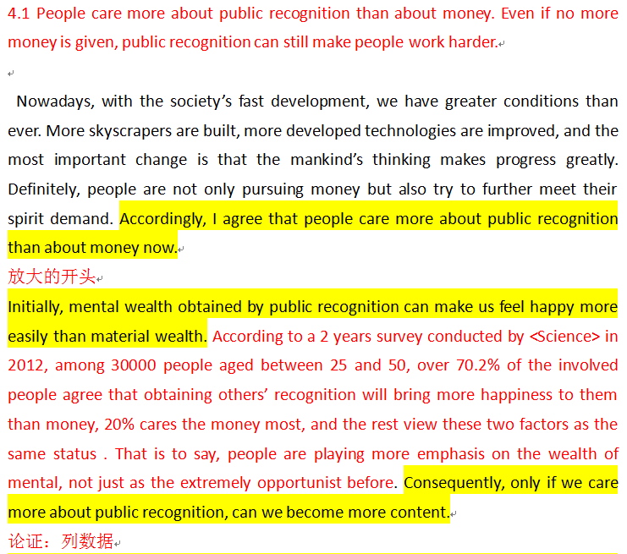
学生杰作：

Slide 47
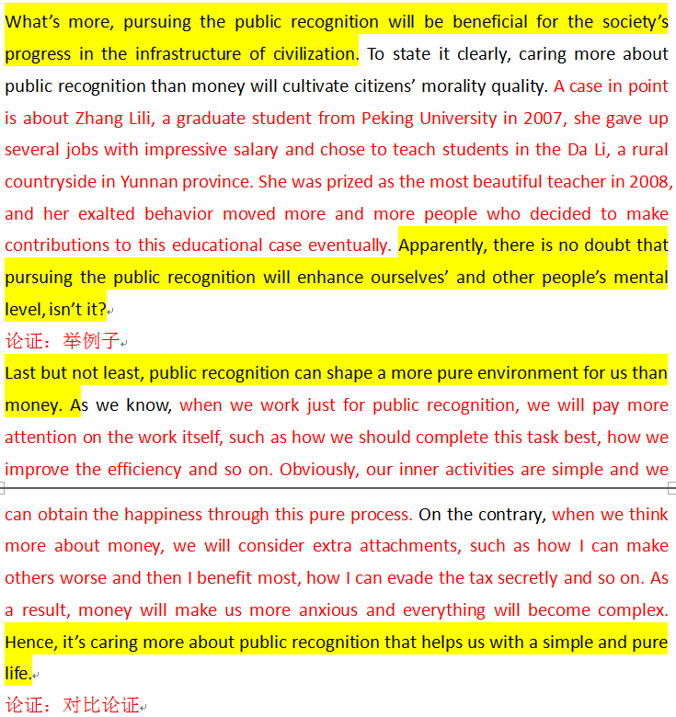

Slide 48

Do you agree or disagree with the following statement?
It is better to work in a large
company than in a small company.

Slide 49
Do you agree or disagree with the following statement?
It is better to work in a large
company than in a small company.
Agree
•工资高，福利待遇好
•工作环境好，有效率
•交到更多朋友
Disagree
•工资高
•升职相对容易
•工作压力小

Slide 50

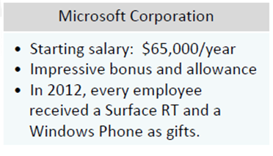
Do you agree or disagree with the following statement?
It is better to work in a large
company than in a small company.

Slide 51
Do you agree or disagree with the following statement?
It is better to work in a large
company than in a small company.
Agree
•工资高，福利待遇好
•工作环境好，有效率
•交到更多朋友
Disagree
•工资高
•升职相对容易
•工作压力小

Slide 52
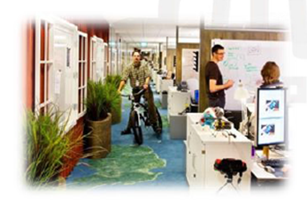
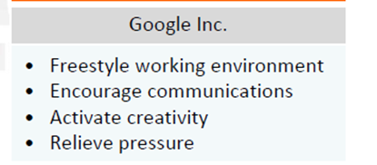
Do you agree or disagree with the following statement?
It is better to work in a large
company than in a small company.

Slide 53
Introduction
让步对立面观点正确性 undoubtedly…….
转折however/nevertheless……..
表自己观点I could hardly agree more with the statement that……
我的理由如下 ，the merits of which will be illustrated as follows.
Main body1-3
论点（言简意赅）
论据（解释说明论点）
论证（举例论证、对比论证、列数据、道理论证）
小总结（装逼句型）
Conclusion

