Slide 1
15SE205 Programming in Java
Hour 2

Slide 2
Agenda
Introduction to Data Types and Variables
Introduction to Operators
Introduction to Control Structures
Introduction to java through migration
C----- > C++----- > Java

Slide 3
Data Types in Java
Data types represent the different values to be stored in the variable. In java, there are two types of data types:
Primitive data types
Non-primitive data types

Slide 4
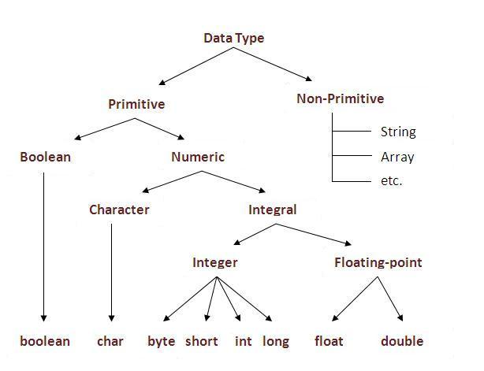
Data Types

Slide 5
Data Types and Variables
Use of Data types
Primitive Data Types
Byte,short,int,long,float,double,char,boolean
User defined Data Types
enum,classes
Variables
Values assigned to variables is called literals
Ex: int a=20; 'a' is an integer variable and 20 an integer literal

Slide 6
Ranges
long: 64 bits
Int: 32 bits
short: 16 bits
byte: 8bits
double:64 bits
float: 32 bits
char: 8 bits
boolean:true or false

Slide 7
Initialization
Static initialization
float a=2234.5;
Dynamic initialization
float b=a*2.5667+(3.899+5.908);

Slide 8
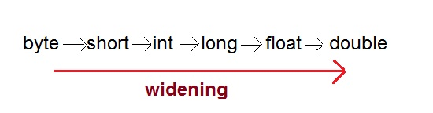
Type Casting
Assigning a value of one type to a variable of another type is known as Type Casting.
Example :
int x = 10;byte y = (byte)x; In Java, type casting is classified into two types,
Widening Casting(Implicit)

Slide 9
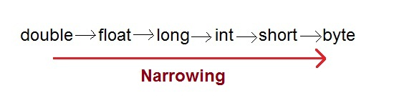
Type Casting
Narrowing Casting(Explicitly done)

Slide 10
Operators
Arithmetic → + , - , * , /
Bitwise → ~ , &, | , ^, >>,>>>,<<,&=,|=,^=,>>=,>>>=,<<=
Relational → ==, !=,>,<,>=,<=
Boolean Logical → &, |,^,||,&&,!,&=,|=,^=,==,!=,?:
Assignment → =
? Operator → expression1 ? expression2:expression3

Slide 11
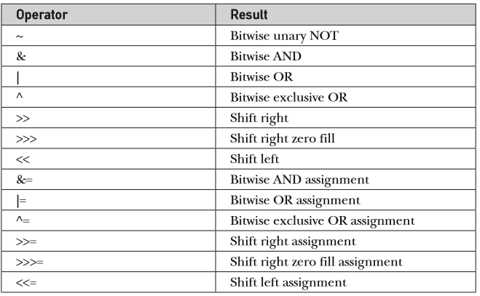
Bitwise Operator

Slide 12
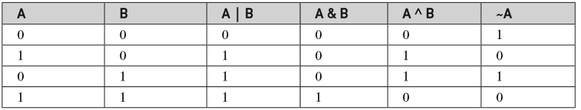
Bitwise Operator

Slide 13
Bitwise Operator
Code ……?

Slide 14
Control Structures
Selection: If, switch (Java 7: Switch with Strings )
Iteration: while, do-while, for, for-each
Jump: break, continue, return

Slide 15
Introduction to java through migration C----- > C++----- > Java
Write a program in C, C++ and java to take 2 inputs and perform any 4 operations based on user choice.

Slide 16
Demonstration by Mentor

Slide 17
My first encounter with Java
Basic skeleton of Java
What is a method?
What is command line arguments?
How to compile and run a java file?
What is compile time and Runtime?

Slide 18
Oh, this how you look!!!!
public class Fish{
public static void main(String[] args){
//This is to create Object of type Fish
Fish angelFish=new Fish();
}

Slide 19
Java journey
What is an IDE? NetBeans, Eclipse
To Compile in command prompt
javac Fish.java (Source code)-->Fish.class (Byte code)
To Run
Java Fish
To Run with command line arguments
Java Fish a 3 *

Slide 20
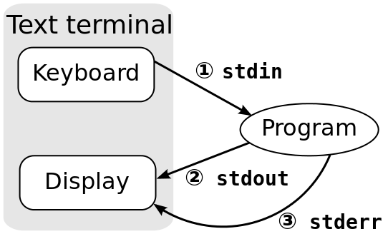
A bit of I/O!!!
What is standard input, Standard output,Standard error?

Slide 21
How to take inputs from user?
Scanner class
import java.util.*;
Scanner scan=new Scanner(System.in);
String s=scan. NextLine();
System.out.println(s);

Slide 22
What is expected from you?
Expectation at end of Hour 2:
Capable of understanding and installing jdk and Netbeans IDE.
Capable of understanding, writing and executing a basic java program with object orientation skills.

Slide 23
MCQ
Later…

Slide 24
Short Questions
Tabulate Operator Precedence in Java and solve one example covering almost all the precedence considered.
Think of an application which is capable of demonstrating the use of almost all data types. Do write a java program.
What is the effect of converting an integer to byte? Justify.
How negative numbers are represented in Java? Justify with an example
Differentiate >>> and >> operators with an example.

Slide 25
Lab Questions

Slide 26
Tutorial_week1
Program1: Apply an Object oriented paradigm (hint:classes) using java to develop a stand alone application without a method to print "I am enjoying my program in JAVA and I swear I will put all my sincere efforts to grow each day technically" Level: Basic
Program 2: Apply an Object oriented paradigm using java to develop a stand alone application to print what the user demands using methods Hint: Single class.Level: Basic

Slide 27
Tutorial_week1
Program 3: Apply an Object oriented paradigm using java to develop a stand alone application to call a method to do the same but from another class.Hint: more than one class needed. Level: Basic
Program 4: Apply an Object oriented paradigm using java to develop a stand alone application for Number conversion in java. (may be for this we would introduce the basic data types) Level: Intermediate

Slide 28
Tutorial_week1
Program 5: Write a Program in C, C++ and Java for the given scenario.
Write a program to calculate the total and average of marks in 2 subjects. Repeat the program for 2 students. Validate the mark is never less than 0 or greater than 100 before assigning to the respective variables. Your Program should also be capable of identifying the student with the best score and display the same.
Note: Weightage will be given to appropriate methods and variable names, proper code logic and apt comments)

