Slide 1
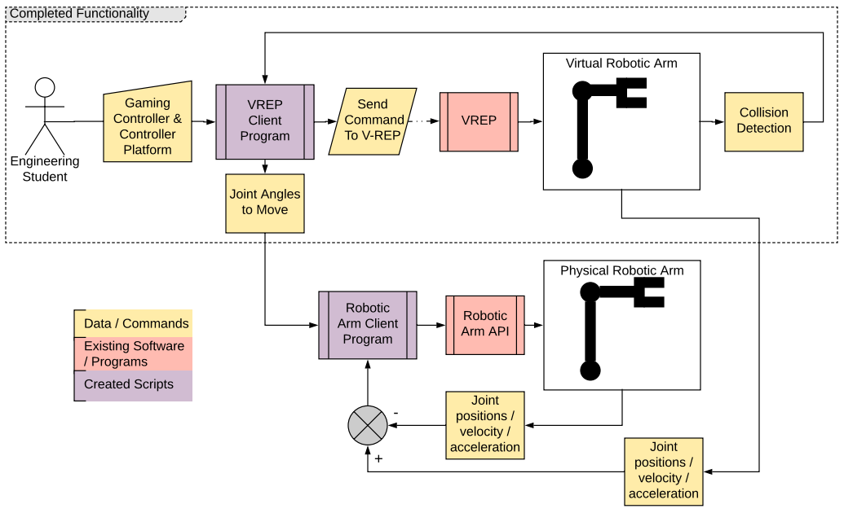
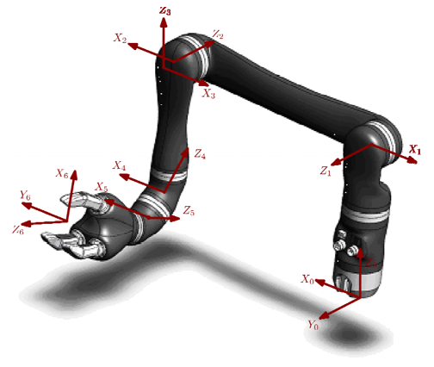
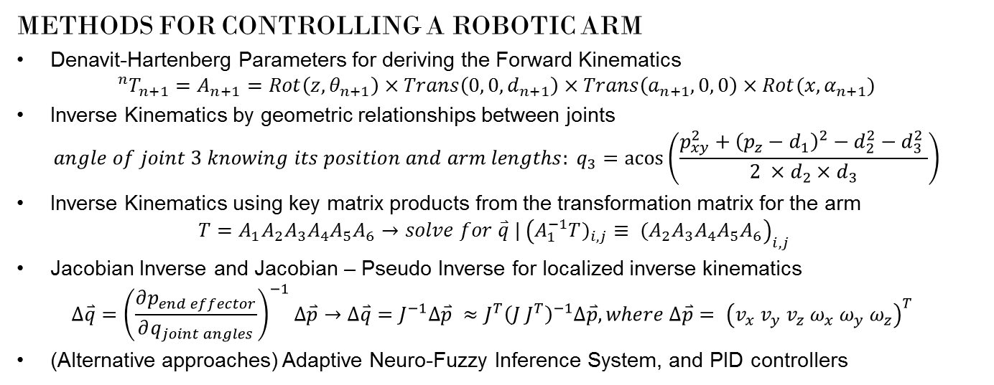
Virtual Robotics Experimentation Platform
Callum Rohweder & Dr Surya Singh
BACKGROUND
VREP
Is a program that allows the simulation of robotic manipulations. All actuation and sensing is controlled within custom Lua scripts, whilst the amount of torque supplied by motors can be tuned with the use of PID controllers.
The remote API can be used to give real-time commands, such as moving a particular joint, or return parameters such as location relative to an object within the scene.
OBJECTIVES
The purpose of this thesis is to develop a robust method of controlling the gripper position of the Kinova Jaco arm in VREP, and using this as a collision avoidance environment, that can then control a physical robotic arm. This can only be accomplished by evaluating the reliability and processing time of different control approaches, to ensure real-time movement. Using the VREP remote API, a client program for testing the different VREP features and control methods was created.
VREP CLIENT PROGRAM
Uses VREP’s remote API in C,
Connects to VREP via socket connection, allowing blocking, data streaming and unblocking commands to move between,
Object handles are saved to a text file on first start-up to map to objects in the scene,
The arm can be configured to either FK or IK modes,
When the scene is in FK mode, the client program offers 3 methods of moving the virtual arm given IK inputs,
The inputs can be either from a keyboard, or a gaming controller (where the controls are turned into keyboard commands).
METHODS FOR CONTROLLING A ROBOTIC ARM
Denavit-Hartenberg Parameters for deriving the Forward Kinematics ${}_{ }^{n}{T_{n+1}=A_{n+1}=Rot\left(z, θ_{n+1}\right)×Trans\left(0, 0, d_{n+1}\right)×Trans\left(a_{n+1}, 0, 0\right)×Rot(x, α_{n+1})}$
Inverse Kinematics by geometric relationships between joints $angle of joint 3 knowing its position and arm lengths: q_{3}=\operatorname{acos}\left(\frac{{p_{xy}^{2}+{\left(p_{z}−d_{1}\right)}^{2}−d}_{2}^{2}−d_{3}^{2} }{2 ×d_{2}×d_{3}}\right)$
Inverse Kinematics using key matrix products from the transformation matrix for the arm $T=A_{1}A_{2}A_{3}A_{4}A_{5}A_{6}→solve for \overset{⃑}{q} | {\left(A_{1}^{−1}{T)}_{i,j}≡ {(A}_{2}A_{3}A_{4}A_{5}A_{6}\right)}_{i,j}$
Jacobian Inverse and Jacobian – Pseudo Inverse for localized inverse kinematics $∆\overset{⃑}{q}={\left(\frac{∂p_{end effector}}{∂q_{joint angles}}\right)}^{−1}∆\overset{⃑}{p}→∆\overset{⃑}{q}=J^{−1}∆\overset{⃑}{p} ≈J^{T}{\left(J J^{T}\right)}^{−1}∆\overset{⃑}{p}, where ∆\overset{⃑}{p}= {\left(v_{x} v_{y} v_{z} ω_{x}{ ω}_{y}{ ω}_{z}\right)}^{T}$
(Alternative approaches) Adaptive Neuro-Fuzzy Inference System, and PID controllers

