Slide 1
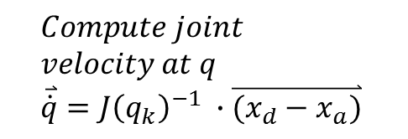

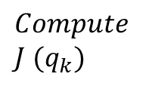

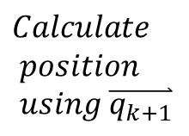

$$x_{d}$$
$$Compute joint \\ velocity at q \\ \overset{⃑}{\dot{q}}=J{\left(q_{k}\right)}^{−1} ∙\overset{⃑}{(x_{d}−x_{a})}$$
$$Compute new \\ joint angles \\ \overset{⃑}{q_{k+1}}=\overset{⃑}{q_{k}}+ ∆_{t}∙\overset{⃑}{\dot{q}}$$
$$Calculate \\ position \\ using \overset{⃑}{q_{k+1}}$$
$$x_{a}$$
$$Compute \\ J (q_{k})$$

Slide 2
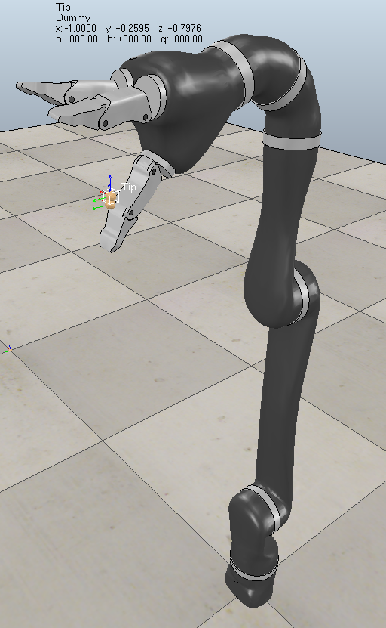
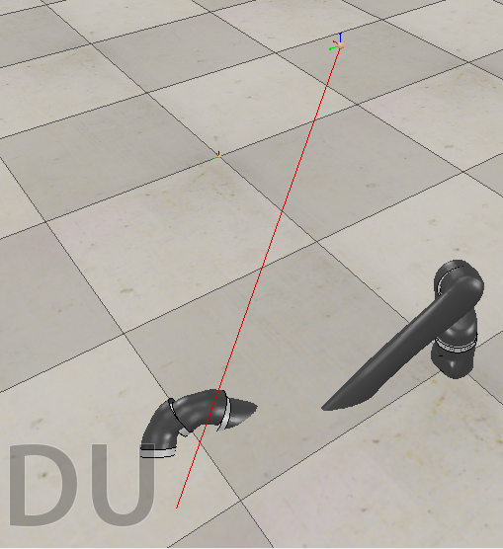
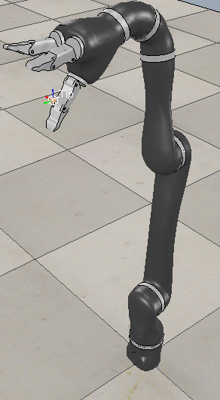

Slide 3































$α=\frac{1}{6} q_{4}$
$β=\frac{1}{6} {(q}_{5} −\frac{π}{2})$
74.1
$$P′$$
271.472
$$α$$
$$β$$
$$R$$
$$P$$
$$q_{3}$$
$$S$$
$$q_{6}$$
202.95
$42.7816\tan\left(\frac{π}{3}\right)=74.01$
202.78
$$q_{4}$$
$$R$$
$$R$$
$$P′$$
$$2×\frac{ D_{4}\sin\left(\frac{π}{6}\right) }{tan⁡(\frac{π}{3})}\cos\left(\frac{π}{3}\right)=42.7816⁡$$
$$q_{5}$$
85.563
$$P$$
$$q_{3}$$
$$D_{5}$$
250
$$q_{2}$$
$$S$$
$$P$$
$$\frac{π}{3}$$
$$\frac{π}{6}$$
$$D_{4}$$
$D_{4}cos⁡(\frac{π}{6})$ = 64.172
410
$$q_{2}$$
275.5
$$z$$
$$q_{1}$$
$$x$$
$$y$$

Slide 4







$$z$$
$$S_{d}$$
$$S_{a}$$
$$θ_{z}$$
$$y$$
$$θ_{xy}$$
$$x$$

