Slide 1
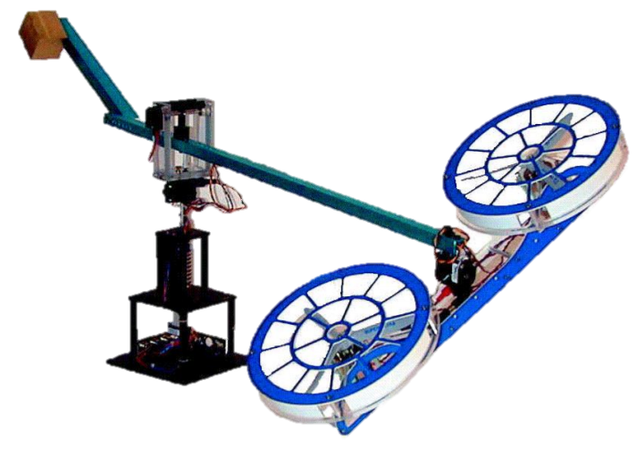
Quanser Helicopter
Lachlan Arundell
Arnav Joshi
Callum Rohweder
Harry Veivers

Slide 2
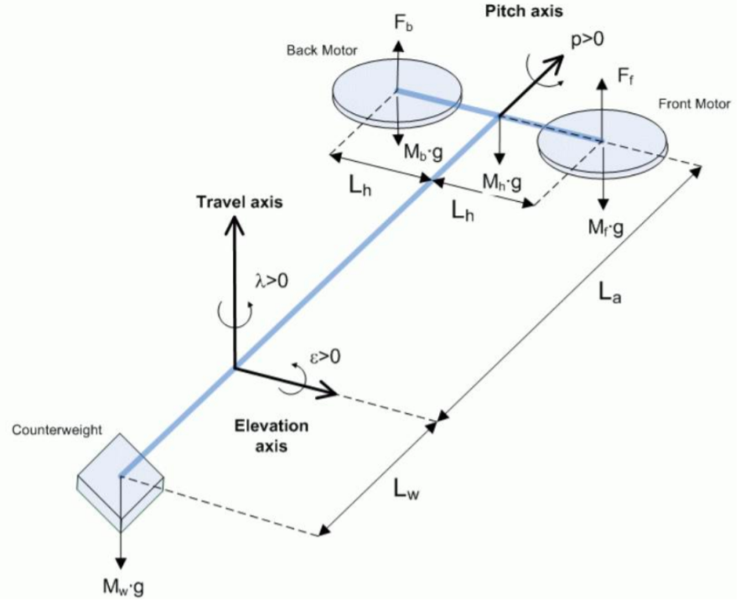
Linearised System – Design Philosophy
Although all real systems exhibit some form of non-linear behaviour, it is linear behaviour which provides a regime more easily susceptible to modelling.
Thus, it is of interest to utilise the lumped parameter model to create a linearized system describing the plant:

Slide 3
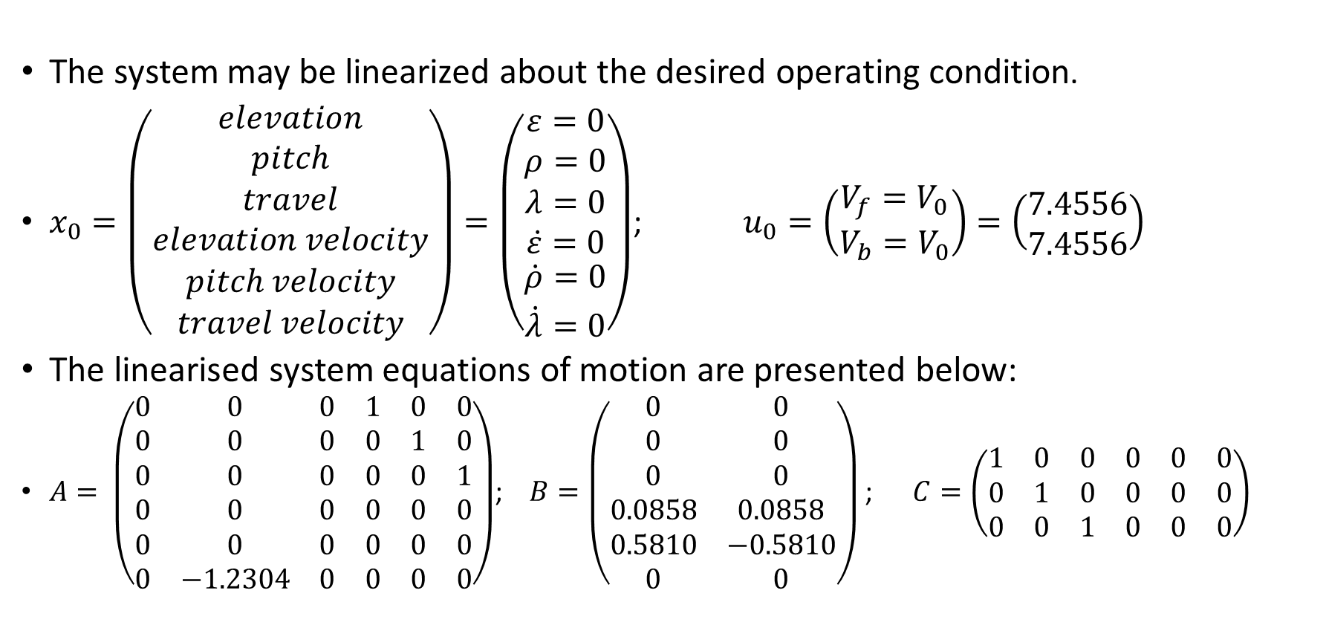
Linearised System – Design Procedure
The system may be linearized about the desired operating condition.
$x_{0}=\left(\begin{matrix}elevation \\ pitch \\ \begin{matrix}travel \\ elevation velocity \\ \begin{matrix}pitch velocity \\ travel velocity\end{matrix}\end{matrix}\end{matrix}\right)=\left(\begin{matrix}ε=0 \\ ρ=0 \\ \begin{matrix}λ=0 \\ \dot{ε}=0 \\ \begin{matrix}\dot{ρ}=0 \\ \dot{λ}=0\end{matrix}\end{matrix}\end{matrix}\right)$; $u_{0}=\left(\begin{matrix}V_{f}=V_{0} \\ V_{b}=V_{0}\end{matrix}\right)=\left(\begin{matrix}7.4556 \\ 7.4556\end{matrix}\right)$
The linearised system equations of motion are presented below:
$A= \left(\begin{matrix}0 & 0 & 0 & 1 & 0 & 0 \\ 0 & 0 & 0 & 0 & 1 & 0 \\ 0 & 0 & 0 & 0 & 0 & 1 \\ 0 & 0 & 0 & 0 & 0 & 0 \\ 0 & 0 & 0 & 0 & 0 & 0 \\ 0 & −1.2304 & 0 & 0 & 0 & 0\end{matrix}\right)$; $B=\left(\begin{matrix}0 & 0 \\ 0 & 0 \\ 0 & 0 \\ 0.0858 & 0.0858 \\ 0.5810 & −0.5810 \\ 0 & 0\end{matrix}\right)$ ; $C=\left(\begin{matrix}1 & 0 & 0 & 0 & 0 & 0 \\ 0 & 1 & 0 & 0 & 0 & 0 \\ 0 & 0 & 1 & 0 & 0 & 0\end{matrix}\right)$

Slide 4
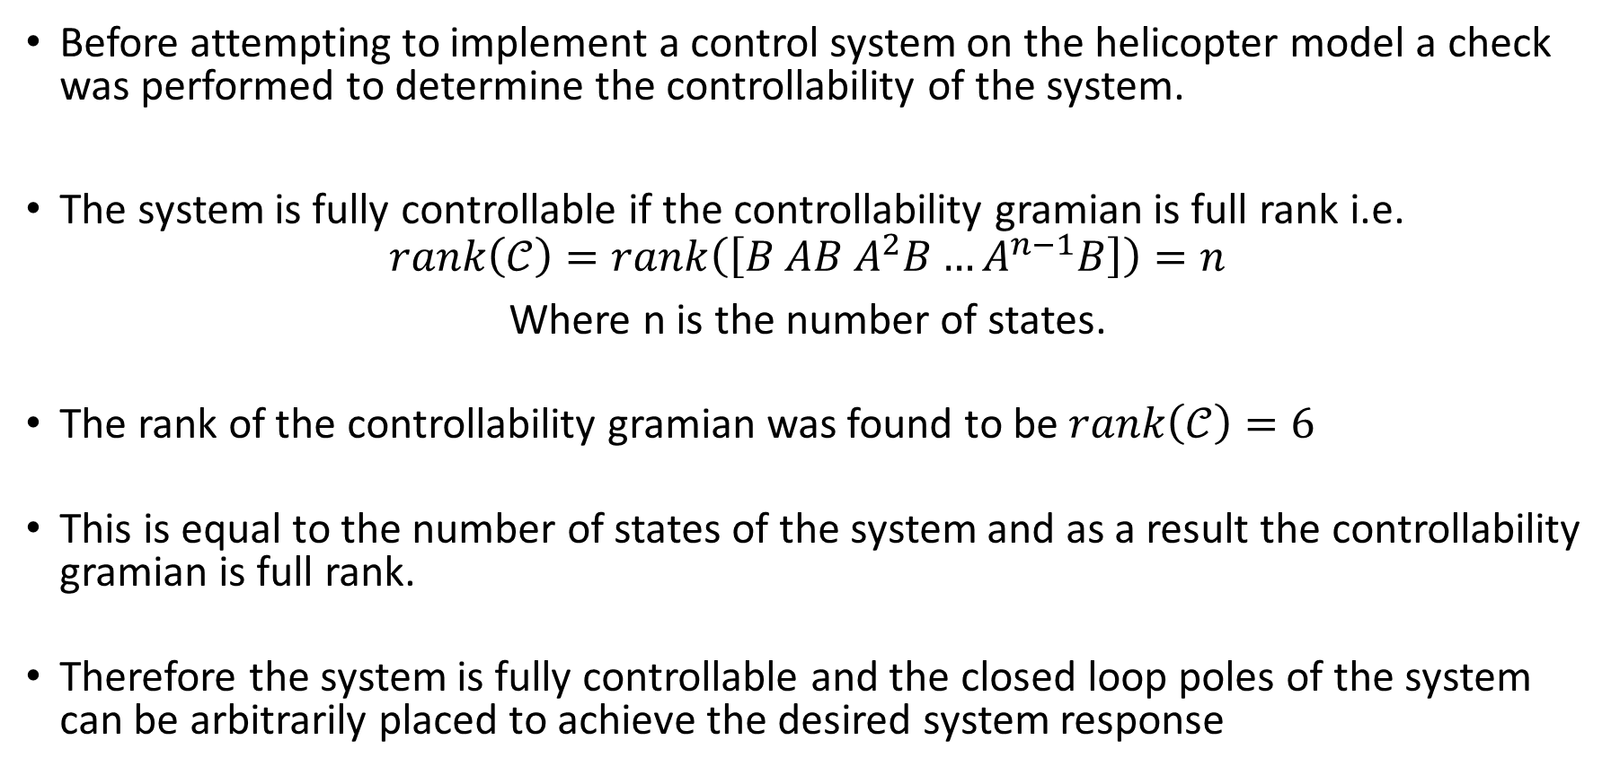
Controllability
Before attempting to implement a control system on the helicopter model a check was performed to determine the controllability of the system.
The system is fully controllable if the controllability gramian is full rank i.e.
$$rank\left(𝒞\right)=rank\left(\left[B AB A^{2}B…A^{n−1}B\right]\right)=n$$
Where n is the number of states.
The rank of the controllability gramian was found to be $rank\left(𝒞\right)=6$
This is equal to the number of states of the system and as a result the controllability gramian is full rank.
Therefore the system is fully controllable and the closed loop poles of the system can be arbitrarily placed to achieve the desired system response

Slide 5
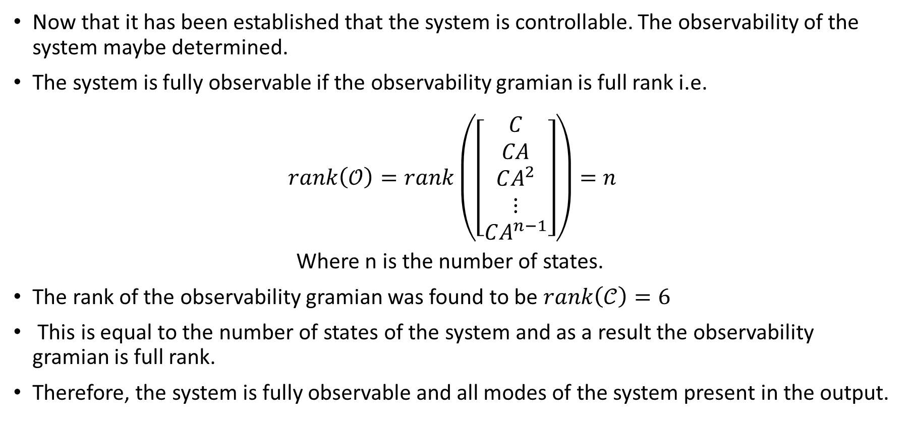
Observability
Now that it has been established that the system is controllable. The observability of the system maybe determined.
The system is fully observable if the observability gramian is full rank i.e.
$$rank\left(𝒪\right)=rank\left(\left[\begin{matrix}C \\ CA \\ \begin{matrix}CA^{2} \\ ⋮ \\ CA^{n−1}\end{matrix}\end{matrix}\right]\right)=n$$
Where n is the number of states.
The rank of the observability gramian was found to be $rank\left(𝒞\right)=6$
This is equal to the number of states of the system and as a result the observability gramian is full rank.
Therefore, the system is fully observable and all modes of the system present in the output.

Slide 6
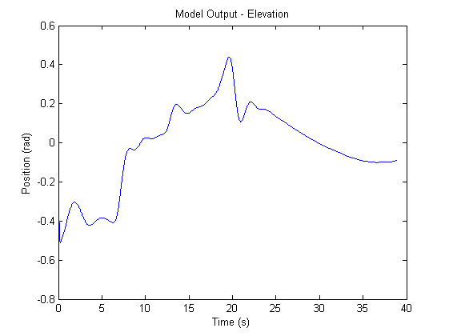
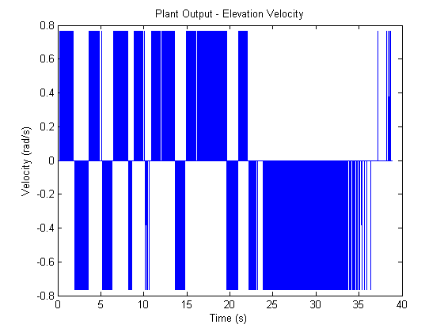
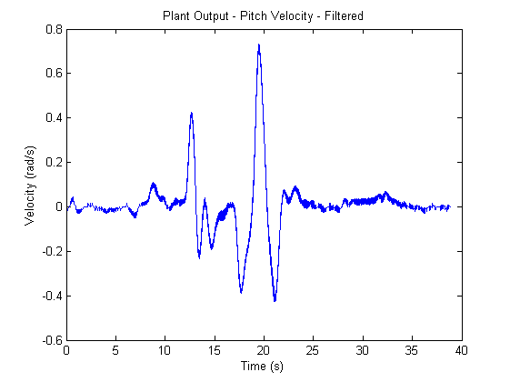
LQR – State Feedback
Implementation of state feedback is required in-order to effectively control the system such that it can be driven to and regulated about arbitrary operational states. For a controllable system, this is achieved through appropriate placement of the closed loop poles of the system such that it will be driven to the provided reference state.
However, there is a problem when using state feedback for this system as optical encoders are used to measure the position states for the system.
Continuous differentiation and even low pass filtering result in a unacceptable level of noise when attempting to determine the velocity states from the encoder readings.

Slide 7
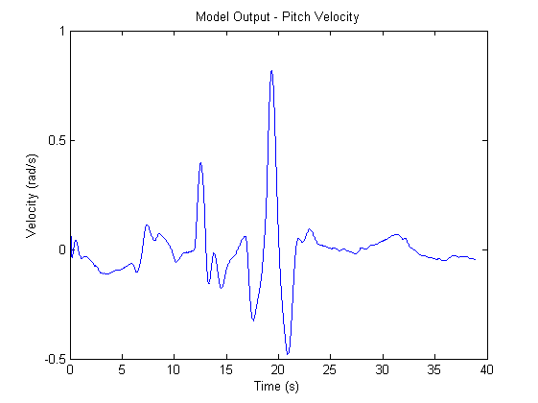
LQE – State Estimate Observer
In-order to effectively design state feedback without encountering the issues mentioned before, an observer is required.

Slide 8
LQE – State Estimate Observer Design
Due to discrepancy between the system and model dynamics, a Luenberger observer is required to drive the error towards zero.
The design of such an observer requires appropriate selection of its poles in-order to achieve the desired dynamics. These poles have to be faster than the state feedback poles to ensure the observer is updated effectively.

Slide 9
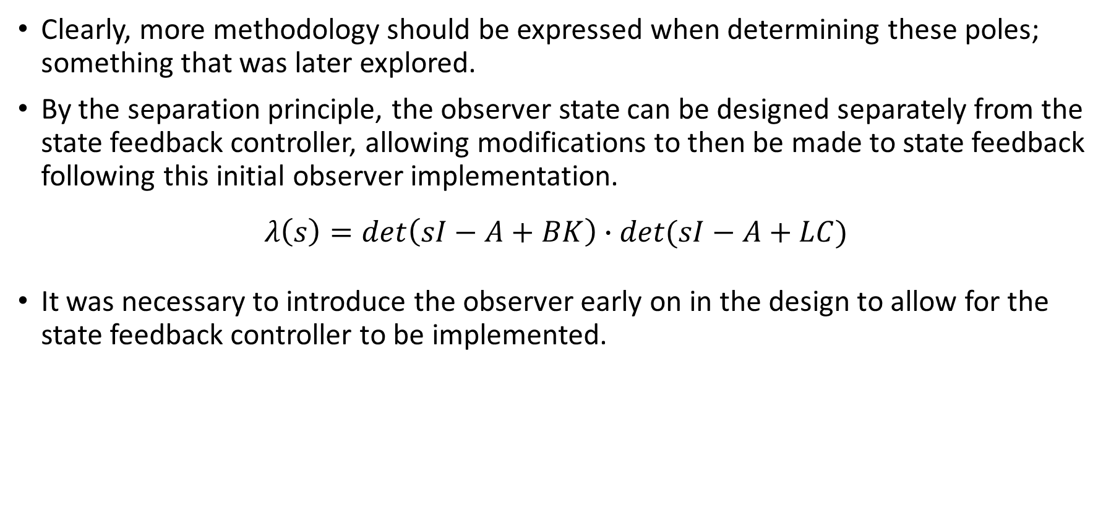
Separation Principle
Clearly, more methodology should be expressed when determining these poles; something that was later explored.
By the separation principle, the observer state can be designed separately from the state feedback controller, allowing modifications to then be made to state feedback following this initial observer implementation.
$$λ\left(s\right)=\det\left(sI−A+BK\right)∙det⁡(sI−A+LC)$$
It was necessary to introduce the observer early on in the design to allow for the state feedback controller to be implemented.

Slide 10
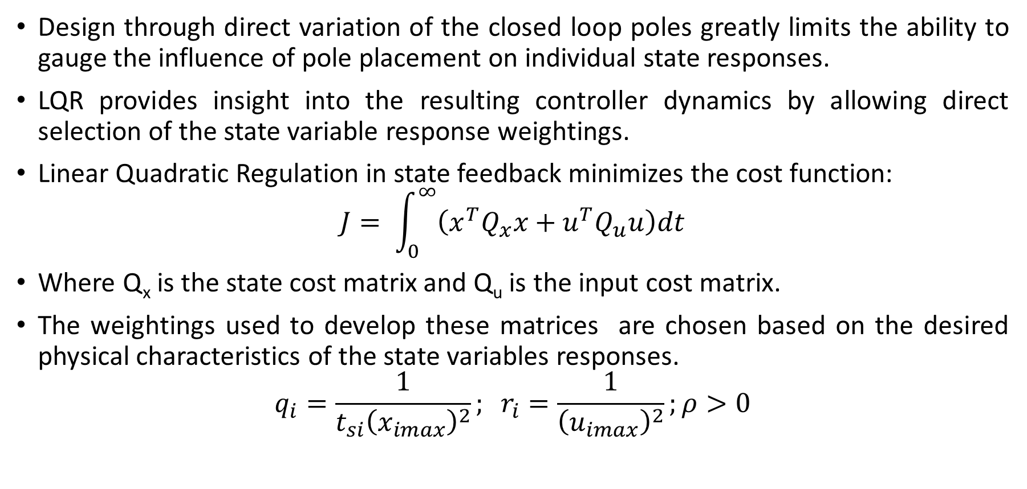
LQR – Design Procedure
Design through direct variation of the closed loop poles greatly limits the ability to gauge the influence of pole placement on individual state responses.
LQR provides insight into the resulting controller dynamics by allowing direct selection of the state variable response weightings.
Linear Quadratic Regulation in state feedback minimizes the cost function:
$$J= \int_{0}^{∞}{\left(x^{T}Q_{x}x+u^{T}Q_{u}u\right)dt}$$
Where Q_{x} is the state cost matrix and Q_{u} is the input cost matrix.
The weightings used to develop these matrices are chosen based on the desired physical characteristics of the state variables responses.
$$q_{i}=\frac{1}{t_{si}{\left(x_{imax}\right)}^{2}}; r_{i}=\frac{1}{{\left(u_{imax}\right)}^{2}};ρ>0$$

Slide 11
LQR – Design Procedure – Desired Behaviour
The following requirements describe the desired behavioural characteristics of the helicopter system:
Moderate control applied to pitch rate. Enough to allow swift response to changes in travel reference while avoiding highly oscillatory pitching motion.
Strong travel control should correspond to strong pitch control due to direct coupling. Need to ensure this does not limit range of pitching motion.
Travel rate should be strongly controlled to prevent overshoot during helicopter motion. Simultaneously need helicopter to be responsive.
Elevation requires weaker control as its motion is not conflicted by another state due to the absence of cross coupling.
Tuning of Qx is of primary importance as it will address the above requirements directly. Qu is determined based on the trade-off required between regulation and control effort to achieve the desired response.

Slide 12
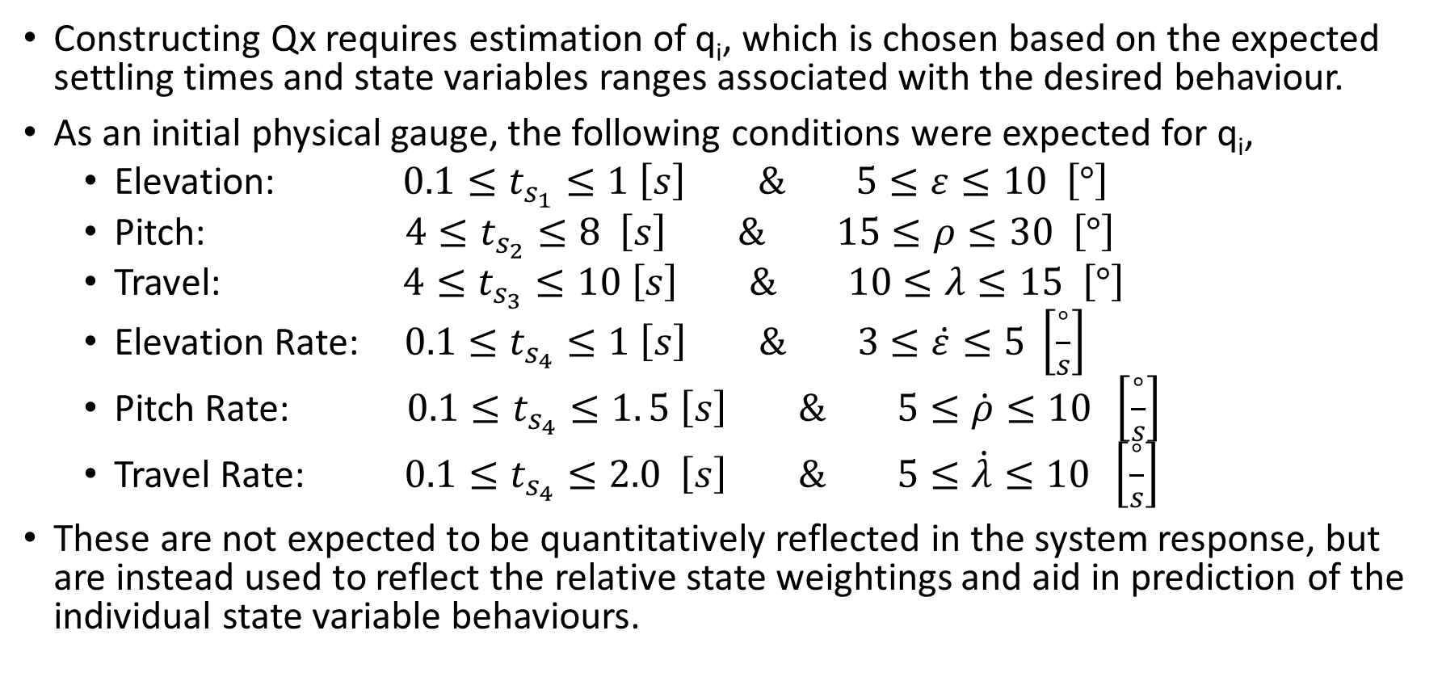
LQR – Design Procedure – Physical Conditions
Constructing Qx requires estimation of q_{i}, which is chosen based on the expected settling times and state variables ranges associated with the desired behaviour.
As an initial physical gauge, the following conditions were expected for q_{i},
Elevation: $0.1≤t_{s_{1}}≤1 \left[s\right] \& 5≤ε≤10 \left[°\right]$
Pitch: $4≤t_{s_{2}}≤8 \left[s\right] \& 15≤ρ≤30 \left[°\right]$
Travel: $4≤t_{s_{3}}≤10 \left[s\right] \& 10≤λ≤15 \left[°\right]$
Elevation Rate: $0.1≤t_{s_{4}}≤1 \left[s\right] \& 3≤\dot{ε}≤5 \left[\frac{°}{s}\right]$
Pitch Rate: $0.1≤t_{s_{4}}≤1. 5 \left[s\right] \& 5≤\dot{ρ}≤10 \left[\frac{°}{s}\right]$
Travel Rate: $0.1≤t_{s_{4}}≤2.0 \left[s\right] \& 5≤\dot{λ}≤10 \left[\frac{°}{s}\right]$
These are not expected to be quantitatively reflected in the system response, but are instead used to reflect the relative state weightings and aid in prediction of the individual state variable behaviours.

Slide 13
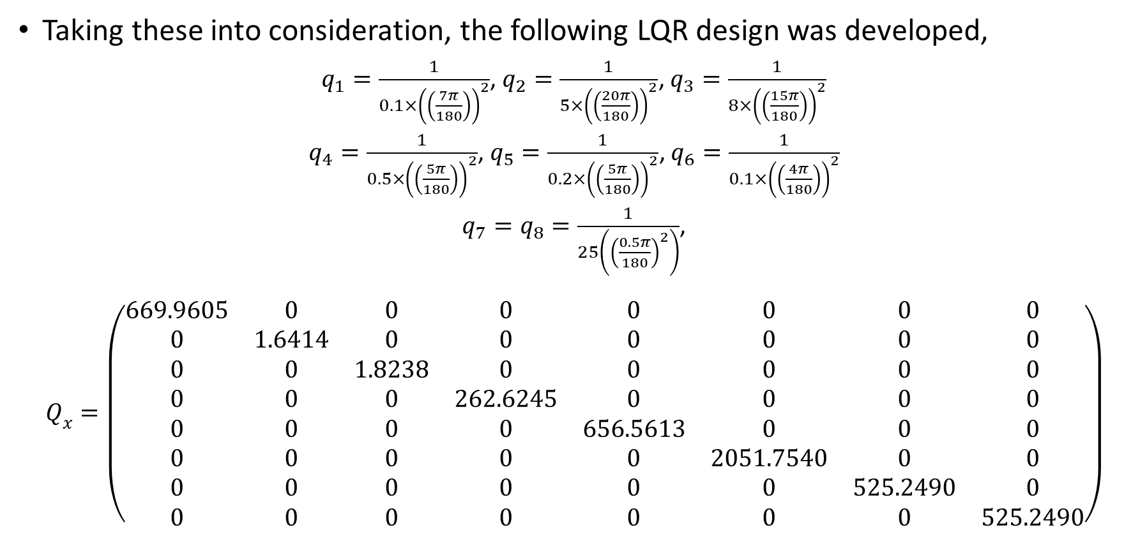
LQR – Design Procedure
Taking these into consideration, the following LQR design was developed,
$q_{1}=\frac{1}{0.1×{\left(\left(\frac{7π}{180}\right)\right)}^{2}}$, $q_{2}=\frac{1}{5×{\left(\left(\frac{20π}{180}\right)\right)}^{2}}$, $q_{3}=\frac{1}{8×{\left(\left(\frac{15π}{180}\right)\right)}^{2}}$
$q_{4}=\frac{1}{0.5×{\left(\left(\frac{5π}{180}\right)\right)}^{2}}$, $q_{5}=\frac{1}{0.2×{\left(\left(\frac{5π}{180}\right)\right)}^{2}}$, $q_{6}=\frac{1}{0.1×{\left(\left(\frac{4π}{180}\right)\right)}^{2}}$
$q_{7}=q_{8}=\frac{1}{25\left({\left(\frac{0.5π}{180}\right)}^{2}\right)}$,
$$Q_{x}=\left(\begin{matrix}669.9605 & 0 & 0 & 0 & 0 & 0 & 0 & 0 \\ 0 & 1.6414 & 0 & 0 & 0 & 0 & 0 & 0 \\ 0 & 0 & 1.8238 & 0 & 0 & 0 & 0 & 0 \\ 0 & 0 & 0 & 262.6245 & 0 & 0 & 0 & 0 \\ 0 & 0 & 0 & 0 & 656.5613 & 0 & 0 & 0 \\ 0 & 0 & 0 & 0 & 0 & 2051.7540 & 0 & 0 \\ 0 & 0 & 0 & 0 & 0 & 0 & 525.2490 & 0 \\ 0 & 0 & 0 & 0 & 0 & 0 & 0 & 525.2490\end{matrix}\right)$$

Slide 14
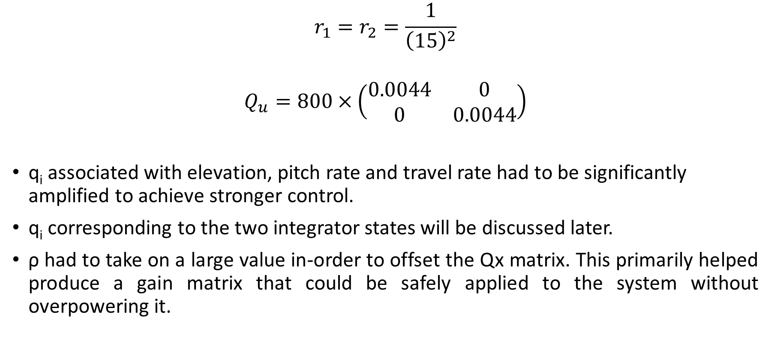
LQR – Design Procedure
$$r_{1}=r_{2}=\frac{1}{{\left(15\right)}^{2}}$$
$$Q_{u}=800×\left(\begin{matrix}0.0044 & 0 \\ 0 & 0.0044\end{matrix}\right)$$
q_{i} associated with elevation, pitch rate and travel rate had to be significantly amplified to achieve stronger control.
q_{i} corresponding to the two integrator states will be discussed later.
ρ had to take on a large value in-order to offset the Qx matrix. This primarily helped produce a gain matrix that could be safely applied to the system without overpowering it.

Slide 15
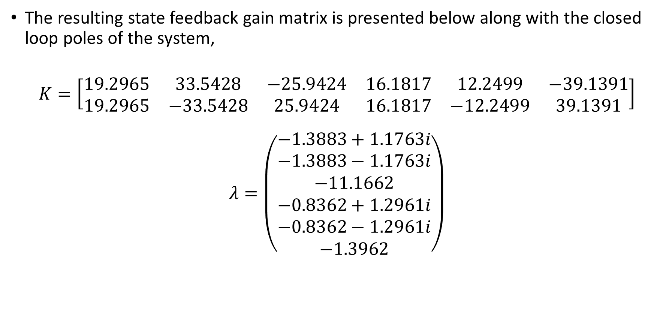
LQR – Design Procedure
The resulting state feedback gain matrix is presented below along with the closed loop poles of the system,
$$K=\left[\begin{matrix}19.2965 & 33.5428 & −25.9424 & 16.1817 & 12.2499 & −39.1391 \\ 19.2965 & −33.5428 & 25.9424 & 16.1817 & −12.2499 & 39.1391\end{matrix}\right]$$
$$λ=\left(\begin{matrix}−1.3883+1.1763i \\ −1.3883−1.1763i \\ −11.1662 \\ −0.8362+1.2961i \\ −0.8362−1.2961i \\ −1.3962\end{matrix}\right)$$

Slide 16
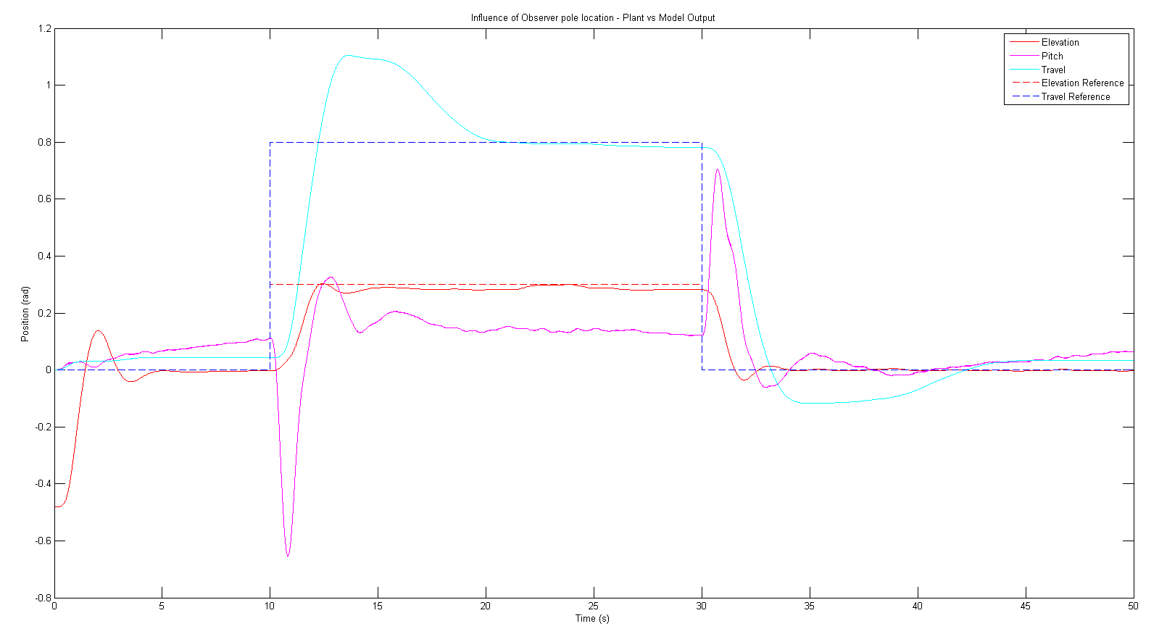
LQR – Design Procedure
Final K design system response.

Slide 17
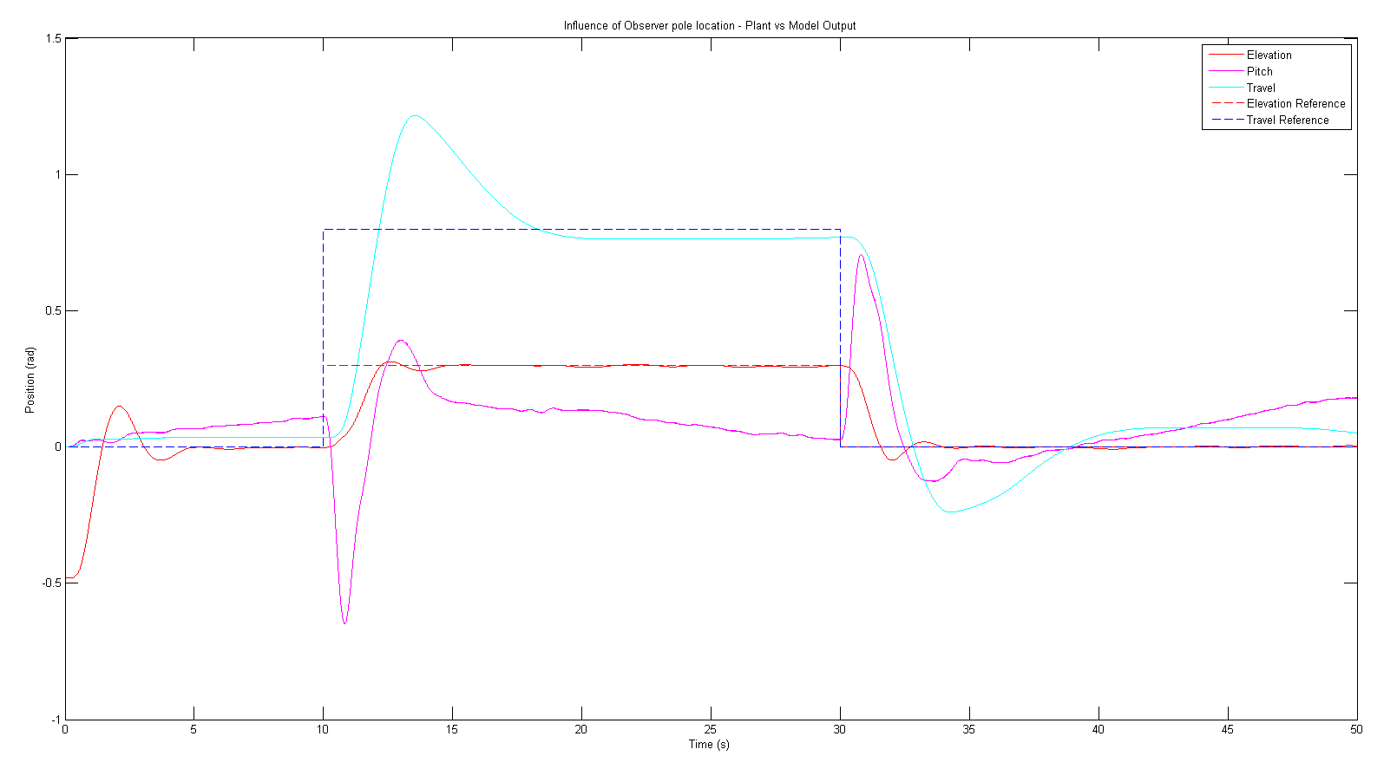

LQR – Design Procedure – Test
The response for an initial K design based on the set constraints is presented below,
$$K=\left[\begin{matrix}15.9133 & 27.1234 & −22.4179 & 14.1954 & 10.9002 & −29.1913 \\ 15.9133 & −27.1234 & 22.4179 & 14.1954 & −10.9002 & 29.1913\end{matrix}\right]$$

Slide 18
LQR – Design Procedure – Observations
Several solutions to the K matrix failed to reflect the requirements. Elevation and travel gains were found to be highly sensitive along with pitch rate control.
Elemental gains within K had varying sensitivities and cross coupling behaviour:
Changing q_{i} for any of the pitch/travel related states directly affected gains associated with the remaining states.
Extreme q_{i} values are required for particular state variables in-order to address issues associated with its sensitivity.
Selection of r_{i} not crucial as input behaviours for both motors are within the same range.
Choice of ρ is simply based on the desired strength of the controller. Effectively acts as an indirect scaling factor for K.

Slide 19
LQI – Integral Feedback Motivation
In order to make the system control robust to process noise and random disturbances, integral feedback was implemented with the aim of eliminating steady state error.
The required integral feedback gain was designed using the ‘lqi’ function in MATLAB©. In-order to do this, two additional states had to be introduced, namely the elevation and travel integrator states, z.

Slide 20
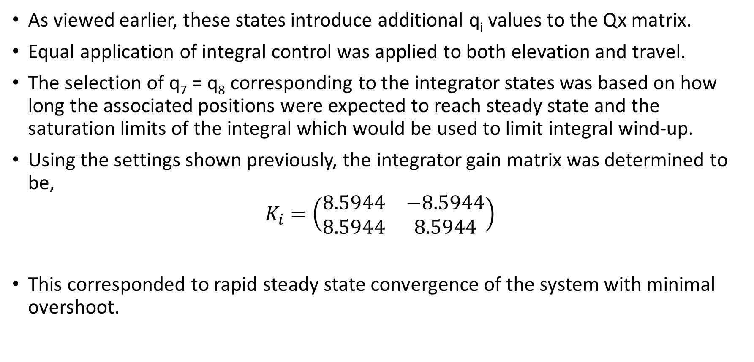
LQI – Integral Feedback Design
As viewed earlier, these states introduce additional q_{i} values to the Qx matrix.
Equal application of integral control was applied to both elevation and travel.
The selection of q₇ = q₈ corresponding to the integrator states was based on how long the associated positions were expected to reach steady state and the saturation limits of the integral which would be used to limit integral wind-up.
Using the settings shown previously, the integrator gain matrix was determined to be,
$$K_{i}=\left(\begin{matrix}8.5944 & −8.5944 \\ 8.5944 & 8.5944\end{matrix}\right)$$
This corresponded to rapid steady state convergence of the system with minimal overshoot.

Slide 21
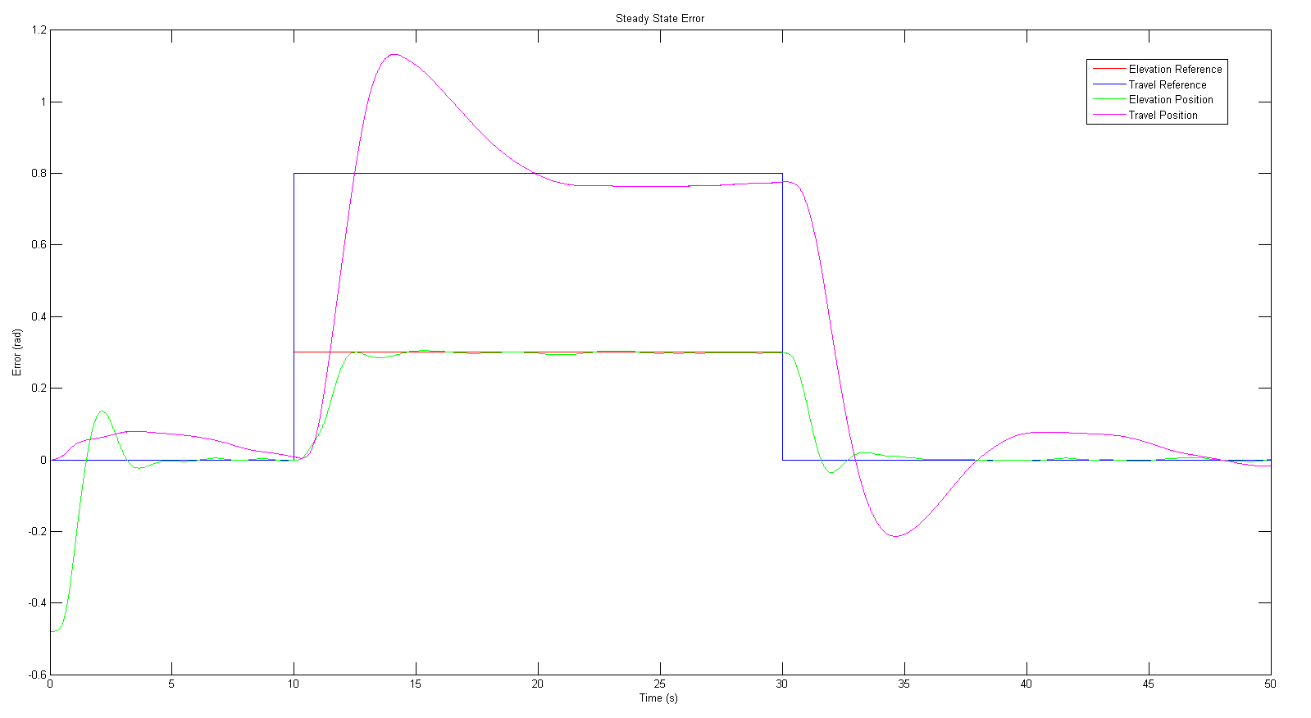
LQI – Integral Feedback Design
The system response to an automated trajectory, corresponding to the final K and K_{i} gain matrices is presented below,
Position vs Reference
Position (rad)

Slide 22
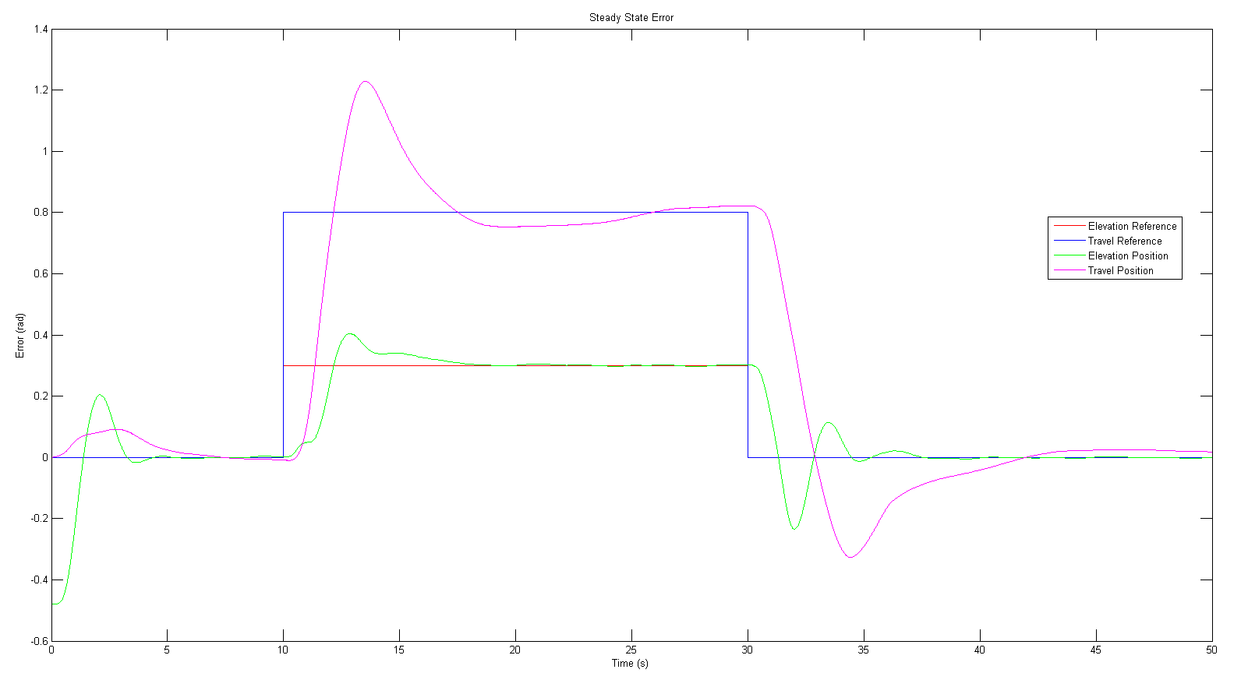
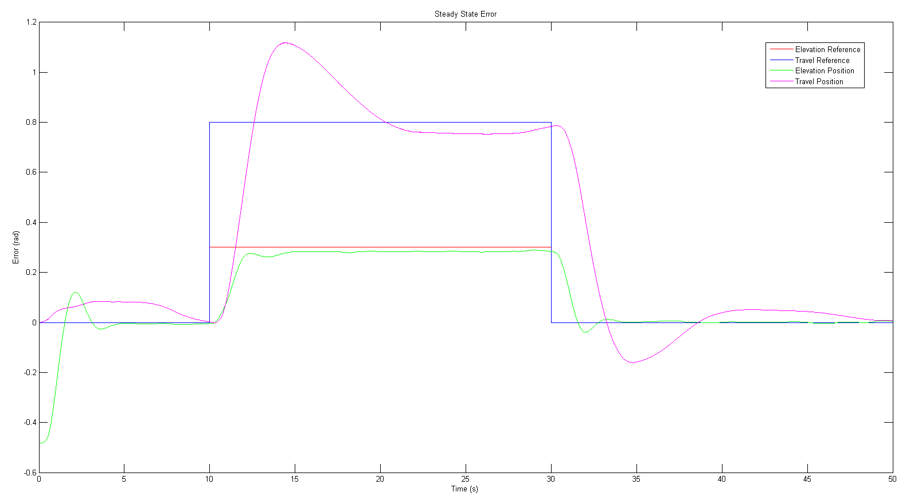
LQI – Integral Feedback Design
Testing other potential K_{i} matrices produce the following, less optimal responses,
The figure on the left corresponds to lower K_{i} gains, which displayed greater overshoot and longer settling time (slower convergence to steady state).
The figure on the right corresponds to higher K_{i} gains, which displayed reduced overshoot and faster steady state convergence, however steady state error was not entirely eliminated.
Position vs Reference
Position vs Reference
Position (rad)
Position (rad)

Slide 23
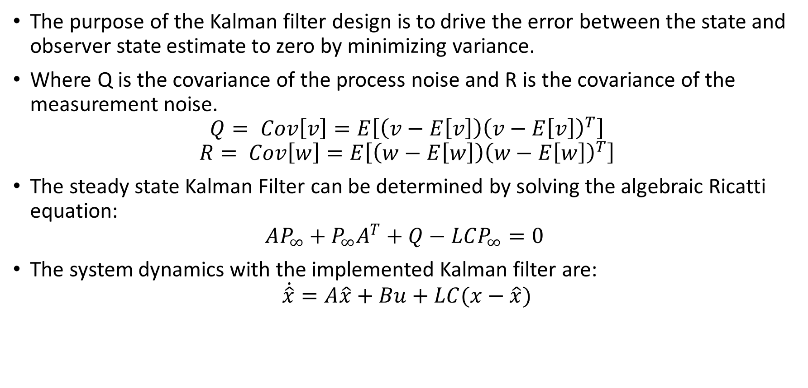
Kalman Filter – Motivation for Observer Improvement
The purpose of the Kalman filter design is to drive the error between the state and observer state estimate to zero by minimizing variance.
Where Q is the covariance of the process noise and R is the covariance of the measurement noise.
$$Q= Cov\left[v\right]=E\left[\left(v−E\left[v\right]\right){\left(v−E\left[v\right]\right)}^{T}\right]$$
$$R= Cov\left[w\right]=E\left[\left(w−E\left[w\right]\right){\left(w−E\left[w\right]\right)}^{T}\right]$$
The steady state Kalman Filter can be determined by solving the algebraic Ricatti equation:
$$AP_{∞}+P_{∞}A^{T}+Q−LCP_{∞}=0$$
The system dynamics with the implemented Kalman filter are:
$$\dot{\hat{x}}=A\hat{x}+Bu+LC(x−\hat{x})$$

Slide 24
Kalman Filter – Design Procedure
An experimental process was performed in order to estimate both the measurement noise and the process noise of the physical system.
The measurement noise was determined by inputting the bias voltage into the system, such that the helicoptered hovered at the operating point, and recording the encoder position measurement.
The process noise was determined by applying a step change in elevation reference. The estimator output was then subtracted from the plant output to determine an estimate of the error.
It was found that this procedure did not provide a realistic estimate for the noise and covariance. Ultimately this approach was abandoned.
Instead the Kalman filter gains were designed based on best engineering practices and the desired system response.

Slide 25
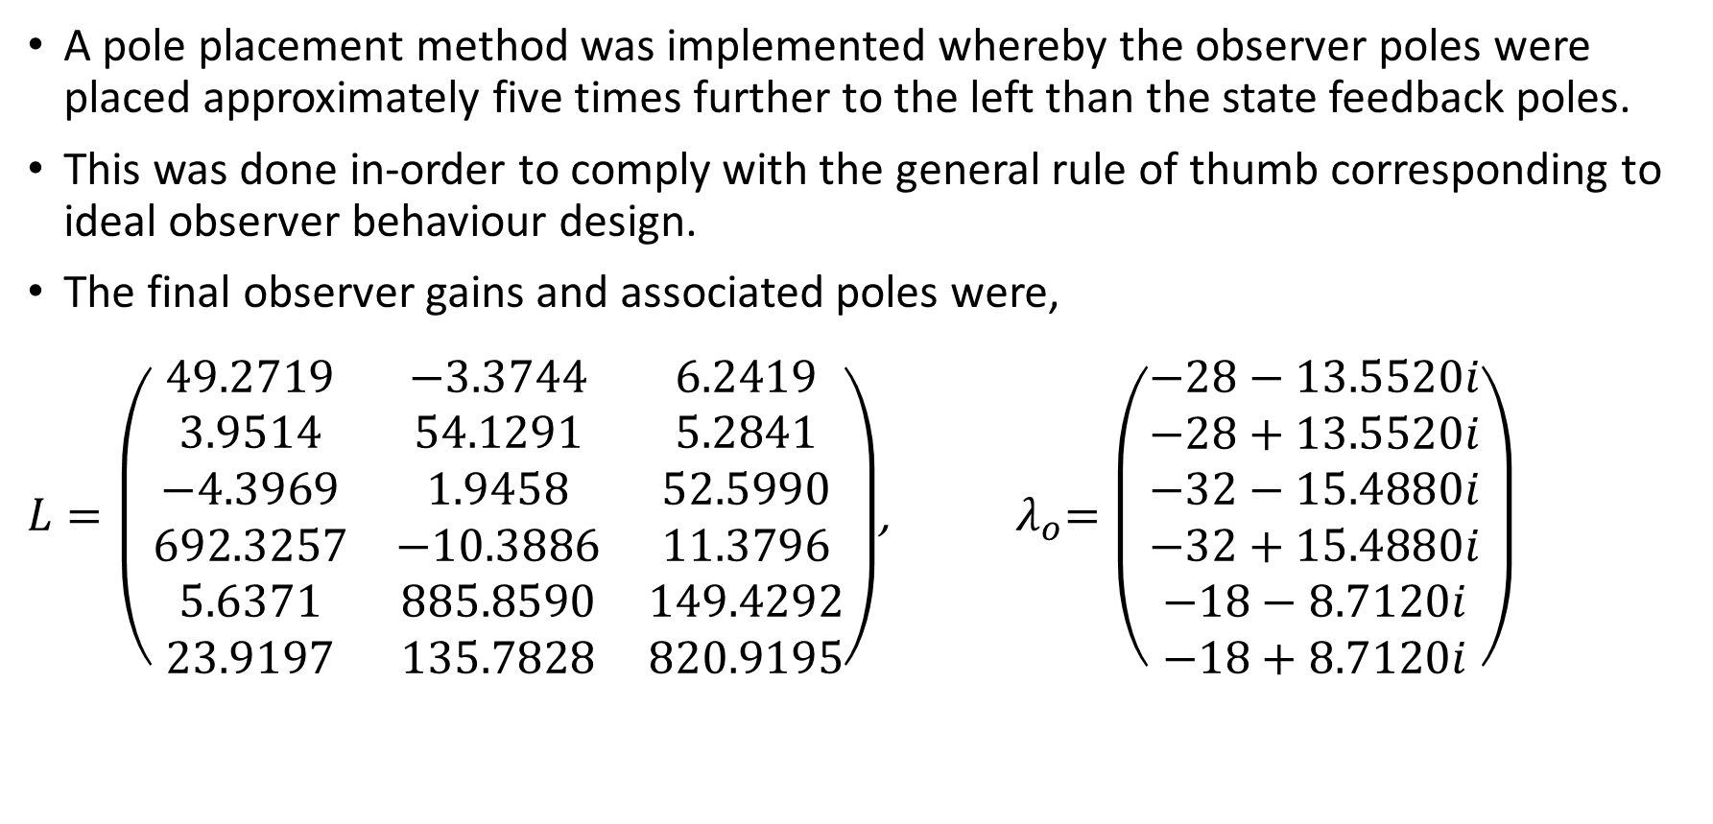
Kalman Filter – Implementation – Pole Placement
A pole placement method was implemented whereby the observer poles were placed approximately five times further to the left than the state feedback poles.
This was done in-order to comply with the general rule of thumb corresponding to ideal observer behaviour design.
The final observer gains and associated poles were,
$L=\left(\begin{matrix}49.2719 & −3.3744 & 6.2419 \\ 3.9514 & 54.1291 & 5.2841 \\ −4.3969 & 1.9458 & 52.5990 \\ 692.3257 & −10.3886 & 11.3796 \\ 5.6371 & 885.8590 & 149.4292 \\ 23.9197 & 135.7828 & 820.9195\end{matrix}\right)$, ${ λ}_{o}=\left(\begin{matrix}−28−13.5520i \\ −28+13.5520i \\ −32−15.4880i \\ −32+15.4880i \\ −18−8.7120i \\ −18+8.7120i\end{matrix}\right)$

Slide 26
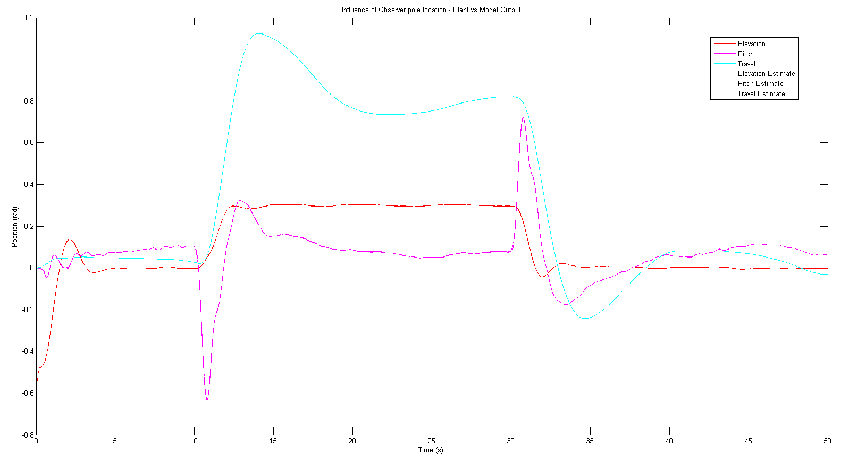
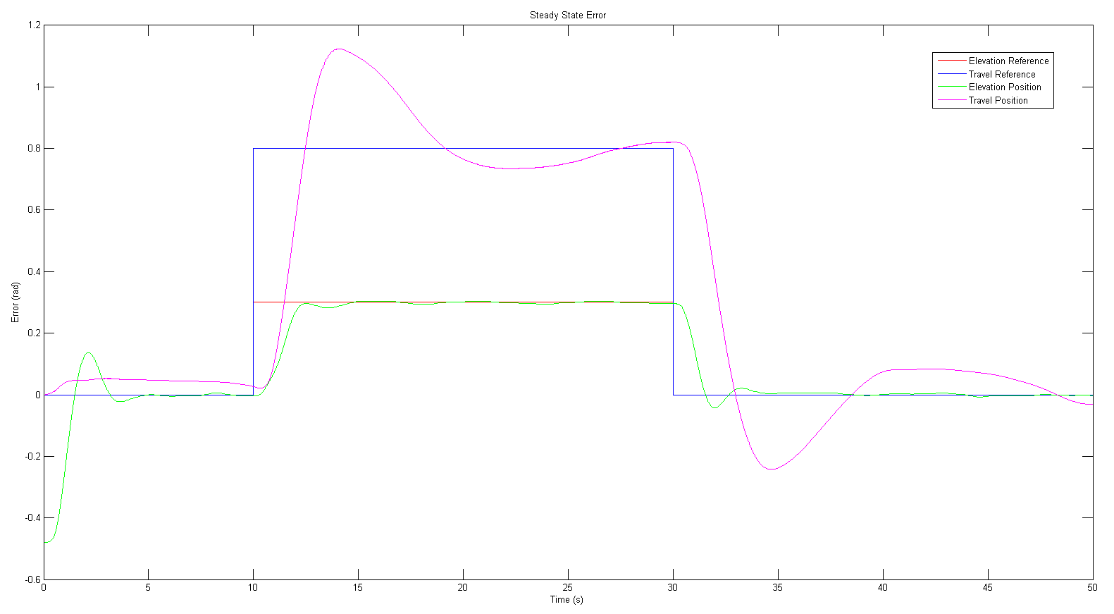
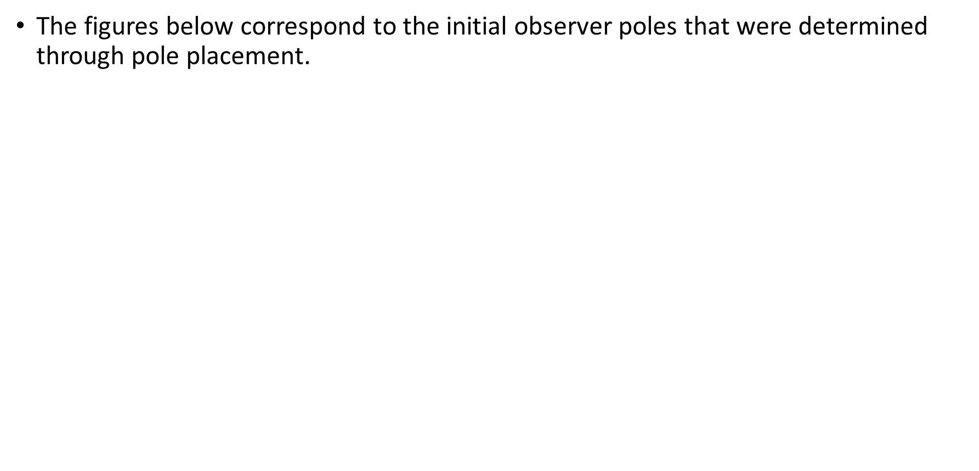
Kalman Filter – Implementation – Pole Placement
The figures below correspond to the initial observer poles that were determined through pole placement.
Position vs Reference
Position (rad)

Slide 27
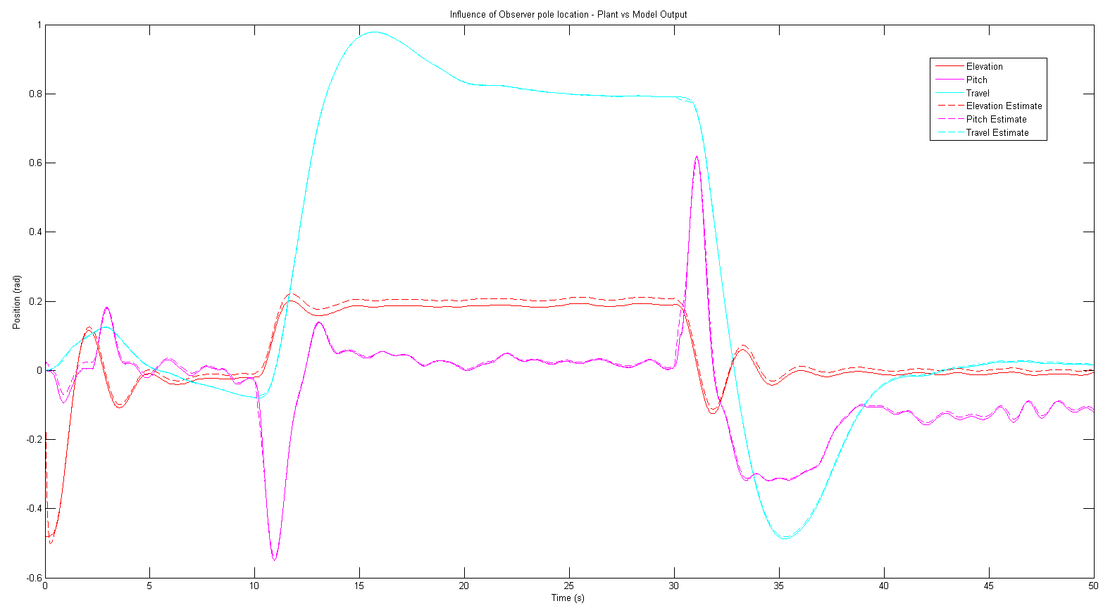
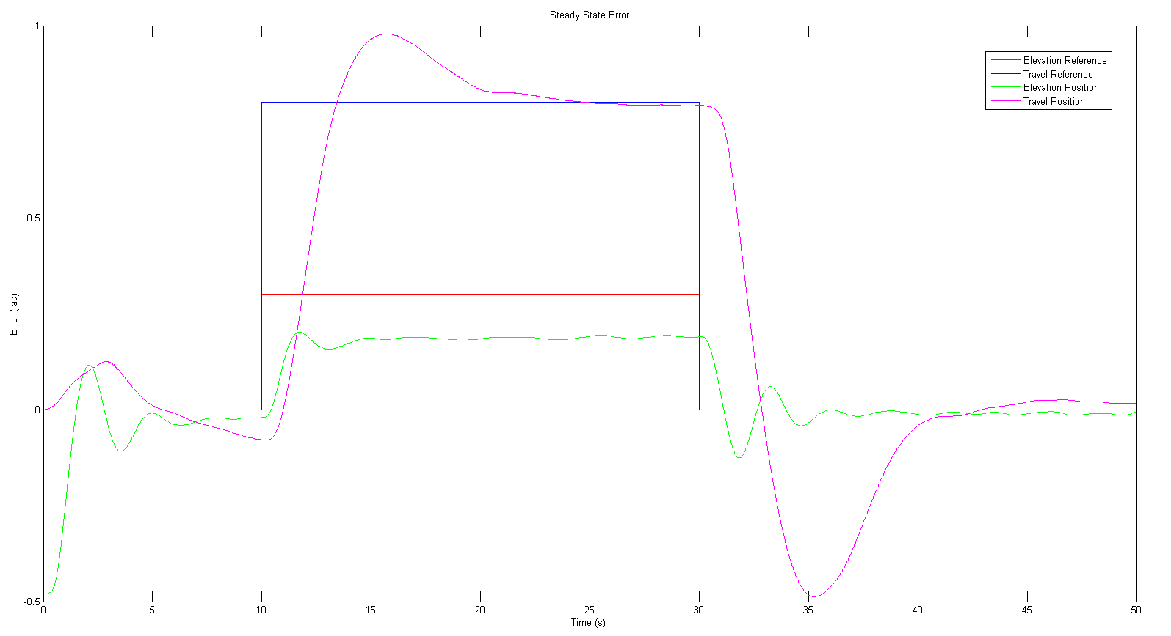

Kalman Filter – Implementation – Observer Pole Influence
The influence of pole placement and damping were studied when selecting the final observer design,
$λ_{o}=\left(\begin{matrix}−7−1.75i \\ −7+1.75i \\ −8−2i \\ −8+2i \\ −4.5−1.125i \\ −4.5+1.125i\end{matrix}\right)$, observer poles four times slower than the final poles used.
Position vs Reference
Position (rad)

Slide 28
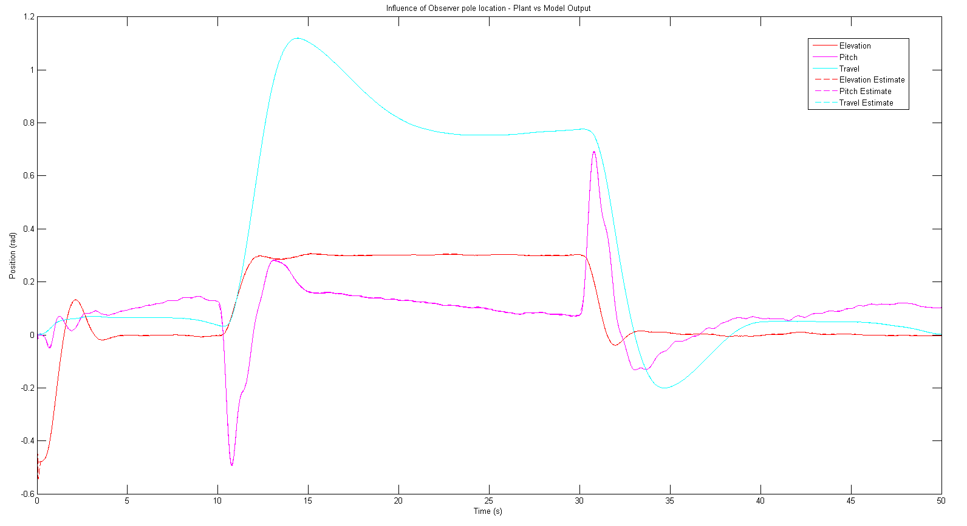
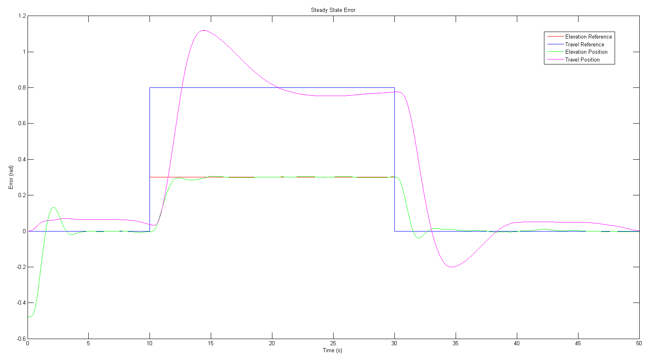

Kalman Filter – Implementation – Observer Pole Influence
$λ_{o}=\left(\begin{matrix}−28−13.5520i \\ −28+13.5520i \\ −32−15.4880i \\ −32+15.4880i \\ −18−8.7120i \\ −18+8.7120i\end{matrix}\right)$, poles have damping ratio of 0.9 (compared to 0.97 for initial poles).
Position vs Reference
Position (rad)

Slide 29
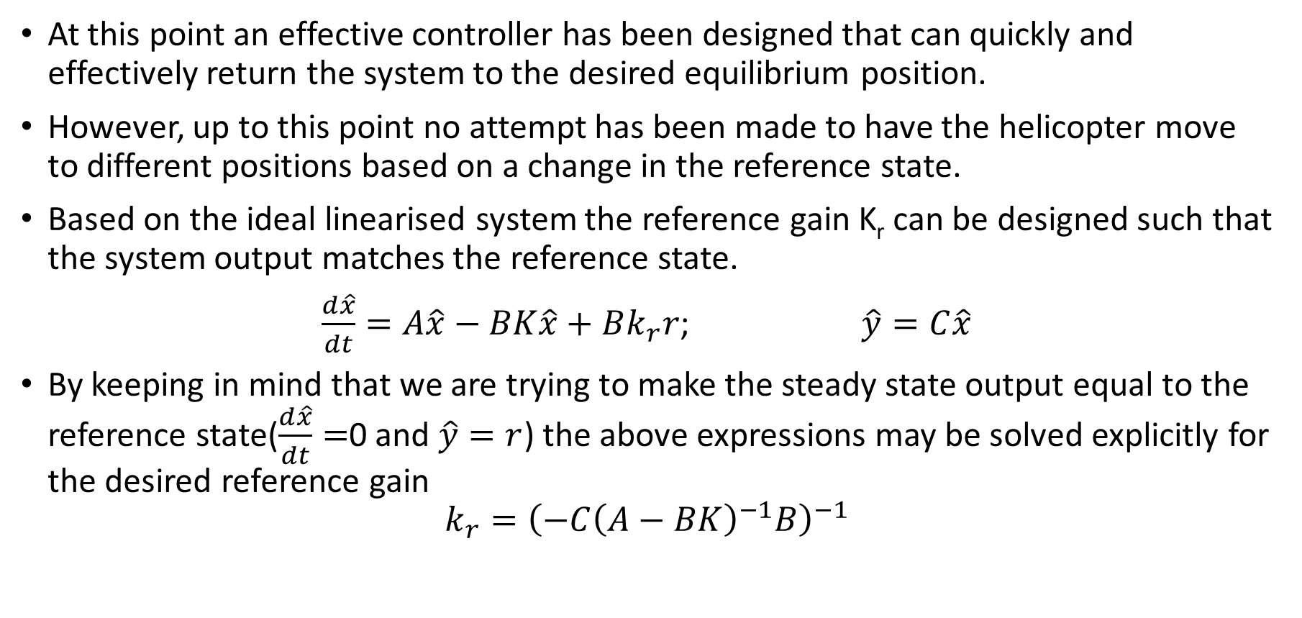
Reference State – Motivation
At this point an effective controller has been designed that can quickly and effectively return the system to the desired equilibrium position.
However, up to this point no attempt has been made to have the helicopter move to different positions based on a change in the reference state.
Based on the ideal linearised system the reference gain K_{r} can be designed such that the system output matches the reference state.
$\frac{d\hat{x}}{dt}=A\hat{x}−BK\hat{x}+Bk_{r}r$; $\hat{y}=C\hat{x}$
By keeping in mind that we are trying to make the steady state output equal to the reference state($\frac{d\hat{x}}{dt}=$0 and $\hat{y}=r$) the above expressions may be solved explicitly for the desired reference gain
$$k_{r}={\left(−C{\left(A−BK\right)}^{−1}B\right)}^{−1}$$

Slide 30
Reference State – Gain Design
The provided joystick can be used to set the desired reference state for the helicopter. However, the joystick provides a reference for only two states.
The joystick works by changing the reference when an operating force is applied, however, it does not zero when the force is removed. Instead the last reference input is held constant.
It is thus more intuitive for the joystick to set the reference state for the helicopter elevation and travel.
From the system dynamics matrix there is a coupling between the pitch angle and the travel axis acceleration.
The helicopter pitch will change to enable the desired change in travel position. State feedback will then maintain the helicopter pitch at the operating point once the reference has been achieved.

Slide 31
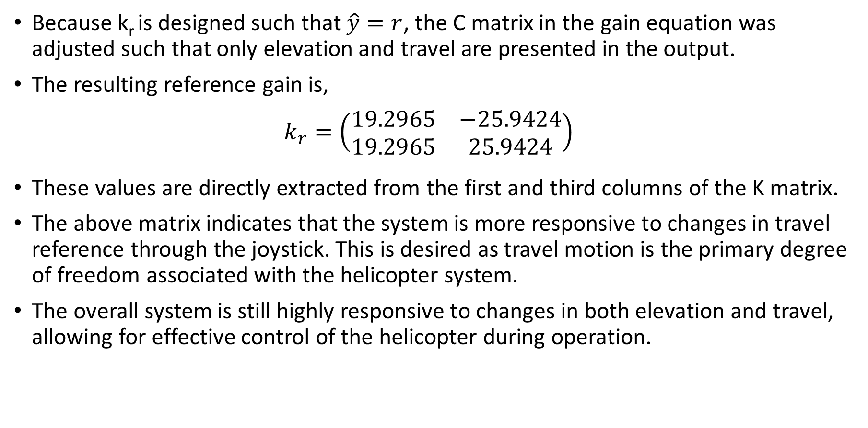
Reference State – Gain Design
Because k_{r} is designed such that $\hat{y}=r$, the C matrix in the gain equation was adjusted such that only elevation and travel are presented in the output.
The resulting reference gain is,
$$k_{r}=\left(\begin{matrix}19.2965 & −25.9424 \\ 19.2965 & 25.9424\end{matrix}\right)$$
These values are directly extracted from the first and third columns of the K matrix.
The above matrix indicates that the system is more responsive to changes in travel reference through the joystick. This is desired as travel motion is the primary degree of freedom associated with the helicopter system.
The overall system is still highly responsive to changes in both elevation and travel, allowing for effective control of the helicopter during operation.

Slide 32
Demonstration

